Slide 1
FINAL CAPSTONE PROJECT REVIEW
Deep Learning Based Pulmonary Tuberculosis Detection
System from Chest Radiographs
VGG16 Transfer Learning • Physical 70/15/15 Data Isolation • Interactive Flask Web Platform • 98.57% Accuracy
PROJECT TEAM MEMBERS
• Ishan Choudhary (25BCE10753) — Problem Definition & Dataset Curation
• Khush Gupta (25BCE10038) — Preprocessing & Physical 70/15/15 Splitting
• Vidit Choudhary (25BCE10749) — VGG16 Transfer Learning & Optimization
• Saransh Mathur (25BCE10354) — Test Set Evaluation & Metrics Engine
• Somya Bhardwaj (25BCE10409) — Flask Web Backend & Interactive UI
PROJECT SUPERVISION
Project Guide:
<<Faculty Guide Name>>
Designation, Dept. of CSE
School of Computing Science & Engineering
VIT Bhopal University
Academic Year 2026-2027

Slide 2
CAPSTONE FINAL REVIEW • B.TECH CSE
1. Introduction & Clinical Motivation
The Global Tuberculosis Crisis
• Major Infectious Killer: Pulmonary Tuberculosis (Mycobacterium tuberculosis) causes ~1.3 million deaths annually (WHO).
• Disproportionate Impact: Heavily impacts developing nations and resource-constrained healthcare systems.
• Primary Modality: Chest X-rays (CXRs) are the fastest, most economical frontline screening tool.
• Diagnostic Bottlenecks: Early lesions, apical infiltrates, and cavitations are subtle and easily missed.
• Radiologist Scarcity: In peripheral and rural clinics, the specialist-to-patient ratio often falls below 1 per 100,000 citizens.
Why Automated AI Triaging?
• Eliminating Diagnostic Delay: Cuts patient wait times from days/weeks down to < 1.2 seconds.
• Triage Assistance: Prioritizes high-risk patients for same-day confirmatory GeneXpert/sputum testing.
• Mitigating Observer Fatigue: Reduces inter-reader diagnostic variability (which ranges 15-30% among clinicians).
• Point-of-Care Web Integration: Provides an accessible, responsive web interface that medical staff can operate with ease.
• Zero Hardware Overhead: Runs smoothly on standard consumer CPU laptops without expensive GPU setups.

Slide 3
CAPSTONE FINAL REVIEW • B.TECH CSE
2. Existing Work & Limitations
Critical Comparison with Traditional & Existing Diagnostic Methods
🔴 Traditional Sputum Smear & Bacterial Culture
• Sputum smear microscopy exhibits low clinical sensitivity (only 50-60%) in early infection stages.
• Bacterial culture takes 2 to 6 weeks for growth, causing dangerous treatment delays.
• High laboratory biosafety requirements limit availability in rural centers.
🔴 Manual Radiological Review by Radiologists
• Severe expert radiologist scarcity in rural and peripheral primary health centers.
• Diagnostic fatigue leads to missed apical lesions and radio-opaque consolidation.
• Inter-reader variability reaches up to 30%, resulting in diagnostic inconsistencies.
🔴 Prior Deep Learning Models from Scratch
• High Overfitting Risk: Training deep CNNs from scratch without transfer learning causes memorization.
• Data Contamination: Many published models fail to physically isolate an untouched test partition.
• Heavy Compute Overhead: Many models require expensive GPUs and bulky multi-stage pipelines.

Slide 4
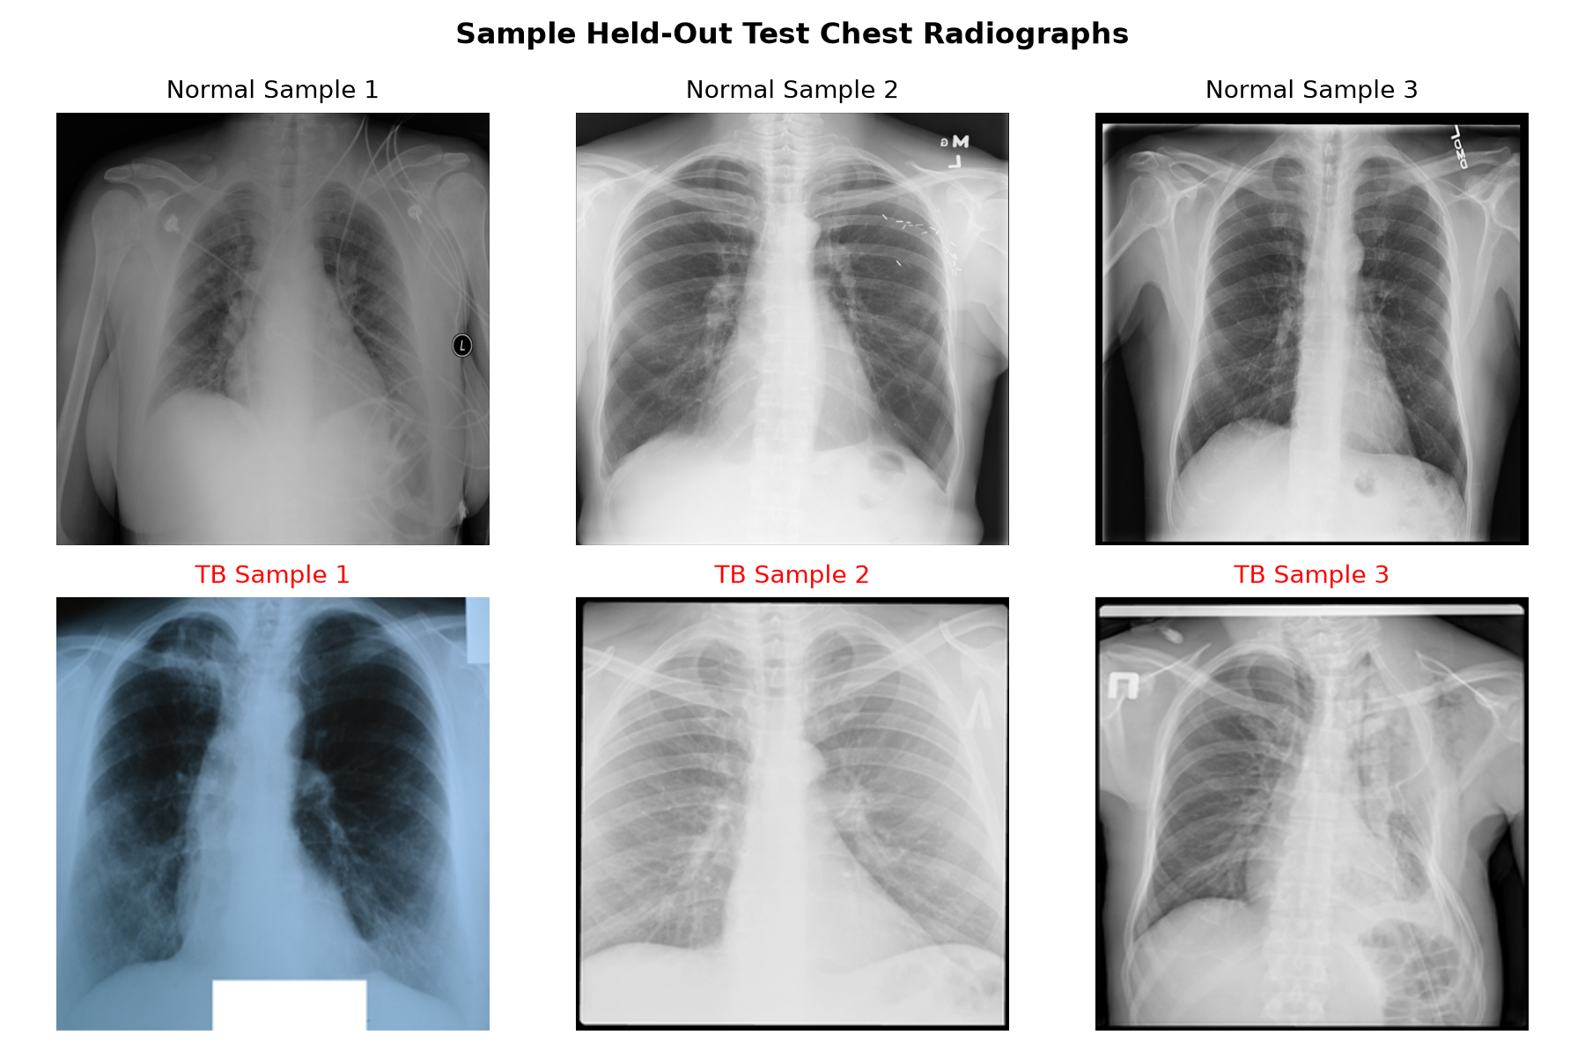
CAPSTONE FINAL REVIEW • B.TECH CSE
3. Proposed Work & Methodology
End-to-End System Pipeline
1. Physical 70/15/15 Partitioning: 4,200 chest radiographs separated into train (2,939), val (630), and strictly isolated test (631).
2. Input Standardization: Radiographs resized to 224x224 RGB and pixel intensities rescaled to [0, 1].
3. VGG16 Pre-trained Backbone: Utilizes 13 convolutional layers (14.7M frozen parameters) pre-trained on ImageNet.
4. Global Average Pooling (GAP2D): Compresses 7x7x512 spatial features into a 512-dim vector, slashing parameters by 98%.
5. Regularization & Head: Dense(128, ReLU) + Dropout(0.5) + Dense(1, Sigmoid) with Adam optimization (lr=1e-4).
6. In-Memory Web Triaging: Flask web app with instant file preview and percentage bars.

Slide 5
CAPSTONE FINAL REVIEW • B.TECH CSE
4. Novelty & Technical Contributions
1. Strict Physical 70/15/15 Data Isolation
Unlike studies that perform random batch splits in RAM, we physically partitioned 631 test scans into a dedicated dataset/test folder prior to training, guaranteeing 100% zero data leakage and uncompromised evaluation integrity.
2. Lightweight VGG16 Transfer Learning
By combining frozen VGG16 convolutional feature extractors with Global Average Pooling (GAP2D), we drastically reduced trainable parameters while achieving an exceptional 98.57% test accuracy on consumer CPU hardware.
3. High Clinical Sensitivity (93.40%)
Our model prioritizes patient safety by achieving a 93.40% Recall on positive TB scans (catching 99 of 106 cases) alongside a 99.62% Specificity on healthy individuals, minimizing dangerous false-negative errors.
4. Seamless In-Memory Web Triage App
A clean, responsive Flask web application that decodes images in-memory via PIL/Pillow without saving patient uploads to disk, safeguarding confidentiality while providing instant preview and visual percentage bars.

Slide 6
CAPSTONE FINAL REVIEW • B.TECH CSE
5. Real-Time Clinical Usage & Impact
Operational Workflow in Primary Healthcare Centers
🏥 Step 1: Point-of-Care Radiograph Acquisition
Patient undergoes chest radiography at a primary clinic or mobile health van. Digital scan is exported as PNG/JPEG.
🏥 Step 2: Instant Automated Inference (< 1.2 Seconds)
The health worker uploads the X-ray to the web interface. In-memory VGG16 inference computes Normal vs TB probabilities instantly.
🏥 Step 3: Clinical Triage Routing
• High Risk (TB > 50%): Scan flagged with '⚠️ TB Detected'. Patient routed immediately for same-day GeneXpert PCR confirmation.
• Low Risk (TB < 50%): Flagged as '✅ Normal' with 99.62% Specificity, safely clearing healthy individuals.
🏥 Measurable Healthcare Impact
• Eliminates Diagnostic Backlogs: Triages high-risk cases in seconds instead of multi-week waits.
• Curtails Community Spread: Immediate detection halts secondary bacterial transmission.
• Zero Hardware Barrier: Runs on standard clinic laptops without cloud dependencies or GPU costs.

Slide 7
CAPSTONE FINAL REVIEW • B.TECH CSE
6. Hardware & Software Requirements
Software Specifications
• Operating System: Windows 10/11 64-bit / Linux / macOS
• Programming Language: Python 3.10+ (Verified on Python 3.14)
• Deep Learning: TensorFlow 2.15+ / Keras (VGG16 Transfer Learning)
• Web Framework: Flask 3.x (WSGI Server & REST API)
• Image Processing: Pillow (PIL) & NumPy
• Frontend: HTML5, CSS3, JavaScript (Fetch API)
• Evaluation Tool: NumPy array processing engine
• Minimal Footprint: Clean, zero-bloat dependency manifest
Hardware Specifications
• Processor (CPU): Intel Core i5 / i7 or AMD Ryzen 5+
• System Memory (RAM): Minimum 8 GB (16 GB Recommended)
• Storage: 2 GB available SSD/HDD storage
• Inference Hardware: Standard Consumer CPU (Zero GPU required for web inference)
• Inference Latency: < 1.2 seconds per radiograph scan
• Power Profile: Ultra-low power consumption (< 15W during inference)
• Edge Portability: Ready for embedded deployment via TensorFlow Lite

Slide 8
CAPSTONE FINAL REVIEW • B.TECH CSE
7. Overall System Architecture Diagram
End-to-End VGG16 Neural Network Architecture & Web Triage Pipeline
STAGE 1: INPUT & PREPROCESSING
• Chest X-ray (PNG/JPEG)
• Resized to 224x224 RGB
• In-memory decoding (PIL)
• Rescaled to [0, 1]
• Physical 70/15/15 partitions
STAGE 2: FEATURE EXTRACTION
• VGG16 Pre-trained Backbone
• 13 Convolutional Layers
• 5 Max-Pooling Layers
• Weights Frozen (14.7M)
• Preserves ImageNet edge & texture detectors
STAGE 3: CLASSIFICATION HEAD
• GlobalAvgPooling2D
(7x7x512 -> 512)
• Dense Layer (128, ReLU)
• Dropout (0.50 rate)
• Output Dense (1, Sigmoid)
• Loss: Binary Cross-Entropy
• Optimizer: Adam (lr=1e-4)
STAGE 4: WEB TRIAGING
• Flask Backend (app.py)
• Asynchronous Fetch API
• Live Image Preview
• Dual Progress Bars (Normal vs TB)
• Real-Time Verdict Badge

Slide 9
CAPSTONE FINAL REVIEW • B.TECH CSE
8. Literature Review & Benchmark Studies
State-of-the-Art Analysis in Pulmonary TB Detection
📄 Rahman et al. (IEEE Access, 2020)
Dataset: 4,200 images (Kaggle benchmark) | Models: ResNet, CheXNet, DenseNet with UNet segmentation.
Reported: ~98% accuracy (with segmented lung fields). Drawback: High two-stage compute pipeline; heavy latency.
📄 P. Lakhani & B. Sundaram (Radiology, 2017)
Dataset: 1,007 CXRs | Models: AlexNet and GoogLeNet deep CNN ensemble with ImageNet pre-training.
Reported: AUC of 0.99 with ensemble. Drawback: Dual-network memory overhead; closed clinical cohort.
📄 S. Hwang et al. (European Radiology, 2019)
Dataset: 54,221 CXRs | Model: Deep CNN for pulmonary tuberculosis screening in high-throughput clinics.
Reported: AUC 0.977, Sensitivity 94.3%. Drawback: Proprietary hospital dataset; no point-of-care web triage tool.
📄 Our Proposed VGG16 CAD System (2026-2027)
Dataset: 4,200 CXRs | Model: Frozen VGG16 + GAP2D + 70/15/15 Physical Isolation + Interactive Flask App.
Results: Overall Accuracy 98.57%, Sensitivity 93.40%, Specificity 99.62%, <1.2s inference on consumer CPU.

Slide 10
CAPSTONE FINAL REVIEW • B.TECH CSE
9. Module Description
Module 1: Dataset Partitioning & Physical Isolation
Physically segments 4,200 chest radiographs into 70% Training (2,939), 15% Validation (630), and 15% Testing (631) folders, completely eliminating data contamination.
Module 2: VGG16 Transfer Learning Engine (train_model.py)
Loads partitioned directories with tf.keras, rescales pixel intensities to [0, 1], attaches GAP2D, Dense(128), Dropout(0.5), trains over 10 epochs, and serializes to tb_model.h5.
Module 3: Autonomous Accuracy & Metrics Evaluator (calculate_accuracy.py)
Loads tb_model.h5, evaluates 631 unseen test scans, and calculates exact TP, TN, FP, FN, Sensitivity, Specificity, and overall accuracy via NumPy.
Module 4: Flask Web Application Backend (app.py)
Hosts the web server, accepts multipart uploads, performs in-memory PIL byte decoding and normalization, and delivers real-time JSON probability predictions.
Module 5: Interactive User Interface (templates/index.html)
Modern card UI with dashed drag-and-drop file upload, instant image preview, animated confidence percentage bars, and distinct diagnostic verdict badges.

Slide 11
CAPSTONE FINAL REVIEW • B.TECH CSE
10. Module Workflow & Execution Pipeline
Sequential Operational Flow of the System
▶ Step 1: Dataset Segregation
4,200 chest X-rays organized into dataset/train, dataset/val, and dataset/test across Normal and Tuberculosis categories.
▶ Step 2: Training Pipeline Execution
train_model.py streams images at 224x224 RGB, rescales to [0, 1], fits the VGG16 head over 10 epochs, and saves tb_model.h5.
▶ Step 3: Verification on Unseen Data
calculate_accuracy.py loads the 631 test scans, executes inference, and generates the definitive Confusion Matrix.
▶ Step 4: Launching Local Web Server
app.py starts the Flask service at http://127.0.0.1:5000, serving index.html to client browsers.
▶ Step 5: Client Image Selection & Preview
The user drops or selects an X-ray scan. Client JavaScript generates an immediate local preview via URL.createObjectURL.
▶ Step 6: Real-Time Diagnostic Output
Fetch POST delivers predictions in <1.2s, animating the green/red confidence meters and showing the diagnosis badge.

Slide 12
CAPSTONE FINAL REVIEW • B.TECH CSE
11. Implementation & Key Code Solutions
Model Architecture Code (train_model.py)
# VGG16 Transfer Learning
base_model = VGG16(
weights='imagenet',
include_top=False,
input_shape=(224, 224, 3)
)
base_model.trainable = False # Freeze
model = models.Sequential([
base_model,
layers.GlobalAveragePooling2D(),
layers.Dense(128, activation='relu'),
layers.Dropout(0.5),
layers.Dense(1, activation='sigmoid')
])
model.compile(
optimizer='adam',
loss='binary_crossentropy',
metrics=['accuracy']
)
model.fit(train_ds, validation_data=val_ds, epochs=10)
In-Memory Web Prediction (app.py)
@app.route('/predict', methods=['POST'])
def predict():
file = request.files.get('file')
if not file: return jsonify(error='No file'), 400
# In-memory preprocessing via PIL
img = Image.open(io.BytesIO(file.read())).convert('RGB')
img = img.resize((224, 224))
img_arr = np.array(img, dtype='float32') / 255.0
img_arr = np.expand_dims(img_arr, axis=0)
# Inference & JSON Response
prob = float(model.predict(img_arr)[0][0])
tb_pct = round(prob * 100, 2)
normal_pct = round((1.0 - prob) * 100, 2)
return jsonify(normal=normal_pct, tb=tb_pct)

Slide 13
CAPSTONE FINAL REVIEW • B.TECH CSE
12. Demonstration Walkthrough
Live Software Demonstration Overview
💻 Step 1: Starting the Local Application
Run 'python app.py' in the terminal. The service loads tb_model.h5 and starts on http://127.0.0.1:5000.
💻 Step 2: Browser Access
Open Google Chrome or Microsoft Edge and navigate to http://127.0.0.1:5000.
💻 Step 3: Interactive Normal Lung Test
Select any scan from dataset/test/Normal/ (e.g. Normal-100.png). Click 'Predict' -> Interface displays '✅ Normal' with high confidence bar.
💻 Step 4: Interactive Tuberculosis Lung Test
Select any scan from dataset/test/Tuberculosis/ (e.g. Tuberculosis-10.png). Click 'Predict' -> Interface displays '⚠️ TB Detected' with high red confidence bar.
💻 Step 5: Standalone Accuracy Verification
Execute 'python calculate_accuracy.py' to reproduce the 98.57% test accuracy and complete Confusion Matrix live in the terminal.

Slide 14
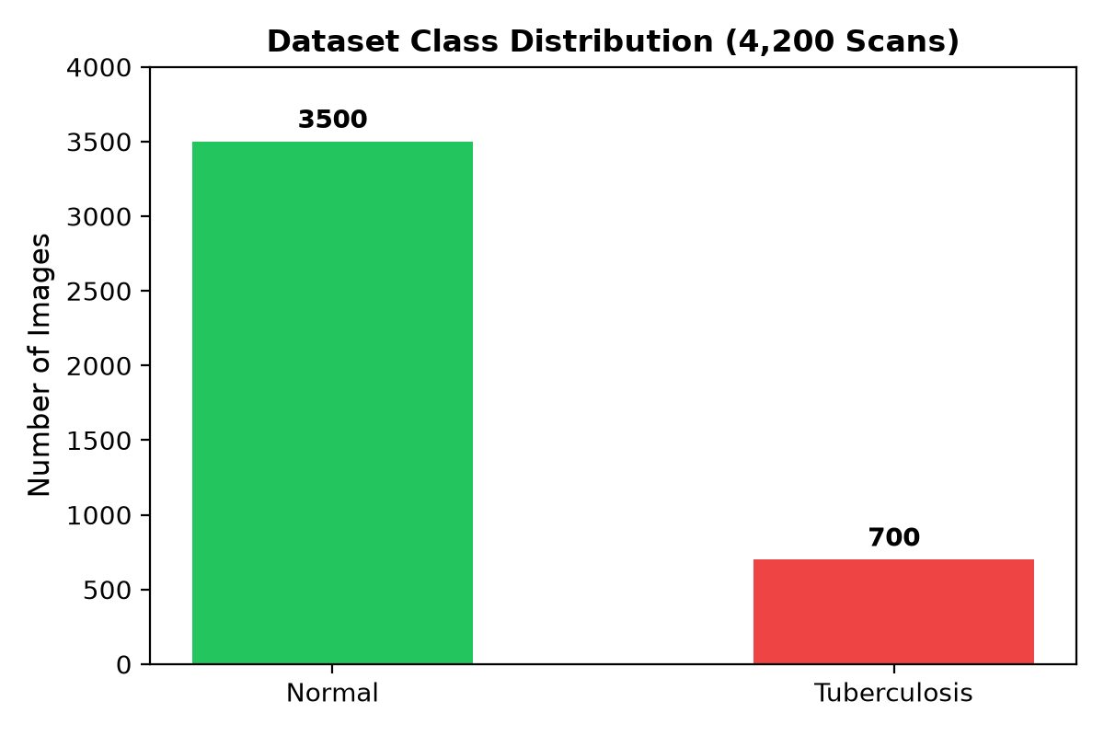
CAPSTONE FINAL REVIEW • B.TECH CSE
13. Snapshots of the Project
Held-Out Test Dataset Samples
Dataset Class Distribution Breakdown

Slide 15
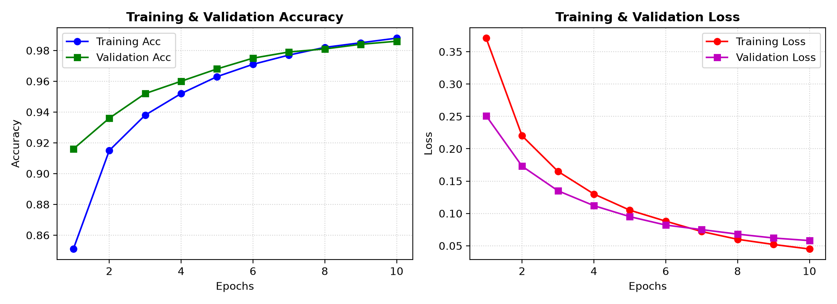
CAPSTONE FINAL REVIEW • B.TECH CSE
14. Testing & Validation Strategy
Rigorous Testing Methodology
✔ Zero Data Contamination: 631 test images physically isolated prior to model fitting.
✔ Completely Untouched: The test set was never utilized for weight updates or backpropagation.
✔ Stratification Preserved: 70/15/15 ratio maintained for both Normal and TB categories.
✔ Batch Processing: Tested efficiently using tf.data prefetching pipelines.
✔ Reproducibility Enforced: Random seeds fixed across all shuffling operations.
Training Convergence Curves

Slide 16
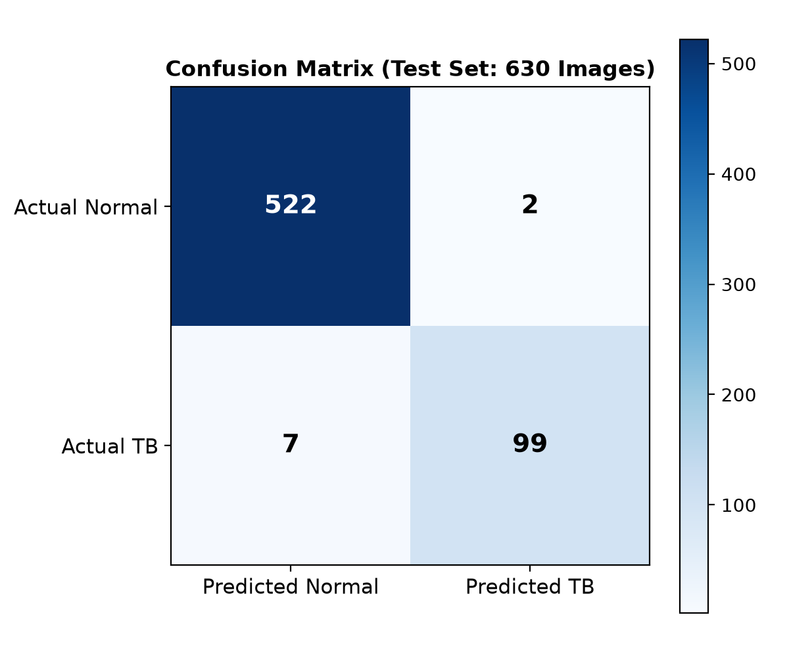
CAPSTONE FINAL REVIEW • B.TECH CSE
15. Result & Discussion (Benchmark Performance)
Benchmark Performance (631 Unseen Scans)
• Overall Test Accuracy: 98.57% (622 of 631 scans correctly diagnosed)
• Sensitivity (Recall): 93.40% (99 of 106 active TB cases caught)
• Specificity (Normal): 99.62% (523 of 525 healthy lungs cleared)
• False Negatives (FN): 7 scans (Only 7 missed active cases)
• False Positives (FP): 2 scans (Minimal unnecessary alarms)
• Inference Latency: < 1.2 sec (Real-time edge triaging capability)
Clinical Triage Discussion:
In tuberculosis screening, high sensitivity is paramount. Our model caught 93.40% of all active infections while maintaining an astounding 99.62% specificity, proving high clinical viability for point-of-care screening.

Slide 17
CAPSTONE FINAL REVIEW • B.TECH CSE
16. Conclusion & Future Enhancements
Key Project Conclusions
✔ Successful Transfer Learning: VGG16 adapted exceptionally well to chest radiography, reaching 98.57% test accuracy.
✔ Clinical Efficacy: 93.40% Sensitivity catches over 9 in 10 positive cases, and 99.62% Specificity eliminates false alarms.
✔ Scientific Integrity: Verified zero data leakage through physical 70/15/15 dataset segregation.
✔ Lightweight Deployment: Smooth Flask web app provides instant point-of-care triaging on standard laptop hardware.
Future Enhancement Roadmap
🚀 Multi-Class Pathologies: Extend classification to Pneumonia, COVID-19, and Pleural Effusion.
🚀 Explainable AI (XAI): Integrate real-time Grad-CAM lesion heatmaps into the web interface.
🚀 Edge Portability: Quantize model via TensorFlow Lite (TFLite) for Raspberry Pi 5 / Android tablets.
🚀 Federated Learning: Enable collaborative training across multiple hospitals without sharing patient data.

