Slide 1
Sobel Filter
GNR-607 Course Project

Slide 2
THEORY
Apply sobel mask for x-direction
Apply sobel mask for y-direction
Let A be the source image
Consider G_{x} and G_{y} are two images, each point contain the horizontal & vertical derivative approximations respectively

Slide 3

Computation
where ∗denotes the 2-dimensional signal processing convolution operation
The matrix used in G_{x} is sobel operator for x-axis
The matrix used in G_{y} is sobel operator for y-axis

Slide 4
Computation
At each point in the image, the resulting gradient approximations can be combined to give the gradient magnitude, using:
G² = G_{x}² + G_{y}²
Finally we display the magnitude G as the final output.
We can also apply a threshold while displaying the image

Slide 5

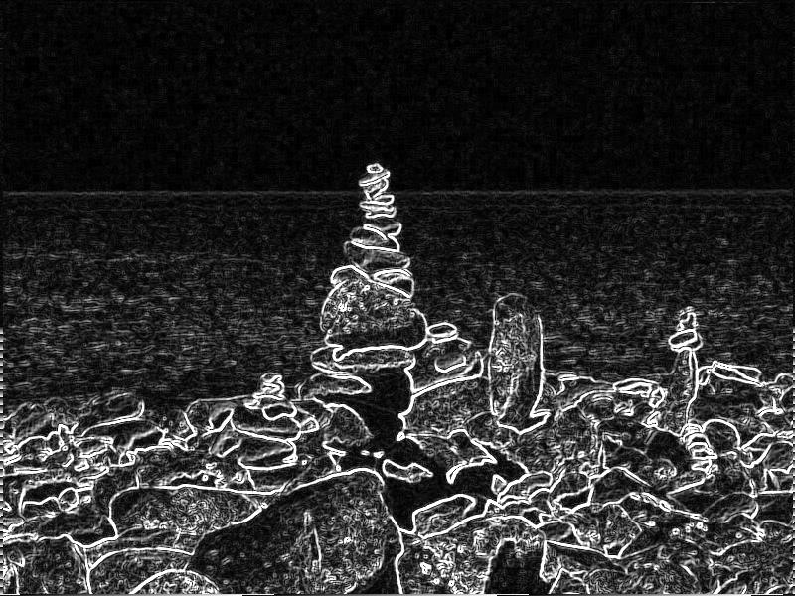
Sample Output

Slide 6

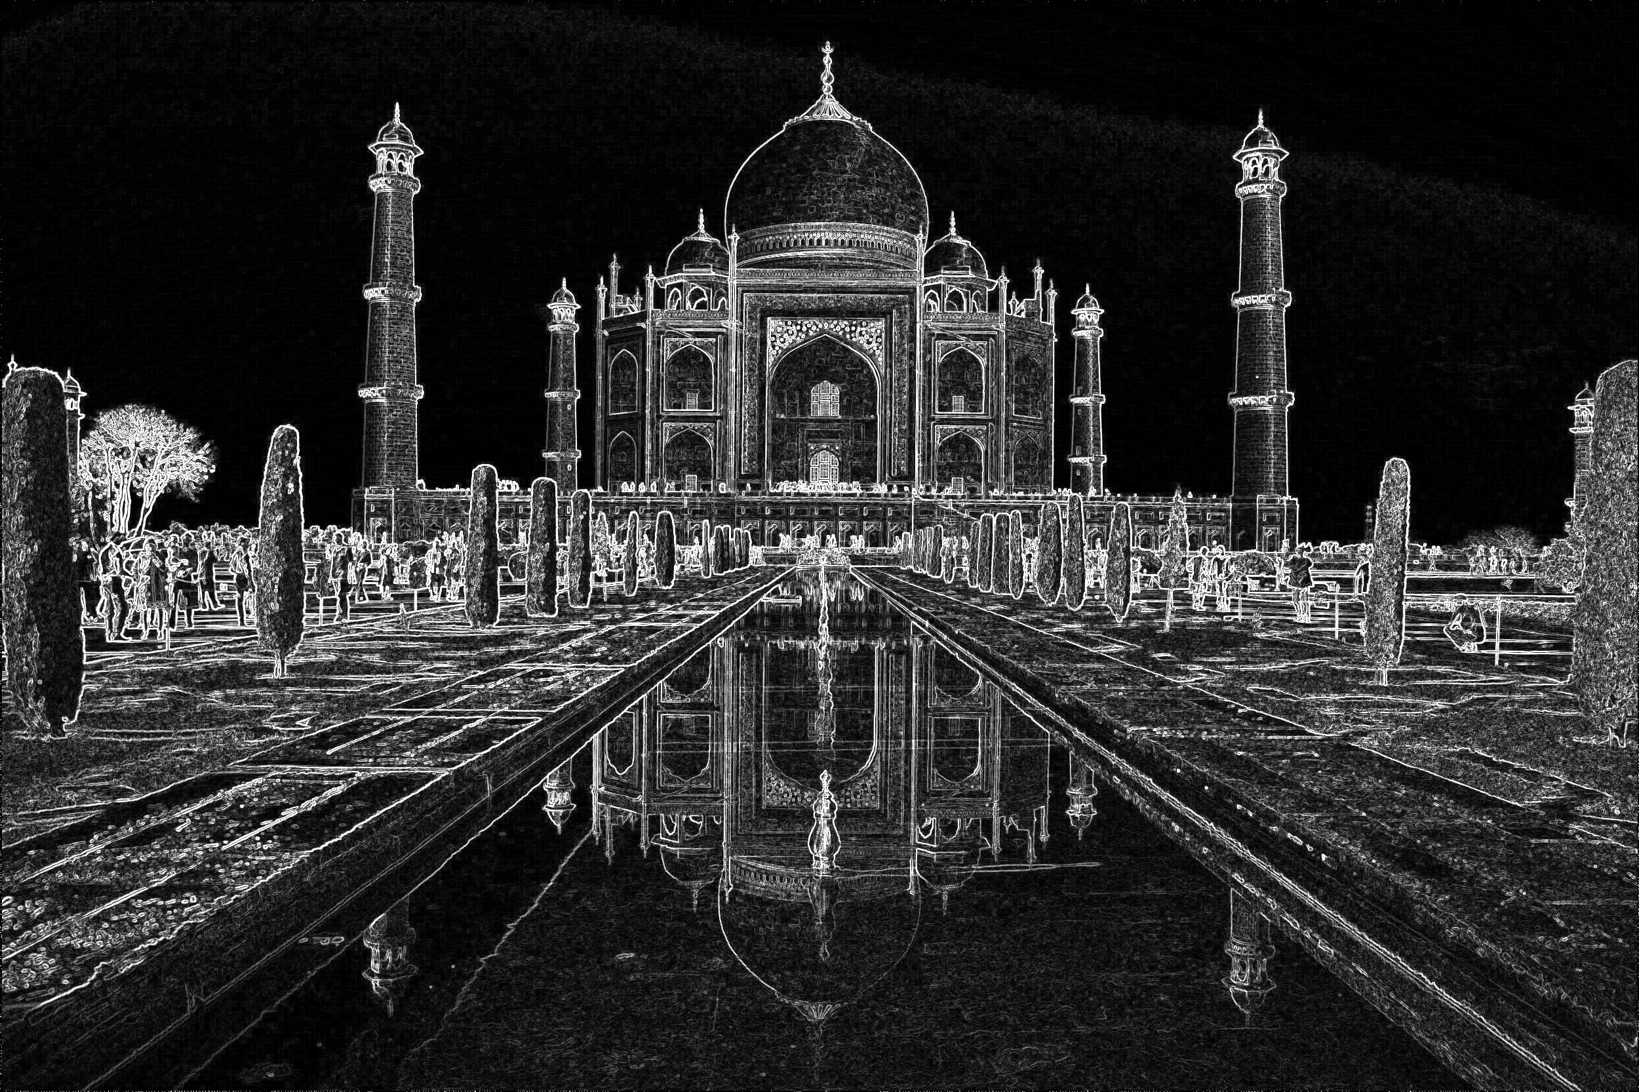
Sample Output

Slide 7
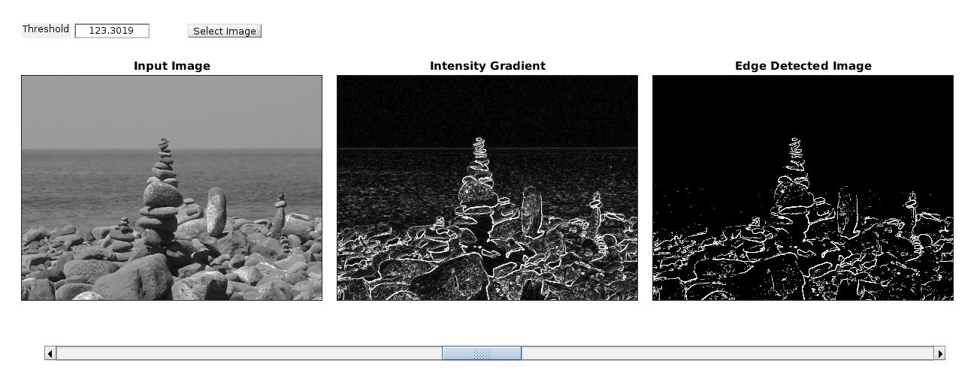
GUI Interface

