Slide 1
Incident IQ
Automated first-pass triage for SQ / EPS tickets
Ticket in, evidence-backed root cause out — with the queries that prove it, a recommended fix, and a note on how to stop it recurring.
Read-only by construction · nothing posts without a human approving it
Notes:
One-line pitch: this does the first hour of triage on a support ticket — the part that is mechanical — and hands an engineer a starting point with evidence attached. It never changes anything.

Slide 2
THE PROBLEM
First-pass triage is mechanical, and it is expensive
Every ticket starts the same way
Read the ticket. Work out which service. Find the right app name in New Relic. Write the query. Read the code. Most of that is lookup, not judgement.
The context is scattered across three systems
Jira has the report, New Relic has the behaviour, GitHub has the cause. Correlating them by hand is where the time goes.
Knowledge leaves with whoever fixed it
The cause lands in a comment thread, not a runbook. The next person with the same symptom starts from zero.
The cost is the engineer's attention, not the ticket
An interrupted engineer pays far more than the ten minutes the lookup took.
Notes:
Frame it as lookup versus judgement. We are not trying to replace the diagnosis — we are trying to delete the lookup that precedes it, and to stop losing what we learn.

Slide 3
WHAT IT DOES
Give it a ticket key; it does the first pass
1
Reads the ticket
Description, comments, and any attached log files. Pulls out ids, timestamps and error signatures in code, not in the model.
2
Investigates
Discovers the real New Relic app names, queries errors and logs over the ticket's own time window, then reads the service code on GitHub to explain what it found.
3
Writes it up
A plain-English summary, a recommended fix, a checklist, and every query it ran — posted as one Jira comment, on approval.
Typical run: 2–4 minutes, 50–65 tool calls, $0.50–$0.80 of model time.
Bounded three ways at once — turns, dollars, and tool calls — so a confused run stops rather than spirals.
Notes:
The three columns map exactly to the four phases in the architecture slide; intake and the gate are collapsed into step 1 here.

Slide 4
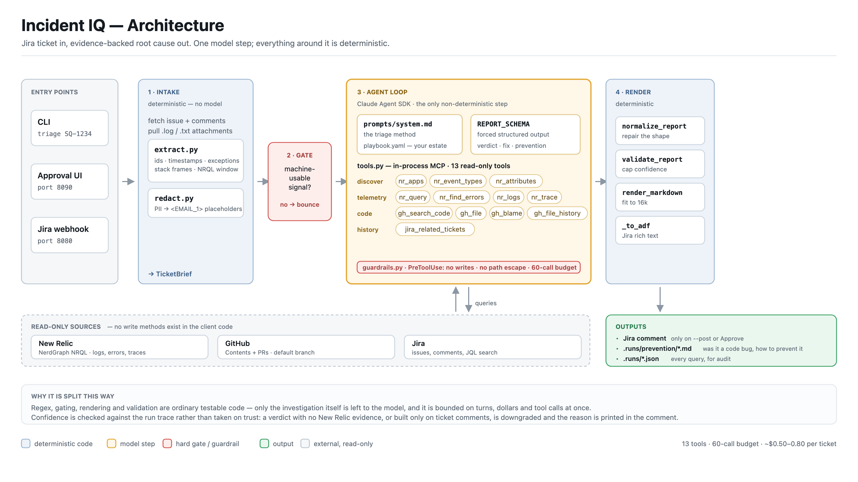
ARCHITECTURE
How it is put together
Notes:
Everything blue is ordinary deterministic code we unit-test. The one amber box is the only place a model makes a decision, and it is wrapped in the red guardrail strip. Read-only sources along the bottom; the single write — one Jira comment — on the right.

Slide 5
HOW IT INVESTIGATES
The method it is made to follow
1 · Do not adopt anyone's conclusion
Ticket comments and prior tickets are labelled as unverified claims. They decide what to look for, never what to believe.
2 · Discover before filtering
Repo name, service name and New Relic app name are all different. A guessed app name returns zero rows that look exactly like 'nothing is broken'.
3 · Find the failure signature
Errors and logs over the ticket's own window, down to an exception class and ideally a trace id.
4 · Explain it in the code
Search for the literal log message, then blame and PR history for the line that produced it.
5 · Converge, or stop and say so
A root cause only when logs, data and code agree. Otherwise it reports what it narrowed down — which is a good outcome, not a failure.
Notes:
Step 1 is the one that took the most work. Left neutral, a confident ticket comment becomes the model's answer and the whole run turns into a paraphrase of what someone already wrote.

Slide 6
THE OUTPUT
What lands on the ticket
Summary
Four or five plain sentences. No file paths, no class names — written for whoever decides whether to escalate.
Recommended fix
The change, where to make it, how to confirm it worked, and any interim workaround.
Checklist
Tickable items: what triage established, the fix, and at least one prevention item.
Read this before acting on it
Any confidence the system reduced, and why it reduced it.
Technical detail & evidence
Root cause, code location, and each claim tied to the query or file that produced it.
Queries run · logs checked
Every query in full, so anyone can re-run it. Plus what log searches were tried and what they returned.
Ordered widest-reader-first: a support lead gets the whole picture before reaching anything with a file path in it.
Notes:
Two audiences, one comment. The top half is for a support lead or PM; the bottom half is for the engineer who picks it up.

Slide 7
TRUST BOUNDARIES
What it cannot do
It cannot change anything
No writes, no shell, no file edits, no ticket transitions. Denied at the hook on every single tool call, not by asking the model nicely.
The clients have no write methods
The security boundary is the code, not the prompt. There is no function to call that would modify New Relic or GitHub.
One side effect exists
A Jira comment — and only after --post on the command line or a human clicking Approve in the review UI.
Personal data never reaches the model
Emails and card numbers are replaced with stable placeholders on the way in and restored on the way out.
60
tool-call budget per run
then it must write up what it has
95
automated tests
guardrails, query repair, rendering
0
writes to production
by construction, not by policy
Notes:
The question this slide answers is 'what happens when it is wrong?' — and the answer is that a wrong comment costs a minute of reading. There is no path to a wrong write.

Slide 8
WHY YOU CAN BELIEVE IT
Confidence is checked, not taken on trust
The model declares what it actually verified
Logs, code, data — confirmed, checked-and-empty, or never checked.
That claim is cross-checked against the run trace
If it says it confirmed the logs but no log query returned a line, the report is downgraded automatically.
A report built only on ticket comments cannot claim a root cause
It is reduced to 'narrowed, not confirmed' at low confidence — because a paraphrase of the ticket is not a diagnosis.
Every downgrade is printed in the comment
Never applied silently. The reader sees the reduction and the reason for it, so a hedged report is the system working.
Notes:
This is the slide that matters for adoption. The failure mode people fear is a confident wrong answer sending someone down the wrong path at 2am. We cap confidence mechanically so that cannot happen quietly.

Slide 9
MEASURED AGAINST 11 RECORDED RUNS
What hardening found
The first build looked like it worked. Reading the run traces rather than the output told a different story.
3 of 4
observability tools silently broken
failed on every run, returning nothing
65%
of data queries returned zero rows
guessed app names, read as 'no errors'
29 → 4
log queries that returned a line
logs were never really searched
14
queries lost to one NRQL mistake
valid SQL, invalid NRQL — now auto-repaired
The lesson we kept relearning
None of this was visible in the reports. The agent wrote confident prose either way — it simply had nothing underneath it. Everything we now check automatically came from reading traces, not read-throughs.
Notes:
Be candid here. The point is not that it was broken; it is that a plausible-sounding report is not evidence of a working system, which is exactly why the confidence checks and the evidence appendix exist.

Slide 10
CURRENT STATE
Where it stands now
13
read-only tools
discovery, telemetry, code, history
~$0.65
median cost per ticket
2–4 minutes end to end
95
tests passing
every fix has a regression test
1
action needed to publish
a human clicking Approve
Investigation now leads with telemetry, not code archaeology
A representative recent run made 27 New Relic queries against 4 GitHub calls — the reverse of where it started.
Queries are published in full
Both as a deep link and as copy-pasteable text, so a claim can always be checked independently.
Every run leaves a prevention document behind
Written whether or not the cause was a code bug.
Notes:
The 27-versus-4 figure is the one to say out loud: it is the clearest single indicator that it is investigating rather than guessing from source code.

Slide 11
PREVENTING THE REPEAT
Every run leaves something behind
Was this a code bug — yes, no, or not established
'No' is a real answer. A misconfiguration the code permits by design is the one most likely to recur unrecorded.
What to change so the class of failure goes away
Not just today's instance of it.
How we would catch it next time
The specific test, alert or dashboard — with the condition and the threshold, not 'add monitoring'.
A paste-able runbook entry
The symptom as it presents, and the first thing to check. Written for whoever picks up the next ticket that looks like this one.
Saved per run
.runs/prevention/
the document
.runs/*.json
every query, for audit
Jira comment
the summary and the fix
Notes:
This is the compounding part. One triage saves an hour; a year of prevention notes changes how fast the team recognises a repeat.

Slide 12
PLAN
How we roll it out
NOW
Dry run
Run it against already-resolved tickets and compare its verdict to the real cause. Nothing posts.
NEXT
Human-approved
Support runs it from the review UI. A person reads every comment before it goes on a ticket.
THEN
Labelled subset
Webhook triage for tickets carrying one label, so we widen by ticket type rather than all at once.
LATER
Default first pass
Only once the false-cause rate is low enough that reading the comment beats ignoring it.
The gate between each step is the same question:
on recently resolved tickets, how often does it name the cause an engineer would have named? We widen when that number earns it — not on a date.
Notes:
Resist a date-driven rollout. The measure is agreement with known causes on resolved tickets, and we should be willing to stay at human-approved indefinitely if that is what the number says.

Slide 13
NEXT STEPS
What we need next
A calibration set — 20 to 30 resolved tickets
With their real root causes, so we can measure agreement instead of guessing at it. This is the single highest-value thing we can be given.
Service ownership in the playbook
App names, repos and owning channel per service. Most remaining mistakes are the agent not knowing our estate, not the agent reasoning badly.
Confirmation that log forwarding is what we think it is
Log searches come back empty far more often than they should. That may be a data-availability problem rather than a quiet system.
A decision on scope
Which ticket types we point it at first.
Notes:
Close on the calibration set. Without resolved tickets to measure against, every claim about accuracy on this deck is an anecdote, including the good ones.

