Slide 1
ZARA
SALES ANALYSIS DASHBOARD
Sales Performance & Product
Placement Analysis
Presented By: Khushi Namdev
September 2026

Slide 2
PROBLEM STATEMENT & OVERVIEW
Problem Statement
Overview
Zara generates large amounts of product and sales-related data that can be difficult to interpret in raw form.
A structured analysis is needed to understand sales volume across different product positions.
It is also important to compare sales performance based on promotion and seasonal status.
An interactive dashboard can present these patterns clearly and support data-driven decision-making.
Analyzes Zara product-level sales data using Excel.
Provides a visual view of sales volume and product distribution.
Compares sales volume across product positions, promotion status, and seasonal status.
Uses PivotTables, PivotCharts, KPI cards, and interactive slicers.
Helps present the data in a simple and understandable format.

Slide 3
WHO
WILL
USE
THIS
DASHBOARD?
Zara Management — Monitor overall sales performance and product placement.
Store Managers — Understand sales across different store positions.
Sales & Marketing Teams — Compare sales performance by promotion and seasonal status.
Data Analysts — Identify patterns and support data-driven decisions.
Business Decision-Makers — Use dashboard insights for better planning.

Slide 4
DATA OVERVIEW
Data Source & Dataset | Data Size | Key Fields
Data Source: Kaggle | 252 product records | Product Position
Zara Sales Analysis Dataset | 16 columns | Promotion
 |  | Seasonal
 |  | Sales Volume

Slide 5
DASHBOARD DESIGN
KPI Cards: Total Sales, Number of Products, Average Sales
Column Chart: Sales by Product Position
Bar Chart: Average Sales Volume by Promotion
Bar Chart: Average Sales Volume by Seasonal Status
Pie Chart: Product Distribution by Store Position
Slicers: Product Position, Promotion, Seasonal

Slide 6
Total Sales Volume: 459,573 sales volume across 252 products.
Highest Sales by Product Position: Aisle recorded the highest sales volume at 177,396.
Product Distribution: Aisle had the highest number of products with 97 products
Promotion: Average sales volume was slightly higher for promoted products than non-promoted products.
Seasonal Products: Average sales volume was slightly higher for non-seasonal products than seasonal products.
Overall Average Sales Volume: The average sales volume was 1,823.702.
KEY INSIGHTS

Slide 7
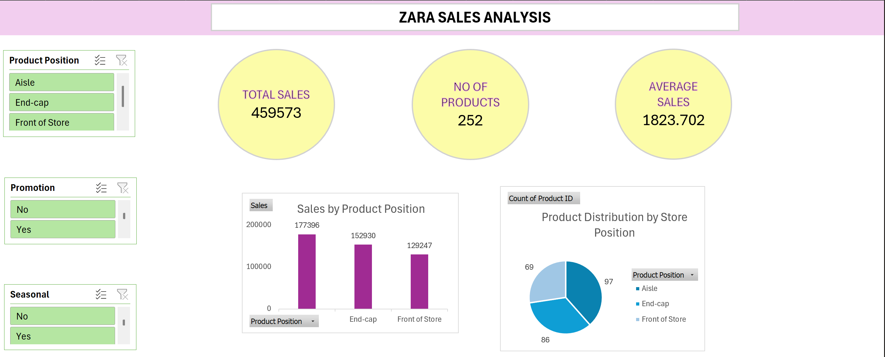
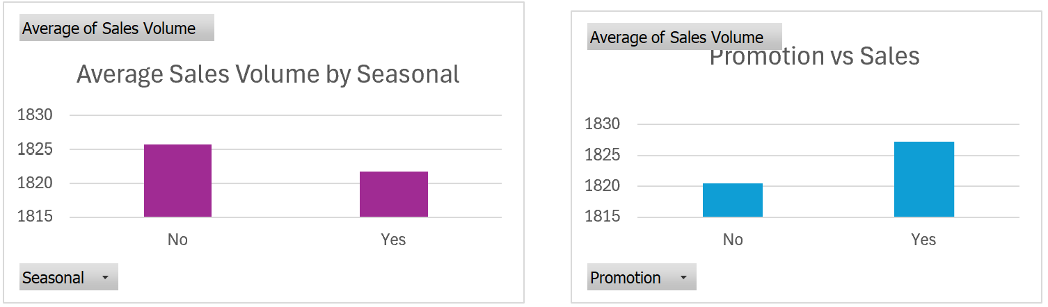
Interactive Excel dashboard developed using PivotTables, PivotCharts, KPI cards, and slicers.

Slide 8
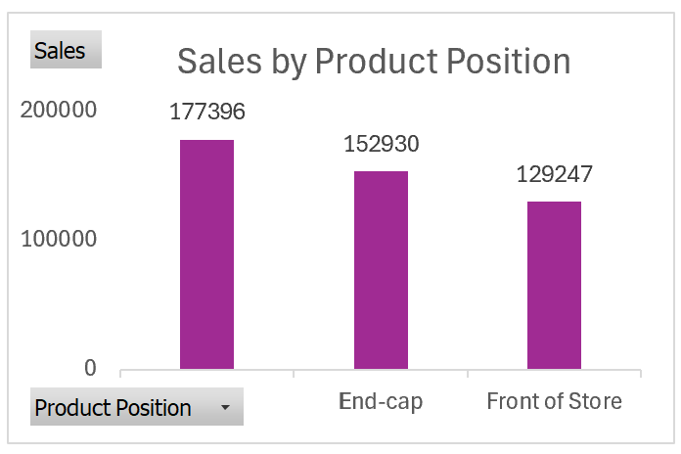
ANALYSIS 1: SALES VOLUME BY PRODUCT POSITION
Aisle: 177,396
End-cap: 152,930
Front of Store: 129,247
Total Sales Volume: 459,573
Observation: Aisle recorded the highest sales volume, followed by End-cap and Front of Store.

Slide 9
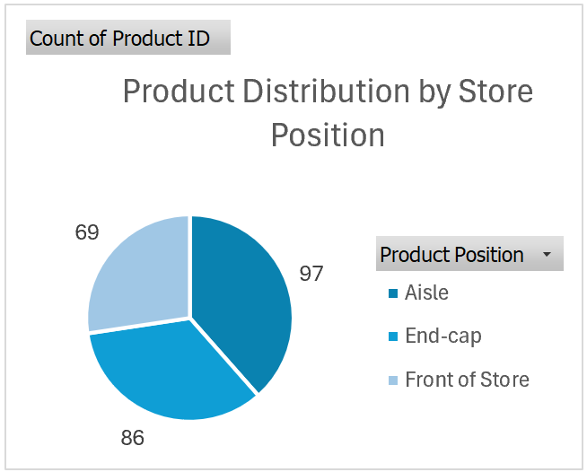
ANALYSIS 2: PRODUCT DISTRIBUTION BY STORE POSITION
Aisle: 97 products
End-cap: 86 products
Front of Store: 69 products
Observation: Aisle has the highest number of products, while Front of Store has the lowest.

Slide 10
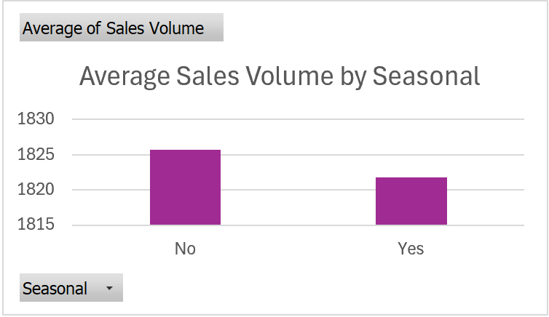
ANALYSIS 3: AVERAGE SALES VOLUME BY SEASONAL
Seasonal: No — Average sales volume = 1,825.74
Seasonal: Yes — Average sales volume = 1,821.73
Observation: Products without seasonal classification had a slightly higher average sales volume than seasonal products.

Slide 11
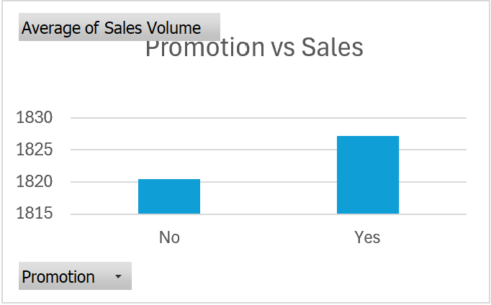
ANALYSIS 4: PROMOTION VS SALES
No Promotion: Average sales volume = 1,820.55
Promotion: Average sales volume = 1,827.18
Observation: Products with promotion had a slightly higher average sales volume than products without promotion.

Slide 12
FUTURE ENHANCEMENTS
Add more product categories for detailed comparison.
Include sales trends over time using historical sales data.
Add more filters for deeper analysis
Connect the dashboard to updated sales data.
Apply forecasting when sufficient historical sales data is available.

Slide 13
CONCLUSION
The dashboard provides a clear view of Zara’s sales performance across 252 products.
Aisle placement recorded the highest total sales volume.
Promotion and seasonal status showed only small differences in average sales volume.
The dashboard uses PivotTables, PivotCharts, KPI cards, and slicers for interactive analysis.
The analysis helps identify sales patterns and supports data-driven decision-making.

Slide 14
THANK YOU

