Slide 1


CAPSTONE PROJECT ON DRIPGUARD: SMART IV INFUSION
MONITORING & PREDICTION SYSTEM
Software + Hardware
Presented by:
Swati Mahto - 22 Khushi Patil - 36 Mrunali Kamble - 19

Slide 2

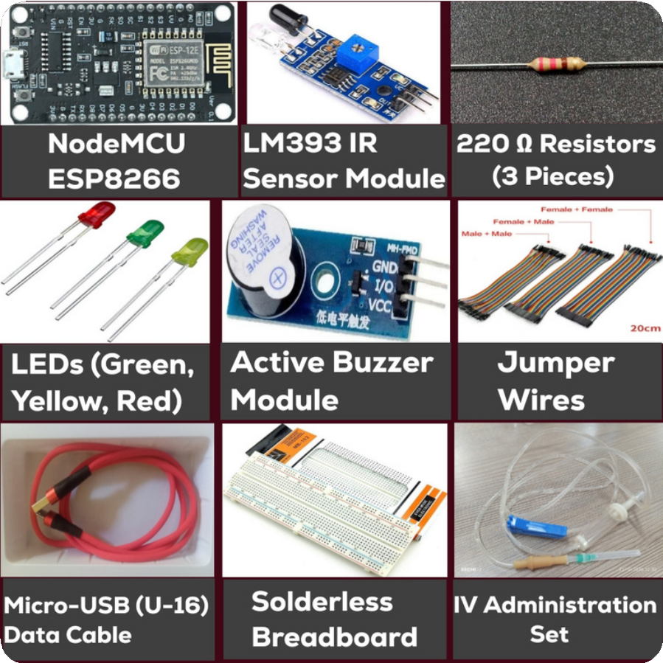
01
DRIPGUARD: HARDWARE COMPONENTS
Smart IV Infusion Monitoring & Prediction System
Main hardware components
NodeMCU ESP8266: Main controller with built-in Wi-Fi connectivity.
LM393 IR Sensor Module: Detects drops passing through the IV drip chamber.
Green LED: Indicates normal status. Yellow LED: Indicates attention status. Red LED: Indicates critical status.
Active Buzzer: Provides audible alerts. 220 Ω Resistors: Limit LED current.
Breadboard and Jumper Wires: Connect the circuit components.
USB Cable: Powers and programs the NodeMCU.

Slide 3
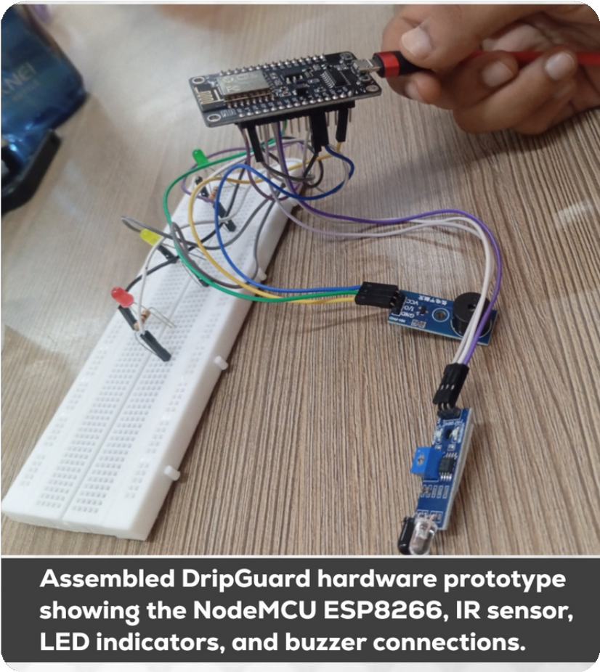
02
HARDWARE PIN CONNECTIONS
NodeMCU ESP8266 connections
Components
IR Sensor Digital Output Green LED D1
Yellow LED D2 Red LED D3
Buzzer Signal D6
NodeMCU Pin D5 (GPIO14) (GPIO5) (GPIO4) (GPIO0) (GPIO12)
Connect each LED through a 220 Ω resistor. Connect the components to the appropriate power supply and common ground.
Verify all connections before powering the circuit.

Slide 4

03
HARDWARE WORKING PRINCIPLE
How the system works
The IR sensor detects drops passing through the IV drip chamber.
The NodeMCU reads the sensor signal and counts the detected drops.
The system calculates the drip rate using the configured settings.
LEDs indicate the programmed monitoring status.
The buzzer provides an alert when a configured condition is met.
Working flow
IV Drip Chamber → IR Sensor → NodeMCU ESP8266 → LEDs and Buzzer
Objective: Demonstrate real-time drop monitoring and status indication.

Slide 5

04
HARDWARE AND TWO-WAY COMMUNICATION
Communication between hardware and software
The NodeMCU connects to the Python backend through 2.4 GHz Wi-Fi.
The backend provides configuration settings such as bag volume, drip factor, and target drip rate.
The NodeMCU processes sensor readings using the configured settings.
The readings are sent to the backend through HTTP requests.
The backend stores and shares monitoring data with the dashboard.
SYSTEM FLOW
NODEMCU ⇄ WI-FI ⇄ PYTHON BACKEND ⇄ DATABASE AND DASHBOARD
BED CONFIGURATION
B01: PHYSICAL HARDWARE MONITORING UNIT.
B02, B03, B04: SIMULATED READINGS FOR DEMONSTRATION.
EACH ADDITIONAL PHYSICAL BED REQUIRES ITS OWN MONITORING UNIT.

Slide 6

05
HARDWARE TESTING AND LIMITATIONS
Testing performed
IR sensor drop detection and counting. NodeMCU startup and Wi-Fi connectivity.
LED status indication. Buzzer alert functionality.
Communication between hardware and dashboard.
Current limitations
Sensor accuracy depends on correct positioning and drop detection.
Wi-Fi interruptions may affect communication.
Multiple physical beds require additional hardware.
Prediction and alert logic require further testing.
Future improvements
Improve sensor accuracy, communication reliability, and system validation.

Slide 7


06
SOFTWARE ARCHITECTURE
Technologies used
Python: Backend logic and data processing. Flask: Backend server and API endpoints.
SQLite: Storage of monitoring readings and
settings.
Streamlit: Interactive monitoring dashboard. Wi-Fi and HTTP: Communication between hardware and backend.
Architecture flow
NodeMCU ESP8266 → Flask Backend →
SQLite Database → Streamlit Dashboard
Purpose: Connect hardware readings, data storage, and visual monitoring in one system.

Slide 8

07
DASHBOARD AND LIVE DEMONSTRATION
Dashboard file: dashboard.py Dashboard features
Bed-wise monitoring cards and status indicators.
Drip rate and flow-rate information. Configured bag volume and estimated remaining time.
IV configuration settings and target drip rate.
Historical readings and alert display.
Run the application
Backend : python app.py
Dashboard: streamlit run dashboard.py
Local addresses:
Backend: http://localhost:5000 Dashboard: http://localhost:8501

Slide 9
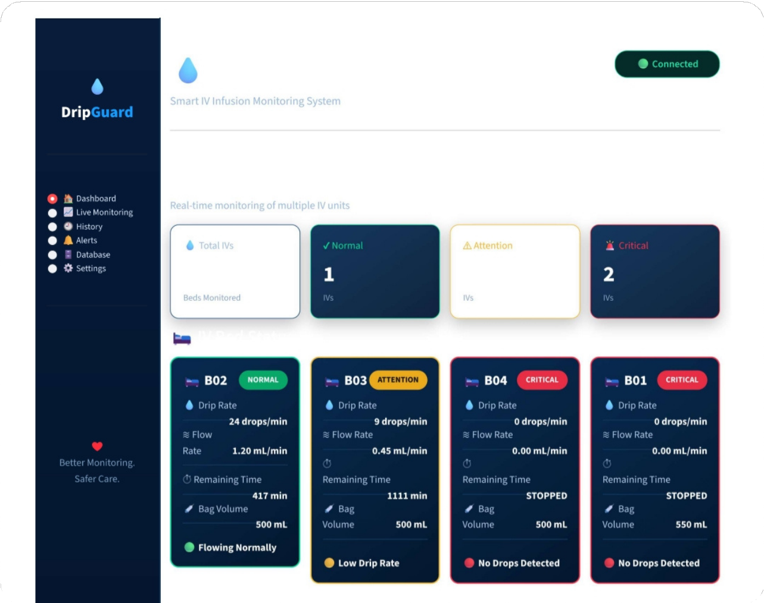
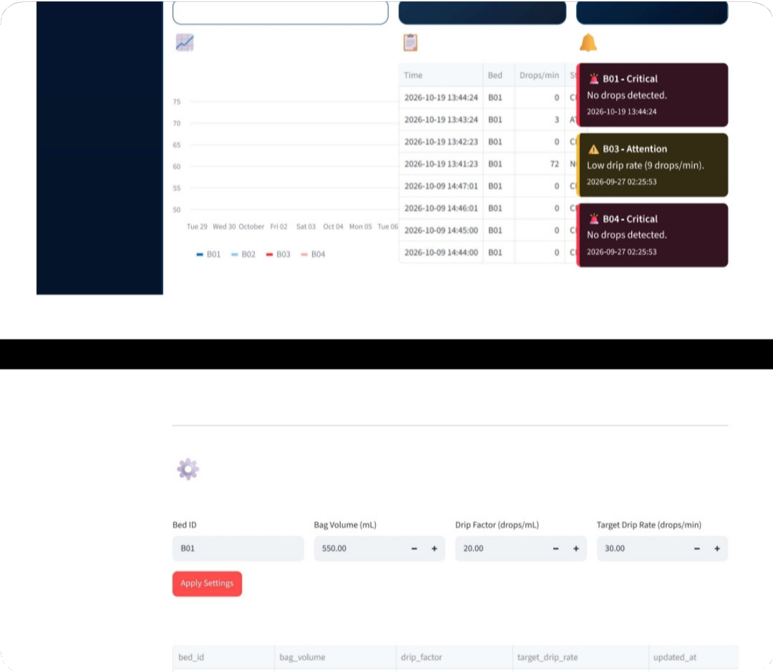

DASHBOARD
08

Slide 10
09
DATABASE AND DATA FLOW
Database: dripguard.db Database technology: SQLite Main tables
readings: Stores monitoring readings and historical data.
iv_settings: Stores configuration settings for each bed.
Data flow
The IR sensor detects drops.
The NodeMCU processes the sensor signal. Readings are transmitted to the Flask backend over Wi-Fi.
The backend processes and stores the data in SQLite.
The Streamlit dashboard retrieves and displays the information.
Demonstration setup: B01 uses physical hardware; B02–B04 use simulated readings.

Slide 11
10
CONCLUSION AND FUTURE SCOPE
Conclusion
DripGuard demonstrates IV drop detection using an IR sensor.
The NodeMCU supports local processing and Wi-Fi communication.
Flask and SQLite support backend processing and data storage.
Streamlit provides a dashboard for monitoring readings and alerts.
Simulated beds demonstrate how the software can display multiple monitoring units.
Future scope
Improve sensor accuracy and communication reliability. Add and test more physical monitoring units.
Refine prediction and alert logic.
Perform extensive technical testing and validation.
Important limitation
DripGuard is a demonstration prototype and must not be used to make clinical decisions.
DripGuard is an academic prototype and is not a clinically validated medical device.

Slide 12

THANK YOU
10

