Slide 1
Project Presentation of Exploratory Project (CS-302)
On
HOMELY STAY
Supervised By
Dr. Arzoo Miglani
Department of Computer Science and Engineering,
Chitkara University, Punjab
Khushi | Kashish | Kashish Garg | Khyati
2110990772 | 2110990743 | 2110990745 | 2110990782

Slide 2


Homely Stay: Your perfect Stay, Just a Tap Away
Homely Stay is a hotel rental platform that offers a wide range of accommodations for every traveler. We connect guests with unique and comfortable places to stay, creating memorable experiences.

Slide 3

Introduction
Homely Stay is a forward-thinking hotel rental platform designed to transform the way people find and book hotel accommodations. At Homely Stay, we offer an extensive range of hotel listings, from budget-friendly options to luxury accommodations. Our platform is built with the latest technology to ensure a fast, secure, and reliable booking process. We continuously update our database to include new listings, giving our users access to the most current and comprehensive selection of hotels.
3

Slide 4

Technology Stack
Frontend | React
Backend | Node.js, Express.js
Database | MongoDB

Slide 5
Environment Setup
React:
Interactive User Interfaces: React allows developers to build highly interactive and responsive user interfaces, enhancing the user experience by making property searches, listings, and bookings seamless and engaging1.
Component-Based Architecture: React’s modular approach enables the creation of reusable components, which simplifies development and maintenance. This ensures that the app remains scalable and easy to manage as it grows.
Node JS :
Node.js is a powerful platform for building home rental applications due to its ability to handle multiple concurrent requests efficiently, making it ideal for managing property listings, user interactions, and real-time updates.
For data management, Node.js works seamlessly with databases like MongoDB (NoSQL)
and MySQL to store user data, property lists.

Slide 6
Environment Setup
Mongo DB and Mongo DB Compass :
It is an ideal database solution for full-stack chat applications due to its flexibility and scalability.
It stores data in JSON-like documents, which allows for handling dynamic data structures like user profiles, property lists, and real-time interactions.
MongoDB Compass is a powerful tool that provides a graphical interface to interact
with the database and simplifies tasks.
Scss:
It makes it easier to manage large and complex stylesheets, ensuring that your code is clean, organized, and easier to maintain.
This reduces redundancy and makes it quicker to implement consistent styling across the application.

Slide 7
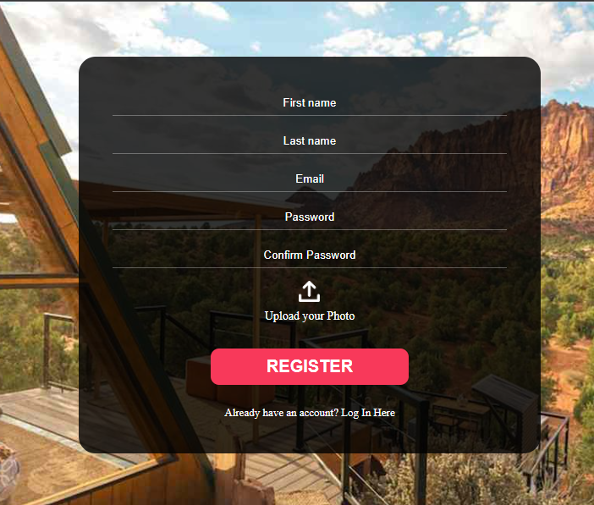
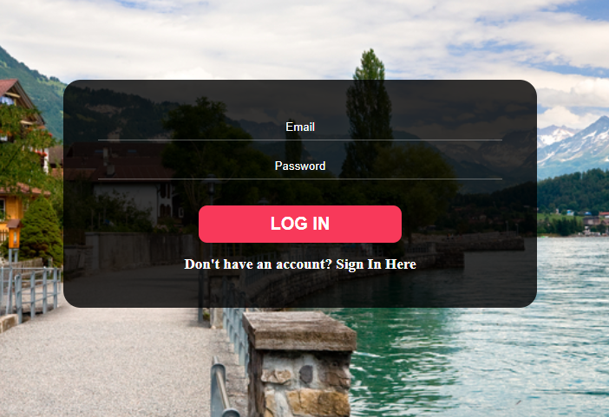
Project Screenshots
< Register Page
Login Page >

Slide 8
About UI
Secure Login and Registration: Implement a system that allows users to create accounts and log in securely. Use password hashing and JWT (JSON Web Tokens) for authentication to ensure user data is protected.
Password Confirmation: Verified that the password is confirmed correctly before storing it in the database.
Field Validations: Ensured that essential fields like property title, description, and price are filled before submitting a listing.
Detailed Property Pages: Each property should have its own details, including high-resolution images, descriptions, pricing, and availability. This helps users make informed decisions.
Database Integration: Utilized a NoSQL database (MongoDB) to store user data, including hashed passwords, emails, and photographs.
Routing Setup: Used react-router-dom to navigate between different pages, such as the home page and property details page.
Responsive Design: Ensured the design adapts to various screen sizes, providing a consistent user experience on both mobile and desktop devices.
User Reviews: Enable users to leave reviews and feedback on properties they have rented. This helps build trust and provides valuable insights for other users.

Slide 9
Thank You
9

