Slide 1

Bug Hunters
KRITICAL HACKS 2026
IGDTUW Delhi · AI/ML Track (Open Innovation) · Student category
Project Title :
TakeSure — Confidence before taking something. Ayurveda × Allopathy herb–drug interaction checker: photo of prescription + photo of product → sourced, plain-language safety verdict + Ministry of Ayush ADR report.
Team Name :
Bug Hunters
Team Members :
Dhriti Garg — Team lead · backend, rule engine, medical research
Shiwani Goyal — Frontend · web app, Hindi/English UI, result card, demo video & pitch
Khushi Gupta — Knowledge base & evidence grading, OCR, PDF/ADR export, TinyFish curation
Track Chosen :
AI/ML Track — Open Innovation · Healthcare
TinyFish :
Mandatory integration implemented — Fetch API verifies every citation · Web Agent drafts interaction rows from monographs · Search + Agent map Indian products to herbs. Human-reviewed, off the verdict path.
Status :
Working prototype: 25 API routes · 49 cited interactions · 78 sources · 58 automated tests · offline-capable.
Aligned with the Ministry of Ayush Pharmacovigilance Programme for ASU&H drugs · decision support, never diagnosis

Slide 2
Bug Hunters
PROBLEM STATEMENT & TARGET AUDIENCE
KRITICAL HACKS 2026
IGDTUW · AI/ML Track
PROBLEM WE'RE SOLVING
TARGET USERS
1
India runs two medical systems side by side — and nobody checks the combination. A thyroid patient on Thyronorm adds ashwagandha for stress; a transplant patient on tacrolimus drinks giloy kadha; a cardiac patient on warfarin takes guggul for cholesterol. Ashwagandha can raise thyroid hormone, giloy can oppose immunosuppression, guggul can increase bleeding.
B2C
Patients & caregivers
Adults 30–70 on long-term medicines who also take Ayurvedic products; family members managing an elder's medicines; Hindi or English, phone-first.
2
The allopathic doctor rarely asks, the patient rarely tells, the chemist has no tool, and the product label says nothing about allopathic medicines.
3
Existing checkers (Medscape, Drugs.com, 1mg) only know allopathic × allopathic pairs; Western herb databases are English-only, paid and do not know Indian brands like Himalaya Ashvagandha or Dabur Giloy Ghanvati.
B2B
Clinicians & pharmacies
MBBS/MD doctors, BAMS vaidyas, hospital pharmacies, retail chemists, telemedicine and hospital-HIS platforms (API).
37%
of hospital patients used allopathic + herbal medicines together
65%
of herbal users lacked knowledge of dose, side effects, interactions
19%
of Indian patients disclose herbal use to their doctor
1,473
ASU&H adverse-event reports nationally since 2018
Impacted: patients on thyroid, diabetes, BP/heart, blood-thinner, transplant or epilepsy medicines and their families; doctors who never hear about the co-use; the Ministry's pharmacovigilance network that never receives the reports.
B2G
Regulators
Ministry of Ayush / NPvCC at AIIA and the 99 Peripheral Pharmacovigilance Centres: structured ICSRs and co-use analytics.
TakeSure · Confidence before taking something · Team Bug Hunters · Kritical Hacks 2026 · Decision support, not diagnosis
2
Notes:
Problem: two systems, nobody checks; three examples; nobody asks or tells; existing tools miss Indian products. Four statistics. Three user groups: patients, clinicians/pharmacies, regulators.

Slide 3
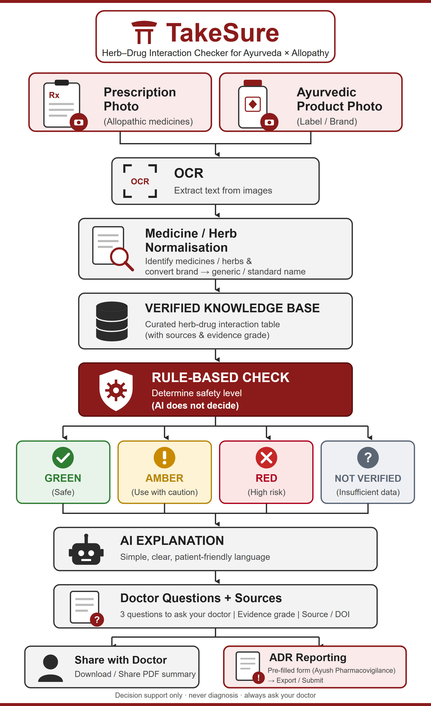
Bug Hunters
TAKESURE — OUR UNIQUE SOLUTION
KRITICAL HACKS 2026
IGDTUW · AI/ML Track
Key Features
Project workflow
1
Scan — Photograph the prescription and the Ayurvedic product label (or type names). OCR reads them; every name is shown for confirmation before anything is checked.
2
Match — Indian brand → generic (Thyronorm → levothyroxine), product → herbs (Chyawanprash → amla, ashwagandha…) via a curated bridge dictionary + fuzzy matching.
3
Decide — Deterministic rule engine over a cited knowledge base → GREEN / AMBER / RED / NOT IN DATABASE, with timing gaps (e.g. keep 2–3 h between Triphala and oral medicines).
4
Explain — AI rewrites only the matched evidence into simple Hindi/English + 3 questions to ask the doctor. It cannot add, remove or re-grade an interaction.
5
Report — One-page PDF with sources for the doctor; one-tap suspected-ADR report in the Ministry of Ayush format for the Ayush Suraksha portal.
Novelty
“Verdict from published data; AI only explains.” The risk level never comes from a language model — it comes from a versioned, cited knowledge-base row. Turn the AI off and the verdict is identical.
The missing bridge table: Indian brand names × Ayurvedic herb synonyms (Sanskrit/Hindi/Latin) × graded published evidence — open, auditable, co-curated with Ayurveda colleges.
TakeSure · Confidence before taking something · Team Bug Hunters · Kritical Hacks 2026 · Decision support, not diagnosis
3
Notes:
Five features: Scan, Match, Decide, Explain, Report. Novelty: verdict from data, AI only explains; the bridge table nobody has built. Right: the project workflow.

Slide 4
Bug Hunters
ROLE OF AI / ML
KRITICAL HACKS 2026
IGDTUW · AI/ML Track
AI everywhere it is safe. Rules in the one place it is dangerous.
Computer vision
OCR
Tesseract 5.4 (pre-trained LSTM) reads prescription and label photos after Pillow pre-processing (grayscale, upscale, autocontrast); English + Hindi models. Roadmap: fine-tune on Indian labels and handwriting.
NLP
Name matching
Entity extraction from messy prescription text; RapidFuzz token matching over a bridge dictionary of Indian brands, generics and Sanskrit/Hindi/Latin synonyms. ≥85 accept, 70–85 ask the user, <70 unrecognised.
LLM
Explainer
Groq-hosted open-weight model (gpt-oss-120b), temperature 0, receives only the matched rows, must return a strict JSON schema; directive language rejected in English and Hindi; knowledge-base fallback. Output: plain-language summary + 3 doctor questions.
Agentic AI
TinyFish research assistant
Web agents fetch citations, read monographs and product pages, and draft knowledge-base rows with sources attached. Human-reviewed. This is how the dataset scales.
Rules
Verdict engine
Deterministic rules R1–R5 over cited rows: severity + evidence grade + drug class → GREEN / AMBER / RED / NOT IN DB. Reproducible, auditable, works with every model switched off.
Why no trained classifier for the verdict: no labelled dataset exists (≈1,473 national reports in 7 years), a classifier cannot explain itself to a doctor or regulator, and medical decision support must be reproducible. Future ML once data exists: OCR fine-tuning on Indian labels, a named-entity model for prescriptions, and a model that ranks under-reported pairs for curation priority.
TakeSure · Confidence before taking something · Team Bug Hunters · Kritical Hacks 2026 · Decision support, not diagnosis
4
Notes:
Five AI layers; rules decide the verdict; why no trained classifier.

Slide 5
Bug Hunters
TECH STACK + ARCHITECTURE
KRITICAL HACKS 2026
IGDTUW · AI/ML Track
TECH STACK
ARCHITECTURE
FE
Frontend
1
Inputs
2
OCR
3
Matcher
4
Rule engine (decides)
Next.js (React) + TypeScript, Tailwind CSS, Framer Motion · installable PWA · Hindi/English UI
Prescription + product label photos, or typed names
Tesseract eng+hin / vision model · file deleted after read
RapidFuzz · brand→generic · product→herbs · user confirms
Rules R1–R5: severity + grade → GREEN / AMBER / RED / NOT IN DB
BE
Backend
FastAPI (Python), Pydantic v2 validation, SQLAlchemy · REST API with typed errors
DB
Database
5
Explainer (AI)
6
Outputs
7
Anonymised log
DB
Knowledge base
PostgreSQL (Supabase) in production; SQLite for offline/demo · tables: herbs, drugs, products, interactions, sources
Groq LLM · matched rows only · JSON schema · cannot change verdict
Result card (Hindi/English) · doctor PDF · ADR report
ids + verdict + state → dashboard for Ministry / NPvCC
PostgreSQL / SQLite · herb × drug rows: severity, grade A/B/C, timing, DOI/PMID
OCR
OCR
Tesseract (eng + hin) on the server; Google Vision / Groq vision model as optional cloud reader
FZ
Matching
FLOW
RapidFuzz token-set matching; ≥85 accept, 70–85 ask the user, <70 not recognised
1
Verdict path
2
AI guardrail
3
Privacy
4
Curation loop (TinyFish)
AI
AI explainer
Photos → OCR text → candidate names → user confirms → rule engine looks up every herb × medicine pair → worst row wins (RED > AMBER > GREEN; unknown is never GREEN).
Only matched rows go to the LLM, which returns {summary_hi, summary_en, timing_gap, doctor_questions[3]}; invalid or directive output is rejected and the knowledge-base text is shown instead.
Uploads are deleted after extraction; the log stores ids and verdicts only — the basis of the anonymised dashboard for the Ministry of Ayush.
Offline from verdicts: Fetch verifies citations, the Web Agent drafts rows from monographs, Search+Agent map products. Every draft keeps its source URL and run id and waits for a reviewer.
Groq API (Llama / GPT-OSS) with JSON-schema output, temperature 0, facts-only prompt, fallback text
PDF
PDF & hosting
ReportLab for doctor summary + ADR form · Vercel (web) + Render/Railway (API)
TF
TinyFish curation
Fetch verifies citations · Web Agent drafts rows from monographs · Search+Agent map products → human-approved drafts
TakeSure · Confidence before taking something · Team Bug Hunters · Kritical Hacks 2026 · Decision support, not diagnosis
5
Notes:
Stack left; eight architecture blocks right; three flow notes: verdict path, AI guardrail, privacy.

Slide 6
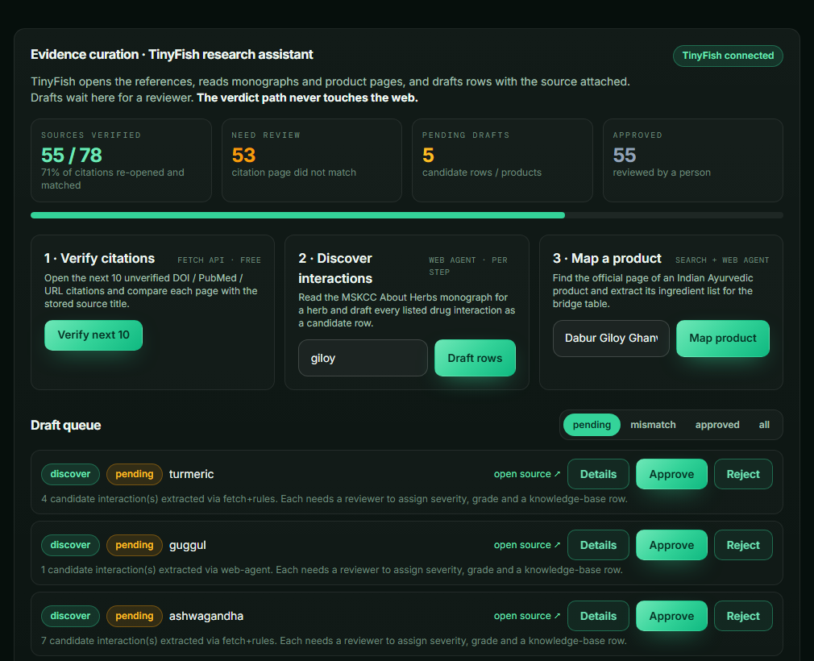
Bug Hunters
TINYFISH INTEGRATION
KRITICAL HACKS 2026
IGDTUW · AI/ML Track
TinyFish is TakeSure's research assistant. It opens the references, reads monographs and product pages, and drafts knowledge-base rows with the source attached. Reviewers approve every row. The verdict path never touches the live web — that is a safety rule, not a limitation.
Fetch API
Verify citations
Live run 19 Oct: 55 of 78 citations verified automatically; 23 listed for review (3 broken links found). Free tier.
Evidence-curation panel on the dashboard
Three stages: Fetch the resolved page; Fetch the Crossref record for bot-blocked DOIs; Search the title for sources without a locator. ≥60% of distinctive title terms matched → verified; otherwise a “mismatch” draft with the best candidate.
Fetch + Web Agent
Discover interaction rows
Live: 7 candidates for ashwagandha, 4 for turmeric in seconds (Fetch + rules); Web Agent fallback for guggul.
Fetch the MSKCC About Herbs page (free, 2 s) and extract every clinical bullet naming a drug, class or interaction verb from our drug dictionary; if the static page yields nothing, POST /v1/automation/run-async with a JSON output_schema and poll the run.
Search + Agent
Map Indian products
Live: Dabur Giloy Ghanvati mapped to giloy (1 g/tablet) in one Agent run (28 steps).
Live: 55/78 sources verified, 5 pending drafts, queue with approve / reject.
GET api.search.tinyfish.ai for the product page, then an Agent run extracts the ingredient list with Latin/Sanskrit names; matched to known herbs.
IMPLEMENTATION STATUS · DEMONSTRABLE
Backend: app/services/tinyfish_service.py (Fetch, Search, Agent clients) · curation_drafts table · 7 routes under /api/curation · 7 offline tests with a mocked TinyFish transport (58 tests total).
Frontend: “Evidence curation” panel on the dashboard with Verify / Discover / Map actions and an approve-reject draft queue; health endpoint reports tinyfish_configured.
Guardrail: TINYFISH_API_KEY lives only on the server; drafts never change a verdict until a reviewer approves. Live demo: Verify next 10 → the sources-verified counter rises.
TakeSure · Confidence before taking something · Team Bug Hunters · Kritical Hacks 2026 · Functional in the prototype
6
Notes:
Three TinyFish jobs, where each lands, implementation status.

Slide 7
Bug Hunters
FEASIBILITY AND SHOWSTOPPERS
KRITICAL HACKS 2026
IGDTUW · AI/ML Track
TECHNICAL
DATA & EVIDENCE
RISK / BLOCKER | MITIGATION
OCR misread Handwritten prescriptions · poor-quality or unusual printed labels | Extracted names shown for user confirmation · manual text entry always available · fuzzy-matching thresholds separate confident from uncertain matches
Unknown herb / drug Herb or drug may not be in the KB · coverage gaps | NEVER guess · neutral “NOT IN DATABASE” result · unknown items logged for future curation · MVP deliberately scoped
Weak / conflicting evidence Limited clinical evidence · sources may disagree | A/B/C grade on every result · source / reference visible · conflicting sources kept at lower confidence, not hidden · KB entries reviewed before publication
LLM hallucination Unsupported medical claims | LLM receives ONLY matched KB info · never determines severity or verdict · schema-validated output · raw KB text if validation fails · safety decision works with LLM off
Medical liability / safety scope Users may read it as a prescription or diagnosis tool | Positioned as DECISION SUPPORT · never says stop / start · no diagnosis or dosing · evidence + sources shown · questions for the doctor · report-incorrect-info mechanism
API / connectivity failure Internet or external API / provider failure | Local / offline fallback · SQLite KB · PaddleOCR runs locally · LLM provider swappable · DB lookup independent of LLM · cached outputs for demo continuity
Proven, off-the-shelf stack
OCR: Google Vision / Paddle OCR
RapidFuzz for name matching
SQL for KB lookup
LLM only explains — rules decide risk
No custom ML training
Public / citable sources: Ayurvedic Pharmacopoeia, NIH LiverTox, MSKCC, PubMed, WHO monographs
Every entry stores evidence, severity & source
Evidence graded A / B / C
RESOURCES
MVP SCOPE
Team: Backend · Mobile/Frontend · Data curation
Local/offline components + free/low-cost infrastructure
Swappable LLM provider
~40 herb–drug pairs · 2 photo inputs · manual text-entry fallback · risk / safety card · ADR reporting form
Not in MVP: diagnosis · dosing · herb–herb interactions · custom ML training
REGULATORY / OPERATIONAL SAFETY
ADR workflow aligned with Ministry/ICSR fields
Links to Ayush Suraksha instead of a parallel reporting system
Photos not retained beyond the session unless the user opts in
Decision support — not diagnosis or prescription
FEASIBILITY
TakeSure · Confidence before taking something · Team Bug Hunters · Kritical Hacks 2026 · Decision support, not diagnosis
7
Notes:
Five feasibility boxes; six risks with mitigations.

Slide 8
Bug Hunters
USP (UNIQUE SELLING PROPOSITION) & BUSINESS MODEL
KRITICAL HACKS 2026
IGDTUW · AI/ML Track
USP (UNIQUE SELLING PROPOSITION)
BUSINESS MODEL
1
India's first safety layer between the two medical systems people already mix — nothing public today checks an Ayurvedic product against an allopathic prescription.
B2C
Free for citizens — Web/PWA checker in Hindi & English; grows the knowledge base and the ADR signal.
2
Verdict from published data; AI only explains — auditable rules over cited rows; the opposite of a “ChatGPT wrapper”.
B2B
API & counter tool — Per-query / subscription API for pharmacy chains, hospital HIS, telemedicine apps; QR on the chemist's bill.
3
Built for India: Indian brand names, Sanskrit/Hindi synonyms, Hindi explanations, Ministry of Ayush ADR format, Ayush Suraksha portal link.
B2G / CSR
Programmes & grants — Co-use analytics and structured ICSRs for the Ministry of Ayush pharmacovigilance network; CSR funding from Ayurvedic brands that want a trust layer.
4
Honest by design: evidence grades, timing gaps instead of alarms, “not in database” instead of guesses.
PLATFORM
Ayush Grid / ABDM integration — verdict attached to the ABHA health record; open KB co-curated with Ayurveda colleges.
WHO BENEFITS · ONE KNOWLEDGE BASE, FOUR USERS
IMPACT · WHY IT MATTERS
PATIENTS & FAMILIES
DOCTORS & VAIDYAS
PHARMACISTS & CHEMISTS
MINISTRY OF AYUSH / NPvCC
1,473
75%
0
60-second verdict in Hindi or English, timing gaps, and three questions to carry to the clinic
Patients finally disclose what they take; a one-page summary with sources bridges both vocabularies
Counter-side cross-check for the only shop that sells both systems' products; QR on the bill
Structured ICSRs in the official format, anonymised co-use analytics by state, early signal detection
ASU&H adverse-event reports nationally since 2018 — TakeSure turns every reaction into a structured ICSR
of herbal users with a side effect never told their doctor — TakeSure hands them the questions to ask
public tools today check an Ayurvedic product against an allopathic prescription — TakeSure is the first
TakeSure · Confidence before taking something · Team Bug Hunters · Kritical Hacks 2026 · Decision support, not diagnosis
8
Notes:
Four USPs, four revenue lines, four beneficiaries, three impact numbers.

Slide 9
Bug Hunters
REVENUE MODEL
KRITICAL HACKS 2026
IGDTUW · AI/ML Track
PRICE ECONOMICS
MARKET RESEARCH
Segment | Offer | Price (launch) | Why this price
B2C · patients & caregivers | Web / PWA checker, Hindi + English | Free | Adoption and the ADR signal are the asset; a paywall would re-create the gap we are closing
B2B · chemists (per outlet) | Counter cross-check + QR on the bill | ₹499 / month | Below one day's margin on a mid-size counter; comparable to billing-software add-ons (₹300–800/month)
B2B · telemedicine / HIS (API) | Per-query verdict API | ₹2 per check, ₹25,000 / year floor | Pure marginal cost is near zero (rules + SQL); ₹2 sits under the ₹5–15 lab/health-ID API norms
B2B · hospital licence | On-prem / private cloud, Hindi PDFs, ADR export | ₹1.5 lakh / year | One pharmacist-hour per day saved covers it; priced like a single clinical-reference subscription
B2G / CSR | Co-use analytics, structured ICSRs, college co-curation | Programme grants ₹10–25 lakh | In line with Ministry of Ayush pharmacovigilance programme funding and brand CSR budgets
Demand: 37% of hospital patients already combine both systems; only 19% tell their doctor (references slide).
Counters: India has ≈ 8.5 lakh retail chemists (AIOCD); 1% adoption = 8,500 outlets × ₹499 × 12 = ₹5.1 crore ARR.
Telemedicine: eSanjeevani alone crossed 30 crore consultations; at 1% of consults checked × ₹2 = ₹6 crore / year.
Ayush sector: Ministry of Ayush values the Ayush market at US$ 24 billion (2020, RIS); no product offers a herb × drug safety layer.
Cost side: verdicts cost ≈ ₹0 (rules + SQLite/Postgres); AI rewording ≈ ₹0.02 per check (Groq); TinyFish curation is a fixed monthly cost (Search/Fetch free, Agent ≈ $0.016 per step).
THREE-YEAR PATH · CONSERVATIVE
Year 1 · pilot
Year 2 · scale
Year 3 · platform
1 city · 50 chemists · 1 telemedicine partner
3 states · 2,000 chemists · 3 HIS integrations
ABDM / Ayush Grid integration · pharmacy chains
₹3–5 lakh revenue · CSR grant ₹10 lakh
₹1.2–1.5 crore ARR
₹5+ crore ARR
Prove counter adoption and ADR flow
Knowledge base 300+ rows reviewed by a college
Verdict on the ABHA record; national co-use analytics
TakeSure · Confidence before taking something · Team Bug Hunters · Kritical Hacks 2026 · Prices are launch assumptions, to be validated in the pilot
9
Notes:
Prices with justification; market sizing from public figures; three-year conservative path.

Slide 10
Bug Hunters
FUTURE SCOPE
KRITICAL HACKS 2026
IGDTUW · AI/ML Track
ROADMAP
24-HOUR BUILD PLAN · 31 OCT – 1 NOV
Knowledge base: 200+ pairs; second-reviewer rule on every citation; faculty review with an Ayurveda college or pharmacology department before public release.
ML once data exists: OCR fine-tuned on Indian labels and handwriting; a named-entity model for prescriptions; ranking of under-reported pairs for curation priority.
TinyFish: scheduled monthly re-verification of every citation; agent monitoring of LiverTox and Ayush Suraksha for new signals; product-catalogue sweeps of Himalaya, Dabur, Patanjali, Baidyanath.
Integration: Ayush Grid / ABDM so the verdict and ADR sit on the ABHA record; pharmacy-chain API; chemist QR pilot in one city.
Out of scope by design: diagnosis, dosing, herb–herb interactions, any trained model deciding a verdict.
Set up at venue; load KB; core loop photo → OCR → confirm → verdict green.
0–3 h
3–9 h
TinyFish verifier over all 78 citations; reviewer pass on mismatches.
9–15 h
Agent discovery for 16 herbs → draft rows → review → 100+ rows.
15–19 h
Product mapping for top 30 Indian products; Hindi in every PDF.
19–22 h
Public deploy (Vercel + Render + Supabase); chemist QR flow.
22–24 h
Freeze, run tests, rehearse the demo on the deployed link.
TakeSure · Confidence before taking something · Team Bug Hunters · Kritical Hacks 2026 · Decision support, not diagnosis
10
Notes:
Roadmap and the 24-hour plan.

Slide 11
Bug Hunters
RESEARCH & REFERENCES
KRITICAL HACKS 2026
IGDTUW · AI/ML Track
RESEARCH & REFERENCES
COMPARISON WITH EXISTING TOOLS
Sharma 2018: ashwagandha & thyroid trial
FEATURE | MEDSCAPE · DRUGS.COM · 1MG | MSKCC · NATURAL MEDICINES | TAKESURE (OUR APP) | WHY TAKESURE?
Ayurveda × allopathy check | ✗ Allopathic × allopathic pairs only ★☆☆☆☆ 1 / 5 | ~ Single-herb monographs only ★★☆☆☆ 2 / 5 | ✓ Prescription × Ayurvedic product, every herb–drug pair checked ★★★★★ 5 / 5 | ★ Only tool that checks the two systems people already mix.
Indian brands & Hindi | ~ Partly covered ★★★☆☆ 3 / 5 | ✗ Western herbs, English only ★☆☆☆☆ 1 / 5 | ✓ Indian brands + Sanskrit / Hindi synonyms, Hindi UI ★★★★★ 5 / 5 | ★ Matches Himalaya, Dabur and the names patients actually use.
Sources on every verdict | ✓ Sources shown ★★★★☆ 4 / 5 | ✓ Sources shown ★★★★☆ 4 / 5 | ✓ Sources + grade A/B/C with DOI/PMID; marked “needs verification” until re-checked ★★★★☆ 4 / 5 | ★ Weak evidence is shown as weak, never hidden — and we say so when a citation is not yet re-verified.
ADR report to Ministry | ✗ No reporting ★☆☆☆☆ 1 / 5 | ✗ No reporting ★☆☆☆☆ 1 / 5 | ✓ One-tap report in Ministry of Ayush format ★★★★★ 5 / 5 | ★ Feeds the Ayush pharmacovigilance network.
OVERALL RATING | Medscape 2.3 / 5 ★★☆☆☆ | MSKCC 2.0 / 5 ★★☆☆☆ | TakeSure 4.8 / 5 ★★★★★ | TakeSure scores 2.5 points higher than the best alternative.
1
RCT, 50 patients, 600 mg/day, 8 weeks
pubmed.ncbi.nlm.nih.gov/28829155
2
Gohil & Patel 2007: herb–drug case reports
133 cases, only 6% well documented (Indian J Pharmacol)
doi.org/10.4103/0253-7613.33432
3
Ghosh et al. 2009: herb–drug interaction
Fallout of poor doctor–patient communication (JCDR)
jcdr.net/articles/PDF/576/501.pdf
4
Interactions between substances in Ayurveda
Food–drug & Ayurveda–modern drug review, 2013
doi.org/10.1515/dmdi-2013-0014
5
NSSO Survey on Ayush 2022-23 (MoSPI press note)
Ayurveda is the most used Ayush system
mospi.gov.in/…/PressNote_Ayush_13062024N.pdf
6
Ayush Suraksha portal (Ministry of Ayush)
Suspected ADR reporting for ASU&H drugs
suraksha.ayush.gov.in
7
ASU&H pharmacovigilance (ITRA, Jamnagar)
PPvC / IPvC reporting network
itra.ac.in/pharmacovigilance
8
Open-source tools we build on
OCR (Tesseract) and name matching (RapidFuzz)
github.com/tesseract-ocr · github.com/rapidfuzz
Ratings out of 5 are the team's assessment on the four features compared (sourced = 4, +1 with evidence grade · partly = 3 · single herb = 2 · none = 1). TakeSure takes 4/5 on Sources deliberately: every citation stays marked “needs verification” until a second reviewer re-opens the DOI/PMID.
9
TinyFish documentation
Fetch, Search and Web Agent APIs used for evidence curation
docs.tinyfish.ai
TakeSure · Confidence before taking something · Team Bug Hunters · Kritical Hacks 2026 · Decision support, not diagnosis
11
Notes:
Eight references with live links; honest comparison with existing tools.

