Slide 1

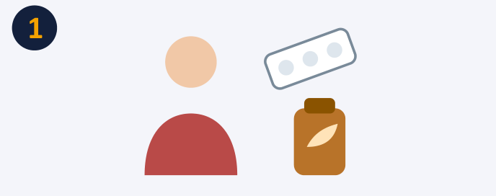

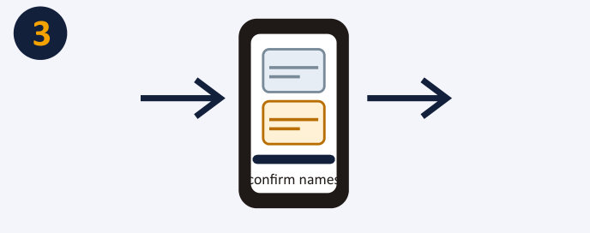
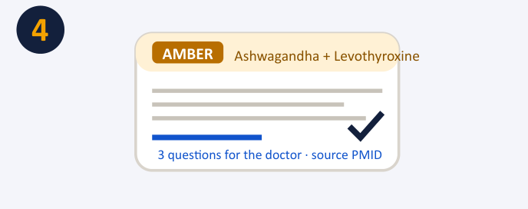
TakeSure — Confidence before taking something
Scan both. Check the pair. Ask the right questions.
HACK@BVP 8.0 · Abstract Round
Team Bug Hunters
Dhriti Garg · Shiwani Goyal · Khushi Gupta
An Ayurveda × Allopathy herb–drug interaction checker for Indian patients, doctors and the Ministry of Ayush
DOMAIN: Health & Well-Being (AI4Impact secondary) · SDG 3 · SDG 9 · SDG 10
One patient's story — the gap today, and what TakeSure would do about it
Mother takes Thyronorm for thyroid and starts ashwagandha for stress.
Nobody asks, nobody tells. Her doctor never hears of it; the label says nothing.
She photographs both. TakeSure reads the names, confirms them and checks the pair.
AMBER. A cited source, timing advice, three questions. One tap sends the PDF to her doctor.
1
The problem
2
Proposed solution
Two medical systems, zero cross-checking. A thyroid patient on Thyronorm adds ashwagandha; a transplant patient on tacrolimus drinks giloy kadha; a cardiac patient on warfarin takes guggul.
Each pair can cause harm: ashwagandha can raise thyroid hormone, giloy can oppose immunosuppression, guggul can increase bleeding.
Nobody asks, nobody tells. The doctor rarely asks about herbs, the patient rarely mentions them, the chemist has no tool, the label says nothing.
Existing tools do not cover it. Medscape, Drugs.com and 1mg check only allopathic × allopathic pairs; Western herb databases are English-only, paid and do not know Indian brands like Himalaya Ashvagandha or Dabur Giloy Ghanvati.
Scan both. The patient photographs the allopathic prescription and the Ayurvedic product label (or types the names); every name is confirmed before checking.
Match Indian names. Brand → generic (Thyronorm → levothyroxine) and product → herbs (Chyawanprash → amla, ashwagandha…) with Sanskrit / Hindi / Latin synonyms.
Decide from data. A rule engine checks every herb–drug pair against a curated, cited knowledge base: GREEN / AMBER / RED / NOT IN DATABASE, with timing advice.
Explain simply. AI rewrites only the matched evidence into plain Hindi or English, with sources and three questions to ask the doctor.
Report in one tap. A one-page PDF for the doctor and a pre-filled suspected-ADR report in the Ministry of Ayush format for the Ayush Suraksha portal.
37%
of hospital patients use allopathic and herbal medicines together
65%
of herbal users do not know the dose, side effects or interactions
19%
of Indian patients ever disclose herbal use to their doctor
1,473
ASU&H adverse-event reports received nationally since 2018
Our rule: The verdict comes from published data; AI only explains it.
3
Approach — project workflow
Prescription photo
allopathic medicines
›
1 · OCR
read both images; user confirms names
›
2 · Match
brand → generic; product → herbs; synonyms
›
3 · Knowledge base
cited herb–drug table; grade A/B/C
›
Rule engine
decides severity; AI does not
›
GREEN
›
4 · AI explains
simple Hindi/English + 3 doctor questions
›
Doctor PDF
verdict + sources
AMBER
Product photo
Ayurvedic label / brand
RED
ADR report
Ministry of Ayush format
NOT IN DB
Verdict rules: Worst row wins; an unknown pair is never shown as green; grade-C evidence caps at AMBER; the answer is identical with the AI switched off.
Feature | Medscape · Drugs.com · 1mg | MSKCC · Natural Medicines | TakeSure
Ayurveda × allopathy pair check | ✗ | ~ single herbs | ✓ every pair
Indian brands & Hindi | ~ | ✗ | ✓ brands + synonyms
Source on every verdict | ✓ | ✓ | ✓ + evidence grade
ADR report to Ministry of Ayush | ✗ | ✗ | ✓ one tap
Stack. Next.js + TypeScript PWA (Hindi/English UI) · FastAPI + Pydantic REST API · PostgreSQL in production, SQLite offline · Tesseract OCR · RapidFuzz matching (≥85 accept, 70–85 ask the user) · Groq LLM, JSON-schema output, temperature 0 · ReportLab PDFs. No model training; runs fully offline on a laptop.
Knowledge base. 40–60 herb × drug pairs curated from PubMed, NIH LiverTox, MSKCC, WHO monographs and the Ayurvedic Pharmacopoeia, graded on the Stockley's model. Decision support only, never diagnosis. Sample rows:
Herb × drug | Verdict | What happens | Source
Ashwagandha × Levothyroxine | AMBER · grade B | May raise thyroid hormone | Sharma 2018, PMID 28829155
Guggul × Warfarin | RED · grade B | May increase bleeding risk | MSKCC About Herbs
Giloy × Tacrolimus | RED · grade C | May oppose immuno-suppression | Nagral 2021, LiverTox
Our assessment from each tool's public documentation.
4
Expected impact
✓
Patients & caregivers A sourced answer before the first dose, in their own language, instead of silence or a guess. Free for citizens.
✓
Doctors, vaidyas & chemists Finally learn what patients actually take; a QR on the chemist's bill or an API inside hospital and telemedicine systems makes the check routine.
✓
Ministry of Ayush Structured, reproducible ADR reports and real co-use data from the catchment of its 99 peripheral pharmacovigilance centres.
✓
Novelty Nothing public today checks an Ayurvedic product against an allopathic prescription. TakeSure builds the missing bridge table: Indian brands × Ayurvedic herb synonyms × graded evidence, open and auditable. Honest by design: grades, timing gaps instead of alarms, “not in database” instead of guesses.
Aligned with the Ministry of Ayush Pharmacovigilance Programme for ASU&H drugs · decision support only, never diagnosis
Team Bug Hunters · HACK@BVP 8.0 · BVEST XIII
Notes:
One-page abstract for the Hack@BVP 8.0 Abstract Round. Problem, proposed solution, approach (workflow), expected impact.

