Slide 1

Bug Hunters
HACK@BVP 8.0 · Bharati Vidyapeeth's College of Engineering, New Delhi · Round 1
TakeSure — Confidence before taking something
Project Title :
TakeSure — Confidence before taking something. Ayurveda × Allopathy herb–drug interaction checker: photo of prescription + photo of product → sourced, plain-language safety verdict + Ministry of Ayush ADR report.
Team Name :
Bug Hunters
Team Members :
Dhriti Garg — Team lead · backend, rule engine, medical research
Shiwani Goyal — Frontend · web app, Hindi/English UI, result card, demo video & pitch
Khushi Gupta — Knowledge base & evidence grading, OCR, PDF/ADR export
Track Chosen :
Health & Well-Being (AI4Impact secondary) · SDG 3 · SDG 9 · SDG 10
Explanation video :
https://drive.google.com/file/d/13c1pPE8lp9RVvS2NlUYUJiIB65z5fgvx/view
Aligned with the Ministry of Ayush Pharmacovigilance Programme for ASU&H drugs · decision support, never diagnosis

Slide 2
Bug Hunters
PROBLEM STATEMENT & TARGET AUDIENCE
HACK@BVP 8.0
BVCOE · New Delhi
PROBLEM WE'RE SOLVING
TARGET USERS
1
India runs two medical systems side by side — and nobody checks the combination. A thyroid patient on Thyronorm adds ashwagandha for stress; a transplant patient on tacrolimus drinks giloy kadha; a cardiac patient on warfarin takes guggul for cholesterol. Ashwagandha can raise thyroid hormone, giloy can oppose immunosuppression, guggul can increase bleeding.
B2C
Patients & caregivers
Adults 30–70 on long-term medicines who also take Ayurvedic products; family members managing an elder's medicines; Hindi or English, phone-first.
2
The allopathic doctor rarely asks, the patient rarely tells, the chemist has no tool, and the product label says nothing about allopathic medicines.
3
Existing checkers (Medscape, Drugs.com, 1mg) only know allopathic × allopathic pairs; Western herb databases are English-only, paid and do not know Indian brands like Himalaya Ashvagandha or Dabur Giloy Ghanvati.
B2B
Clinicians & pharmacies
MBBS/MD doctors, BAMS vaidyas, hospital pharmacies, retail chemists, telemedicine and hospital-HIS platforms (API).
37%
of hospital patients used allopathic + herbal medicines together
65%
of herbal users lacked knowledge of dose, side effects, interactions
19%
of Indian patients disclose herbal use to their doctor
1,473
ASU&H adverse-event reports nationally since 2018
Impacted: patients on thyroid, diabetes, BP/heart, blood-thinner, transplant or epilepsy medicines and their families; doctors who never hear about the co-use; the Ministry's pharmacovigilance network that never receives the reports.
B2G
Regulators
Ministry of Ayush / NPvCC at AIIA and the 99 Peripheral Pharmacovigilance Centres: structured ICSRs and co-use analytics.
TakeSure · Confidence before taking something · Team Bug Hunters · HACK@BVP 8.0
Decision support · not diagnosis 2
Notes:
Problem: two systems, nobody checks; three examples; nobody asks or tells; existing tools miss Indian products. Four statistics. Three user groups: patients, clinicians/pharmacies, regulators.

Slide 3
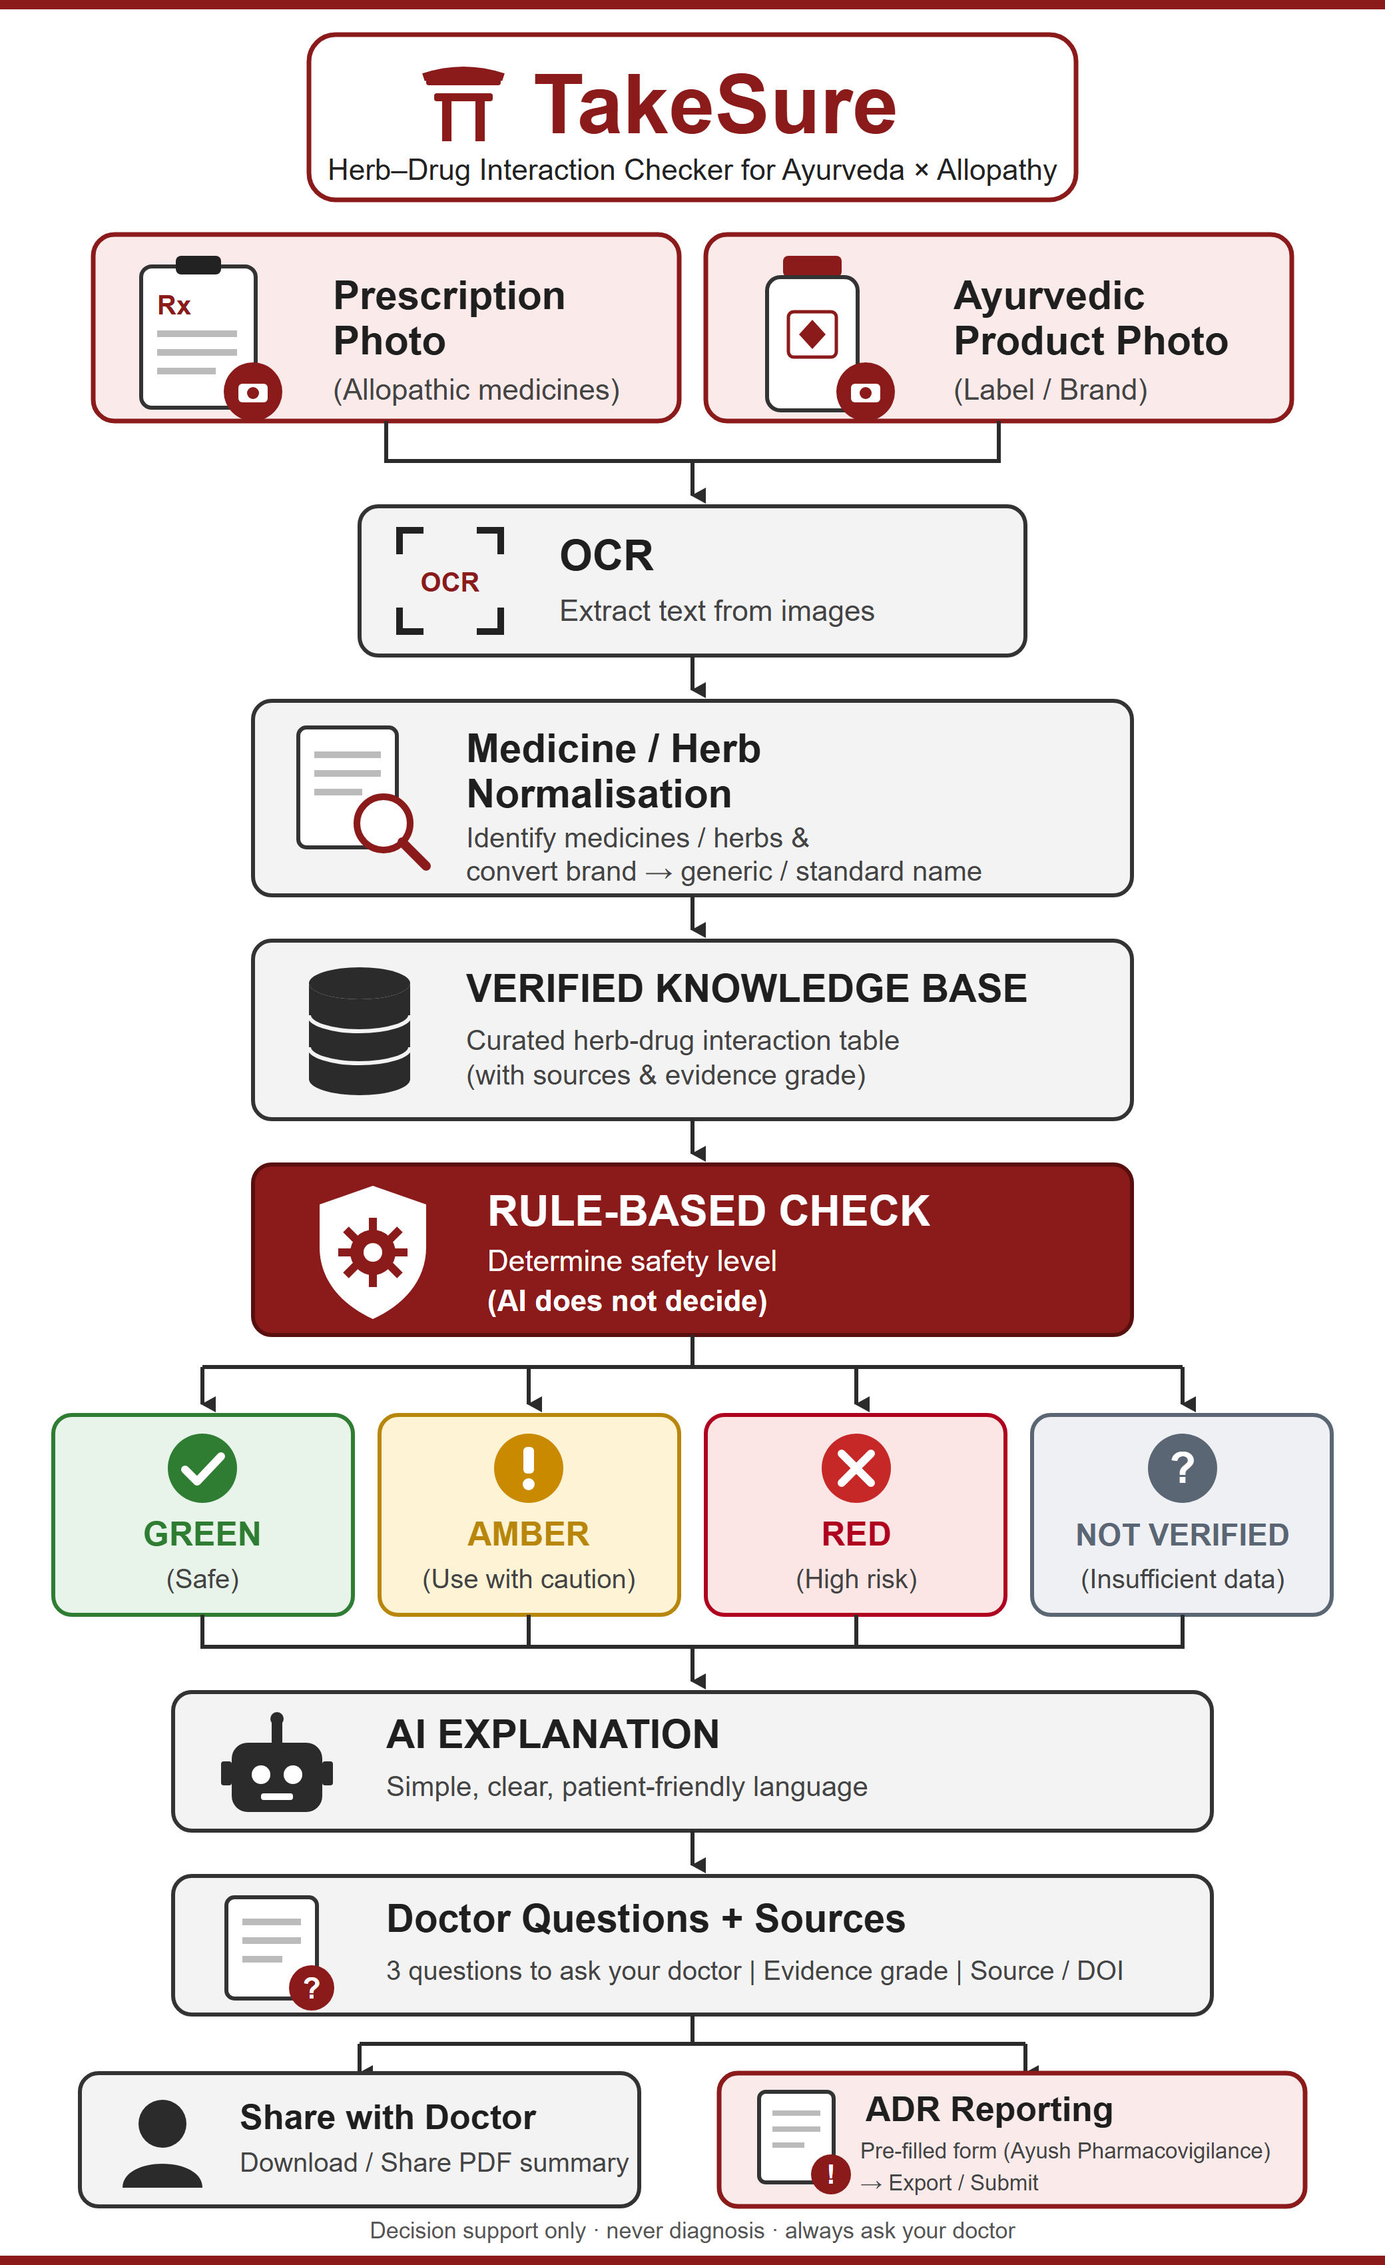
Bug Hunters
TAKESURE — OUR UNIQUE SOLUTION
HACK@BVP 8.0
BVCOE · New Delhi
Key Features
Project workflow
1
Scan — Photograph the prescription and the Ayurvedic product label (or type names). OCR reads them; every name is shown for confirmation before anything is checked.
2
Match — Indian brand → generic (Thyronorm → levothyroxine), product → herbs (Chyawanprash → amla, ashwagandha…) via a curated bridge dictionary + fuzzy matching.
3
Decide — Deterministic rule engine over a cited knowledge base → GREEN / AMBER / RED / NOT IN DATABASE, with timing gaps (e.g. keep 2–3 h between Triphala and oral medicines).
4
Explain — AI rewrites only the matched evidence into simple Hindi/English + 3 questions to ask the doctor. It cannot add, remove or re-grade an interaction.
5
Report — One-page PDF with sources for the doctor; one-tap suspected-ADR report in the Ministry of Ayush format for the Ayush Suraksha portal.
Novelty
“Verdict from published data; AI only explains.” The risk level never comes from a language model — it comes from a versioned, cited knowledge-base row. Turn the AI off and the verdict is identical.
The missing bridge table: Indian brand names × Ayurvedic herb synonyms (Sanskrit/Hindi/Latin) × graded published evidence — open, auditable, co-curated with Ayurveda colleges.
TakeSure · Confidence before taking something · Team Bug Hunters · HACK@BVP 8.0
Decision support · not diagnosis 3
Notes:
Five features: Scan, Match, Decide, Explain, Report. Novelty: verdict from data, AI only explains; the bridge table nobody has built. Right: the project workflow.

Slide 4
Bug Hunters
TECH STACK + ARCHITECTURE
HACK@BVP 8.0
BVCOE · New Delhi
TECH STACK
ARCHITECTURE
FE
Frontend
1
Inputs
2
OCR
3
Matcher
4
Rule engine (decides)
Next.js (React) + TypeScript, Tailwind CSS, Framer Motion · installable PWA · Hindi/English UI
Prescription + product label photos, or typed names
Tesseract eng+hin / vision model · file deleted after read
RapidFuzz · brand→generic · product→herbs · user confirms
Rules R1–R5: severity + grade → GREEN / AMBER / RED / NOT IN DB
BE
Backend
FastAPI (Python), Pydantic v2 validation, SQLAlchemy · REST API with typed errors
5
Explainer (AI)
6
Outputs
7
Anonymised log
DB
Knowledge base
DB
Database
PostgreSQL (Supabase) in production; SQLite for offline/demo · tables: herbs, drugs, products, interactions, sources
Groq LLM · matched rows only · JSON schema · cannot change verdict
Result card (Hindi/English) · doctor PDF · ADR report
ids + verdict + state → dashboard for Ministry / NPvCC
PostgreSQL / SQLite · herb × drug rows: severity, grade A/B/C, timing, DOI/PMID
OCR
OCR
Tesseract (eng + hin) on the server; Google Vision / Groq vision model as optional cloud reader
FLOW
FZ
Matching
1
Verdict path
2
AI guardrail
3
Privacy
RapidFuzz token-set matching; ≥85 accept, 70–85 ask the user, <70 not recognised
Photos → OCR text → candidate names → user confirms → rule engine looks up every herb × medicine pair → worst row wins (RED > AMBER > GREEN; unknown is never GREEN).
Only matched rows go to the LLM, which returns {summary_hi, summary_en, timing_gap, doctor_questions[3]}; invalid or directive output is rejected and the knowledge-base text is shown instead.
Uploads are deleted after extraction; the log stores ids and verdicts only — the basis of the anonymised dashboard for the Ministry of Ayush.
AI
AI explainer
Groq API (Llama / GPT-OSS) with JSON-schema output, temperature 0, facts-only prompt, fallback text
PDF
PDF & hosting
ReportLab for doctor summary + ADR form · Vercel (web) + Render/Railway (API)
TakeSure · Confidence before taking something · Team Bug Hunters · HACK@BVP 8.0
Decision support · not diagnosis 4
Notes:
Stack left; eight architecture blocks right; three flow notes: verdict path, AI guardrail, privacy.

Slide 5
Bug Hunters
FEASIBILITY AND SHOWSTOPPERS
HACK@BVP 8.0
BVCOE · New Delhi
TECHNICAL
DATA & EVIDENCE
RISK / BLOCKER | MITIGATION
OCR misread Handwritten prescriptions · poor-quality or unusual printed labels | Extracted names shown for user confirmation · manual text entry always available · fuzzy-matching thresholds separate confident from uncertain matches
Unknown herb / drug Herb or drug may not be in the KB · coverage gaps | NEVER guess · neutral “NOT IN DATABASE” result · unknown items logged for future curation · MVP deliberately scoped
Weak / conflicting evidence Limited clinical evidence · sources may disagree | A/B/C grade on every result · source / reference visible · conflicting sources kept at lower confidence, not hidden · KB entries reviewed before publication
LLM hallucination Unsupported medical claims | LLM receives ONLY matched KB info · never determines severity or verdict · schema-validated output · raw KB text if validation fails · safety decision works with LLM off
Medical liability / safety scope Users may read it as a prescription or diagnosis tool | Positioned as DECISION SUPPORT · never says stop / start · no diagnosis or dosing · evidence + sources shown · questions for the doctor · report-incorrect-info mechanism
API / connectivity failure Internet or external API / provider failure | Local / offline fallback · SQLite KB · PaddleOCR runs locally · LLM provider swappable · DB lookup independent of LLM · cached outputs for demo continuity
Proven, off-the-shelf stack
OCR: Google Vision / Paddle OCR
RapidFuzz for name matching
SQL for KB lookup
LLM only explains — rules decide risk
No custom ML training
Public / citable sources: Ayurvedic Pharmacopoeia, NIH LiverTox, MSKCC, PubMed, WHO monographs
Every entry stores evidence, severity & source
Evidence graded A / B / C
RESOURCES
MVP SCOPE
Team: Backend · Mobile/Frontend · Data curation
Local/offline components + free/low-cost infrastructure
Swappable LLM provider
~40 herb–drug pairs · 2 photo inputs · manual text-entry fallback · risk / safety card · ADR reporting form
Not in MVP: diagnosis · dosing · herb–herb interactions · custom ML training
REGULATORY / OPERATIONAL SAFETY
ADR workflow aligned with Ministry/ICSR fields
Links to Ayush Suraksha instead of a parallel reporting system
Photos not retained beyond the session unless the user opts in
Decision support — not diagnosis or prescription
FEASIBILITY
TakeSure · Confidence before taking something · Team Bug Hunters · HACK@BVP 8.0
Decision support · not diagnosis 5
Notes:
Five feasibility boxes; six risks with mitigations.

Slide 6
Bug Hunters
USP (UNIQUE SELLING PROPOSITION) & BUSINESS MODEL
HACK@BVP 8.0
BVCOE · New Delhi
USP (UNIQUE SELLING PROPOSITION)
BUSINESS MODEL
1
India's first safety layer between the two medical systems people already mix — nothing public today checks an Ayurvedic product against an allopathic prescription.
B2C
Free for citizens — Web/PWA checker in Hindi & English; grows the knowledge base and the ADR signal.
2
Verdict from published data; AI only explains — auditable rules over cited rows; the opposite of a “ChatGPT wrapper”.
B2B
API & counter tool — Per-query / subscription API for pharmacy chains, hospital HIS, telemedicine apps; QR on the chemist's bill.
3
Built for India: Indian brand names, Sanskrit/Hindi synonyms, Hindi explanations, Ministry of Ayush ADR format, Ayush Suraksha portal link.
B2G / CSR
Programmes & grants — Co-use analytics and structured ICSRs for the Ministry of Ayush pharmacovigilance network; CSR funding from Ayurvedic brands that want a trust layer.
4
Honest by design: evidence grades, timing gaps instead of alarms, “not in database” instead of guesses.
PLATFORM
Ayush Grid / ABDM integration — verdict attached to the ABHA health record; open KB co-curated with Ayurveda colleges.
WHO BENEFITS · ONE KNOWLEDGE BASE, FOUR USERS
IMPACT · WHY IT MATTERS
PATIENTS & FAMILIES
DOCTORS & VAIDYAS
PHARMACISTS & CHEMISTS
MINISTRY OF AYUSH / NPvCC
1,473
75%
0
60-second verdict in Hindi or English, timing gaps, and three questions to carry to the clinic
Patients finally disclose what they take; a one-page summary with sources bridges both vocabularies
Counter-side cross-check for the only shop that sells both systems' products; QR on the bill
Structured ICSRs in the official format, anonymised co-use analytics by state, early signal detection
ASU&H adverse-event reports nationally since 2018 — TakeSure turns every reaction into a structured ICSR
of herbal users with a side effect never told their doctor — TakeSure hands them the questions to ask
public tools today check an Ayurvedic product against an allopathic prescription — TakeSure is the first
TakeSure · Confidence before taking something · Team Bug Hunters · HACK@BVP 8.0
Decision support · not diagnosis 6
Notes:
Four USPs, four revenue lines, four beneficiaries, three impact numbers.

Slide 7
Bug Hunters
RESEARCH & REFERENCES
HACK@BVP 8.0
BVCOE · New Delhi
RESEARCH & REFERENCES
COMPARISON WITH EXISTING TOOLS
Sharma 2018: ashwagandha & thyroid trial
FEATURE | MEDSCAPE · DRUGS.COM · 1MG | MSKCC · NATURAL MEDICINES | TAKESURE (OUR APP) | WHY TAKESURE?
Ayurveda × allopathy check | ✗ Allopathic × allopathic pairs only ★☆☆☆☆ 1 / 5 | ~ Single-herb monographs only ★★☆☆☆ 2 / 5 | ✓ Prescription × Ayurvedic product, every herb–drug pair checked ★★★★★ 5 / 5 | ★ Only tool that checks the two systems people already mix.
Indian brands & Hindi | ~ Partly covered ★★★☆☆ 3 / 5 | ✗ Western herbs, English only ★☆☆☆☆ 1 / 5 | ✓ Indian brands + Sanskrit / Hindi synonyms, Hindi UI ★★★★★ 5 / 5 | ★ Matches Himalaya, Dabur and the names patients actually use.
Sources on every verdict | ✓ Sources shown ★★★★☆ 4 / 5 | ✓ Sources shown ★★★★☆ 4 / 5 | ✓ Sources + grade A/B/C with DOI/PMID; marked “needs verification” until re-checked ★★★★☆ 4 / 5 | ★ Weak evidence is shown as weak, never hidden — and we say so when a citation is not yet re-verified.
ADR report to Ministry | ✗ No reporting ★☆☆☆☆ 1 / 5 | ✗ No reporting ★☆☆☆☆ 1 / 5 | ✓ One-tap report in Ministry of Ayush format ★★★★★ 5 / 5 | ★ Feeds the Ayush pharmacovigilance network.
OVERALL RATING | Medscape 2.3 / 5 ★★☆☆☆ | MSKCC 2.0 / 5 ★★☆☆☆ | TakeSure 4.8 / 5 ★★★★★ | TakeSure scores 2.5 points higher than the best alternative.
1
RCT, 50 patients, 600 mg/day, 8 weeks
pubmed.ncbi.nlm.nih.gov/28829155
2
Gohil & Patel 2007: herb–drug case reports
133 cases, only 6% well documented (Indian J Pharmacol)
doi.org/10.4103/0253-7613.33432
3
Ghosh et al. 2009: herb–drug interaction
Fallout of poor doctor–patient communication (JCDR)
jcdr.net/articles/PDF/576/501.pdf
4
Interactions between substances in Ayurveda
Food–drug & Ayurveda–modern drug review, 2013
doi.org/10.1515/dmdi-2013-0014
5
NSSO Survey on Ayush 2022-23 (MoSPI press note)
Ayurveda is the most used Ayush system
mospi.gov.in/…/PressNote_Ayush_13062024N.pdf
6
Ayush Suraksha portal (Ministry of Ayush)
Suspected ADR reporting for ASU&H drugs
suraksha.ayush.gov.in
7
ASU&H pharmacovigilance (ITRA, Jamnagar)
PPvC / IPvC reporting network
itra.ac.in/pharmacovigilance
Open-source tools we build on
Ratings out of 5 are the team's assessment on the four features compared (sourced = 4, +1 with evidence grade · partly = 3 · single herb = 2 · none = 1). TakeSure takes 4/5 on Sources deliberately: every citation stays marked “needs verification” until a second reviewer re-opens the DOI/PMID.
8
OCR (Tesseract) and name matching (RapidFuzz)
github.com/tesseract-ocr · github.com/rapidfuzz
TakeSure · Confidence before taking something · Team Bug Hunters · HACK@BVP 8.0
Decision support · not diagnosis 7
Notes:
Eight references with live links; honest comparison with existing tools.

