Slide 1


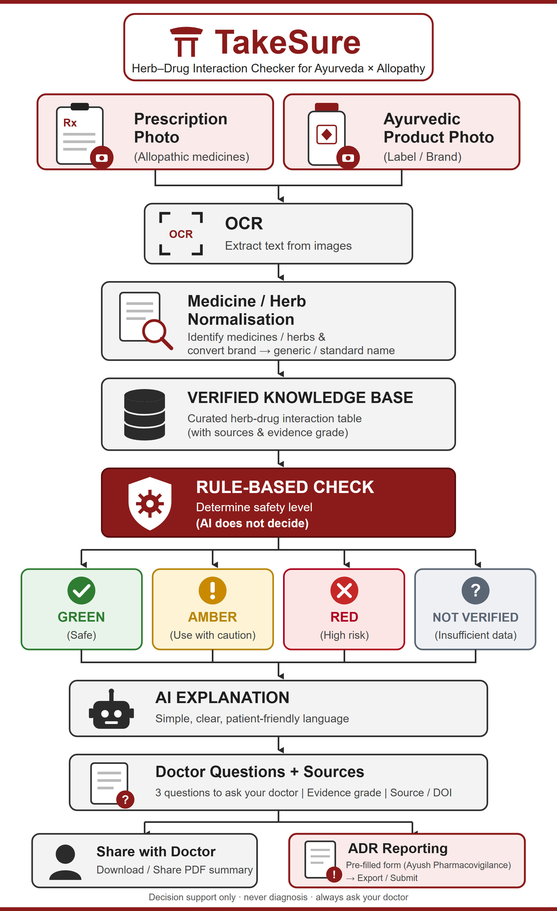
Bug Hunters
OUR UNIQUE SOLUTION
DevSphereIndia
Key Features
1
Scan — Photograph the prescription and the Ayurvedic product label (or type the names). OCR reads them; every name is shown for confirmation before anything is checked.
2
Match — Indian brand → generic (Thyronorm → levothyroxine), product → herbs (Chyawanprash → amla, ashwagandha…) via a curated bridge dictionary + fuzzy matching.
3
Decide — Deterministic rule engine over a cited knowledge base → GREEN / AMBER / RED / NOT IN DATABASE, with timing gaps (e.g. keep 2–3 h between Triphala and oral medicines).
4
Explain — AI rewrites only the matched evidence into simple Hindi/English + 3 questions to ask the doctor. It cannot add, remove or re-grade an interaction.
5
Report — One-page PDF with sources for the doctor; one-tap suspected-ADR report in the Ministry of Ayush format for the Ayush Suraksha portal.
Novelty
“Verdict from published data; AI only explains.” The risk level never comes from a language model — it comes from a versioned, cited knowledge-base row. Turn the AI off and the verdict is identical.
The missing bridge table: Indian brand names × Ayurvedic herb synonyms (Sanskrit/Hindi/Latin) × graded published evidence — open, auditable, co-curated with Ayurveda colleges.
Notes:
Five features: Scan, Match, Decide, Explain, Report. Novelty: verdict from data, AI only explains; the bridge table nobody has built. The workflow on the right is a design diagram of the proposed system.

