Slide 1


FINANCIAL MODELLING OF VEDANTA
KHUSHI BHATI
22113077
khushi_b@ce.iitr.ac.in

Slide 2
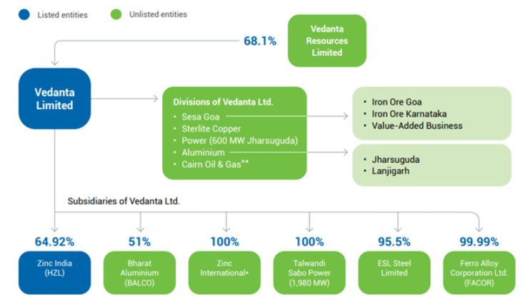
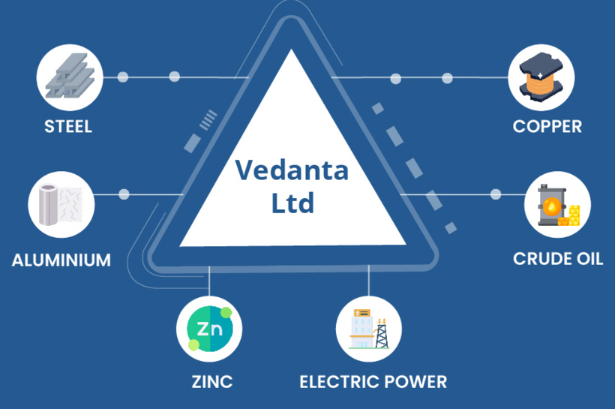
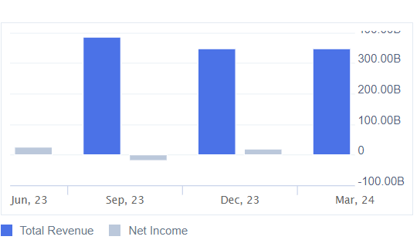
Vedanta Limited is a leading global natural resources conglomerate with key interests in aluminum, zinc-lead-silver, oil and gas, iron ore, steel, copper, power, ferro alloys, nickel, semiconductors, and glass. With strategic assets in India, South Africa, Namibia, and Liberia, Vedanta is well-positioned to generate long-term value and superior cash flows.
OVERVIEW
Vedanta Limited reported earnings for the full year ending March 31, 2024. Sales were INR 1,417,930 million, down from INR 1,454,040 million the previous year. Revenue decreased to INR 1,462,770 million from INR 1,501,590 million. Net income dropped significantly to INR 42,390 million from INR 105,740 million. Basic earnings per share from continuing operations fell to INR 11.42 from INR 28.5, and diluted earnings per share decreased to INR 11.33 from INR 28.32.
4o

Slide 3
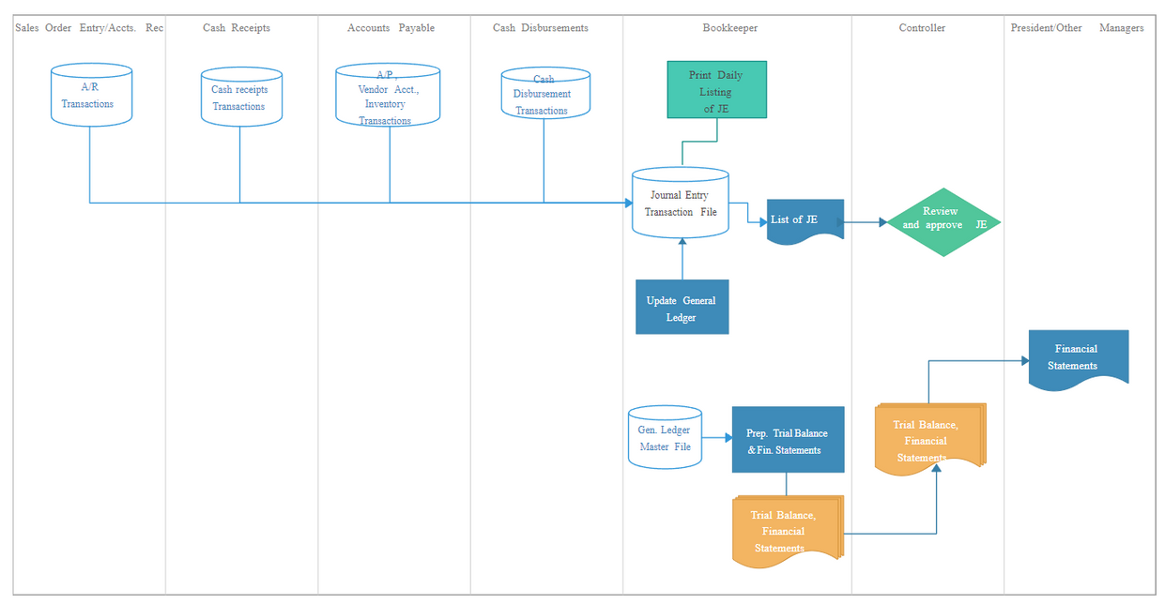
Methodology
2. Key Financial Metrics:
Profitability: Gross Margin, Operating Margin
Liquidity: Current Ratio, Quick Ratio
Leverage: Debt-to-Equity Ratio
Efficiency: Inventory Turnover
Valuation: P/E Ratio
1. Steps Involved:
Objective: Define model purpose
Data Analysis: Analyze historical data
Assumptions & Forecasts: Develop key assumptions
Projections: Income statement, balance sheet, cash flow
Valuation: DCF and CCA techniques
Risk Assessment: Scenario and sensitivity analysis
Validation & Reporting: Ensure accuracy, document model

Slide 4
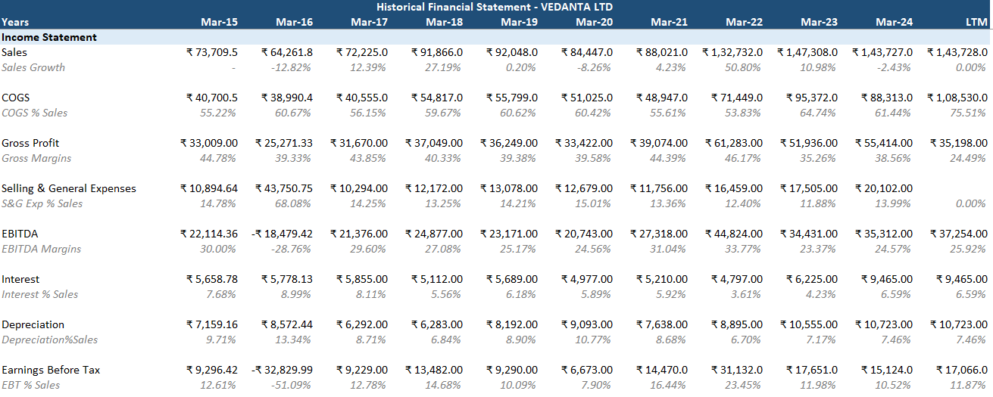
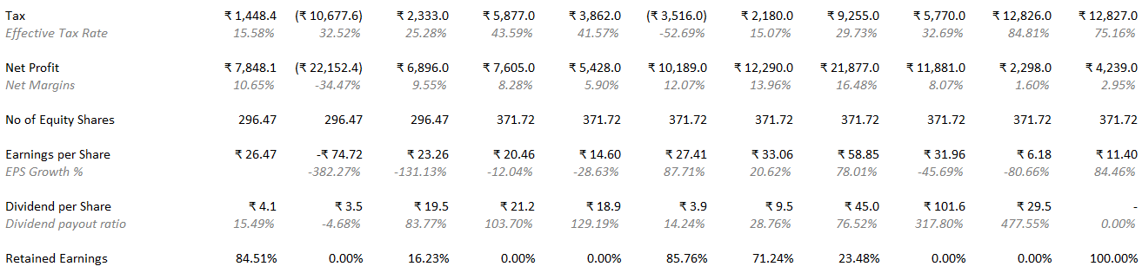
Historical Data Overview

Slide 5
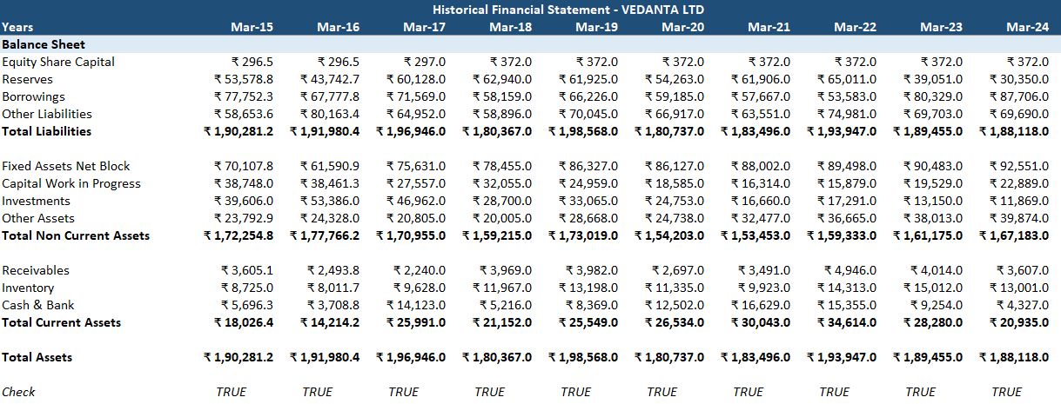
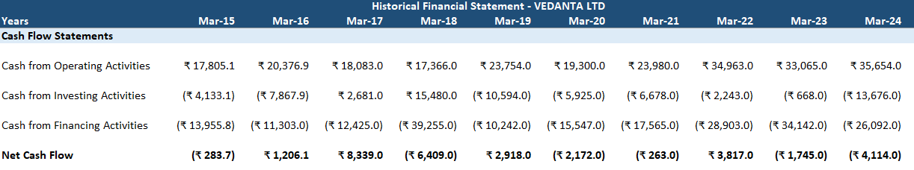
Understanding The Balance Sheet
Cash Flow Statements

Slide 6
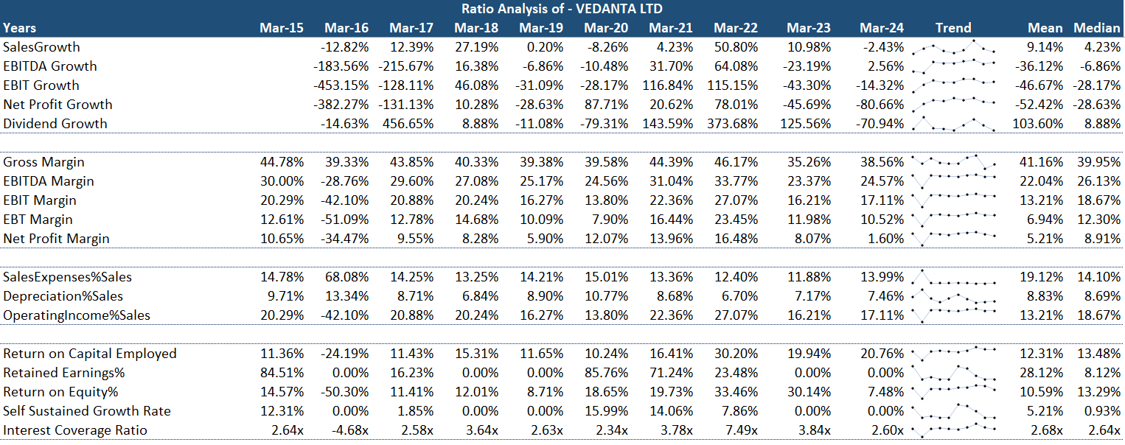
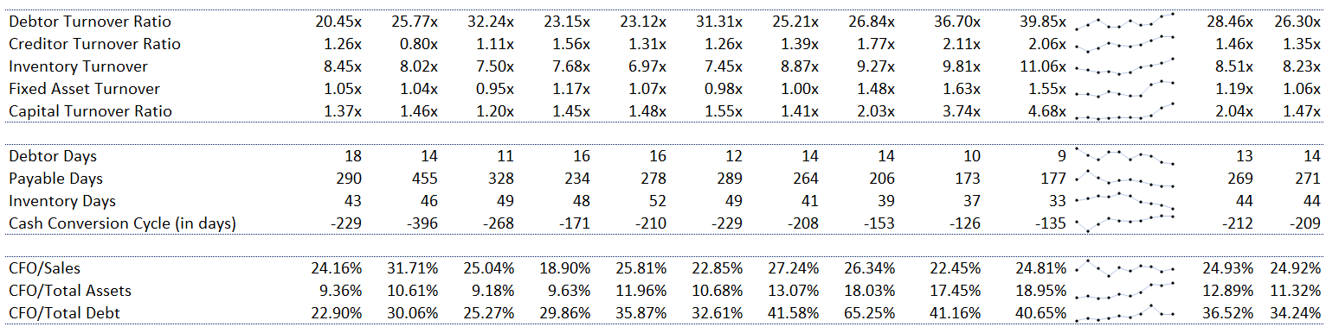
Ratio Analysis

Slide 7
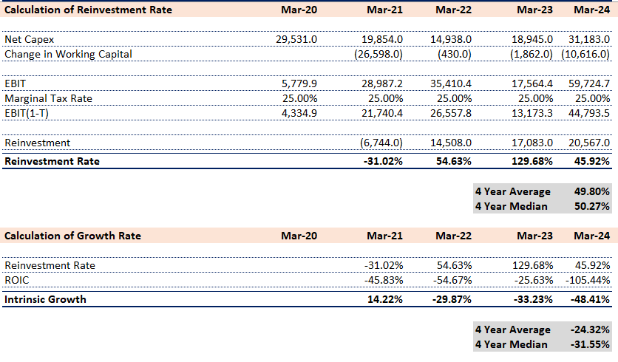
Calculating Reinvestment and Growth Rates

Slide 8
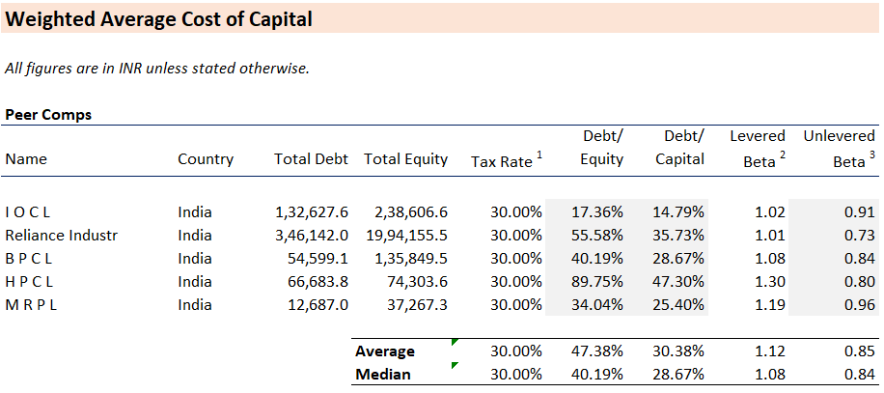
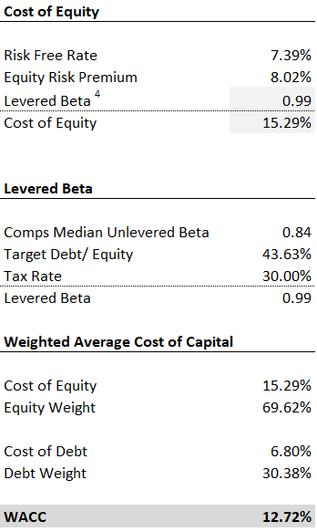
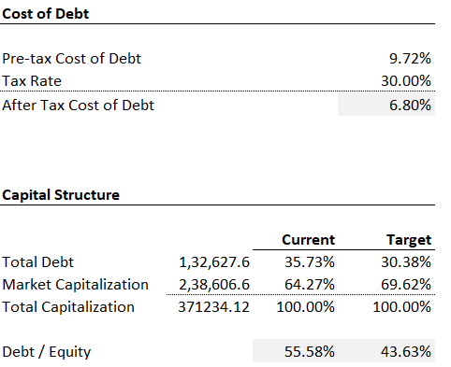
Weighted Average Cost of Capital

Slide 9
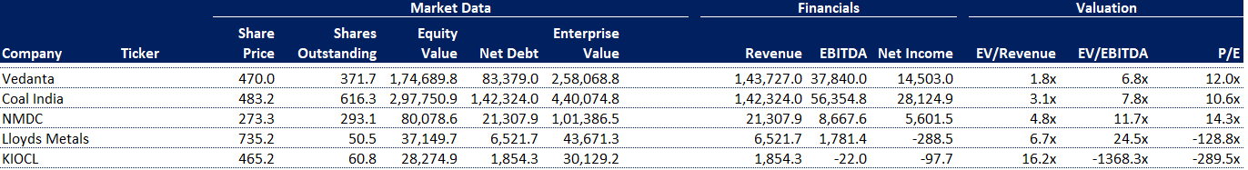
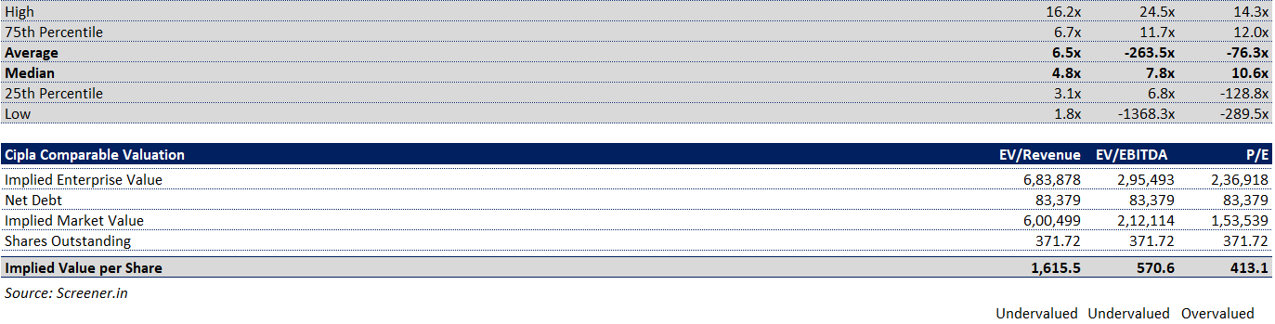
COMPARABLE COMPANY ANALYSIS

Slide 10
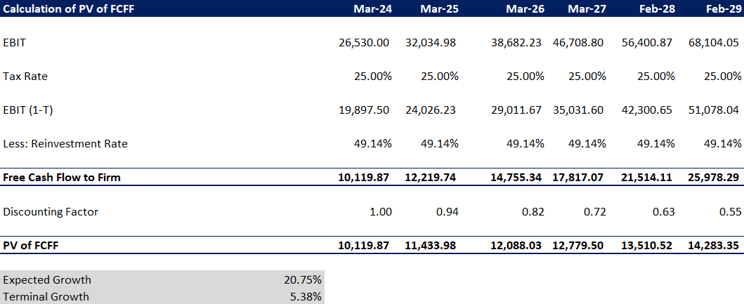
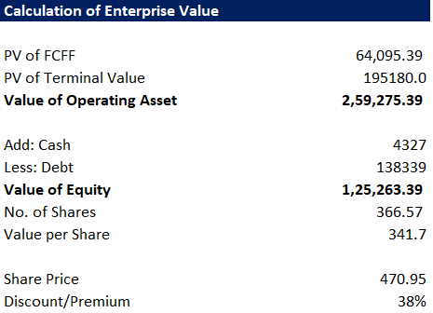
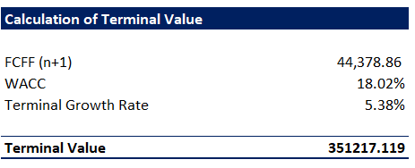
DCF
MODELLING

Slide 11
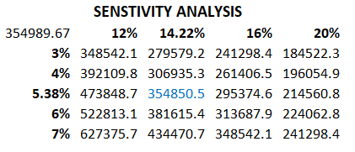
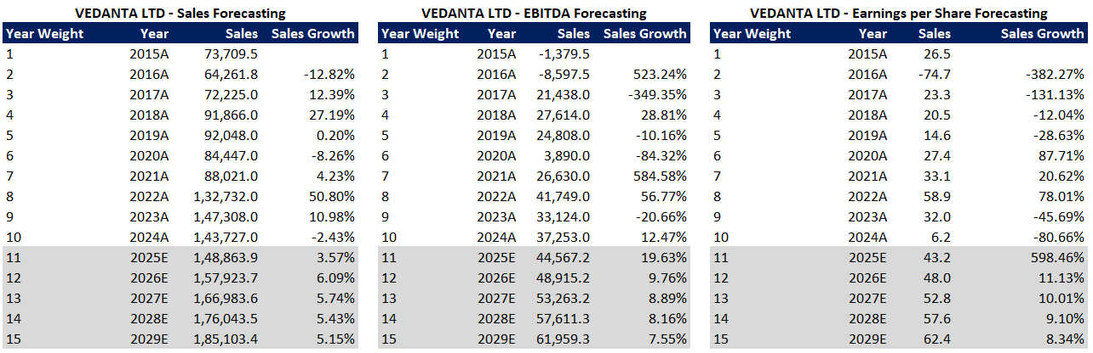
Forecasting

Slide 12
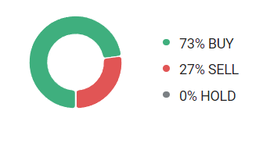
CONCLUSION
Vedanta Limited shares are currently trading at a 38% premium, indicating an overvaluation compared to its intrinsic value. Within the sector, some companies are overvalued while others are undervalued, presenting a mixed landscape.
Despite the current overvaluation, Vedanta has strong fundamentals and growth prospects. Given the potential for market corrections and the company's robust performance, a cautious buy recommendation is advised. Investors should consider purchasing Vedanta shares with the expectation of long-term gains as the market adjusts and the company's value aligns more closely with its fundamentals.
73% Buy recommendation for Vedanta as per all calculations
Currently, the stock prices are slightly overpriced.
All the financial ratios are showing a slow upward trend with lesser profit margins over the years

