Slide 1

Website - GymIgnite
MINI PROJECT (2021-22)
“GymIgnite”
Project Report
Institute of Engineering & Technology
Submitted By -
Deeksha Sengar (191500237)
Khushi Agarwal(191500397)
Deeksha Sharma(191500238)
Under the Supervision Of Mr. Mandeep Singh Technical Trainer
Department of Computer Engineering & Applications
i

Slide 2

Website - GymIgnite
Department of Computer Engineering and Applications
GLA University, 17 km. Stone NH#2, Mathura-Delhi Road,
Chaumuha, Mathura - 281406 U.P (India)
Declaration
I/we hereby declare that the work which is being presented in the Bachelor of technology. Project “Book Finder App”, in partial fulfillment of the requirements for the award of the Bachelor of Technology in Computer Science and Engineering and submitted to the Department of Computer Engineering and Applications of GLA University, Mathura, is an authentic record of my/our own work carried under the supervision of Mr. Mandeep Singh, Technical Trainer, Dept. of CEA,GLA University.
The contents of this project report, in full or in parts, have not been submitted to any other Institute or University for the award of any degree.
Sign: Deeksha Sengar
Name of Candidate: Deeksha Sengar
University Roll No.:191500237
Sign: Deeksha Sharma
Name of Candidate: Deeksha Sharma
University Roll No.:191500238
Sign: KhushiAgarwal
Name of Candidate: Khushi Agarwal
University Roll No.:191500397
ii

Slide 3

Website - GymIgnite
Department of Computer Engineering and Applications
GLA University, 17 km. Stone NH#2, Mathura-Delhi Road,
Chaumuha, Mathura - 281406 U.P (India)
Certificate
This is to certify that the project entitled “GymIgnite”, carried out in Mini Project - I Lab, is a bonafide work by Deeksha Sengar, Khushi Agarwal, Deeksha Sharma and is submitted in partial fulfillment of the requirements for the award of the degree Bachelor of Technology (Computer Science & Engineering).
Signature of Supervisor:
Name of Supervisor: Mr. Mandeep Singh Date:
iii

Slide 4
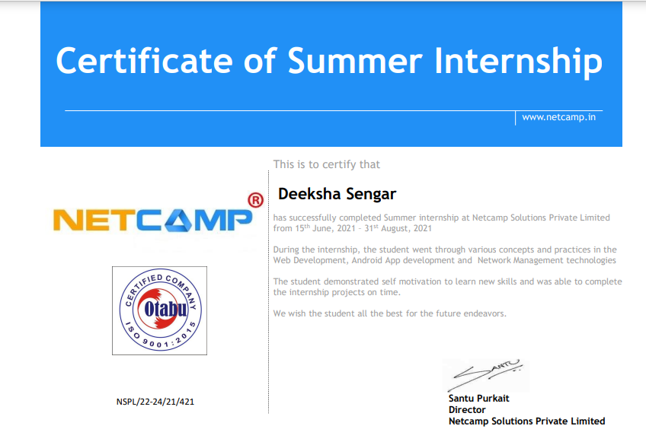
Website - GymIgnite
Training Certificates
•Deeksha Sengar
iv

Slide 5
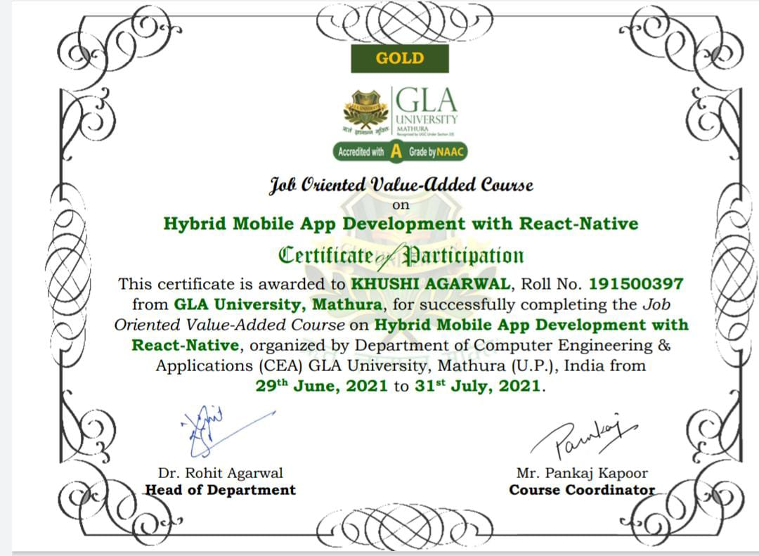
Website - GymIgnite
Khushi Agarwal
v

Slide 6

Website - GymIgnite
• Deeksha Sharma
Vi

Slide 7

Website - GymIgnite
Department of Computer Engineering and Applications
GLA University, 17 km. Stone NH#2, Mathura-Delhi Road,
Chaumuha, Mathura - 281406 U.P (India)
ACKNOWLEDGEMENT
Presenting the ascribed project paper report in this very simple and official form, we would like to place my deep gratitude to GLA University for providing us the instructor Mr Mandeep Singh, our technical trainer and supervisor.
He has been helping us since Day 1 in this project. He provided us with the roadmap, the basic guidelines explaining on how to work on the project. He has been conducting regular meeting to check the progress of the project and providing us with the resources related to the project. Without his help, we wouldn't have been able to complete this project.
And at last but not the least we would like to thank our dear parents for helping us to grab this opportunity to get trained and also my colleagues who helped me find resources during the training.
Thanking You
Sign: DeekshaSengar Sign: Khushi Agarwal
Name of Candidate: Deeksha Sengar Name of Candidate: Khushi Agarwal
University Roll No.:191500237 University Roll No.:191500397
Sign: DeekshaSharma
Name of Candidate: Deeksha Sharma
University Roll No.:191500238
vii

Slide 8
Website - GymIgnite
ABSTRACT
In this project, we are creating an website basically a Gym Information provider website which we have named GymIgnite. This website will provide us a platform to access the active wears we want to wear at the ease of our exercise time. Any active wear item that the user wishes to see or buy will be entered by him in the menu. Apart from searching the items online, the user can also calculate his/her BMR. The app is suitable in the present scenario as the world is being digitalized then why not the gym system. The website will be completely efficient and transparent to the reviews of the people on the activewears and its price. To get more details about the equipments and activewears one can click on the item and get further grave details. Further the about us section provides all the necessary details that the user may need about the website.
website ecosystem is diverse and is changing people’s life all over the world. users are expected to increase because of the advance changes and the way it deals with issues and compatibility. Furthermore designing solutions for the problems that we may face in future is essential. Like this website definitely stands the need of people at any time at their fingertips without any barrier of place.
Viii

Slide 9
Website - GymIgnite
CONTENTS
Cover Page..............................................................................i
Declaration..............................................................................ii
Certificate................................................................................iii
Training Certificate.....................................................................iv
Acknowledgement...................................................................vii
Abstract................................................................................viii
Content...................................................................................ix
List Of figures............................................................................xi
List Of tables..........................................................................xii
Chapter l lntroduction......................................................................
• 1.1 Context...........................................................................
• 1.2 Motivation........................................................................
• 1.3 Objective.........................................................................
• 1.4 Existing System..................................................................
• 1.4 Sources...........................................................................
ix

Slide 10
Website - GymIgnite
Chapter 2 Technology Used...............................................................
• 2.1 HTML............................................................................
• 2.2 CSS..............................................................
• 2.3 JAVASCRIPT............................................................
2.4 PHP………………………………………………..
• 2.4 Basic Terminology..............................................................
Chapter 3 Implementation and User Interface...........................................
• 3.1 Implementation of GymIgnite................................................
• 3.2 User Interface....................................................................
Chapter 4 Conclusion.....................................................................
References............................................................................................
x

Slide 11
Website - GymIgnite
CHAPTER-1
INTRODUCTION
1.1 CONTEXT
This website “GymIgnite” has been submitted in partial fulfilment of the requirements for the award of the degree of Bachelor of Technology in Computer Science and Engineering at GLA University, Mathura supervised by Mr.Mandeep Singh. This project has been completed approximately three months and has been executed in modules, meetings have been organised to check the progress of the work and for instructions and guidelines.
1.2 MOTIVE
In the recent years, we have realized the importance of healthy lifrstyle and how important it is for us to have our resources online. Health has been the greatest source of growing all the while and having it at the reach of our fingertips would be an opportunity hardly any person would afford to miss.
In the century we are living the world is progressing at a really great pace, a lot number of technologies come up every single day. To keep up with the technology is also important to survive in this world of digitalization and learning. Along with this we need to have a place to keep the resources for areas of our interest so we thought of developing a website which could provide us a platform where we could maintain our health.
Moreover this kind of website can be used in by those people who want to attain a good and healthy lifestyle but does not know from where they should start.This would be an excellent effort to provide information without any boundaries to all.
1.3 OBJECTIVE
The main objective of this website is to create a website named “GymIgnite” which will have a lot of information and a space from where people can buy things for themselves. There will be a facility to calculate BMR by inputting age, weight and height.

Slide 12


Website - GymIgnite
This website developed can be used at a variety of places, at rural areas and have its significance. The goal of the website was to provide a way to the beginners to get all the information they desire to get a perfect body and health.
1.4 EXISTING SYSTEM
In the present scenario, we are dealing with the manual searching of gym from thousands of other gyms present in Google gym API. With the help of this website we are able to find a place where we can easily find the information with the help of keywords. As this idea as already implemented here are the some snap how our website will look.
As soon as the user enters the website, there will be landing page containing the name of the website and then there will be a login /signup page .Initially there will be menu as shown in the image below. Then on the basis of certain keywords the website will fetch the results and the information will be displayed as shown in the second screenshot. In this we will add a feature to calculate BMR by inputting height,weight, and age.
(a) (b)
Figure-1: Existing System

Slide 13
Website - GymIgnite
1.5
SOURCES
The source of our project (including all the project work, documentations presentations) will is available at the following
https://github.com/khushia1721/MiniProject
and
link

Slide 14
Website - GymIgnite
CHAPTER-2 TECHNOLOGY USED
2.1 HTML
Hypertext Markup Language is the standard markup language for documents designed to be displayed in a web browser. It can be assisted by technologies such as Cascading Style Sheets and scripting languages as JavaScript.
HTML Tags:
The ‹ ! DOCTYPE html› declaration defines that this document is an HTMLS document.
The ‹ html › element is the root element of an HTML page.
The ‹ head › element contains meta information about the HTML page.
The ‹ t1tle› element specifies a title for the HTNIL page (which is shown in the browser's title bar or in the page's tab).
The ‹ body› element defines the document’s body, and is a container for all the visible contents, such as headings, paragraphs, images, hyperlinks, tables, lists, etc.
The ‹ h1› element defines a large heading.
The ‹ p› element defines a paragraph.
An unordered list starts with the ‹ u1 › tag.
Each list item starts with the ‹11 › tag.

Slide 15
Website - GymIgnite
2.2 CSS
Cascading Style Sheets (CSS) is used to format the layout of a webpage.
With CSS, you can control the color, font, the size of text, the spacing between elements, how elements are positioned and laid out, what background images or background colors are to be used, different displays for different devices and screen sizes, and much more!
CSS can be added to HTML documents in 3 ways:
Inline - by using the style attribute inside HTML elements. Internal - by using a <style> element in the <head> section. External - by using a <link> element to link to an external CSS file.
2.3 JAVASCRIPT
JavaScript is the world's most popular programming lang uage. JavaScript is the programming language of the Web.
JavaScript is easy to learn.

Slide 16
Website - GymIgnite
2.4 PHP
PHP started out as a small open source project that evolved as more and more people found out how useful it was. Rasmus Lerdorf unleashed the first version of PHP way back in 1994.
PHP is a recursive acronym for "PHP: Hypertext Preprocessor"
PHP is a server side scripting language that is embedded in HTML. It is used to manage dynamic content, databases, session tracking, even build entire e-commerce sites.
It is integrated with a number of popular databases, including MySQL, PostgreSQL, Oracle, Sybase, Informix, and Microsoft SQL Server.
PHP is pleasingly zippy in its execution, especially when compiled as an Apache module on the Unix side. The MySQL server, once started, executes even very complex queries with huge result sets in record-setting time.
PHP supports a large number of major protocols such as POP3, IMAP, and LDAP. PHP4 added support for Java and distributed object architectures (COM and CORBA), making n-tier development a possibility for the first time.
PHP is forgiving: PHP language tries to be as forgiving as possible.
PHP Syntax is C-Like.
2.5 BASIC TERMINOLOGY
• Layout: Layout is the parent of view. It arranges all the views in a proper manner on the screen.

Slide 17
Website - GymIgnite
CHAPTER -3
IMPLEMENTATION AND USER INTERFACE
Creating an website concept design with screen sketches and functional flow diagrams is the best way to communicate your vision to the website developer. Making the concept clear to the developer is probably the most important factor in successful website development. Yet it is one of the most common problems or obstacles in a website development outsourcing project.
No matter what the marketing and profit goals are or if you are outsourcing an website for your personal use, you need to fully design and document the website concept if you expect a programmer to make your vision a reality. Developers are not mind readers and even descriptions given during conversations can be very fleeting or interpreted differently. Fully documenting your concept, therefore, leaves little to chance. The two most important things to do are: A) make a comprehensive description of how the website works and what it does (functionality) and B) create a comprehensive description of what the user sees and does (look and feel).
3.1 Implementation of the GymIgnite:
Implementation of GymIgnite is taken place in various phases. Firstly we build the login interface then Navigation drawer i.e. make fragment for each of the list item using the Navigation view and the make various layout for the supporting features and connect the website with the respected page for fetch the required item.

Slide 18
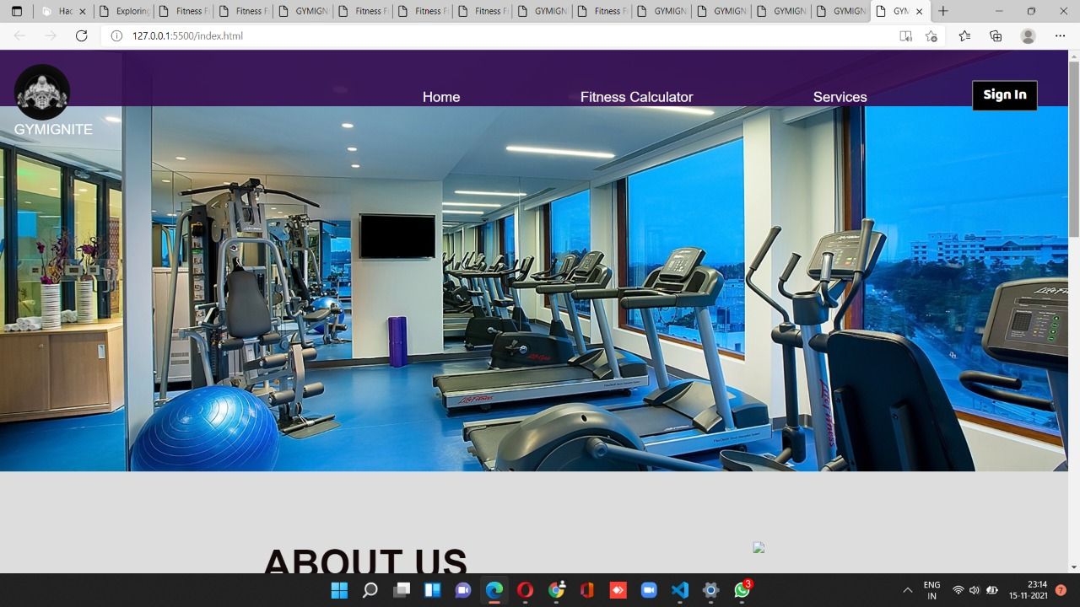
Website - GymIgnite
3.2 User Interface
• Home Page

Slide 19
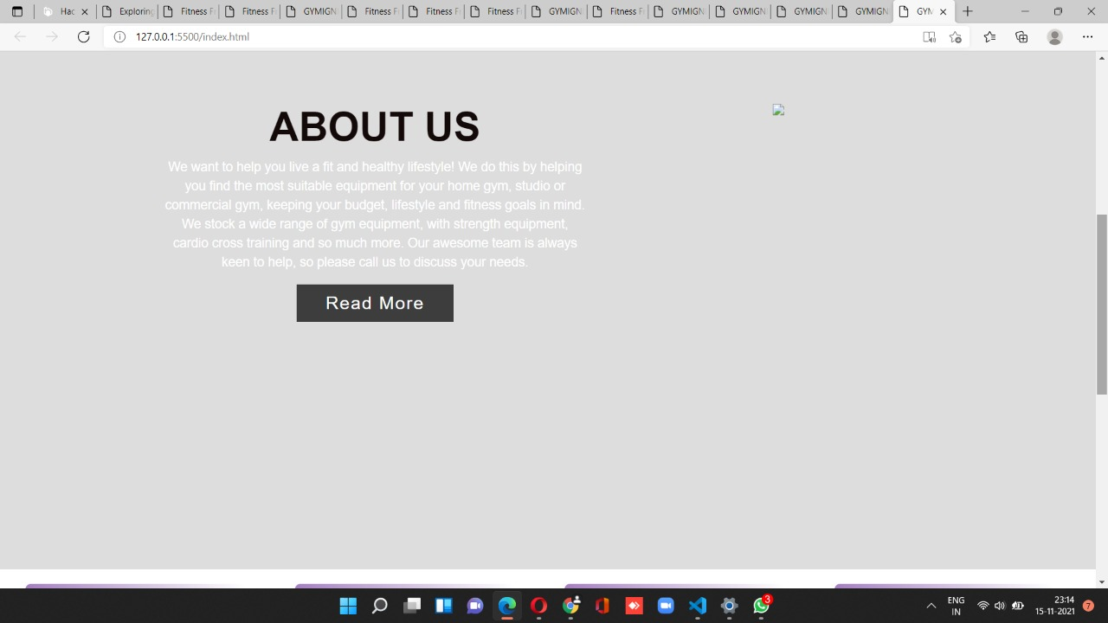
Website - GymIgnite
About Us

Slide 20
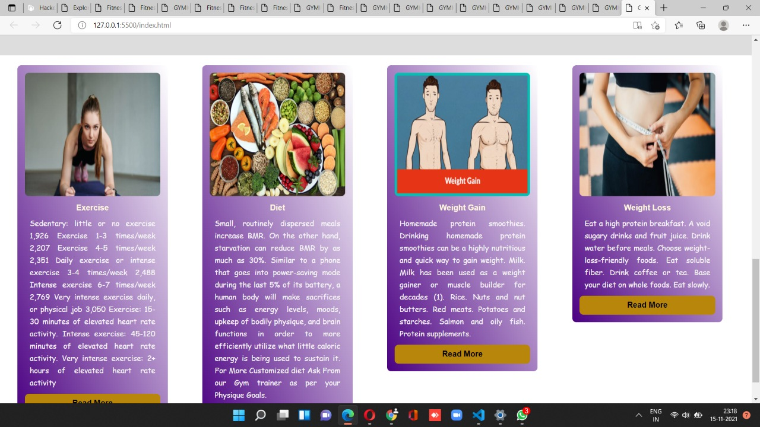
Website - GymIgnite
Navigation Drawer

Slide 21
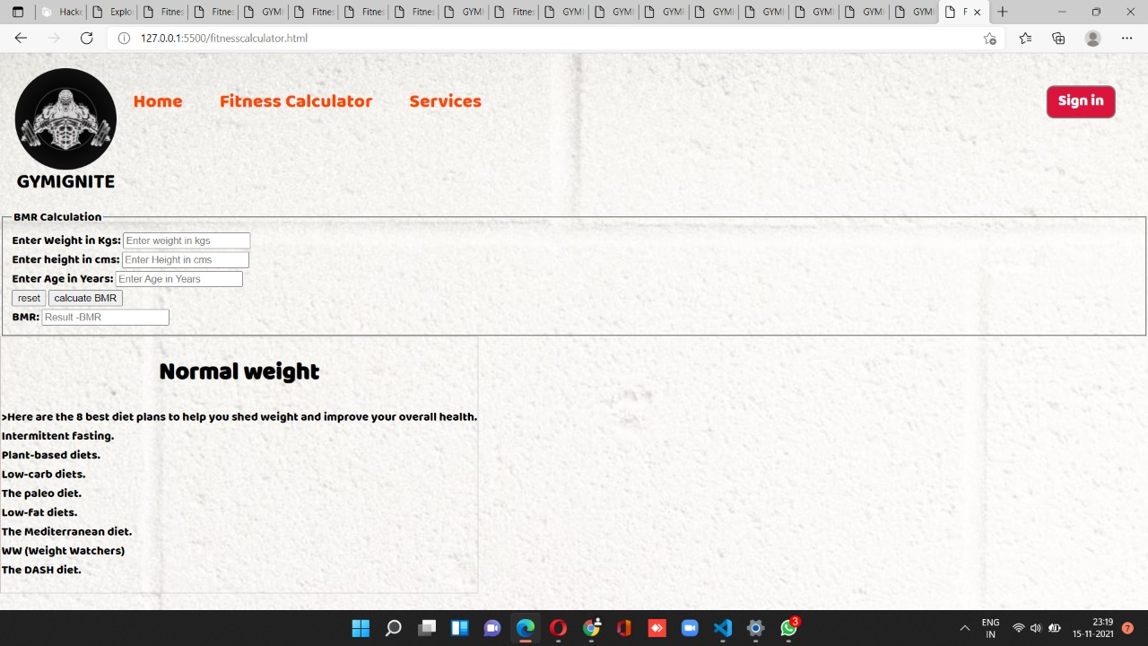
Website - GymIgnite
Fitness Calculator

Slide 22
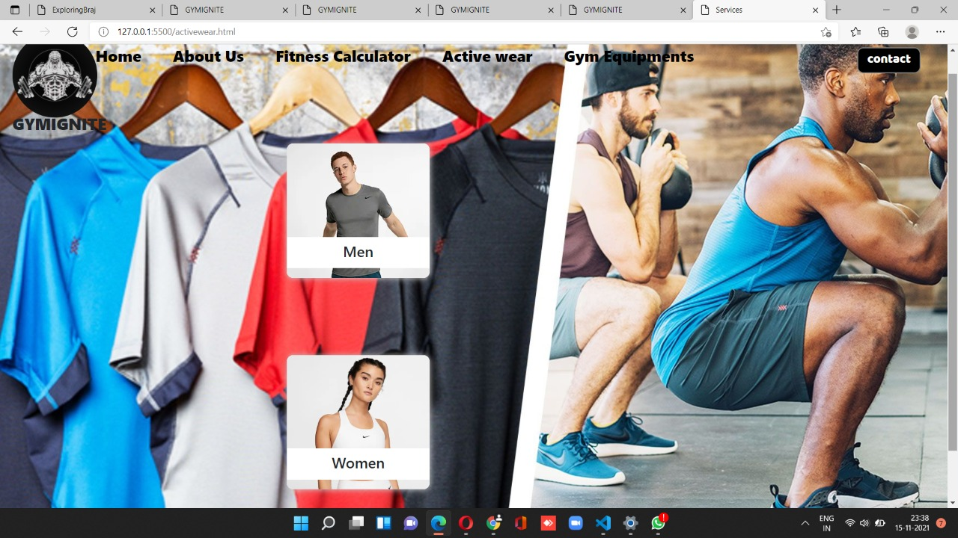
Website - GymIgnite
Services

Slide 23
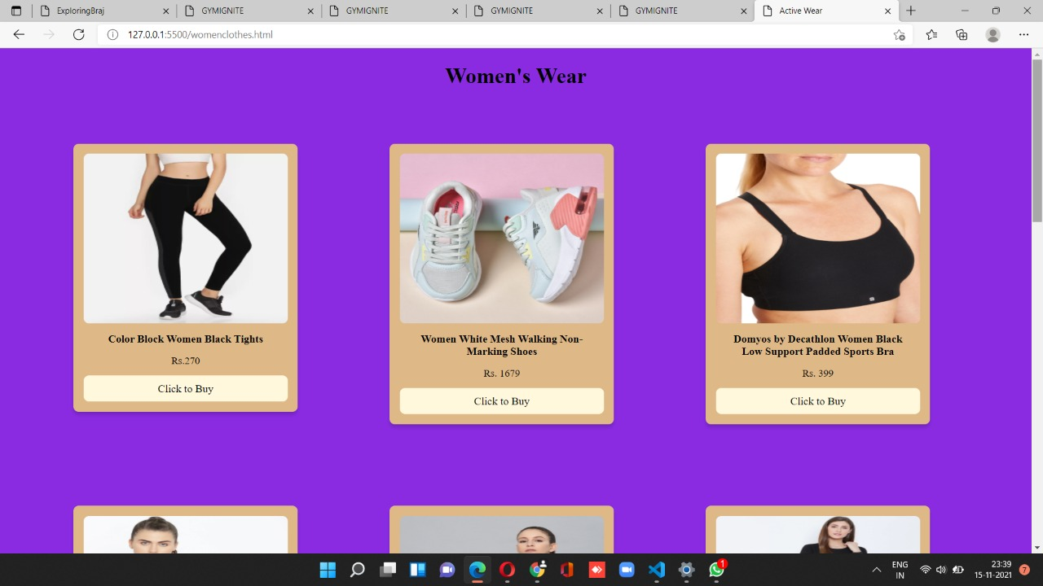
Website - GymIgnite
•Active Wear

Slide 24
Website - GymIgnite
CHAPTER -7 CONCLUSION
Proposed “GymIgnite Website” is website that will allow users specifically beginners to search for information regarding gym. This website takes in a user input and then they can search for gymwear, gymequipments and many more. Search result screen will contain a list of items with following details: item name, link to buy and a snapshot of that item. To get the information of the particular item user can click upon that from the list and then will be taken to the new tab where description and other information related to that will be available. Users can also add calculate their BMR.
This website has wide range of scope in the upcoming era. It is impossible to arrange all the information at one place.so this type of website can reduce the barrier to get knowledge at any place in a cost effective, productive way. For people who are interested in obtaining a good health.

Slide 25
Website - GymIgnite
REFERENCES
1. Introduction to HTML:
https://www.w3schools.com/html/.
Layout:
https://youtu.be/Sj5NX_br5WY
For rectifying the error
https://html.com/

