Slide 1





GCOEY College Website
Government College of Engineering, Yavatmal
Final Year | Dept. Of Computer Engineering
Project Presentation
Atal Ajay Dubey | T2010121245007
Khushi Vijay Chaturkar | T2010121245014
Rajat Subhash Pawar | T2010121245028
Guided By : Prof. Dhiraj D. Shirbhate

Slide 2
1. Introduction
Our project focuses on the development of an advanced and comprehensive online portal for Government College of Engineering Yavatmal (GCOEY), designed to enhance user experience, provide easy access to information, and ensure seamless communication within the college community. By integrating modern web development technologies and adhering to best practices in design and functionality, our goal is to create a user-friendly and efficient platform that meets the needs of students, faculty, and staff. This initiative aligns with our broader vision of leveraging technology to improve institutional operations and foster a connected and informed college environment.

Slide 3

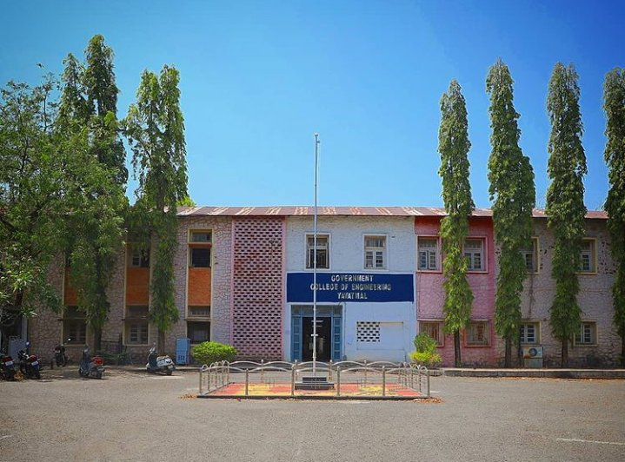
2. Problem Statement
The current Government College of Engineering, Yavatmal (GCOEY) website lacks efficient and secure administrative functionality for uploading and managing data. This limitation hampers the ability of faculty and staff to update content seamlessly, leading to outdated information and reduced user engagement. Our project addresses this issue by developing a robust, secure admin interface that simplifies data management and ensures the integrity and accuracy of the information presented on the website.

Slide 4








3. Methodology
Requirement Analysis
System Design
Database Design
Implementation
Testing
Deployment
User Training and Documentation
Continuous Improvement
By following this methodology, we aim to develop a sophisticated and secure admin functionality for uploading data on the GCOEY college website. This approach ensures that faculty and staff can manage content seamlessly, leading to an updated and engaging user experience for students and visitors.

Slide 5
4. System Requirements
Hardware Requirements
Disk: Capacity >500MB for smooth performance
RAM: 2GB (minimum), 4GB(recommended) and above.
Processor: Dual-core processor or higher (recommended)
Software Requirements
OS: Windows 7 and above or linux
Front End Technology: HTML5 CSS3, JavaScript, Bootstrap 4
Backend Technology: React & Firebase (Database)
Code Editor: Visual Studio Code, Notepad or Other Code Editor
Web Browser: Google Chrome, Mozilla Firefox, or Other Web Browser.

Slide 6
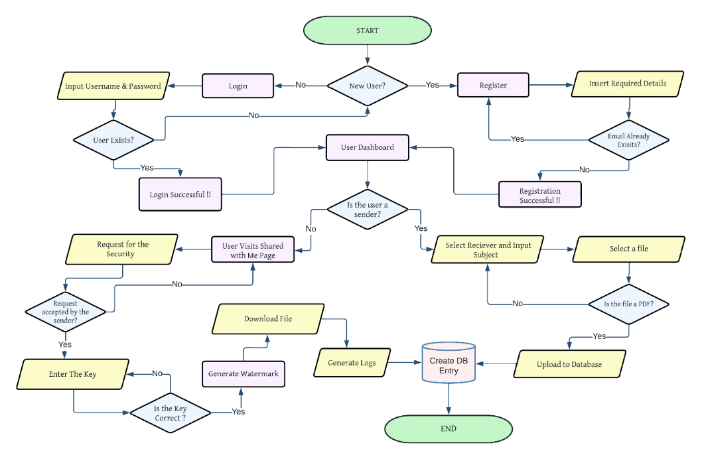
5. Project Architecture

Slide 7
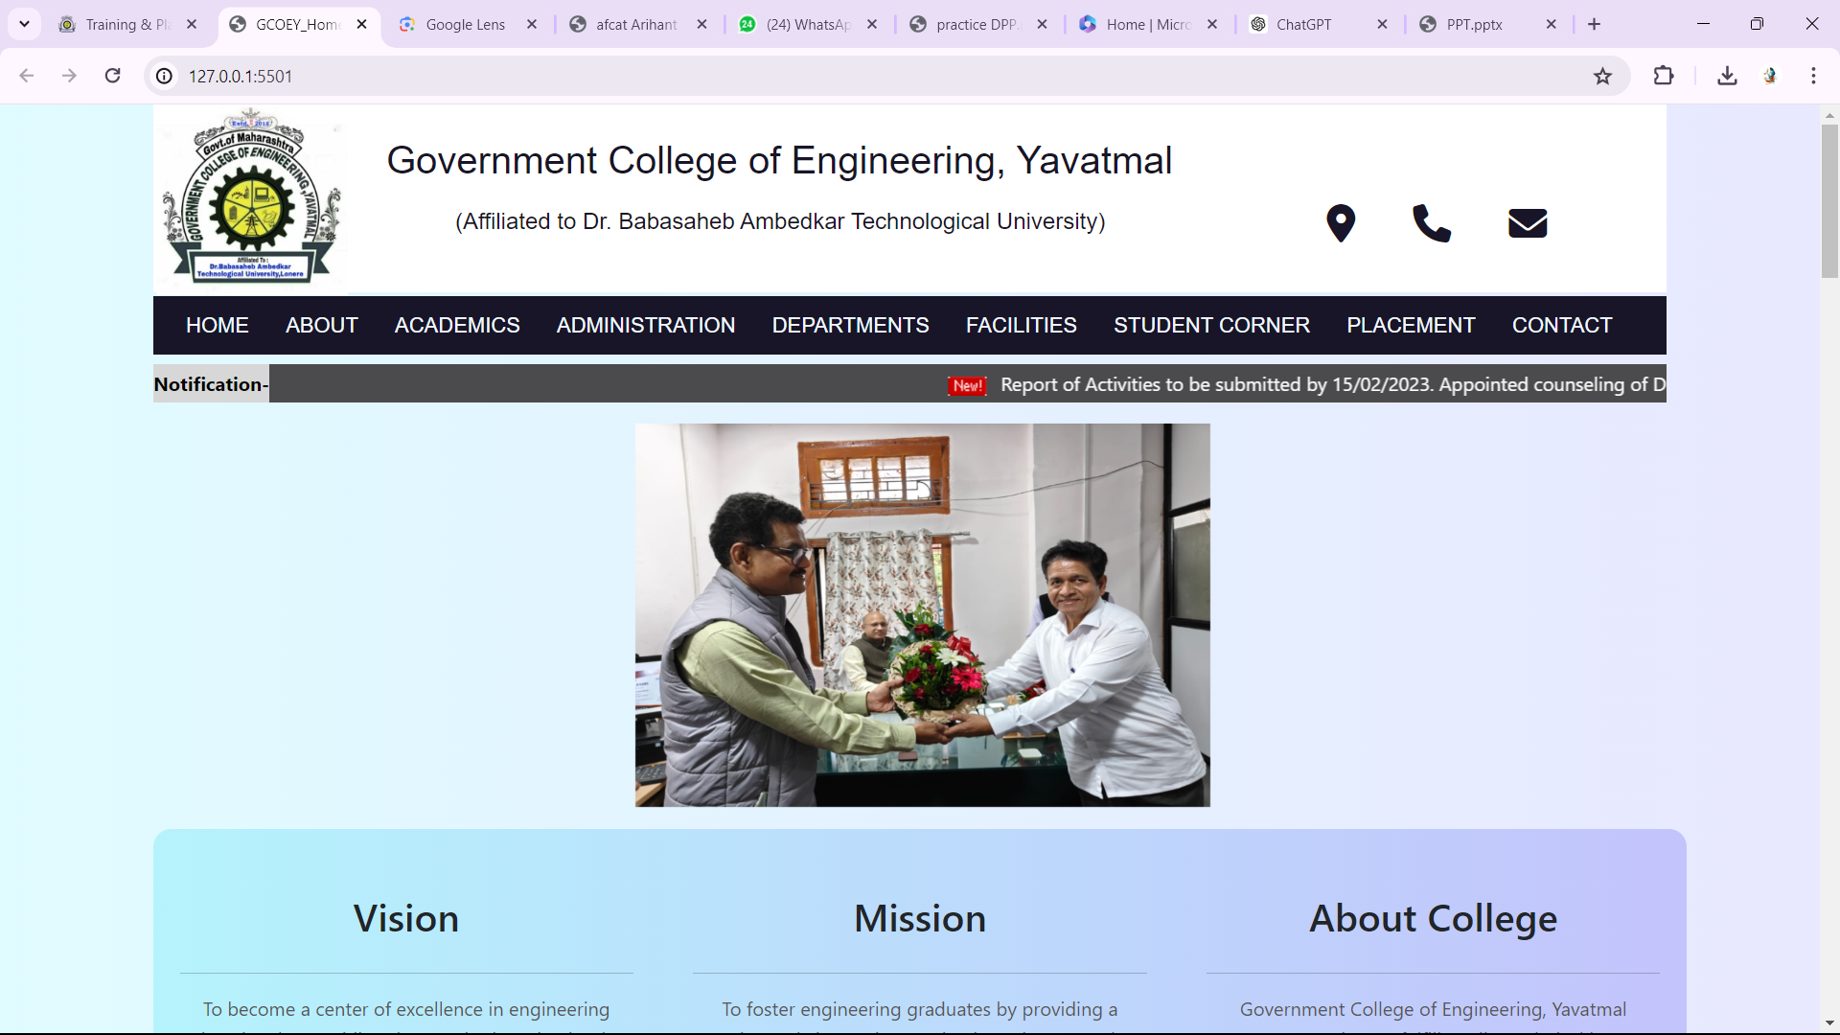
6. Project Implementation

Slide 8

7. Result & Output
The result of the GCOEY college website is a modern, user-friendly platform that provides easy access to information for students, faculty, and staff. Users can navigate through the website intuitively, accessing resources such as course information, event calendars, faculty profiles, and important announcements. The secure admin functionality allows for efficient content management, ensuring that the website remains updated and relevant. Overall, the GCOEY website enhances communication, engagement, and accessibility within the college community.

Slide 9

Conclusion
In conclusion, the development of the GCOEY website represents a significant step towards modernizing and streamlining communication within the college community. Through a systematic approach to design, implementation, and testing, we have created a user-friendly platform that meets the diverse needs of students, faculty, and staff. The secure admin functionality ensures efficient content management, while the responsive design enhances accessibility across devices.

Slide 10

Thank You!
Any questions?

