Slide 1
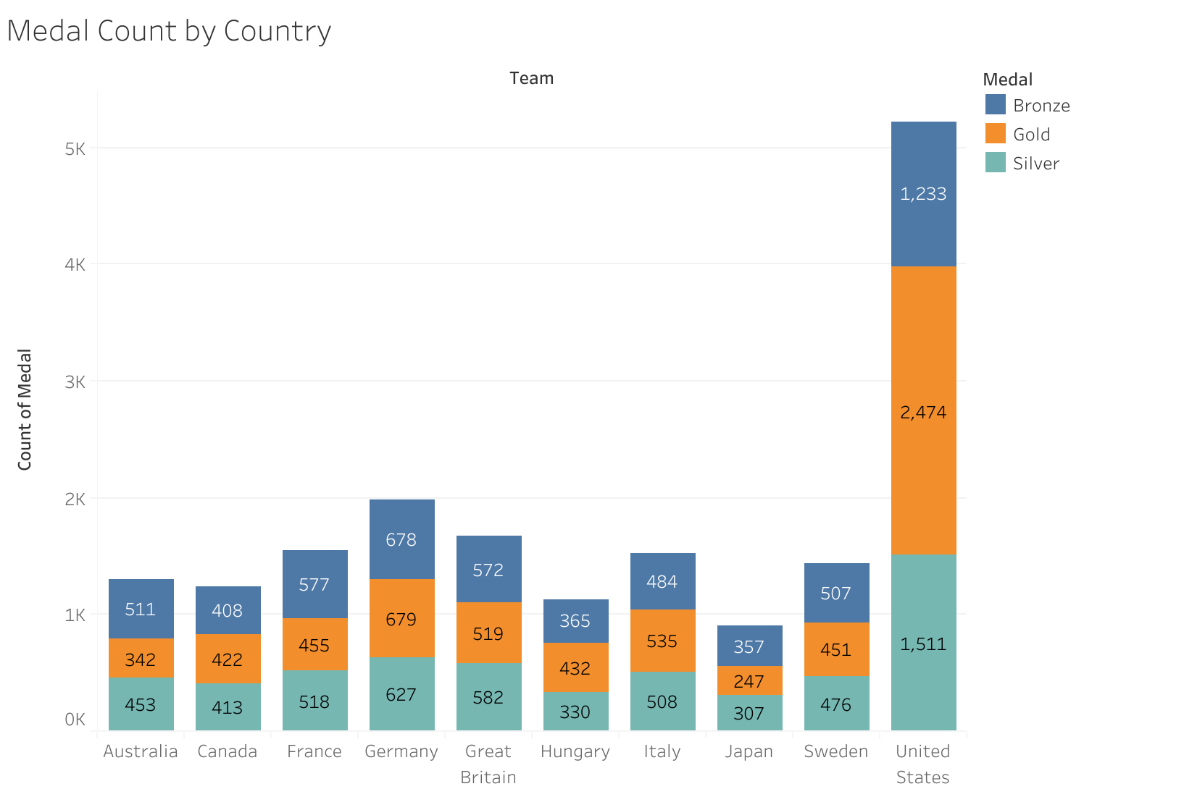
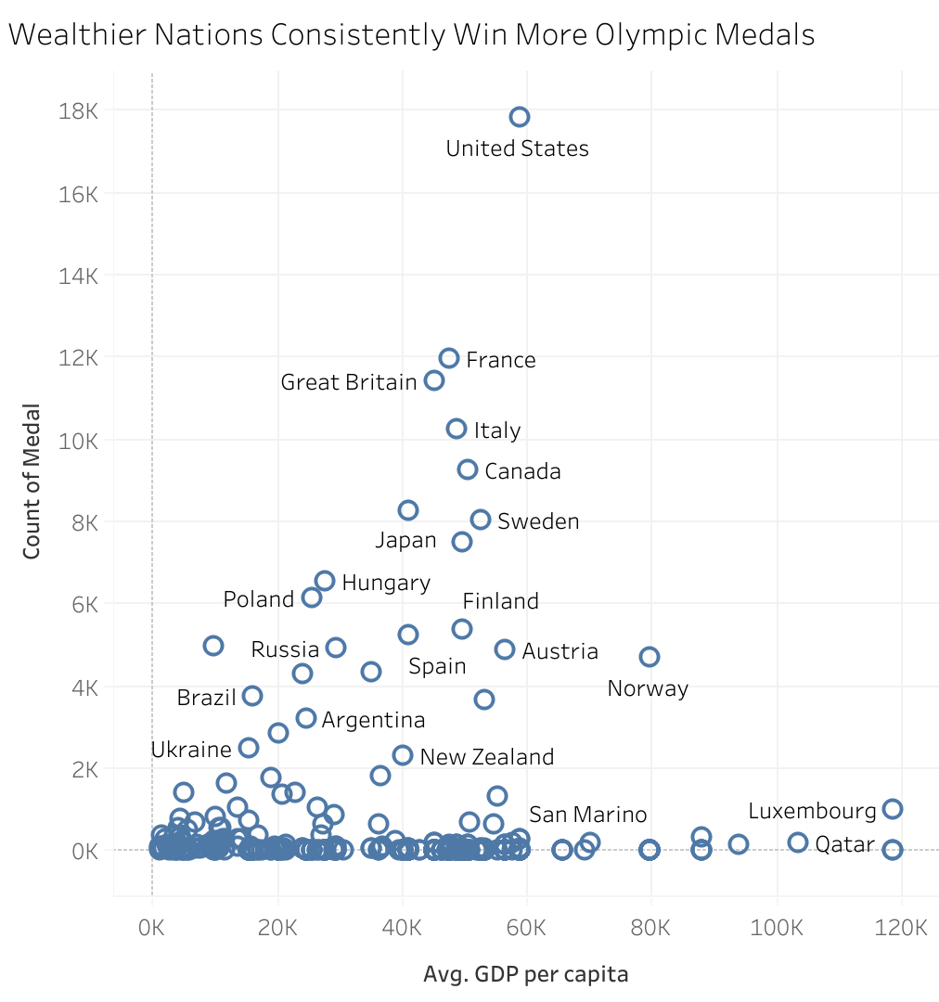
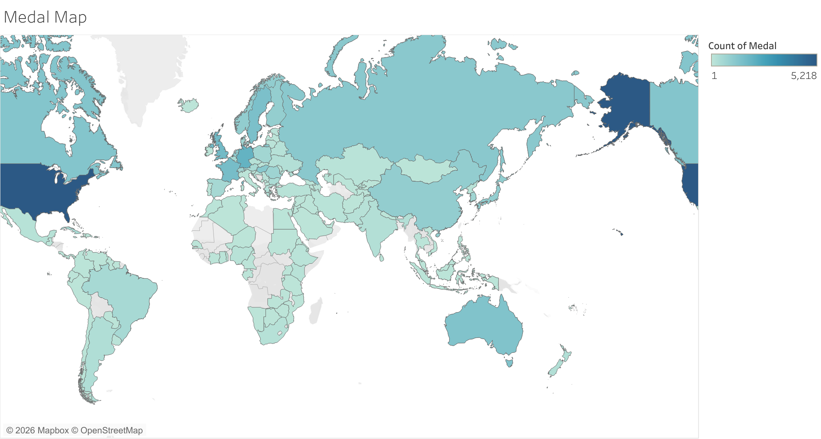
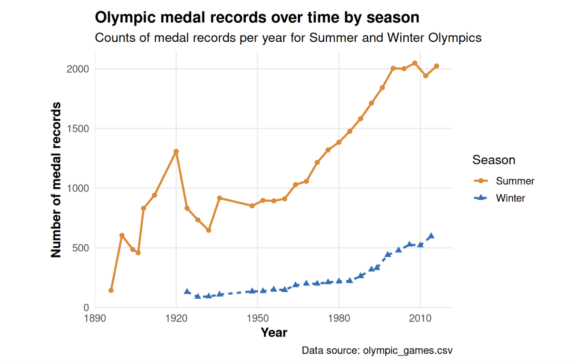
Olympic Success Around the World
Khushi Chaturvedi
DSA 202 (603)
This poster explores how Olympic medal success differs across countries. Using Olympic medal and GDP per capita data, it highlights how medal outcomes reflect a combination of economic resources, geography, and the structure of the Summer and Winter Games.
1. Medal Count by Country
Medal totals are concentrated among a relatively small number of countries, with the United States standing out most strongly in this comparison.
2. GDP per Capita vs Medal Count
Countries with higher GDP per capita often have higher medal totals, suggesting that resources may support Olympic development over time.
3. Medal Map
Higher medal totals are clustered in North America, Europe, Russia, East Asia, and Oceania rather than being evenly distributed worldwide.
4. Olympic Medal Records Over Time by Season
Summer Olympic medal records are consistently higher than Winter totals because the Summer Games include more events and broader participation.
Sources: Kaggle Olympic Games dataset (olympic_games.csv) and Kaggle GDP per capita dataset (gdp-per-capita-worldbank.csv). Visualizations were created in Tableau, and the year-and-season chart was created in R using ggplot2 and dplyr.
Notes:
[Sources] - User-provided chart image: Medal Count by Country.png - User-provided chart image: GDP vs Medal Count.png - User-provided chart image: Medal Map.png - User-provided chart image: cropped_olympic_medals_by_year_season.png - Data sources line based on user statement that both datasets are from Kaggle and filenames referenced in the conversation.

