Slide 1

Hi Everyone, Here is My
Project on
VERVE BRIDGE
TOPIC-Predictive Management for Industrial Equipment Using IoT Data
- KHUSHI

Slide 2
TABLE OF CONTENT
INTRODUCTION
OBJECTIVE
METHODOLOGY
TOOLS & TECHNIQUE UTILIZED
DASHBOARD
KEY INSIGHTS
RECOMMADATION
CONCUSION

Slide 3
INTRODUCTION
Predictive Maintenance using IoT leverages real-time sensor data to monitor equipment health and predict potential failures before they occur. By collecting data on parameters like temperature, vibration, and pressure, IoT devices enable proactive maintenance, reducing downtime and optimizing asset performance. This approach uses machine learning to analyze patterns and provide timely alerts for maintenance needs, ultimately cutting costs and improving operational efficiency. The project focuses on enhancing maintenance strategies through continuous monitoring, predictive analytics, and actionable insights to extend equipment lifespan.

Slide 4
OBJECTIVE
The objective of the Predictive Maintenance IoT project is to proactively monitor equipment health using IoT sensors and prevent unexpected failures. By collecting real-time data, the project aims to analyze machine performance, predict maintenance needs, and optimize the maintenance schedule. This approach seeks to reduce operational downtime, minimize maintenance costs, and extend the lifespan of assets while improving overall efficiency and reliability in industrial operations.

Slide 5
METHODOLOGY
Data Preprocessing
Predictive Modeling
Visualization & Dashboard
Cost-Benefit Analysis
Data Collection
Exploratory
Data Analysis
Anomaly Detection
Evaluation Metrics
Conclusion & Recommendations

Slide 6
TOOLS & TECHNIQUE UTILIZED
1.Python:-
A versatile programming language for data analysis, modeling, and automation.
Key Libraries:
NumPy: Efficient handling of large multidimensional arrays and mathematical operations.
Pandas: Data manipulation and analysis with easy data cleaning and exploratory data analysis (EDA) using DataFrames.
Scikit-learn: Machine learning library used for training models, evaluation, and performance metrics.
Matplotlib : Data visualization library for creating static, animated, and interactive visualizations in Python.
4. Power BI:-
Data visualization and reporting.
Created interactive dashboards to display predictive maintenance insights, machine health status, and potential failure trends.

Slide 7
Steps Completed in Python for Predictive Maintenance Project
Data Manipulation and Cleaning : Python, along with libraries like Pandas, facilitated efficient data cleaning and preprocessing, ensuring high-quality data for analysis. This step significantly reduced noise and errors in the dataset, leading to more accurate modeling outcomes.
Exploratory Data Analysis (EDA) : Python’s data visualization libraries, such as Matplotlib and Seaborn, enabled comprehensive EDA. This helped uncover patterns and relationships in the data, guiding the feature selection process and informing subsequent modeling strategies.
Predictive Modeling : The integration of Scikit-learn allowed for the development of robust predictive models. Various algorithms were easily implemented, enabling quick experimentation and optimization for forecasting equipment failures.

Slide 8
Steps Completed in Python for Predictive Maintenance Project
Automation and Efficiency: Python scripts automated repetitive tasks, such as data loading, preprocessing, and analysis, which enhanced workflow efficiency. This automation not only saved time but also minimized the risk of human error during data handling.
Scalability : Python’s libraries efficiently handled large datasets, making it suitable for scaling analyses as data volume increased. This scalability ensured that the methods employed could be applied to future datasets with similar structures.
Integration Capabilities : Python's flexibility allowed for easy integration with other tools and technologies, such as Power BI, enhancing the overall analytics workflow and facilitating the creation of interactive dashboards.

Slide 9
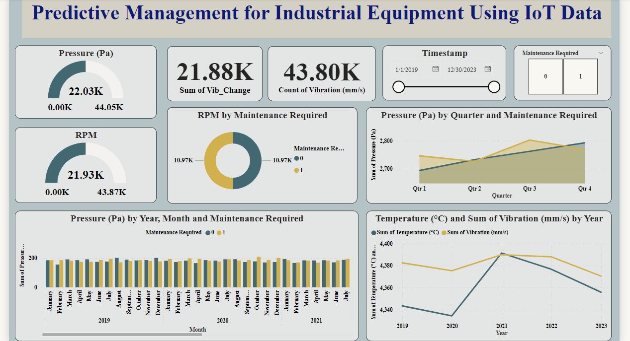
DASHBOARD in POWER BI

Slide 10
KEY INSIGHTS (POWER BI)
Vibration and Maintenance: Higher vibration levels (43.80K mm/s) correlate strongly with maintenance needs, suggesting it as an early predictor for issues.
Pressure Trends: Pressure increases steadily through the year, especially in Q3 and Q4, aligning with maintenance requirements.
RPM and Maintenance: Higher RPM readings (21.93K) are linked to more frequent maintenance, indicating stress on equipment at higher speeds.
Vibration vs. Temperature: Vibration fluctuates more than temperature, showing vibration as a more critical indicator of equipment health.
Seasonal Pressure Spikes: Pressure spikes during certain months suggest opportunities for preemptive maintenance.
Performance Outliers: Significant spikes in vibration, especially around 2020-2021, could indicate potential equipment issues needing further analysis.

Slide 11
RECOMMANDATION
To enhance maintenance processes, it is recommended to implement real-time alerts for critical metrics such as temperature and vibration, using the thresholds identified in the analysis. This approach will allow for proactive interventions to address potential failures before they occur. By optimizing the maintenance schedule with these predictive insights, downtime can be minimized, and overall operational efficiency will improve. Additionally, integrating external environmental factors like humidity could further improve the accuracy and reliability of failure predictions.

Slide 12
CONCLUSION
Predictive maintenance using IoT data is a cost-effective solution that can significantly reduce unplanned equipment downtime. By monitoring sensor data in real time and identifying failure patterns, industries can make informed maintenance decisions, improve operational efficiency, and lower maintenance costs. The predictive models and dashboards developed in this project provide valuable tools for anticipating maintenance needs and improving overall equipment performance.

Slide 13
THANK
YOU

