Slide 1

Title: AI in Digital Forensics and Attribution Subtitle: Exploring the Role of Artificial Intelligence in Cybercrime Investigation Presented by: Azka Sayed and Khushi Singh Date: [11/5/2025]

Slide 2

Introduction to Digital Forensics
This presentation explores the intersection of artificial intelligence and digital forensics, highlighting its techniques, applications, challenges, and future trends.
Definition: Digital forensics is the process of uncovering and interpreting electronic data.
Importance: Vital for solving cybercrimes, fraud, data breaches.
Domains: Computer forensics, mobile forensics, network forensics, cloud forensics.

Slide 3

Role of AI in Digital Forensics

Slide 4

Roles
Automates evidence analysis
Enhances pattern recognition and anomaly detection.
Speeds up case resolution.
Handles large-scale data from various sources.

Slide 5
Problem Statement
Traditional forensics are slow and labor-intensive.
Volume of data is overwhelming.
Attribution is difficult due to anonymity tools (e.g., VPNs, Tor).
Need for intelligent, scalable solutions.

Slide 6
Importance of Attribution in Digital Forencics
Attribution is critical in digital forensics as it involves identifying the entity responsible for
a cyber incident. AI technologies assist in tracing digital footprints and linking activities back to individuals or organizations, which is essential for accountability and prevention of future attacks.

Slide 7

AI Tools in Digital Forensics
Autopsy + Sleuth Kit (TSK)
GitHub: sleuthkit/autopsy
Use: Digital forensics of hard drives, file systems.
AI Integration: You can script modules in Python to include AI-based classifiers (e.g., for image recognition or anomaly detection).
Ease of Use: Moderate — has a GUI and plugin system.

Slide 8
2. Volatility / Volatility3
Use: Memory forensics.
AI Integration: Can be extended to detect malicious patterns in memory using ML models.
Ease of Use: CLI-based; Python skills needed.
3. Maltrail
GitHub: stamparm/maltrail
Use: Network traffic monitoring and anomaly detection.
AI Integration: Already includes basic anomaly detection; you can add ML-based traffic classifiers.
Ease of Use: Easy to deploy via Python; low setup complexity.

Slide 9
Face & File Signature Detection Tool Detection Tool
💻 What It Does:
A lightweight digital forensics utility built with Python and Tkinter.
Provides two core functionalities:
Face Detection using OpenCV (detects number of faces in an image).
File Signature Verification using python-magic (verifies MIME type for tamper detection).
💻 How It Works:
Upload any image (JPG, PNG, BMP, etc.).
The tool:
Displays the image.
Analyzes its true file type (vs. extension).
Scans for human faces using Haar cascades.
Displays results in a simple GUI textbox.
🛠 Use Cases:
Early-stage evidence scanning in forensic labs.
Verifying authenticity of media in legal or journalistic workflows.
Training tool for digital forensics education.

Slide 10

Case Studies – Face Detection & File Signature Use
💻 Case Study 1 – Face Detection in Law Enforcement
Scenario: Police analyze image evidence recovered from a suspect's phone during a human trafficking investigation.
Tool Use: Detects multiple human faces in a crowded room photo.
Impact: Prioritizes this image for deeper facial recognition to identify victims and perpetrators.
💻 Case Study 2 – File Signature Verification in Legal Forensics
A company received a file named “resume.pdf” during a hiring process. File signature detection revealed it was actually a disguised executable (.exe). The file contained a keylogger meant to breach internal systems. Thanks to quick verification, the threat was blocked and reported to authorities.

Slide 11
Market Demand, Audience & Real-World Use
💻 Market Demand
Digital Forensics market projected to reach $22.5B by 2028.
Face Detection market to exceed $12.67B by 2030.
Growing demand due to:
Cybercrime & fraud.
Law enforcement needs.
Corporate & legal compliance.
👥 Who’s Interested
Law enforcement & military cyber units.
Cybersecurity consulting firms.
Insurance & legal sectors.
Digital forensics educators & students.

Slide 12
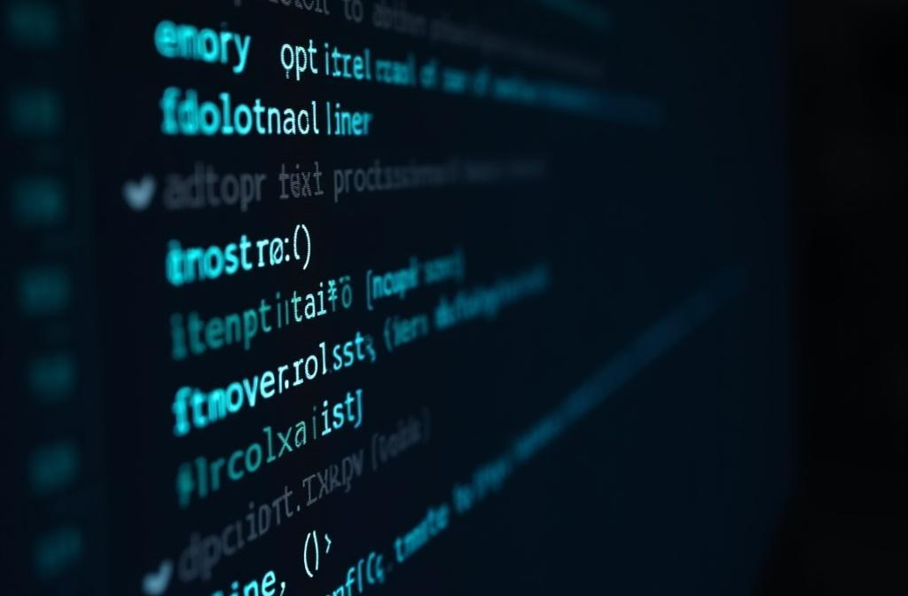
Real-World Use of Face & File Signature Detection Tools:
🔍 File Signature Verification was critical during the ZLoader malware campaign (2021), where attackers used signed DLLs to spread malware.
📁 The tool helped detect malicious files masquerading as trusted formats, preventing execution of disguised threats.
👤 Face detection is widely used in surveillance and access control; during the 2020 Delhi riots, it was used to identify suspects via CCTV footage.
🔐 Both tools are key components in digital forensics workflows for analyzing cybercrime evidence and preventing insider threats.

Slide 13
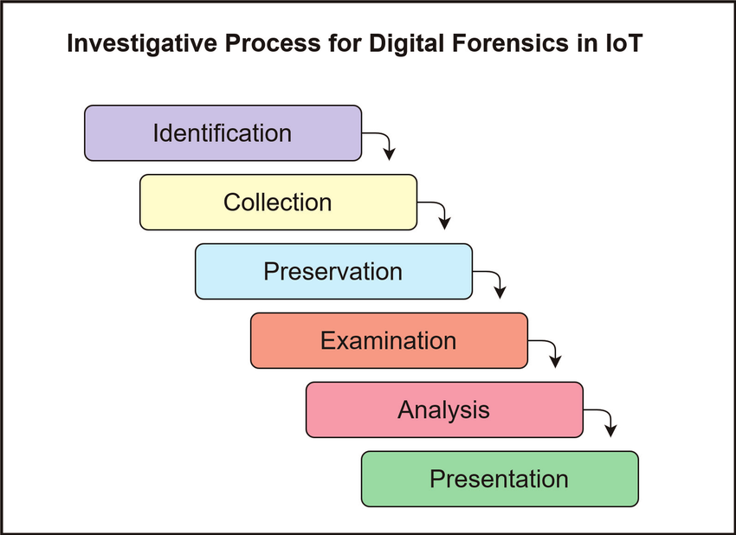
Research Methodology
Step 1: Literature Review on current AI tools in forensics.
Step 2: Case studies on cybercrime investigations.
Step 3: Experiment using AI tools on synthetic datasets.
Step 4: Analyze performance metrics (accuracy, time).

Slide 14
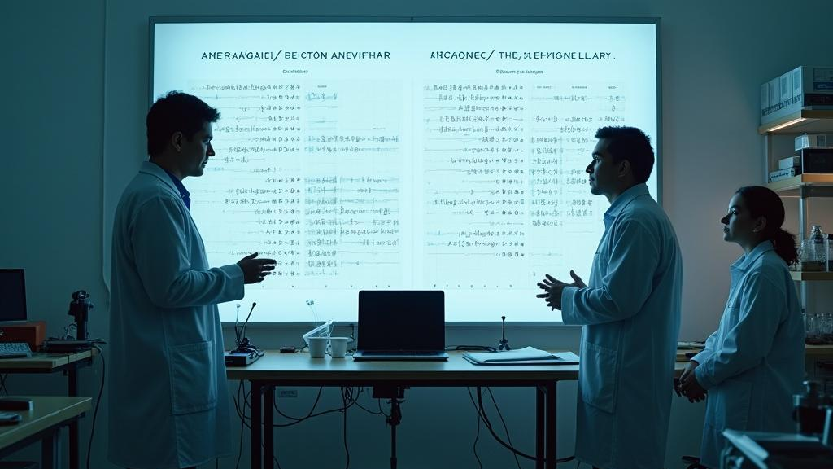
Comparative Analysis

Slide 15

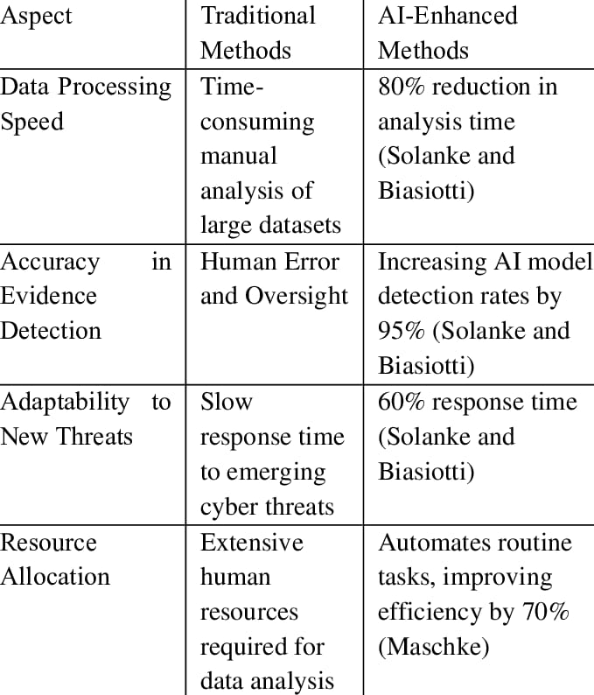

Slide 16
Limitations
AI requires high-quality training data.
May generate false positives/negatives.
Legal admissibility of AI conclusions is still evolving.
Interpretability of AI models (especially deep learning).

Slide 17
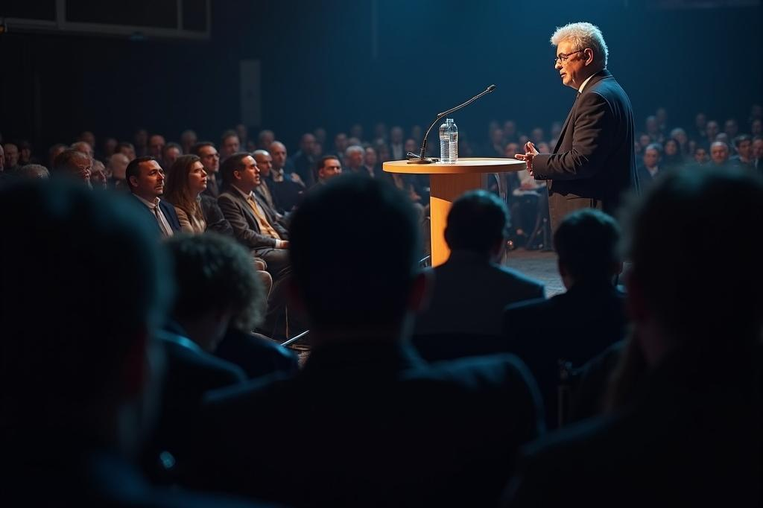
Thank you!

