Slide 1

Basic Details of the Team and Problem Statement
Ministry/Organization Name/Student Innovation: AICTE,MIC-Student Innovation
PS Code:SIH1486
Problem Statement Title: Student Innovation
Team Name: Gladiators
Team Leader Name: Khushii Guptaa
Institute Code (AISHE):19793
Institute Name: MAHATMA GANDHI INSTITUTE OF TECHNOLOGY
Theme Name: Travel and Tourism

Slide 2
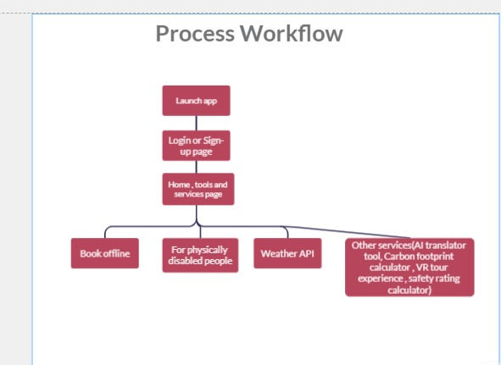
Idea/Approach Details
Describe your idea/Solution/Prototype here:
The tourism industry is vital to the growth of the majority of developing economies, with the potential to create millions of jobs and promote entrepreneurship and innovation.
Developing a platform that includes innovative features for better user experience.
Targeting specific users in rural areas and physically challenged people.
Describe your Technology stack here:
Frontend -HTML ,CSS
Geolocation-Google maps API(with internet) -Mapbox API(without internet)
WeatherAPI- OpenWeatherMap API
Payment- Paypal
Data Base- MongoDB
VR Tools- OpenVR SDK

Slide 3
Idea/Approach Details
Describe your Use Cases here
Describe your Dependencies / Show stopper here
Offline Services
Booking a travel service via SMS and calls(using toll free number) in areas where Internet is not available.
VR Traveling experience
360-degree VR video is used to capture everything about a destination in an immersive way.
Weather API
Integrating a weather API to provide predicted data and recommend safe, enjoyable destinations based on user preferences.
For Physically Disabled
Travelers with any physical disability can travel hassle-free.
Visual impairment: Integration of Google Lens for object scanning and instant recognition of items before them
Mobility impairment: Suggesting alternative locations and if any location is not physically accessible, VR travel experience is provided for them.

Slide 4
Team Member Details
Team Leader Name Khushii Guptaa
Branch: B Tech Stream: CSB Year: III
Team Member 1 Name: N Shrenik Reddy
Branch: B Tech Stream: CSB Year: III
Team Member 2 Name: N Renuka Chowdary
Branch: B Tech Stream: CSB Year: III
Team Member 3 Name: C Sriyan Reddy
Branch: B Tech Stream: CSB Year: III
Team Member 4 Name: S Phani Vardhan
Branch: B Tech Stream: CSB Year : III
Team Member 5 Name: M V Puranjay
Branch: B Tech Stream: ECE Year : III

