Slide 1

Musify
Presented by: Kashish Mahana(2210990497)
Khushi Bansal(2210990511)
Under the supervision of: Mr.Vikas Patel & Ms.Parul Gahelot

Slide 2
Table of Contents
Introduction
Acknowledgment
Problem proposed
Motivation of research
Tools and technology
Code Snapshots
Conclusion
References/links

Slide 3
INTRODUCTION
Musify
Musify, a pioneer in the realm of music streaming, has revolutionized the way we consume and discover music. With it’s vast library of tracks spanning various genres,seamless user interface, it is a user friendly web player which enhances the quality of audio.
It is a simple way to play music of your choice on any device connected to the web with a pleasant experience.

Slide 4
Acknowledgment
I would like to express my sincere gratitude to all those who have contributed to the development of this Spotify clone project. Special thanks to Vikas Patel, whose invaluable insights and expertise have guided us throughout the journey. Additionally, I extend my appreciation to our team members for their dedication and hard work in bringing this vision to life. Lastly, I am thankful to our mentors, friends, and family for their unwavering support and encouragement.

Slide 5
PROBLEM PROPOSED
Personalised recommendations :
Current Challenges: Many existing music streaming platforms struggle to provide users with personalized recommendations tailored to their individual tastes and preferences. This results in users spending significant time searching for new music or feeling overwhelmed by irrelevant suggestions.
Proposed Solution: Our musify will implement advanced algorithms to analyze users' listening habits, preferences, and behaviors. It is user-friendly and is easy to access.
AUDIO QUALITY:
Proposed Solution: Our musify will prioritize the delivery of high-quality audio streaming to ensure a premium listening experience for users.
we aim to offer crystal-clear sound reproduction.
This commitment to audio excellence will set our platform apart and delight users with unparalleled sound fidelity.

Slide 6
OFFLINE LISTENING
• Current Challenges: While most music streaming platforms offer offline listening capabilities, the process of accessing and managing offline content is often not easily available.
• Proposed Solution: Our musify will streamline the offline listening experience, making it effortless for users to enjoy their favorite music anytime, anywhere.It streams offline for all the music preferences regardlessly of the languages or the taste, it provides users with a smooth experience as they can listen to any kind of music offline without any technical issues faced which further degrades the experience of listening
Discovery and Exploration:
• Current Challenges: Despite the vast libraries of music available on existing platforms, users may struggle to discover new artists or genres that align with their interests. This can lead to stagnation in users' musical exploration and a lack of excitement in discovering fresh content.
• Proposed Solution: Our Spotify clone will prioritize enhancing the discovery and exploration features to facilitate serendipitous encounters with new music. Leveraging a combination of user preferences, social interactions, and algorithmic recommendations, the platform will curate personalized discovery experiences tailored to each user's unique taste.

Slide 7
MOTIVATION OF RESEARCH
The motivation behind the development of our project stems from a deep-seated passion for music and a commitment to enhancing the way people interact with and enjoy their favorite tunes. We believe that music has the power to inspire, connect, and uplift individuals, and we are driven by the desire to create a platform that elevates the music streaming experience to new heights.we are motivated by the opportunity to make a positive impact on the music industry by supporting artists, promoting diversity and inclusivity, and fostering a vibrant community of music lovers.
Ultimately, our motivation is rooted in our belief that everyone deserves access to exceptional music experiences, and we are committed to making that vision a reality with our webplayer.

Slide 8





TOOLS AND TECHNOLOGIES
PROGRAMMING LANGUAGES:
HTML,CSS,JAVASCRIPT

Slide 9
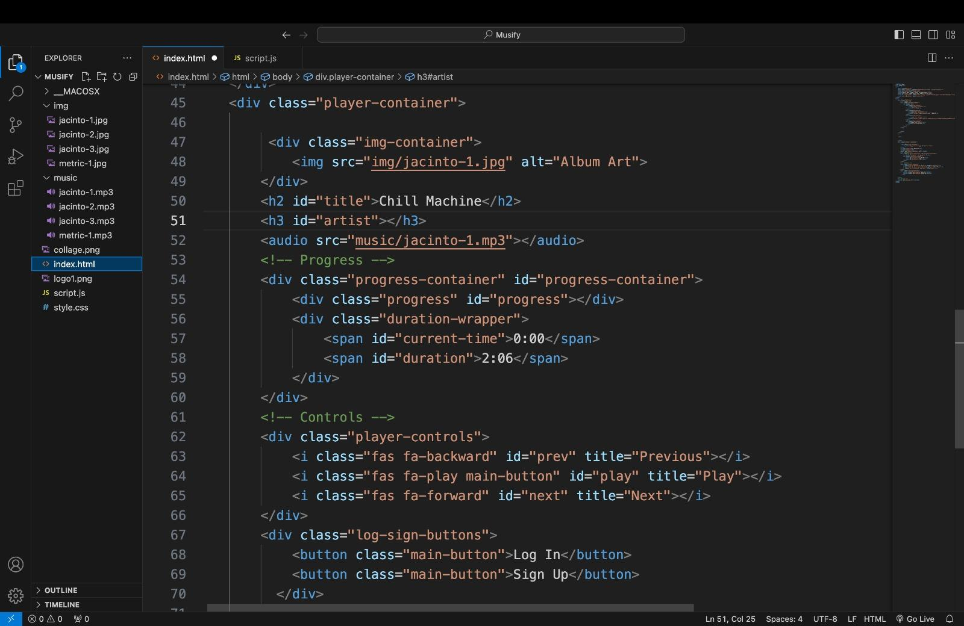
CODE SNAPSHOTS
HTML CODE:

Slide 10
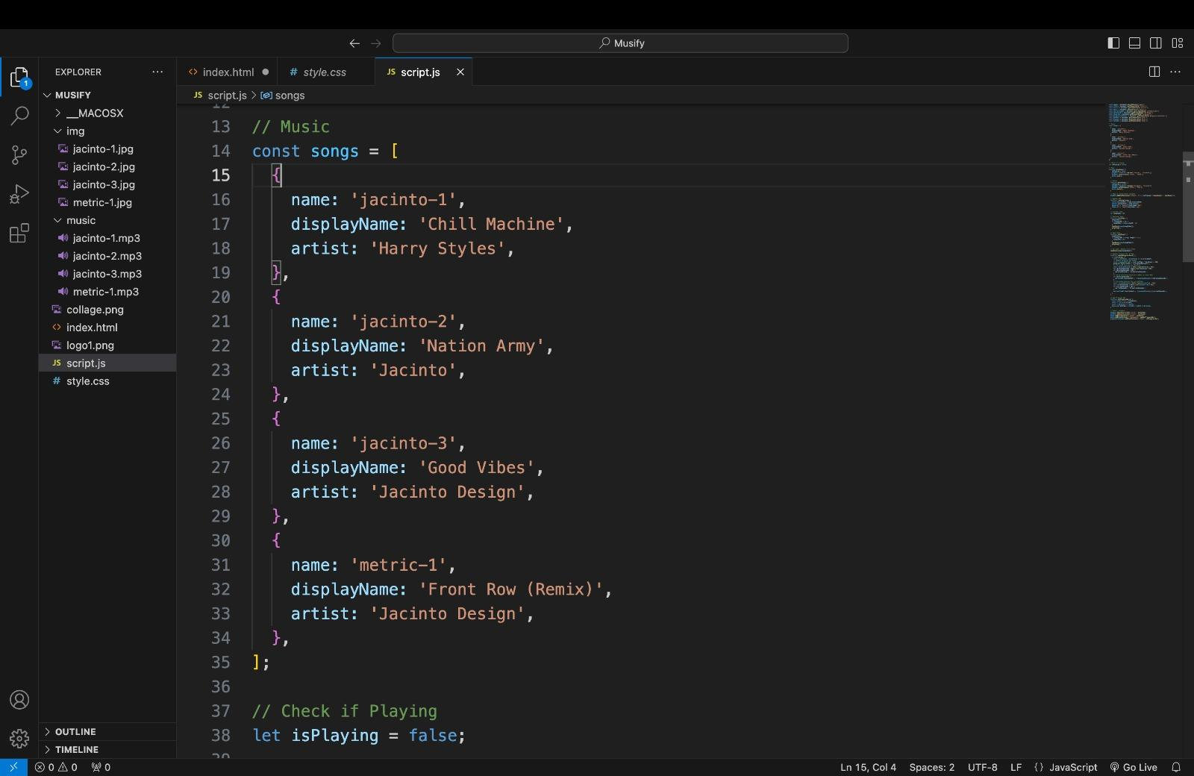
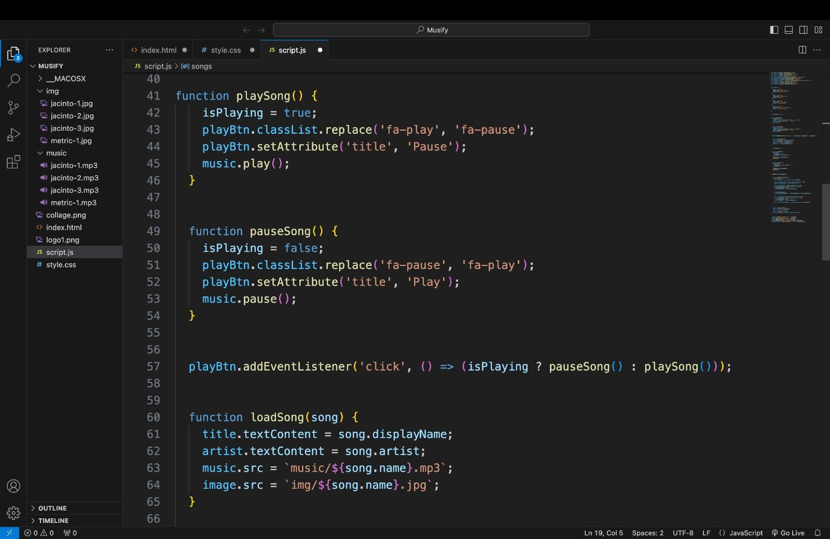
Javascript Code:

Slide 11
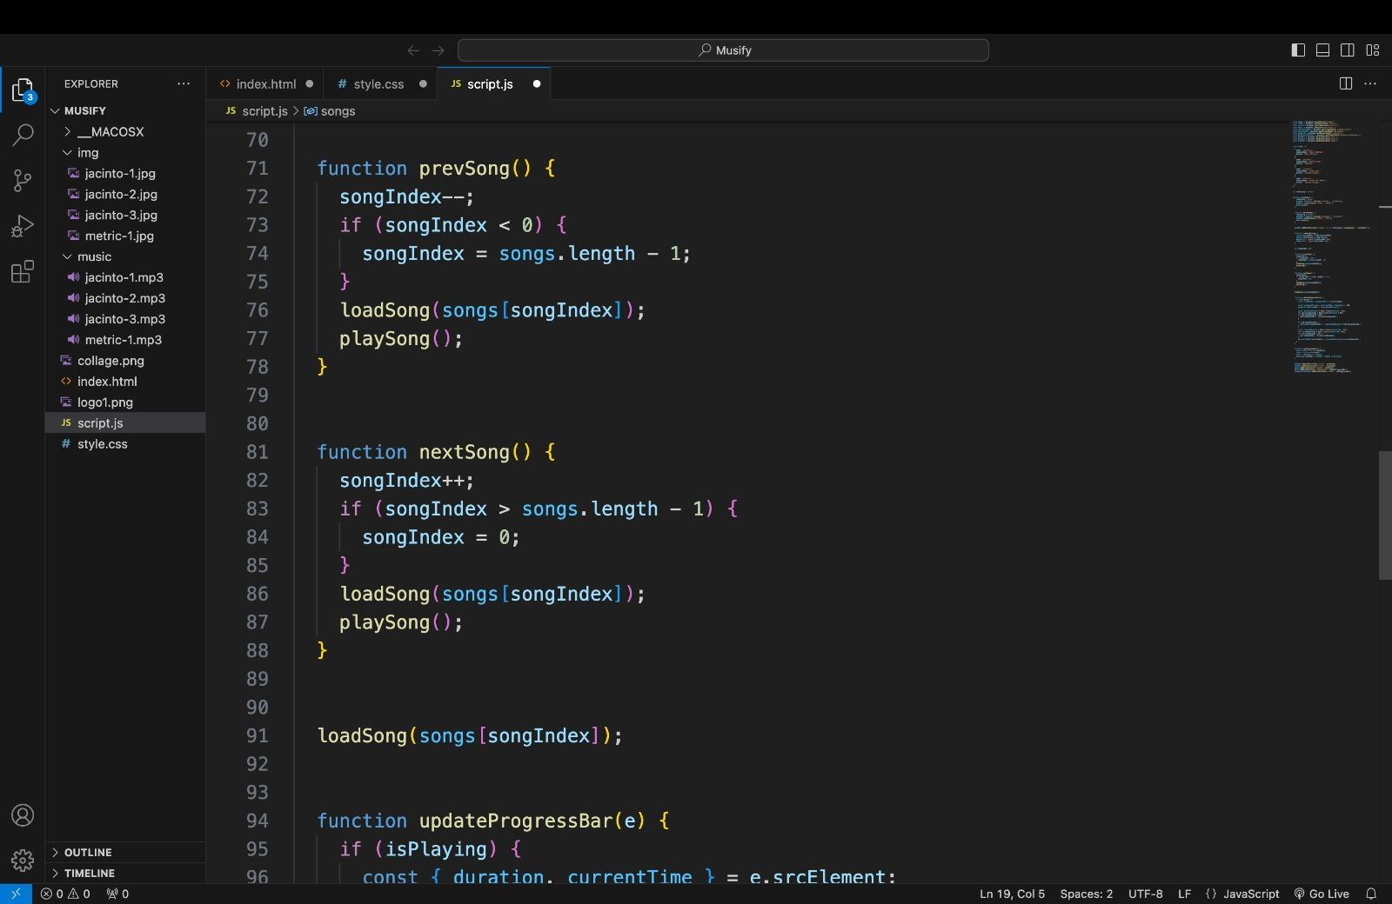
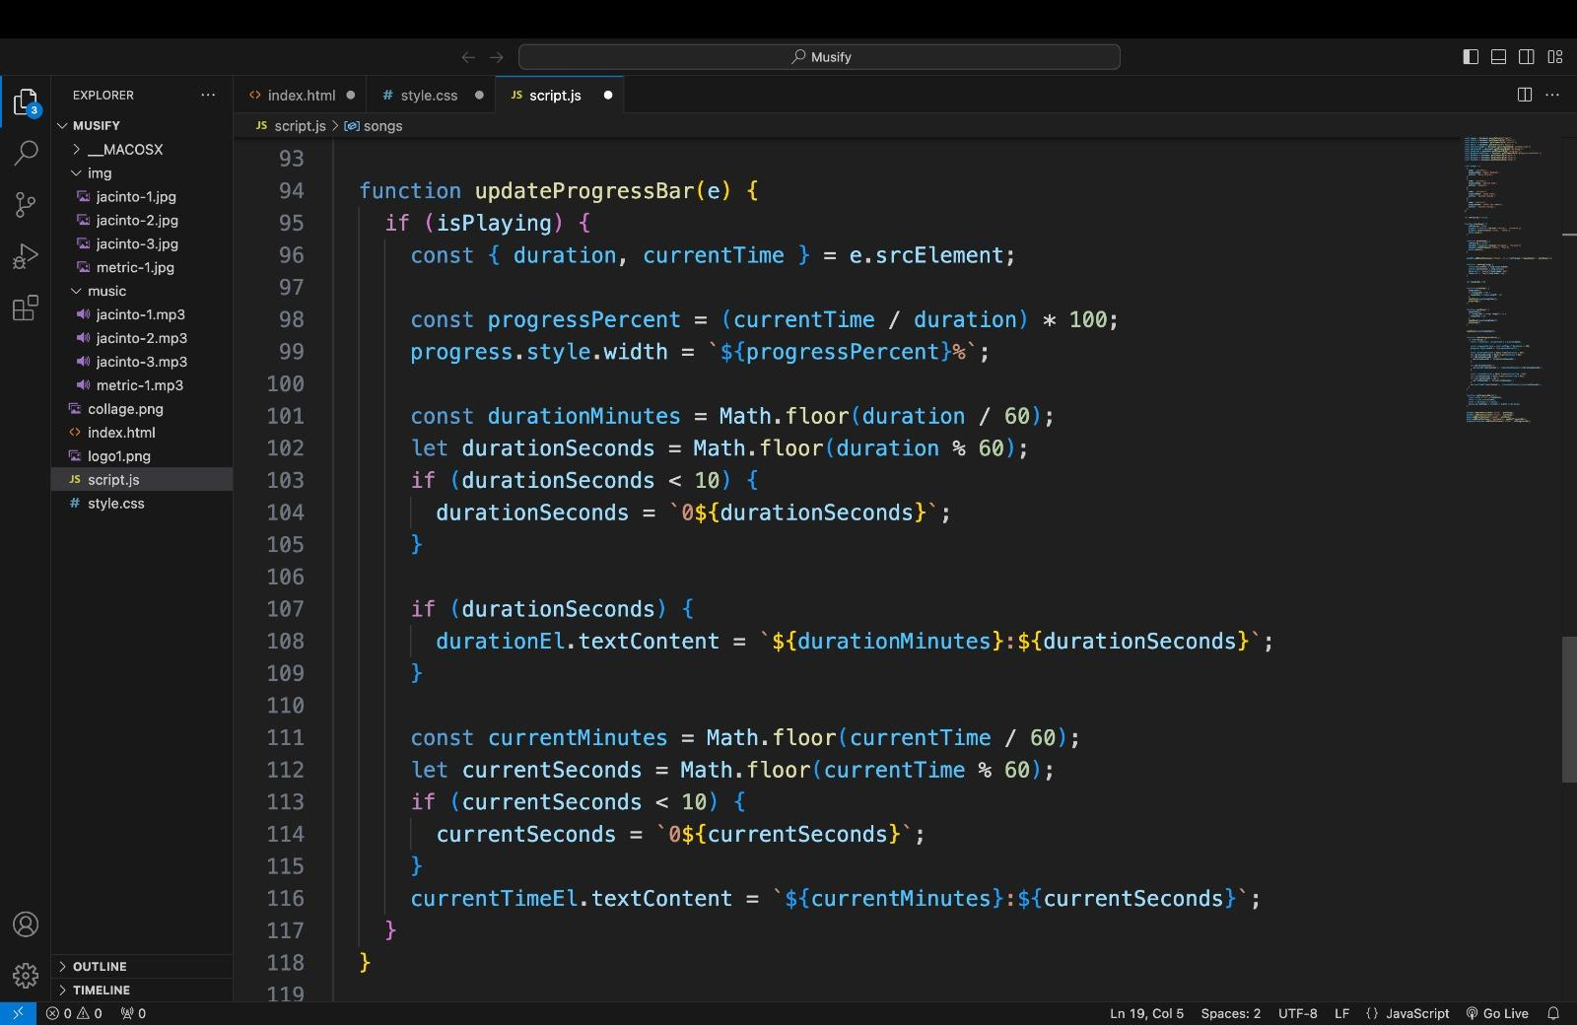

Slide 12
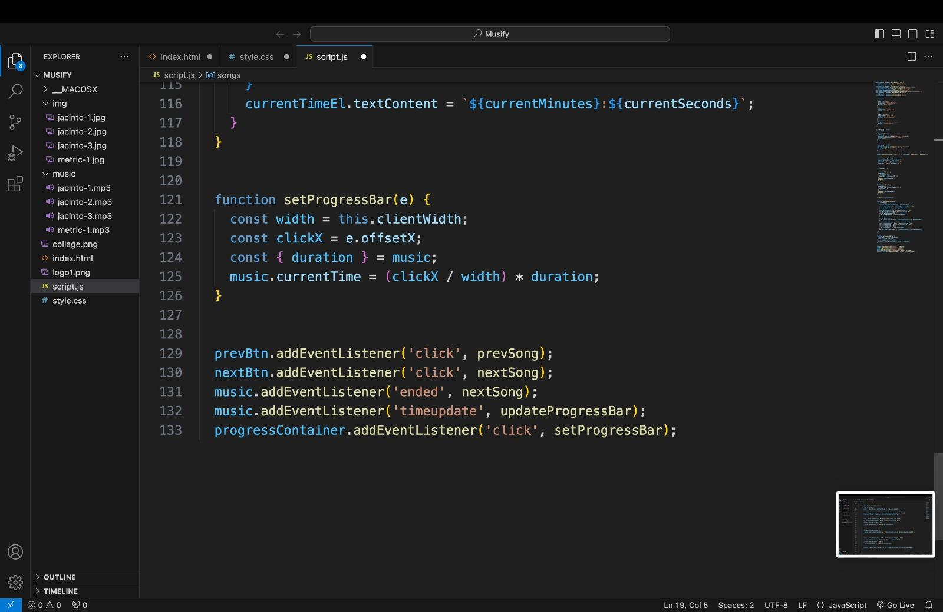

Slide 13
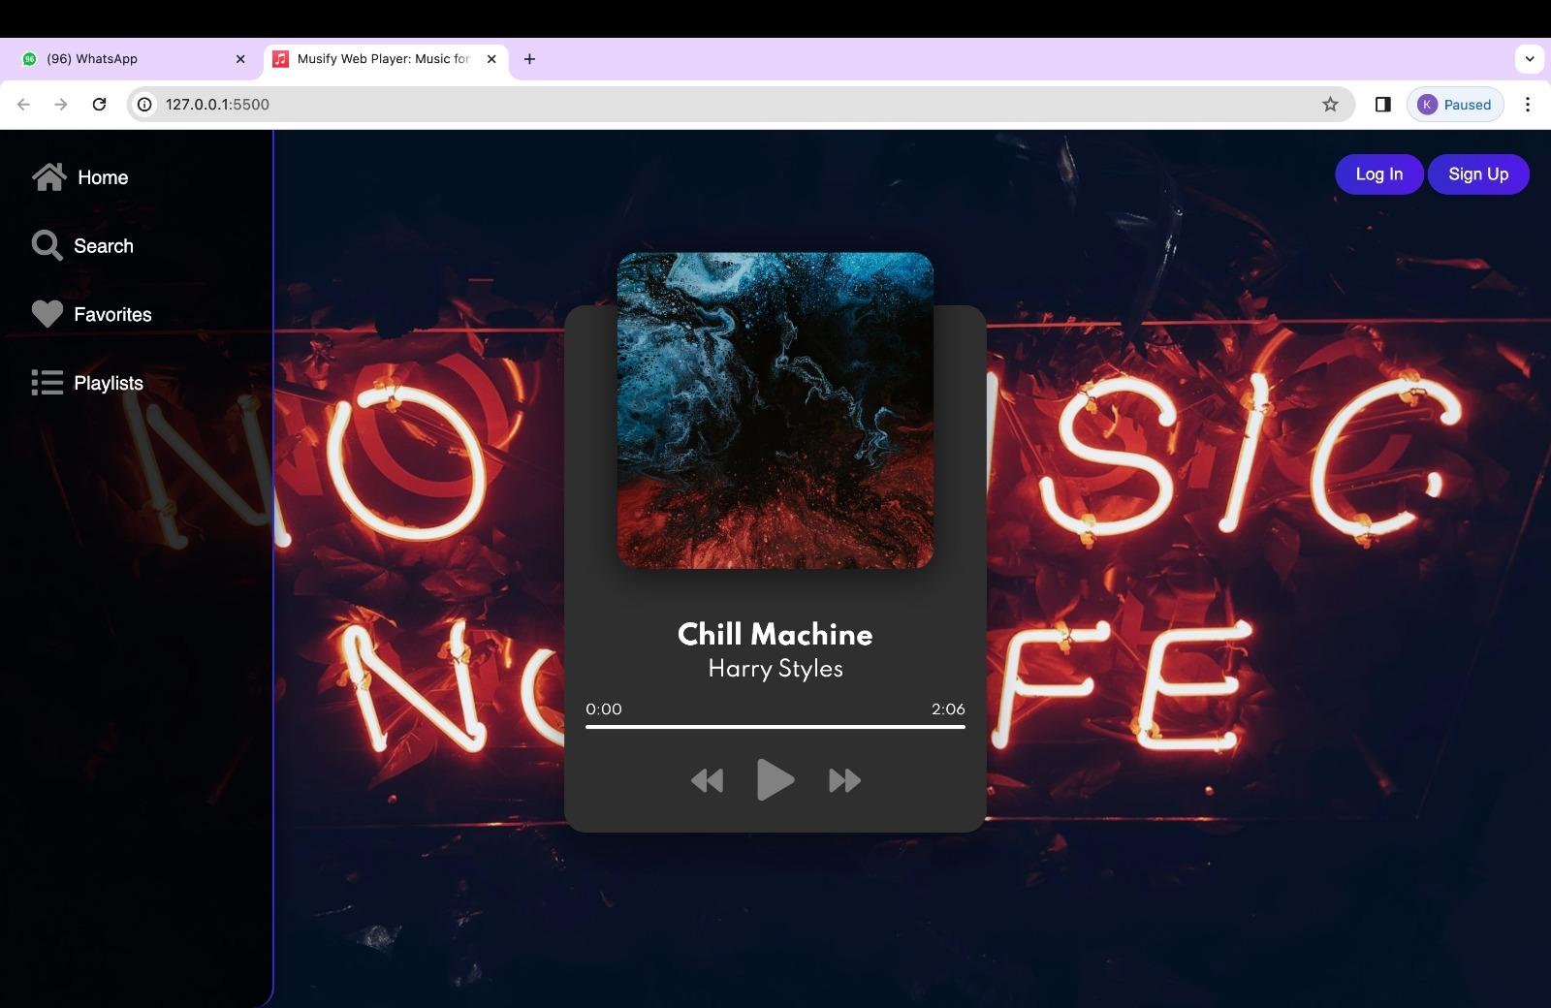
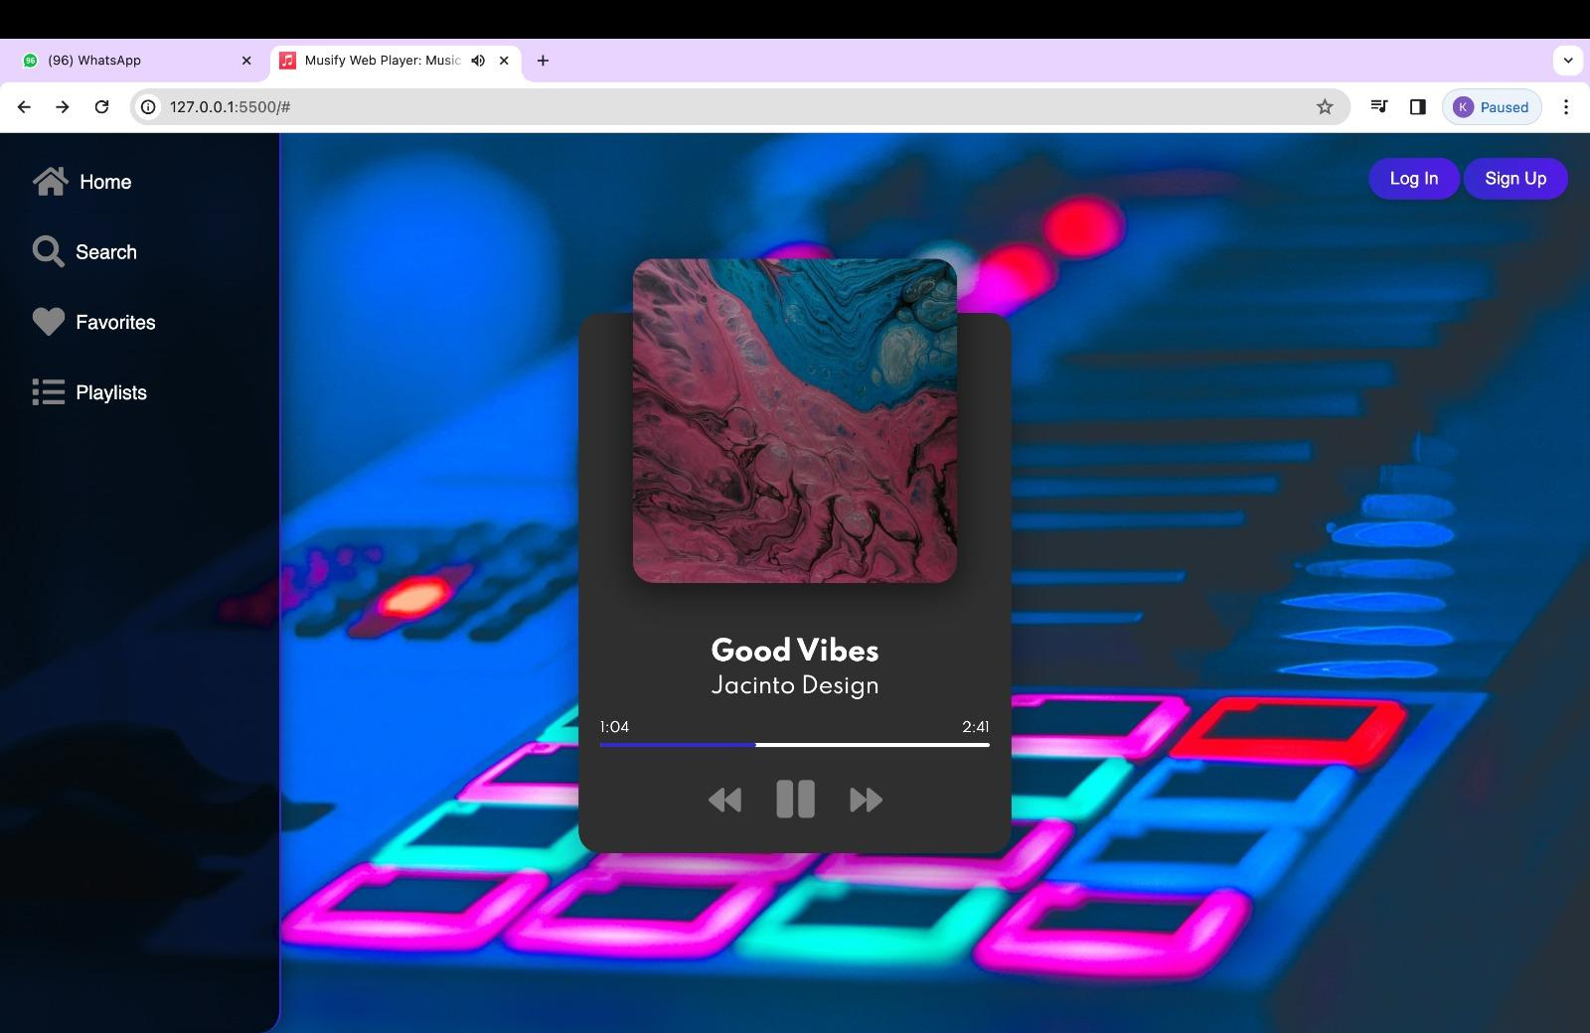
OUTPUT

Slide 14
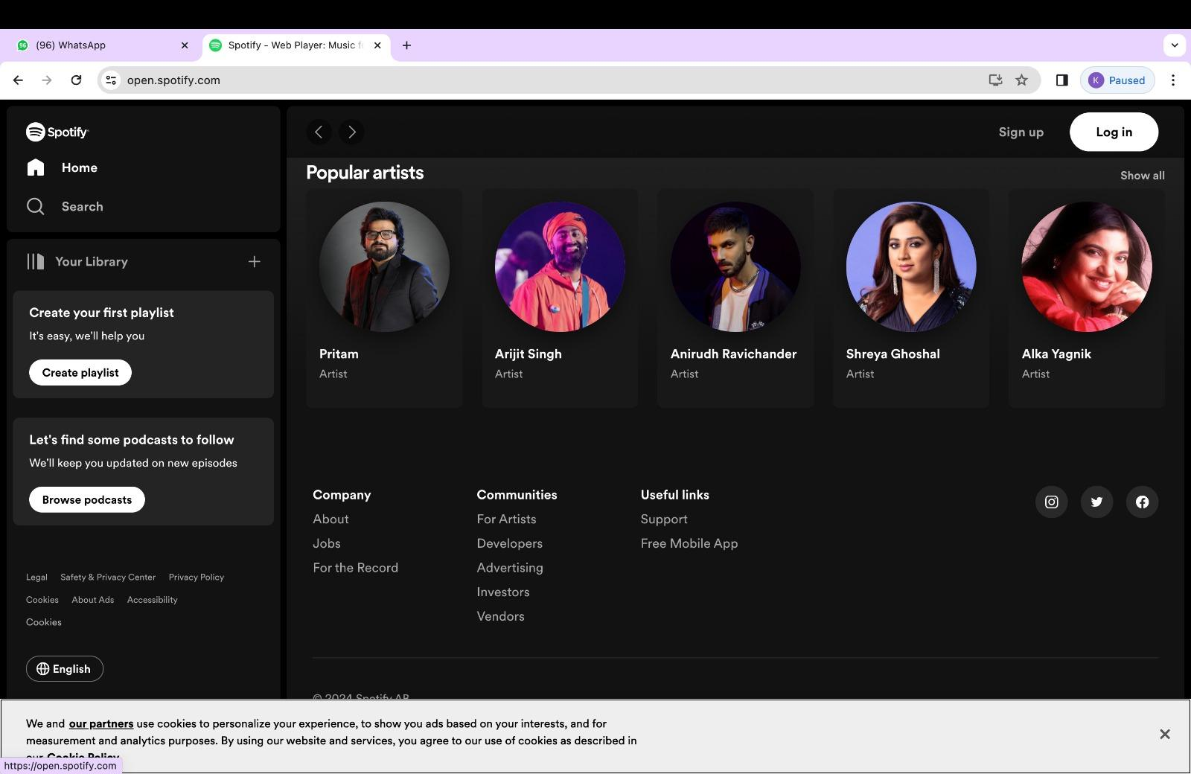

Slide 15
CONCLUSION
In conclusion, our Spotify clone represents a culmination of innovation, passion for music, and a commitment to delivering an unparalleled user experience. Through meticulous attention to detail, cutting-edge technologies, and a deep understanding of user needs, we have created a platform that transcends the boundaries of traditional music streaming services.
Our vision extends beyond mere entertainment; it is a testament to the enduring power of music to unite people across cultures, generations, and borders.
By addressing the challenges and limitations present in existing platforms, our app offers a transformative music listening experience characterized by personalized recommendations, high-fidelity audio streaming, robust social integration, and seamless offline access

Slide 16



REFERENCES
W3SCHOOLS
CHAT GPT
WIKIPEDIA

Slide 17


