Slide 1
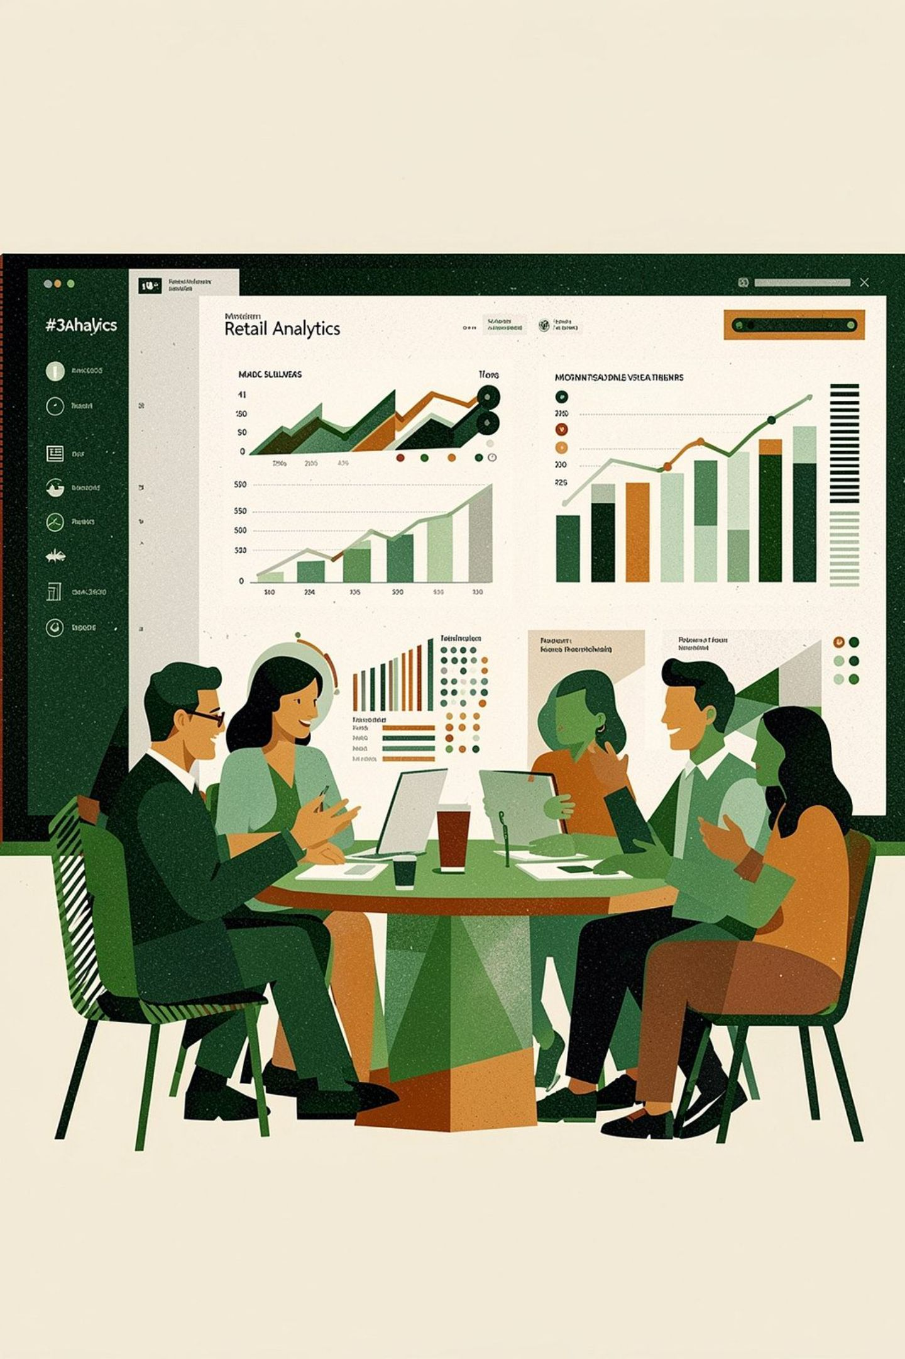
Customer Shopping Behavior Analysis
3,900 transactions · 18 columns · goal: uncover spending, segments, preferences, subscriptions

Slide 2
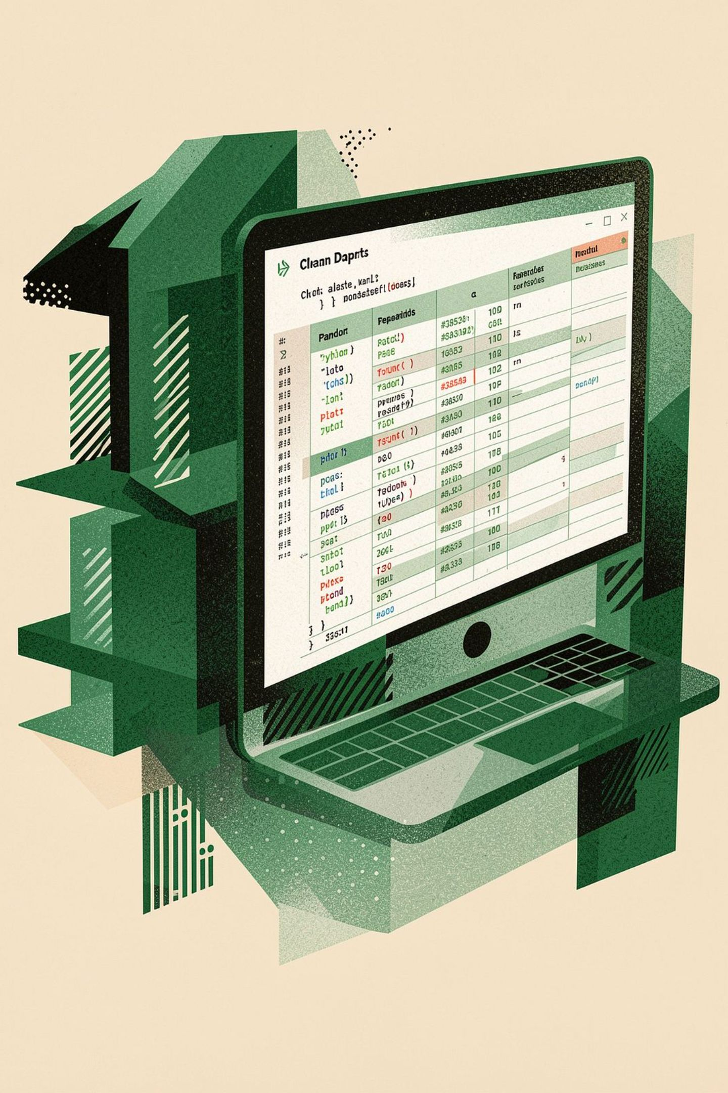
Dataset & Prep
Size
Key Features
Missing Data
Rows: 3,900 · Columns: 18
Demographics, purchase details, behavior, shipping, discounts
37 nulls in Review Rating → imputed by category median

Slide 3

Python EDA Highlights
Loaded with pandas; df.info() & describe()
Renamed columns to snake_case
Engineered age_group and purchase_frequency_days
Dropped promo_code_used (redundant with discount_applied)

Slide 4

Database Integration & SQL
Cleaned DataFrame loaded into PostgreSQL for transactional analysis and queries

Slide 5
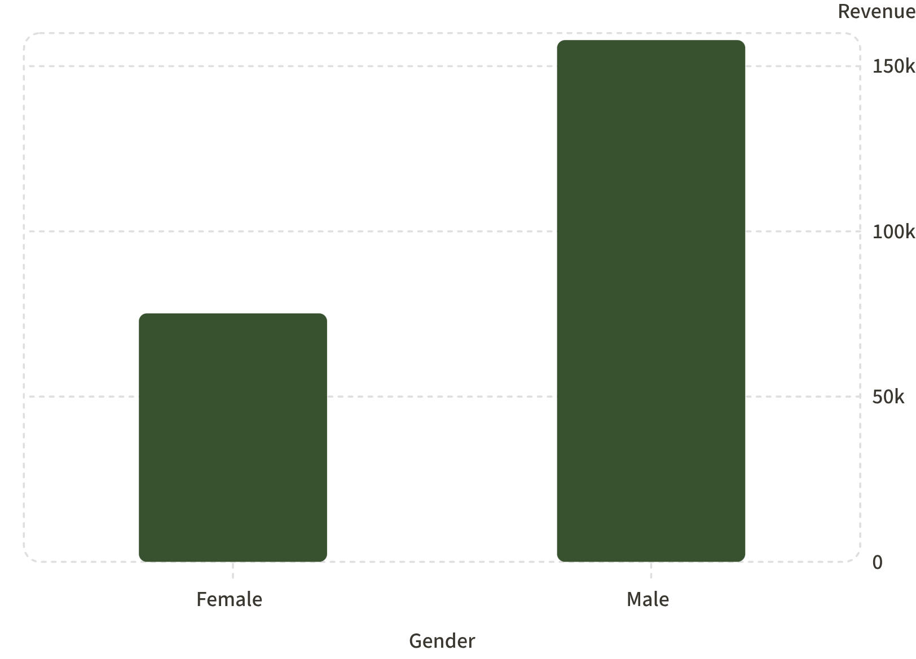

Revenue by Gender
Male revenue is higher in this sample
Use targeted offers by gender where appropriate

Slide 6
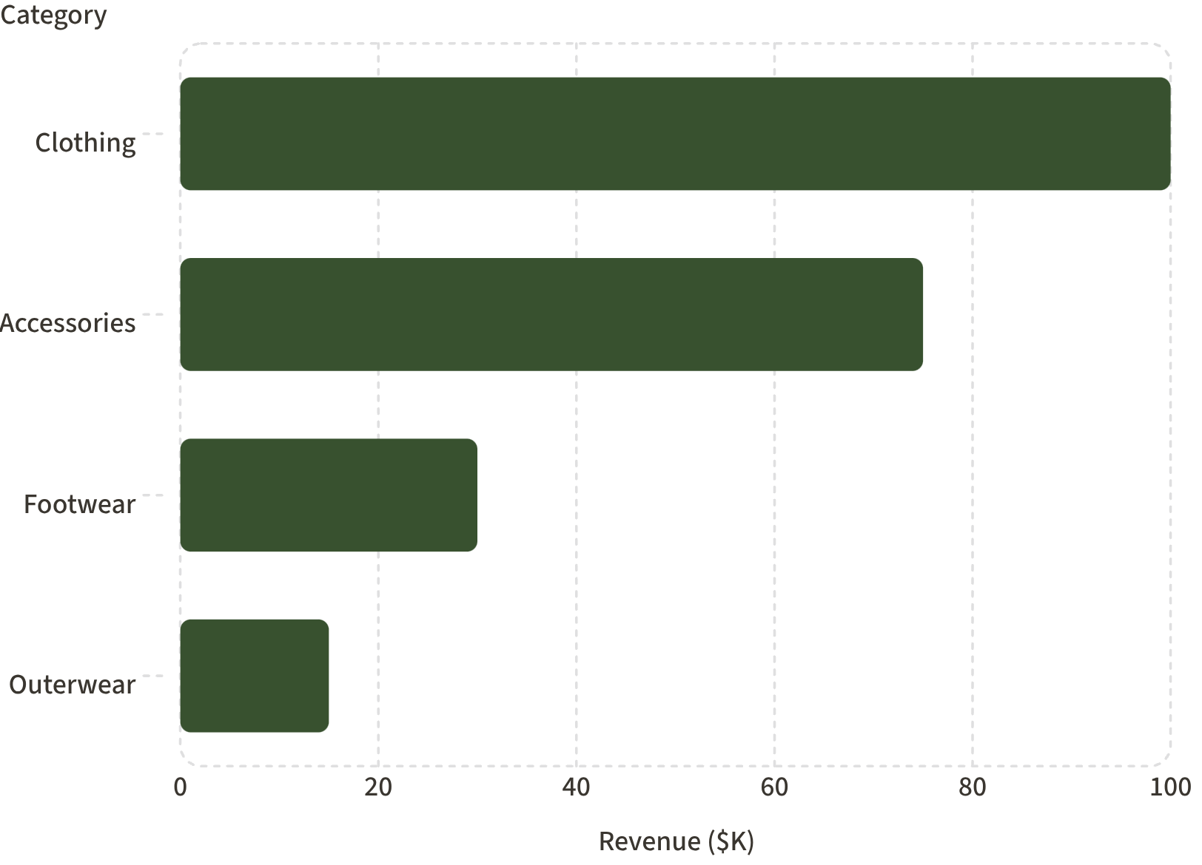
Category Performance
Top revenue: Clothing (≈100K)
Top sales volume: Clothing (~1,800 orders)
Focus: promote Accessories & Footwear to lift growth

Slide 7

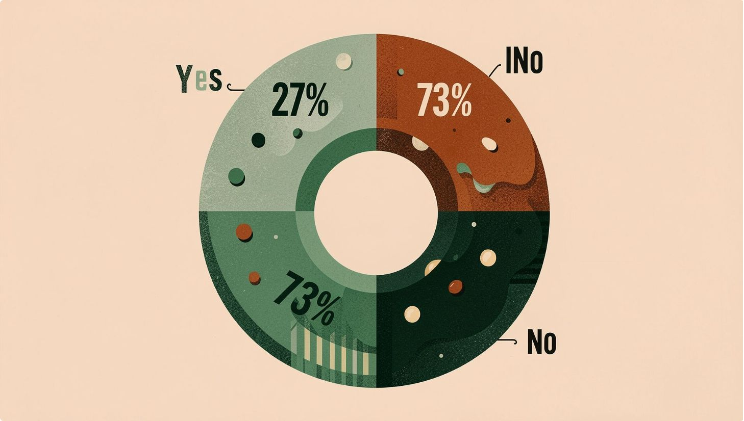


Subscriptions & Segments
Loyal Customers
3,116 customers — primary target for rewards
New
83 customers — onboarding opportunities
Returning
701 customers — convert to loyal
Subscription split: Yes 27% · No 73%

Slide 8
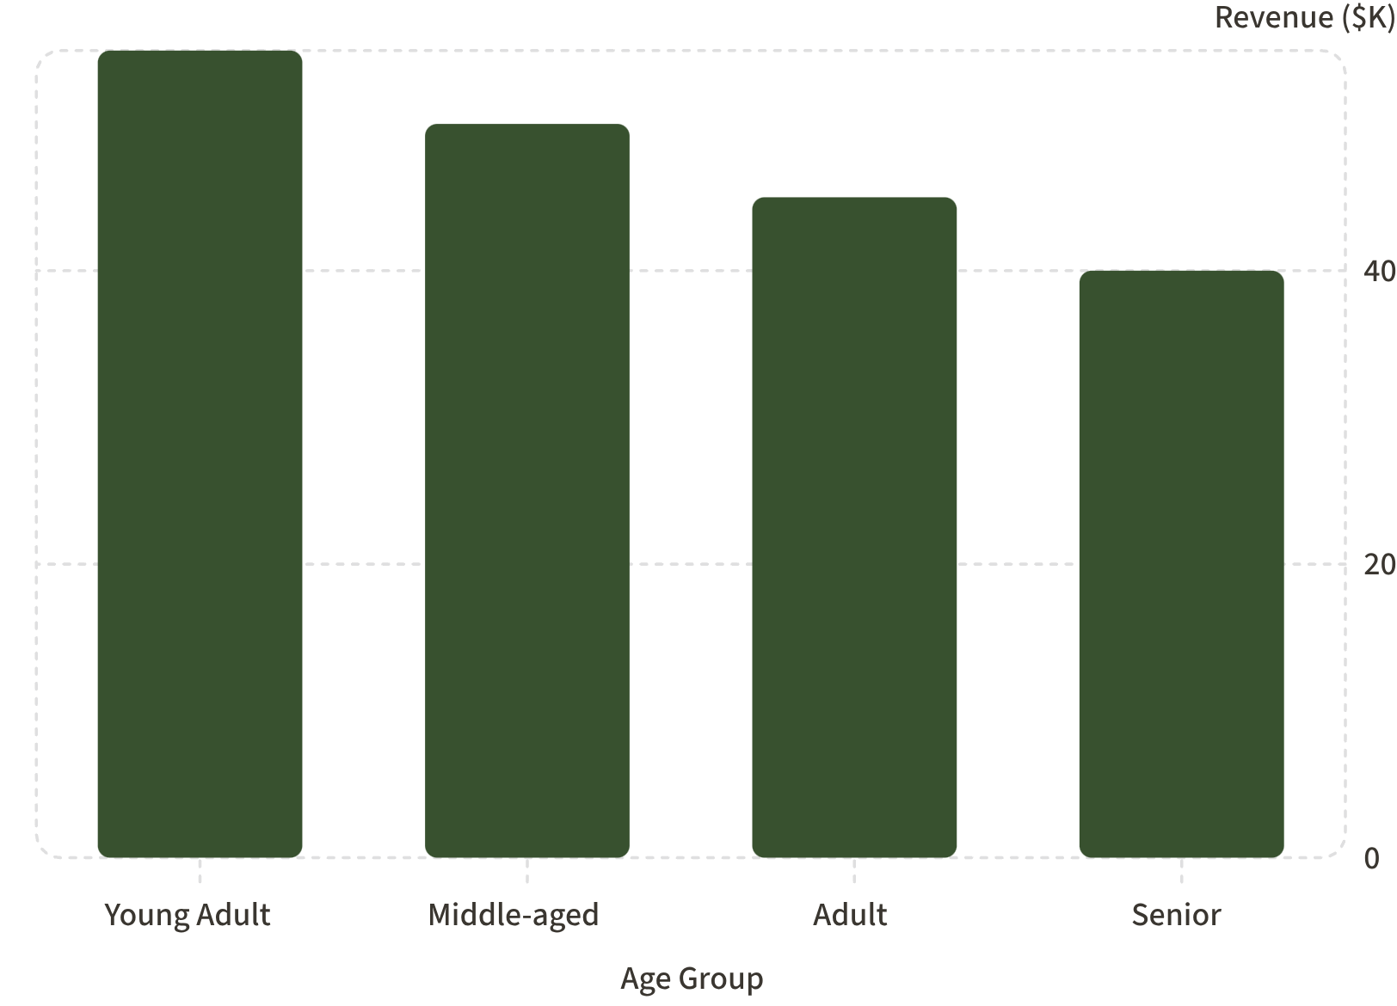
Age Group Revenue
Highest revenue: Young Adults (≈55K)
Strategy: prioritize campaigns for Young Adult & Middle-aged groups

Slide 9
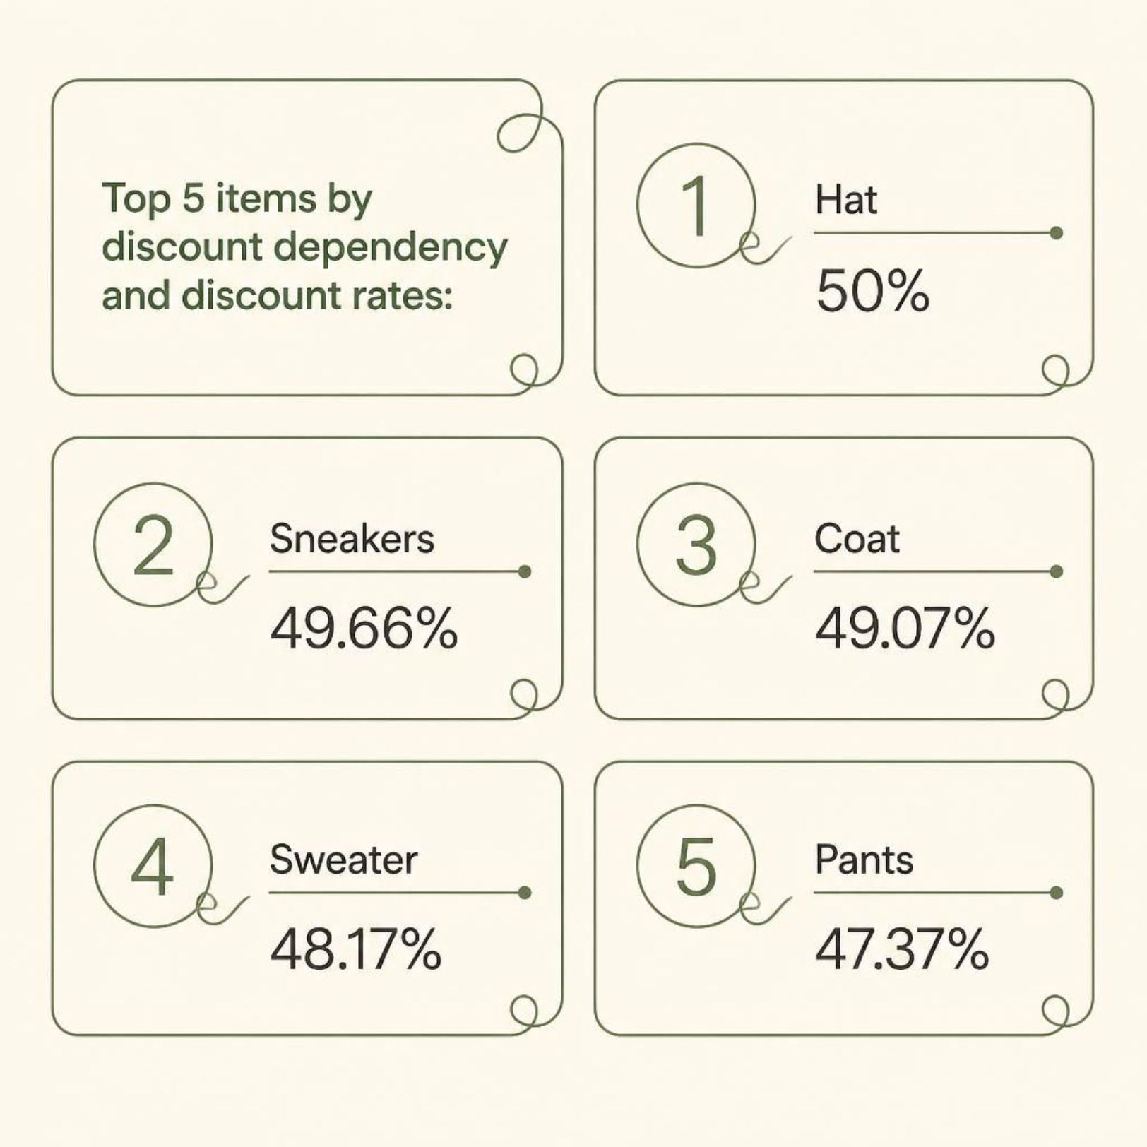
Discount-Dependent Products
High discount rates may erode margins.
Action
Opportunity
Review discount policy for Hats, Sneakers, Coats, Sweaters, Pants
Promote top-rated items (Gloves, Sandals, Boots) with limited discounts

Slide 10
Business Recommendations
Boost Subscriptions
Loyalty Programs
Review Discounts
Exclusive benefits to increase conversion
Reward repeat buyers to grow 'Loyal' segment
Balance promotions with margin control on discount-dependent items
Product Positioning
Targeted Marketing
Highlight top-rated & best-selling products
Focus on high-revenue age groups & express-shipping customers

