Slide 1
NAME: Khushi Bharat Jain UID: 2021700030 BRANCH: CSE-DS EXPERIMENT NO: 3
AIM: Design Interactive Dashboards and Storytelling using Tableau to be performed on the dataset - Disease spread / Healthcare
Link to tableau public:
https://public.tableau.com/app/profile/khushi.jain4331/viz/khushi_jain_adv_exp3/Story1

Slide 2
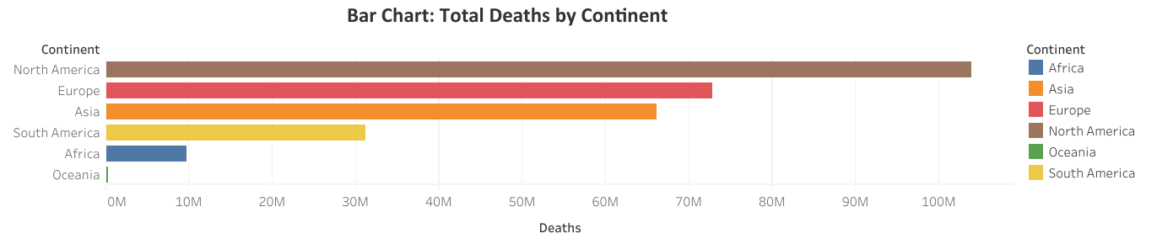
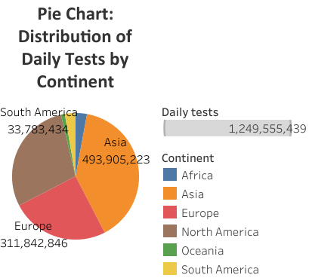
Question Answered:
How do the total deaths from COVID-19 compare across different countries?
Observation:
The chart reveals disparities in death counts across continents.
Europe or the Americas have significantly higher total deaths compared to others like Oceania or Africa.
These differences could reflect the population size, healthcare infrastructure or pandemic response
Question Answered:
What is the proportion of daily COVID-19 tests conducted by continent?
Observation:
The pie chart shows the share of daily tests performed in each continent.
Asia and Europe have performed more daily tests compared to others.
This might reflect differences in testing infrastructure, population size, or outbreak severity.

Slide 3
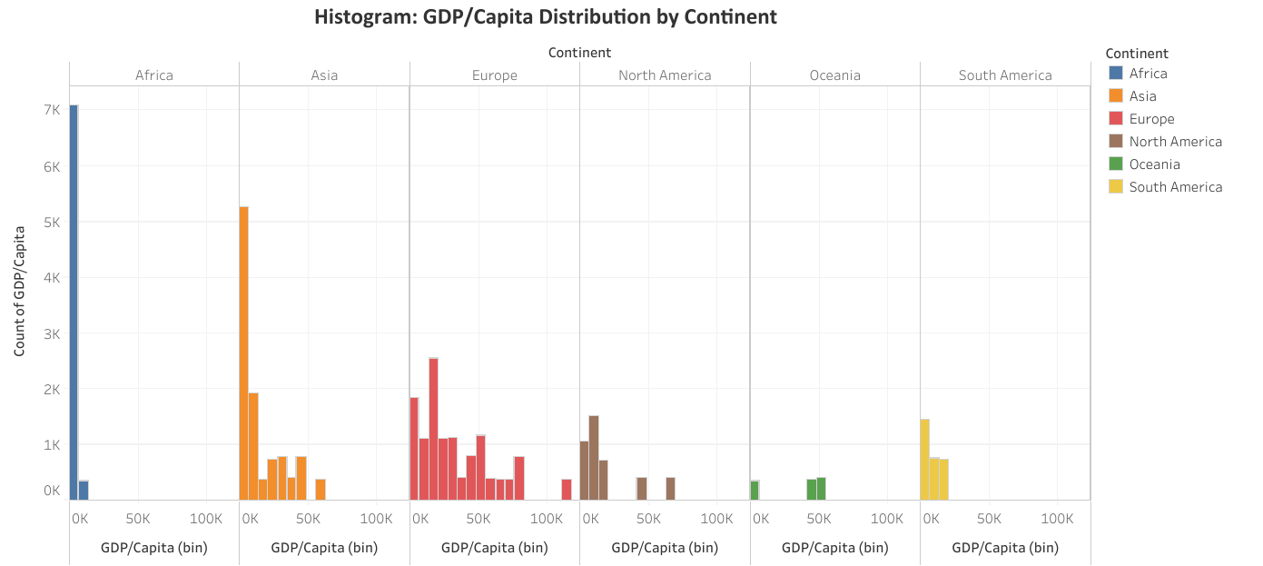
Question Answered:
How is GDP per capita distributed across different continents?
Observation:
The histogram can show if the GDP per capita values are skewed or normally distributed in different continents.
For example, a continent like Europe have a tighter cluster of high GDP per capita, while Africa is skewed towards the lower end.

Slide 4
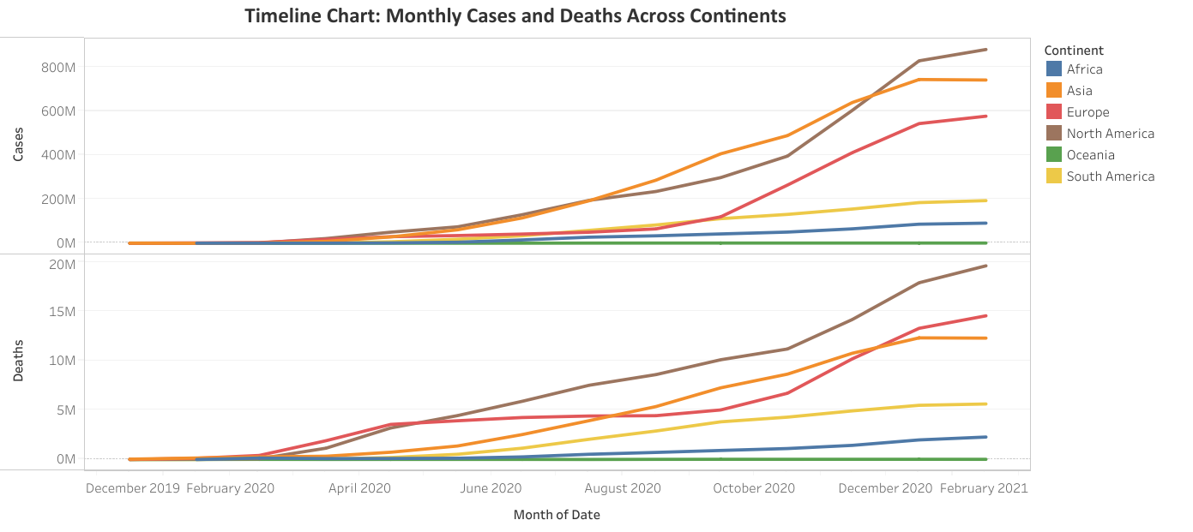
Question Answered:
How have COVID-19 cases and deaths trended over time across continents?
Observation:
This chart can illustrates patterns in the pandemic's spread.
For example, North America has most cases and deaths.
Asia has more cases but Europe over time has more deaths.
Africa and Oceania has low cases and deaths.

Slide 5
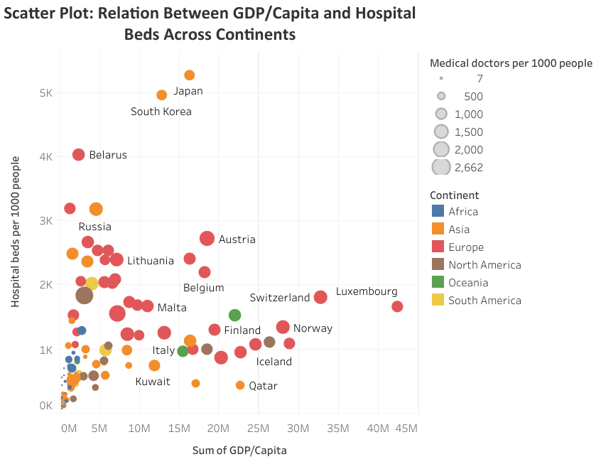
Question Answered:
What is the relationship between GDP per capita and hospital beds per 1000 people across different continents?
Observation:
The scatter plot might reveal that countries with higher GDP per capita also tend to have more hospital beds per 1000 people, suggesting better healthcare infrastructure.
However, outliers show that this isn’t always the case, as some lower-income countries might have relatively more hospital beds or vice versa.
For eg Japan and South Korea has comparatively lower GDP/Capita but have the highest Hospital beds per 1000 people whereas Luxembourg having highest GDP/Capita has low Hospital beds per 1000 people.

Slide 6
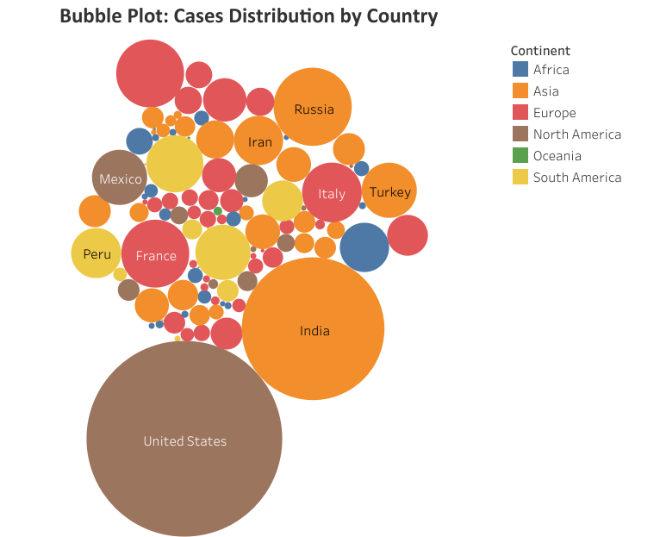
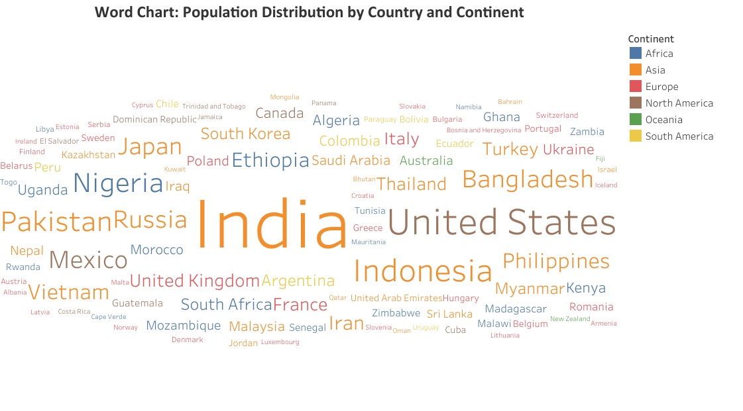
Question Answered:
How do COVID-19 case numbers compare across countries, and what is the regional distribution?
Observation:
Larger bubbles represent countries with higher case numbers.
You can observe the distribution of cases geographically by continent.
For example, countries like the U.S., India, have large bubbles, indicating high case numbers, while smaller countries or regions may have much smaller bubbles.
Question Answered:
Which countries have the largest populations, and how are they distributed across continents?
Observation:
The size of each country’s name reflects its population size.
Larger names like India suggest significant population sizes, while smaller names like Cuba, Fiji reflect smaller populations.
The color coding by continent highlights regional population distribution.

Slide 7
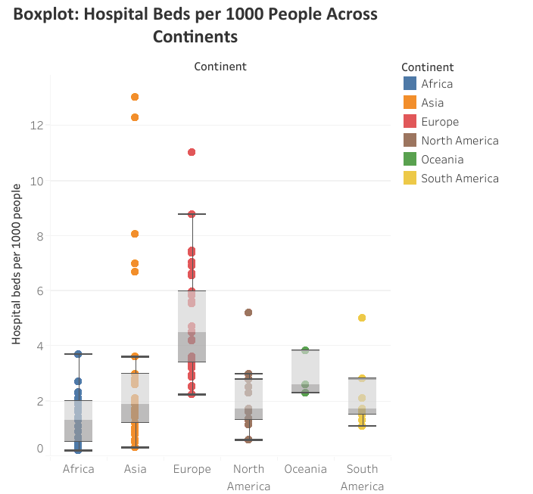
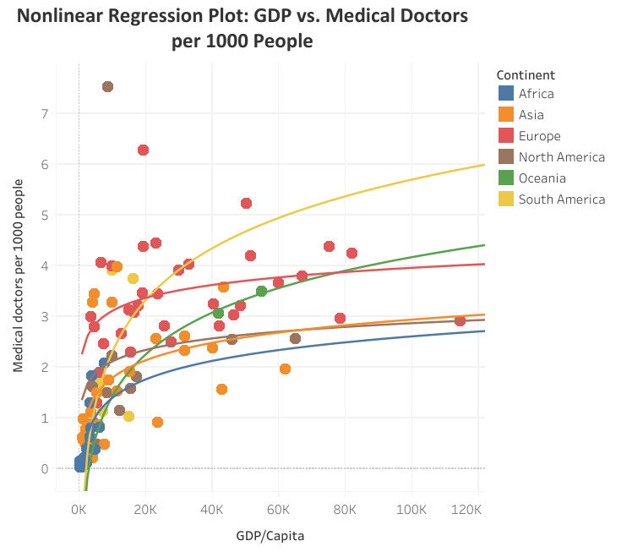
Question Answered:
What is the relationship between GDP/capita and the number of medical doctors per 1000 people across different continents?
Observation:
A positive nonlinear trend shows that countries with higher GDP capita tend to have more doctors.
But the logarithmic trendline could show diminishing returns: wealthier countries don’t always have a proportionally higher number of doctors.
Eg Europe has less returns than South America which has a lower GDP
Question Answered:
How do hospital beds per 1000 people vary across continents?
Observation:
This chart helps reveal the range, median, and spread of hospital beds across continents.
For example, Europe have a higher median hospital beds per 1000 people, while Africa has a lower median. This indicates disparities in healthcare infrastructure.

Slide 8
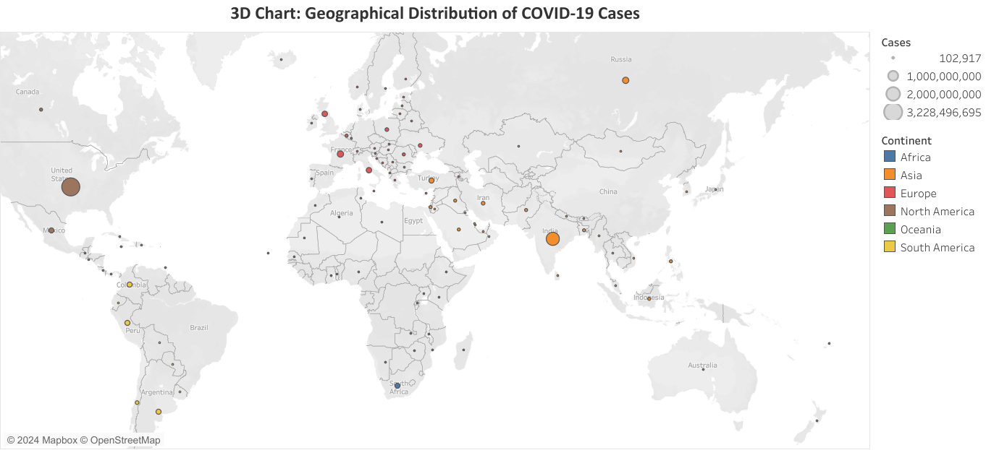
Question Answered:
What is the geographical distribution of COVID-19 cases across countries and continents?
Observation:
The 3D chart provides insights into the global spread of cases.
Continents like Asia and North America have the largest bubbles, indicating higher case numbers in those regions.

Slide 9
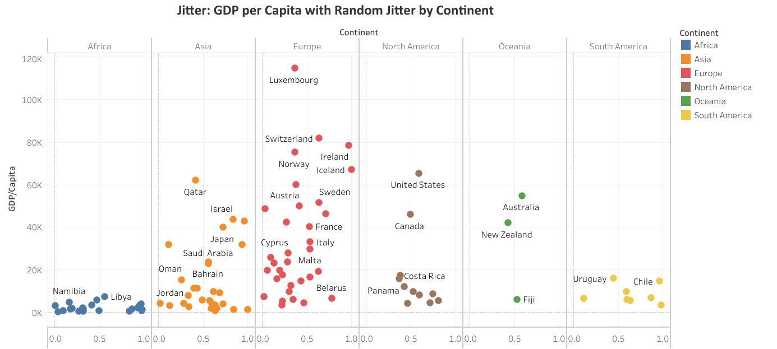
Question Answered:
How is GDP per capita distributed within each continent, with added randomization for better visualization?
Observation:
By using a jitter plot, can avoid data overlapping and better visualize the distribution of GDP per capita across continents.
For example, Europe shows a clustering of countries with high GDP per capita, while Africa displays tight cluster of lower GDP/Capita.
The jitter allows for a clearer view of outliers and clusters within continents.

Slide 10
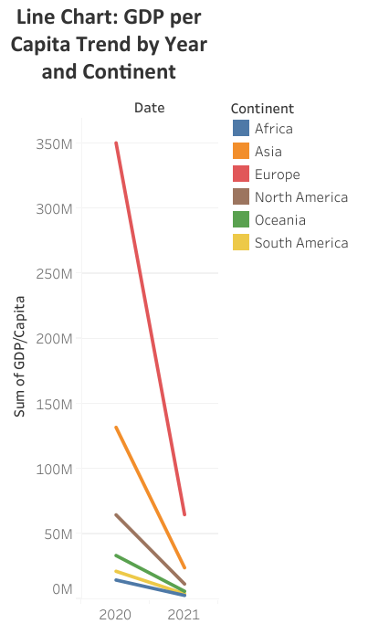
Question Answered:
How has GDP per capita trended over time across different continents?
Observation:
The line chart will shows downward trends in GDP per capita over the years.
For instance, All continents show stagnation or fluctuation due to economic events/COVID-19.
Europe had the highest fall but still its GDP/Capita was greater than other continents

Slide 11
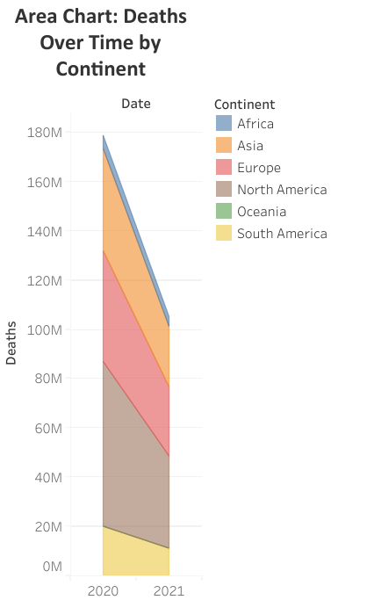
Question Answered:
How have death tolls from COVID-19 changed over time across different continents?
Observation:
This chart can highlight how the death count has evolved across time.
Death count has decreased over the year for all continents
The area chart format allows easy comparison of cumulative deaths over time.

Slide 12
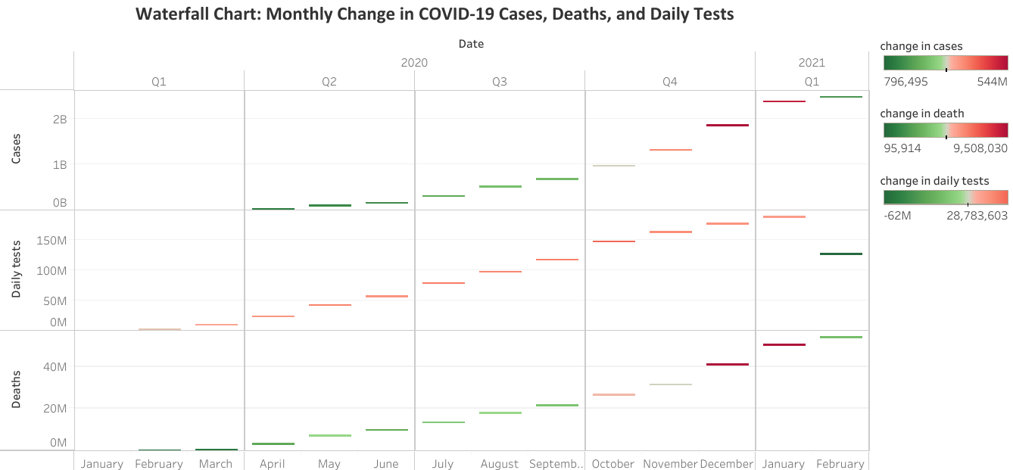
Questions Answered:
How have the COVID-19 cases, daily tests, and deaths changed over time (year, quarter, month)?
Observation:
Cases and Deaths increased significantly in Quarter 4.
Daily Tests reduced in Q1 of 2021 indicating reduction in cases of COVID-19.

Slide 13
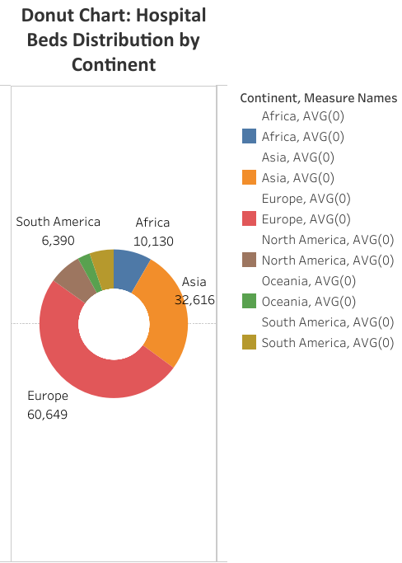
Question Answered:
What is the relative proportion of hospital beds per 1000 people across continents?
Observation:
The donut chart provides a quick visual of which continents have more hospital beds relative to their population size.
Regions like Europe or Asia dominate, indicating stronger healthcare infrastructure, while other regions, such as Africa, occupy smaller portions.

Slide 14
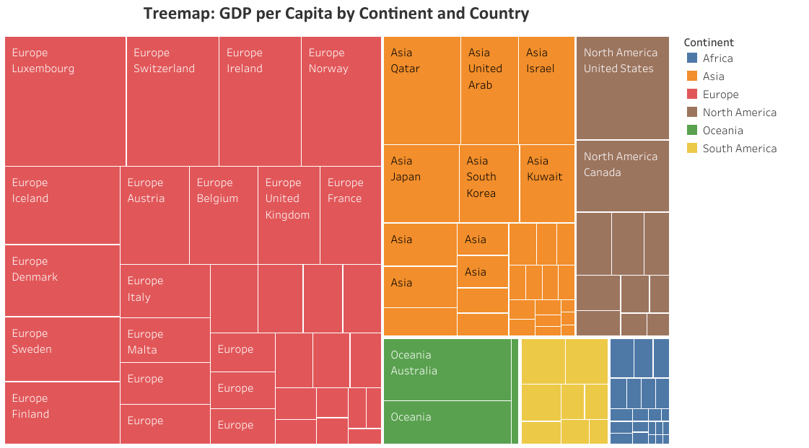
Question Answered:
How is GDP per capita distributed across countries and continents?
Observation:
The treemap provides a proportional representation of GDP per capita across different countries, grouped by continent.
Larger areas represent countries with higher GDP per capita, allowing you to compare the economic power of various countries at a glance.
The colors highlight the continental distribution of wealth.
Europe has highest GDP per Capita and Luxembourg a Country in Europe has the highest GDP per Capita amongst all countries

Slide 15
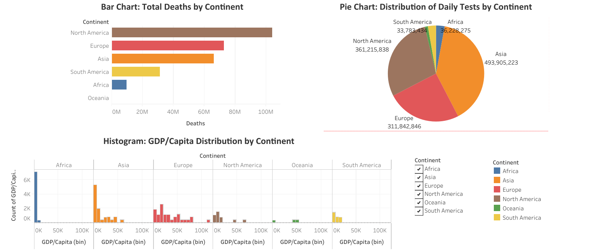
Dashboard 1

Slide 16
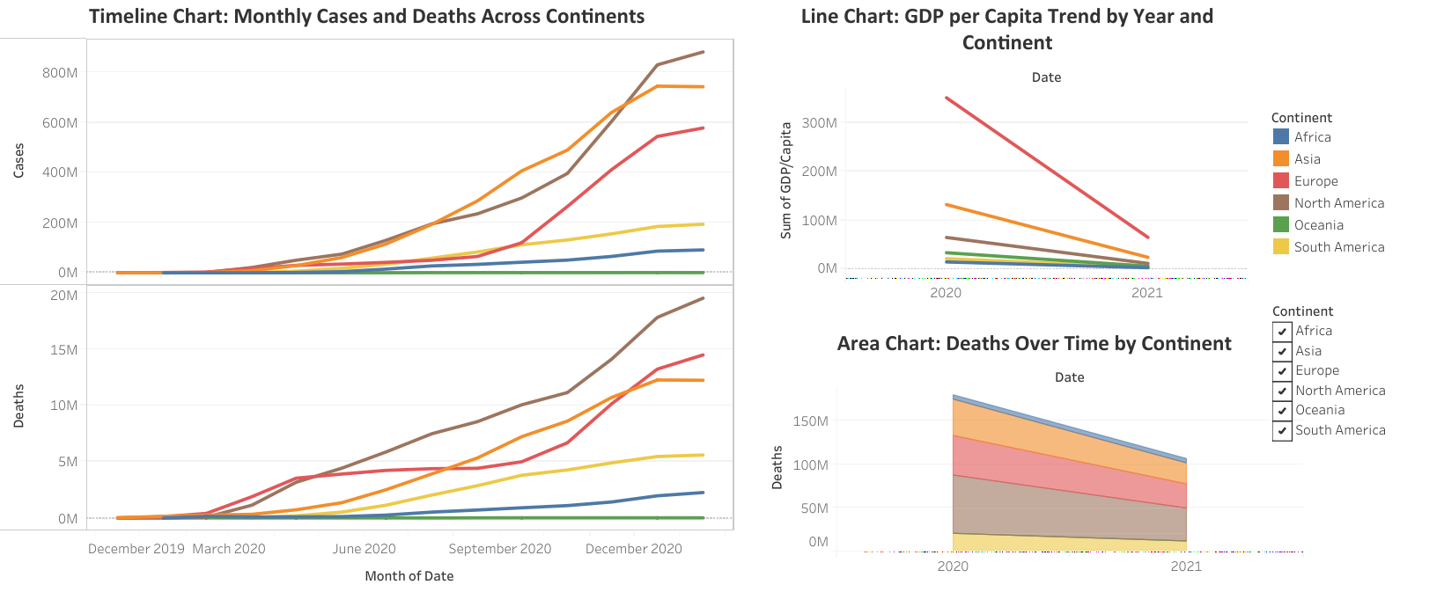
Dashboard 2

Slide 17
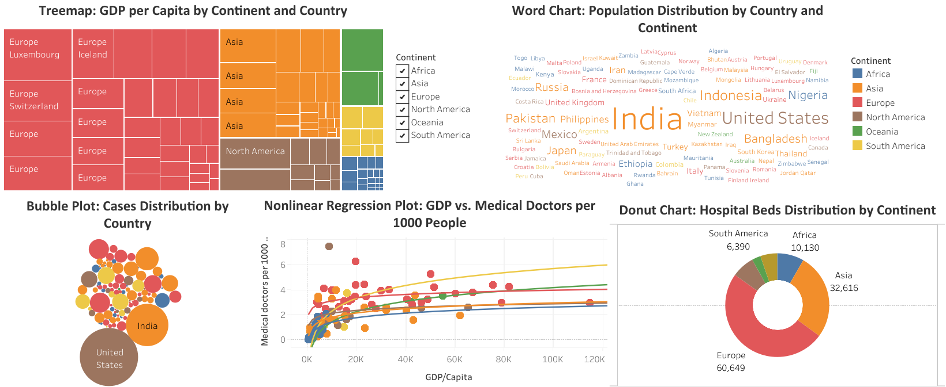
Dashboard 3

Slide 18
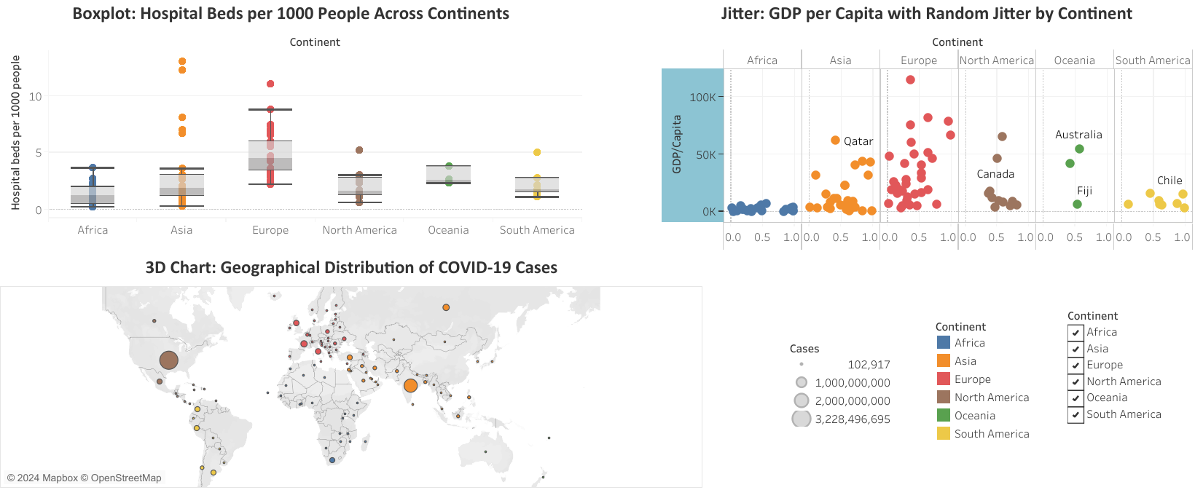
Dashboard 4

Slide 19
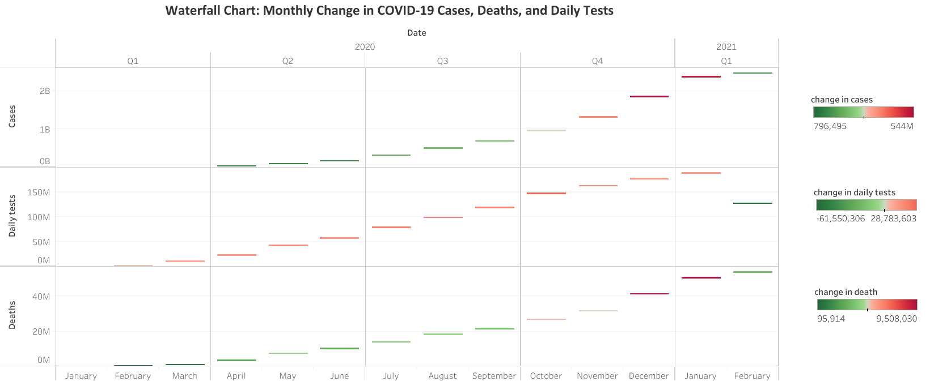
Dashboard 5

Slide 20
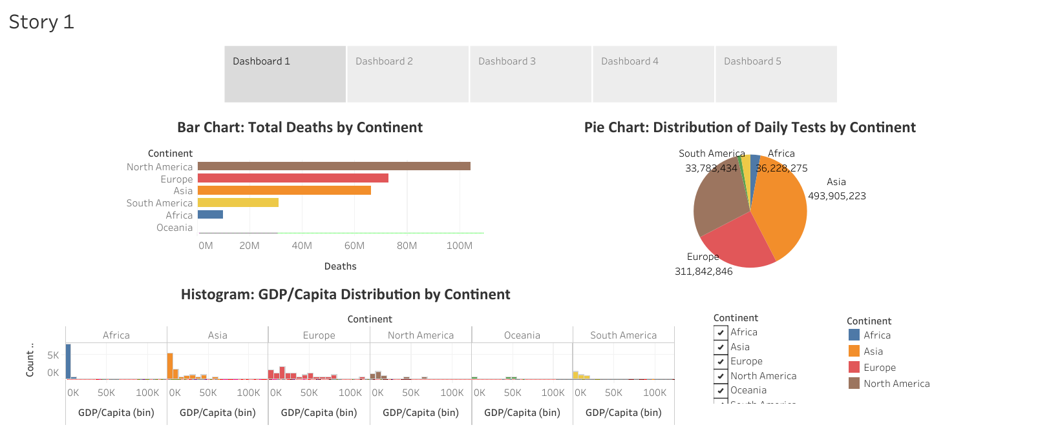
Story

Slide 21
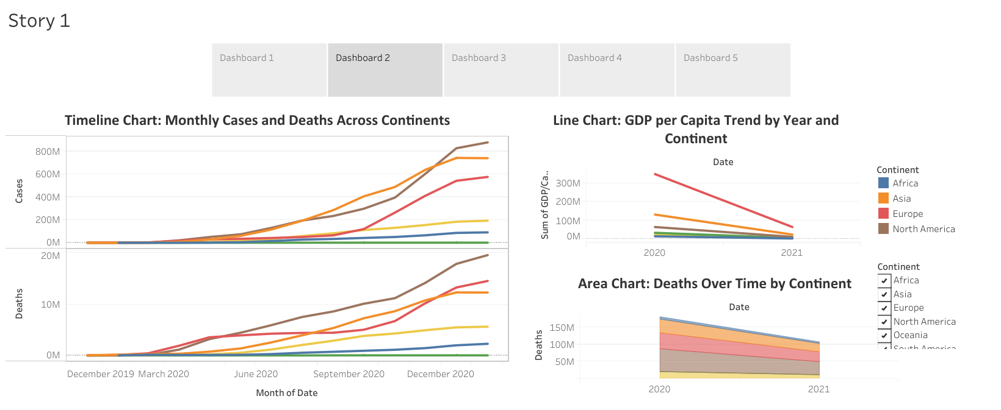

Slide 22
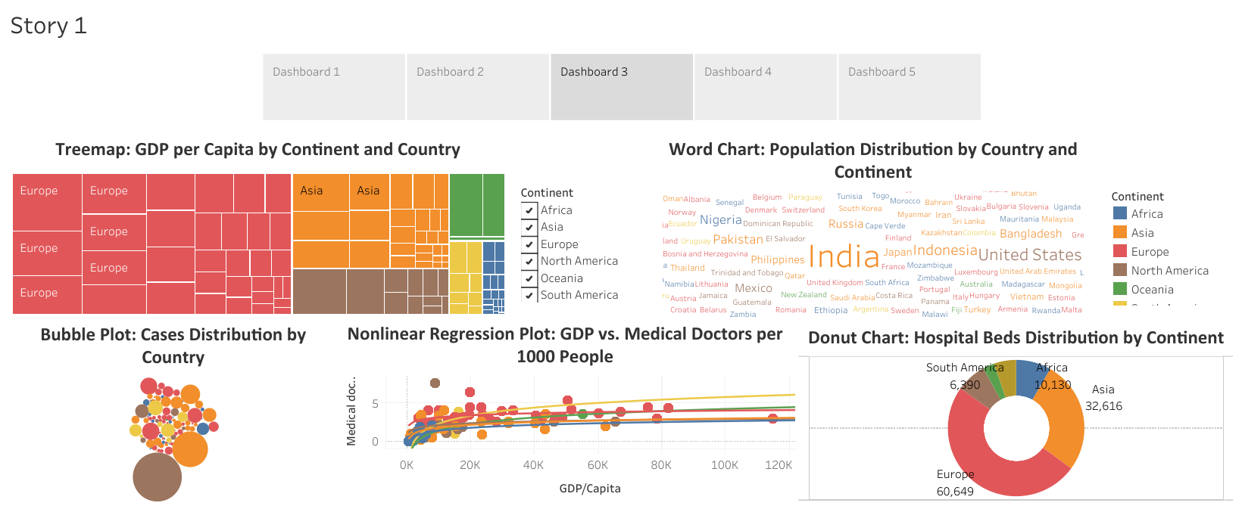

Slide 23
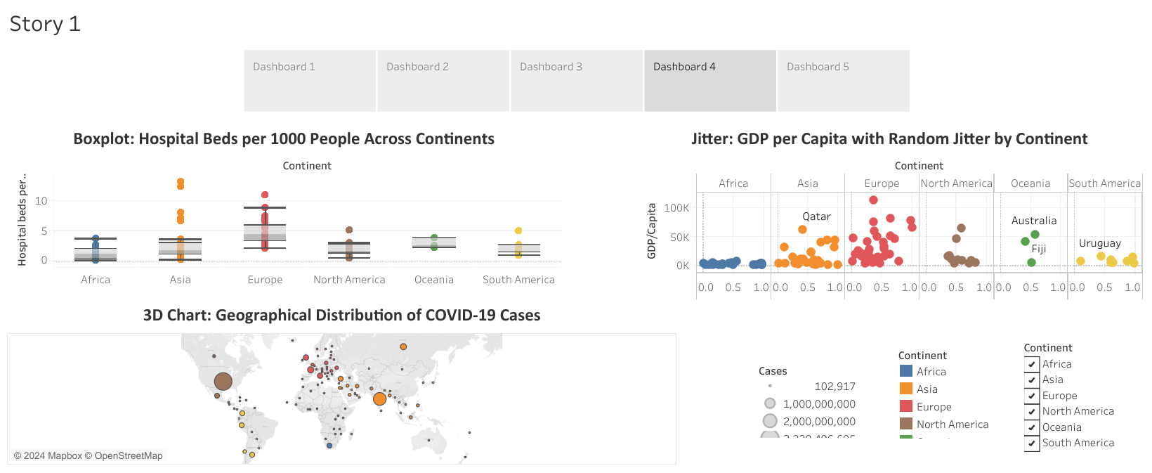

Slide 24
