Slide 1
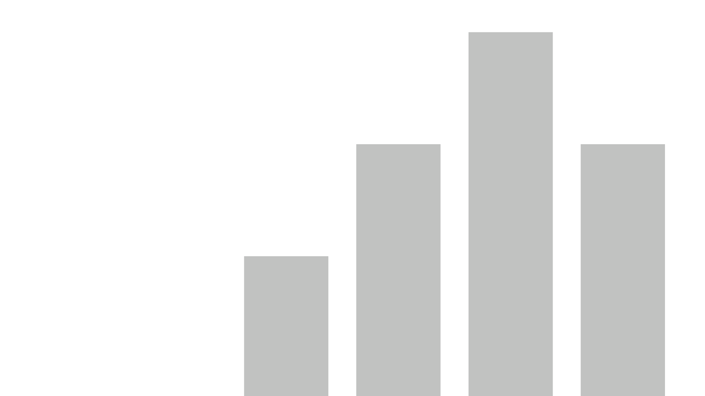


khushi_2021700030_adv6
View in Power BI
Last data refresh:
9/29/2024 4:03:36 PM UTC
Downloaded at:
9/29/2024 4:04:51 PM UTC

Slide 2
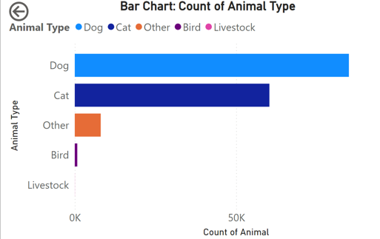
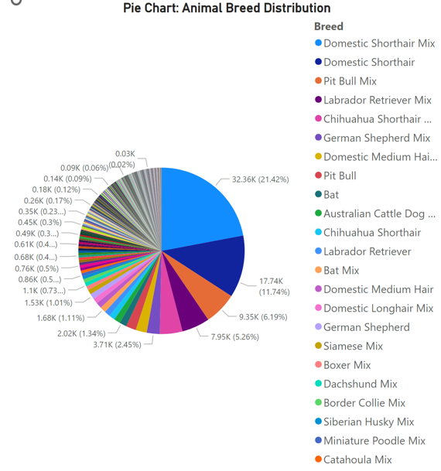
Question Answered:
What is the distribution of different animal types in the dataset?
Observations:
Certain types of animals dominate the dataset (e.g., dogs and cats).
Other animals have significantly lower counts.
Question Answered:
What is the proportion of different breeds in the dataset?
Observations:
The dataset is likely skewed toward a few breeds.
Popular breeds may take up the majority of the pie, while rarer breeds have small slices e.g. Domestic Shorthair Mix

Slide 3
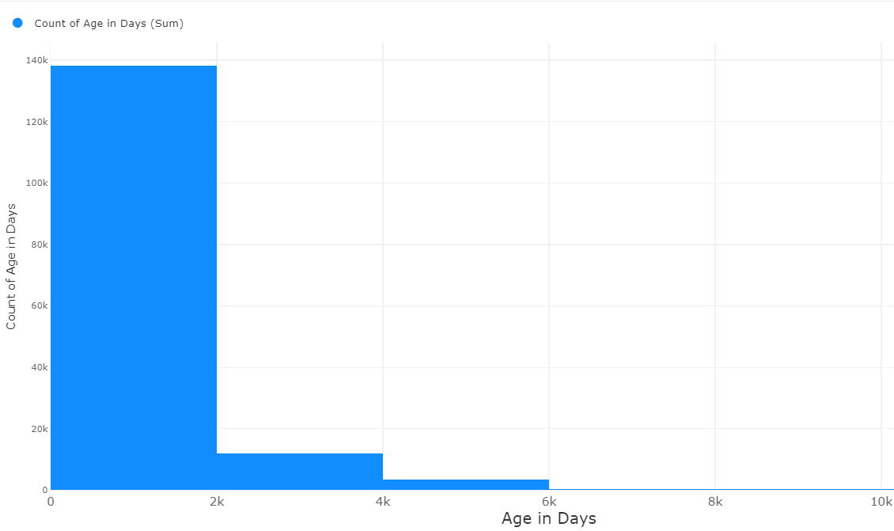
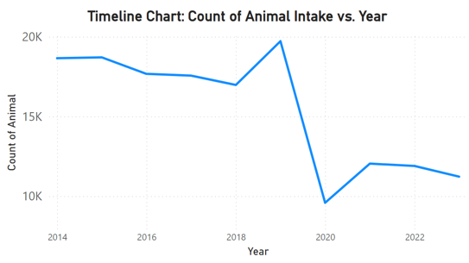
Histogram: Age Distribution at Intake
Question Answered:
What is the age distribution of animals upon intake?
Observations:
There are age clusters, with more animals being taken in at a particular age (e.g., younger animals are more common).
Timeline Chart: Animal Intake over Time
Question Answered:
How has the number of animal intakes changed over the years?
Observations:
There is a decline in intake specifically in 2020, possibly due to covid.

Slide 4
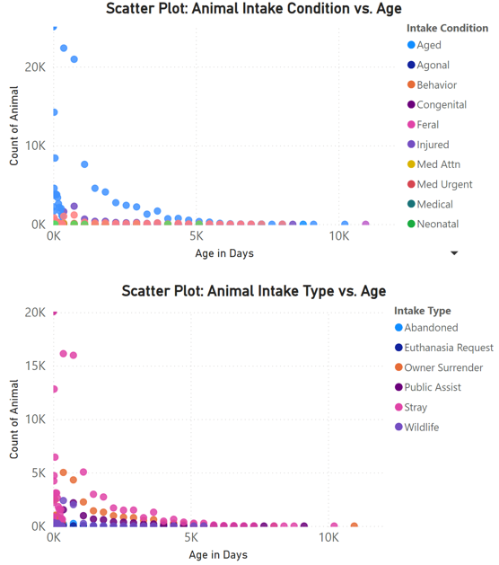
Scatter Plot: Animal Intake Condition vs. Age
Question Answered:
How does the age of animals at intake vary across different intake conditions?
Observations:
The majority of animals appear to be very young (close to 0–500 days old) when brought in under various intake conditions.
Different intake conditions are represented by different colors, making it easier to identify patterns for specific conditions. 'Neonatal' animals are often very young, while 'Aged' animals span a much broader age range.
Scatter Plot: Animal Intake Type vs. Age
Question Answered:
How does the age of animals vary across different intake types?
Observations:
Most animals are very young (close to 0–500 days old) when brought in, regardless of intake type.
'Stray' and 'Owner Surrender' are the most common intake types for younger animals, as seen by the higher concentration of points near the lower end of the age spectrum.

Slide 5
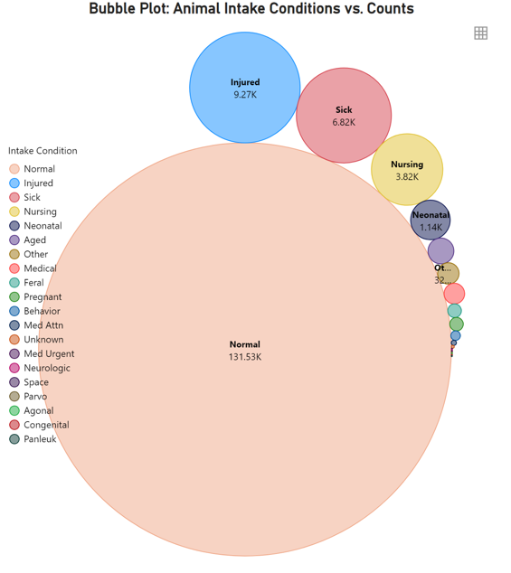
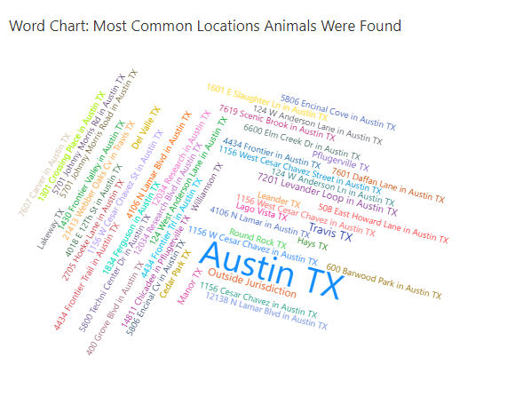
Bubble Plot: Animal Intake Conditions vs. Counts
Question Answered: What are the counts of animals by different intake conditions?
Observations:
Certain conditions have larger bubbles, indicating higher counts.
Normal Animals have the most number of intakes.
Injured and Sick are next with high number of intakes
Word Chart: Most Common Locations Animals Were Found
Question Answered: Where are the most common locations animals were found before intake?
Observations:
Larger words represent locations where animals were found more frequently.
This chart helps identify key hotspots where animals are consistently found, such as particular neighborhoods or public places eg Austin TX
Specific patterns may emerge, such as urban vs. rural areas or proximity to certain landmarks.

Slide 6
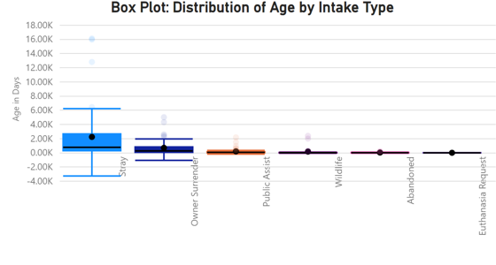
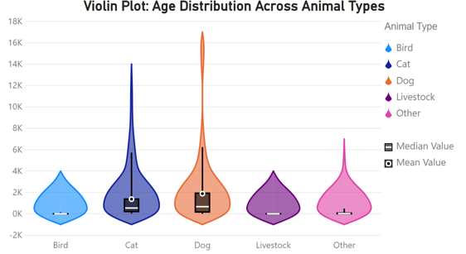
Box Plot: Distribution of Age by Intake Type
Question Answered: How does the age distribution vary across different animal intake types?
Observations:
The graph clearly highlights that 'Stray' animals have a more diverse age range compared to other intake types, where most animals are relatively young.
Violin Plot: Age Distribution Across Animal Types
Question Answered: What is the density of age distribution across different animal types?
Observations:
The shape of the violin plot indicates where ages are concentrated for each animal type.
Some animals have more varied ages upon intake compared to others eg Cat and Dog

Slide 7
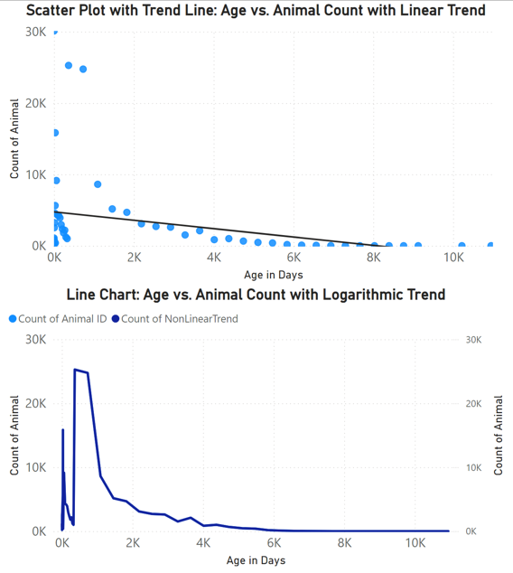
Scatter with Trend Line:Age vs. Animal Count with Nonlinear Trend
Question Answered: What is the linear relationship between age in days and the count of animals?
Observations:
The trend line helps predict future intake patterns based on the age of animals.
Lower aged animals are more likely to be taken in.
Line Chart: Age vs. Animal Count with Logarithmic Trend
Question Answered: How does the animal count change with age, and what does the logarithmic trend show?
Observations:
The trend is logarithmic, indicating that the count decreases nonlinearly with age.
The trend line highlights certain age ranges where intake is particularly high or low. Lower aged animals are more likely to be taken in.
Log Trend fits perfectly that’s why only one (dark blue) line is being seen.

Slide 8
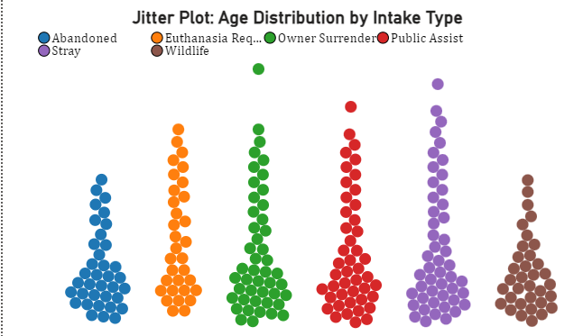
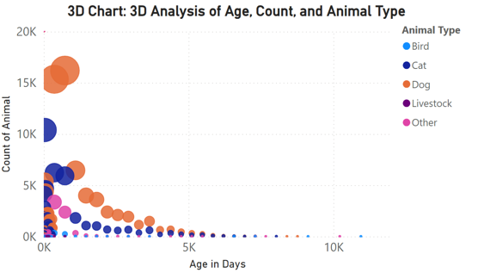
3D Chart: 3D Analysis of Age, Count, and Animal Type
Question Answered: What are the relationships between animal age, count, and animal type in a 3D space?
Observations:
This 3D plot shows how different animal types cluster by age and count.
Larger bubbles represent animal types that are more frequently taken in at certain ages.
Some animals have more varied ages upon intake compared to others eg Cat and Dog
Jitter Plot: Age Distribution by Intake Type
Question Answered: How is the age distributed across intake types with jitter applied?
Observations:
The jitter reveals individual data points, showing more granular insights into how ages vary across different intake types.
All types are clustered on lower end of age.

Slide 9
Next Pages contain how dashboards look:
Purpose of each Dashboard:
Dashboard 1: This dashboard provides insights into animal intake, showing the distribution of animal types, key breeds, and annual intake trends. It highlights the dominance of dogs and cats, as well as fluctuations in intake numbers over the years.
Dashboard 2: This dashboard provides insights into the age distribution of animals at intake, common locations where animals were found, and the conditions in which they were brought in.
Dashboard 3: This dashboard analyzes the relationship between animal intake conditions, types, and their ages. It utilizes scatter plots and trend lines (both linear and logarithmic) to show that the majority of animals are younger at intake, with counts declining as age increases. It helps identify trends in how different conditions and intake types are distributed by age.
Dashboard 4: This dashboard visualizes the distribution of animal age across different intake types and animal categories. It includes box plots, violin plots, jitter plots, and a 3D scatter plot to display trends in age distribution, intake methods, and the relationship between animal count and age. The purpose is to explore and compare patterns in animal intake based on age, intake type, and species.

Slide 10
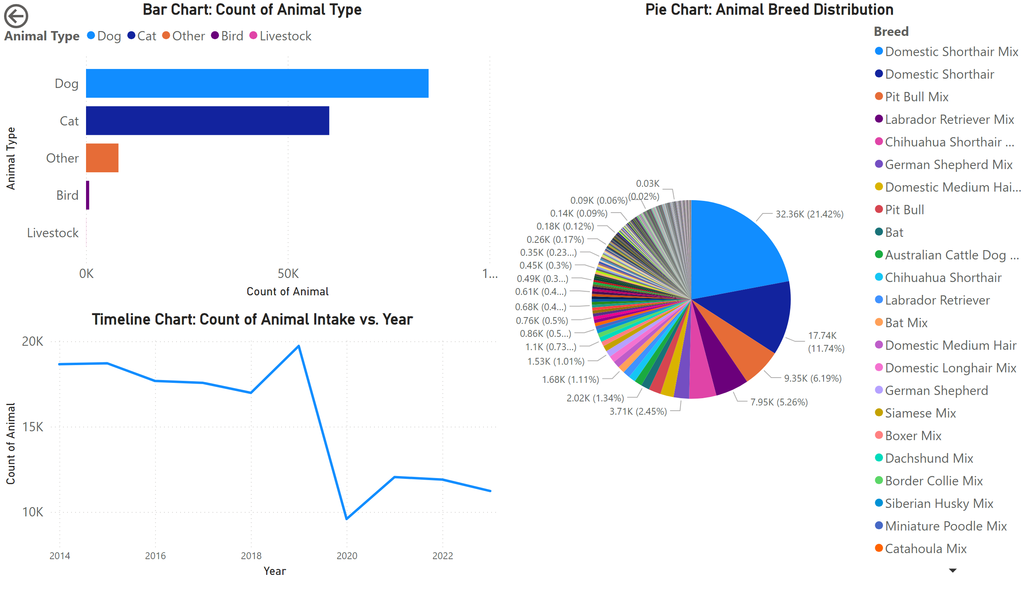
Page 1

Slide 11
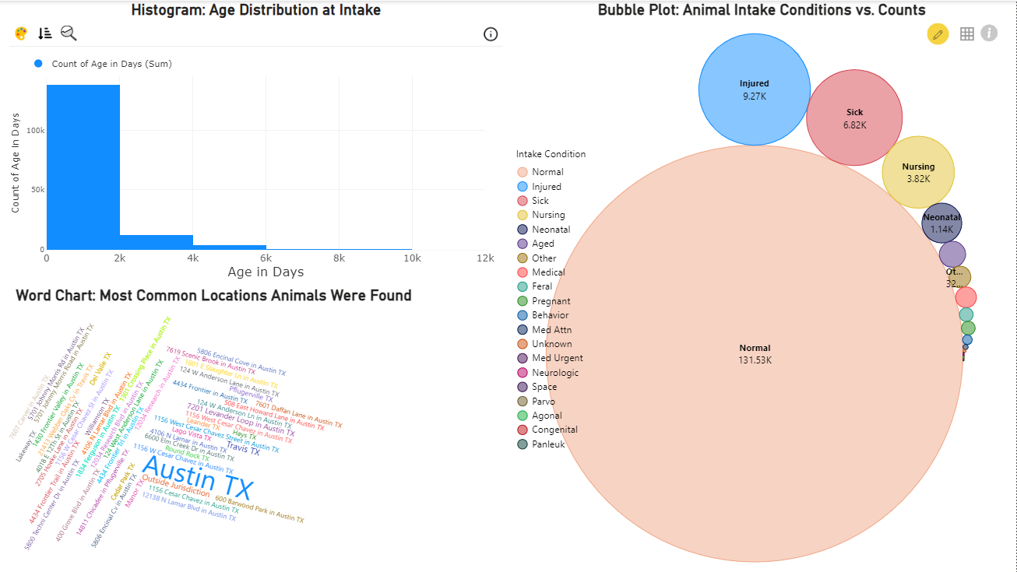
Page 4

Slide 12
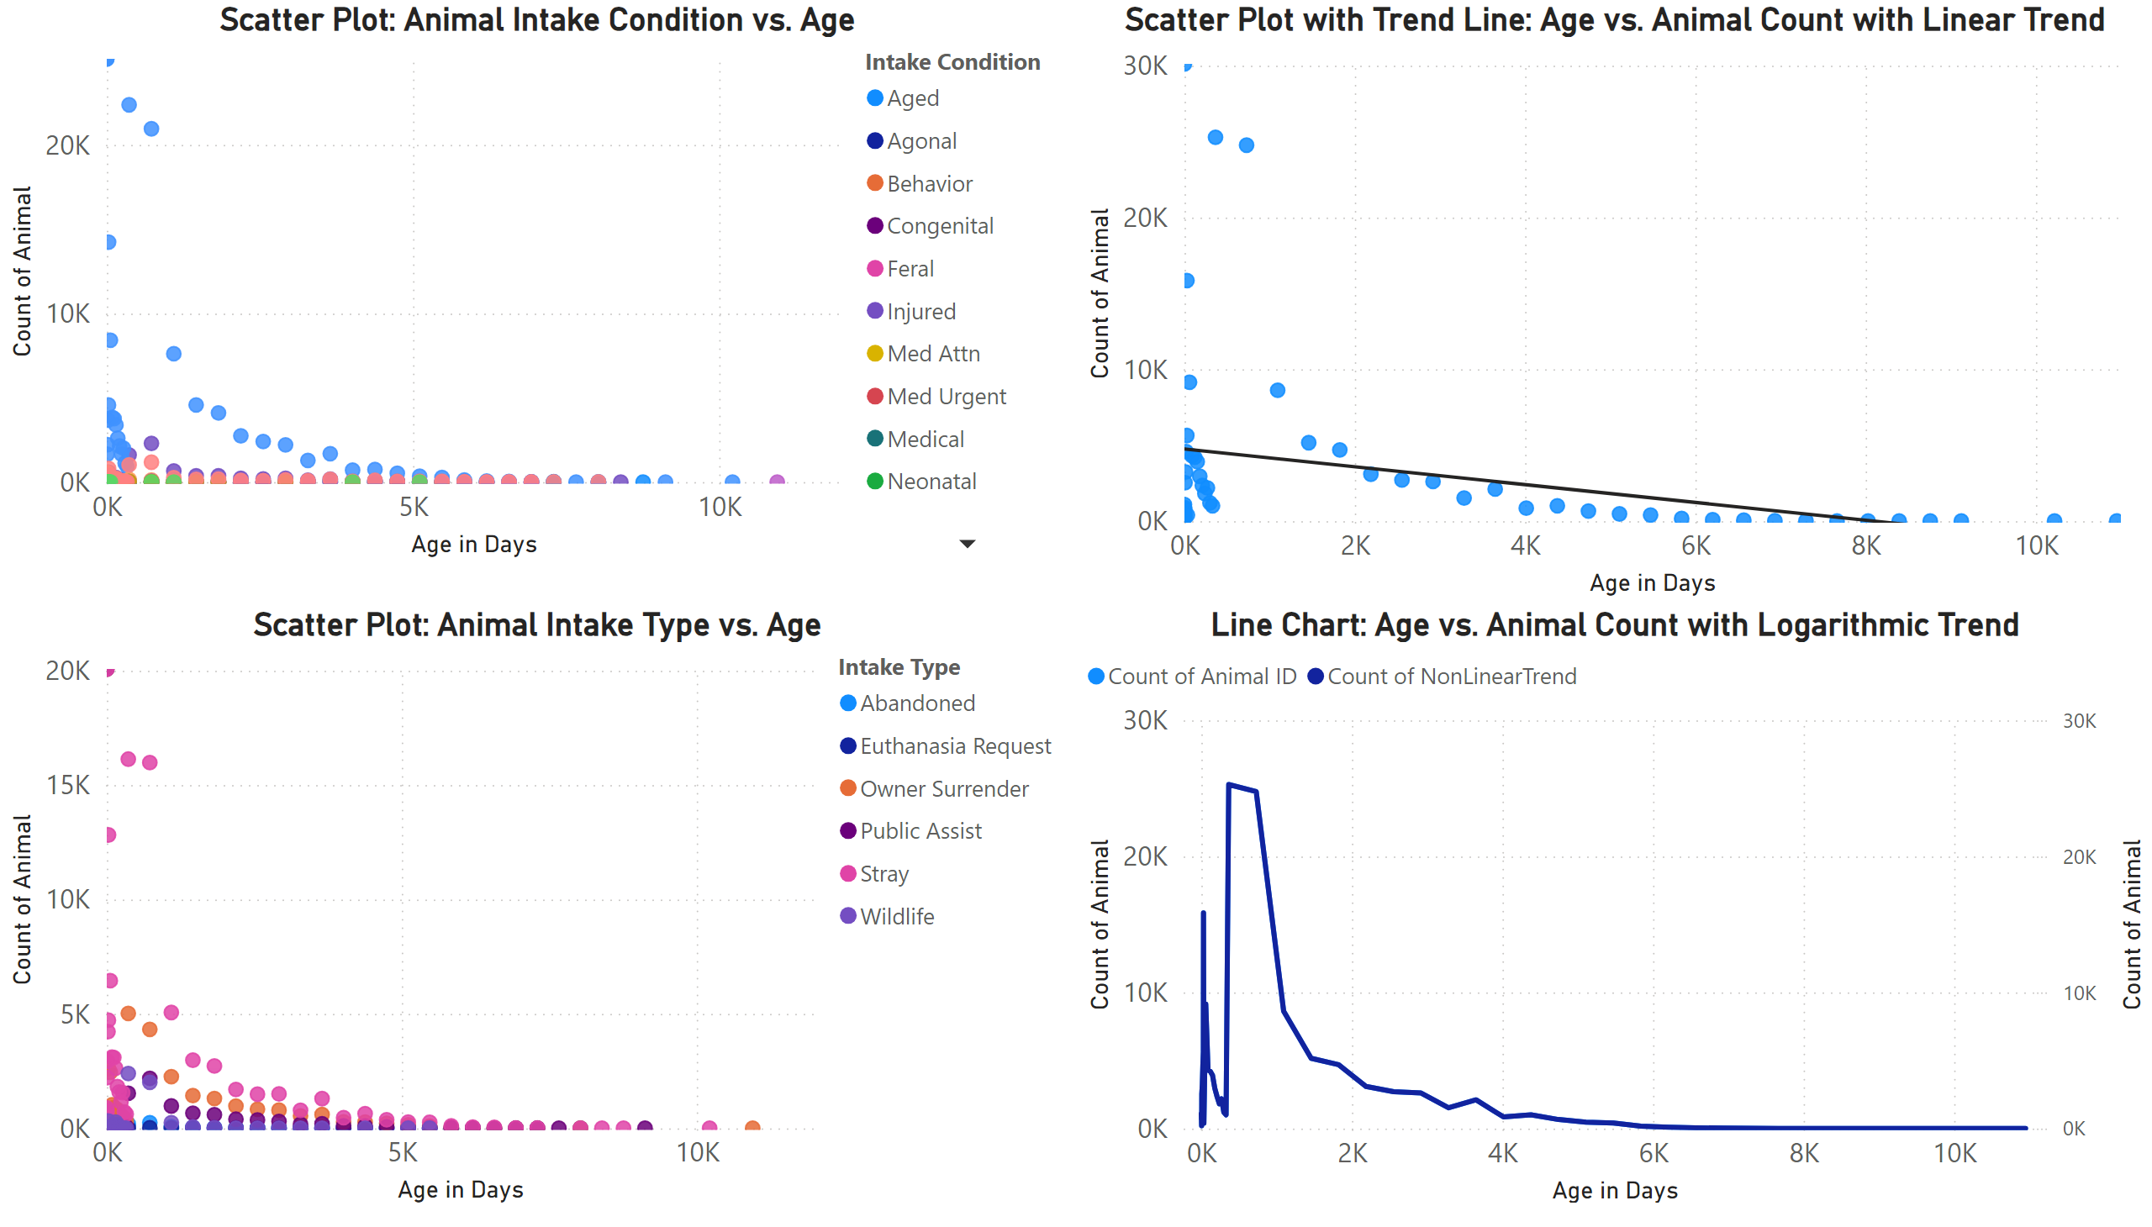
Page 5

Slide 13
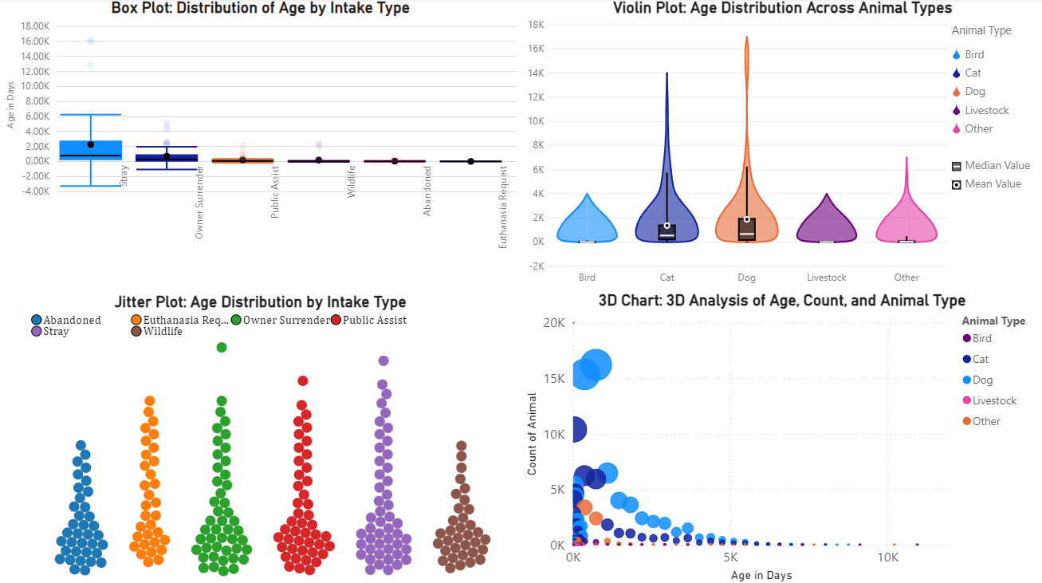
Page 9

