Slide 1








Current: The Future of AI-Driven Banking
Leveraging digital innovation as the #1 banking app for paychecks.
1

Slide 2



Biometric Security & AI Integration
Face ID: Automated biometric authentication for account security.
Passkey Deployment: Advanced cryptographic security to replace traditional passwords.
Real-time System Notifications: Intelligent monitoring of account activity and security settings.
2

Slide 3
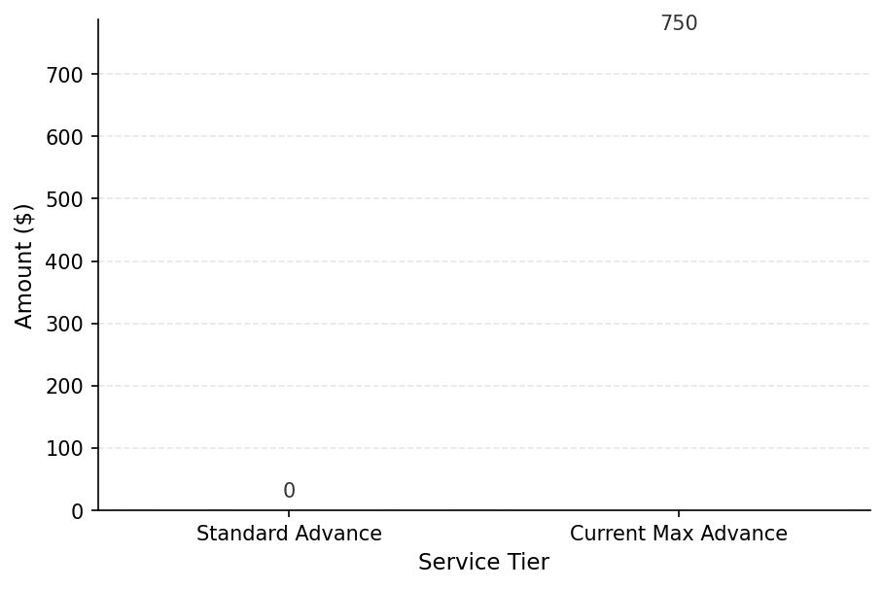
Liquidity and Advance Capital
Access up to $750 in paycheck advances for eligible users.
Finco Advance LLC provides technology-driven financial options.
Instant qualification based on paycheck direct deposit history.
3

Slide 4
Institutional Reliability & Infrastructure
FDIC-Insured: High-level protection for user funds through partner banks.
Global Utility: Integrated card services usable across international networks.
Zero Thresholds: No minimum or maximum balance requirements for account maintenance.
4

Slide 5
Onboarding & System Deployment
Streamlined mobile-first sign-up and card arrival tracking.
Full integration of Spend, Save, Invest, and Advance modules.
Secure login infrastructure managed via the Current Support Center.
5

