Slide 1








The AI Renaissance: Architecting the New Industrial Age
Scaling cognitive capacity and operational efficiency at the velocity of silicon-based logic.
1

Slide 2
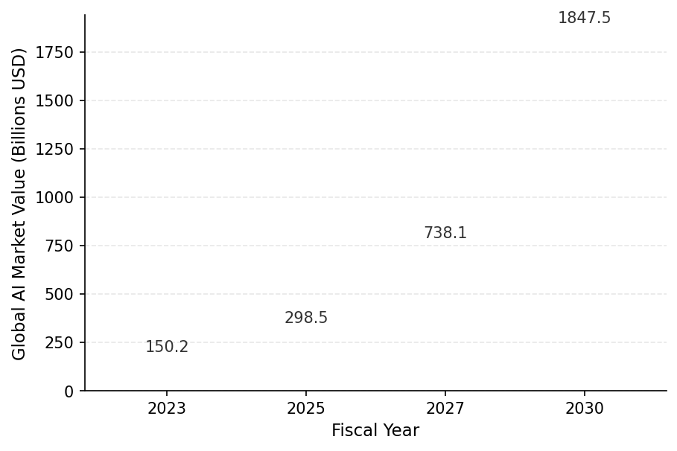



Hyper-Growth: The Multi-Trillion Dollar AI Economic Engine
Projected Compound Annual Growth Rate (CAGR) of 37.3% signals a fundamental shift in global capital allocation.
AI is forecast to inject $15.7 trillion into the global economy by 2030, exceeding the current combined output of India and Germany.
2

Slide 3
The AI-First Enterprise: Integration and Value Capture
Ubiquitous Integration: 72% of global firms have transitioned AI from experimental labs to core business functions.
Capital Prioritization: 40% of organizations are aggressively expanding dedicated AI budgets to secure a competitive 'intelligence moat'.
Functional Dominance: Marketing, Sales, and Product Development account for 79% of successful AI implementation cases.
Proven Profitability: Early adopters report an average ROI of 2.5x, transforming AI from a cost center into a primary revenue driver.
3

Slide 4
Generative AI: Unlocking a 10x Productivity Paradigm
Consumer Velocity: ChatGPT reached 100 million active users in 60 days, the fastest technology adoption curve in history.
Workflow Transformation: Generative models can automate or optimize tasks that currently consume 70% of the average employee's work week.
Developer Velocity: Software engineers leveraging AI coding assistants complete complex architecture tasks 55% faster with fewer syntax errors.
The Compute Arms Race: Frontier LLM training costs have skyrocketed from $10M to over $100M as model complexity scales exponentially.
4

Slide 5
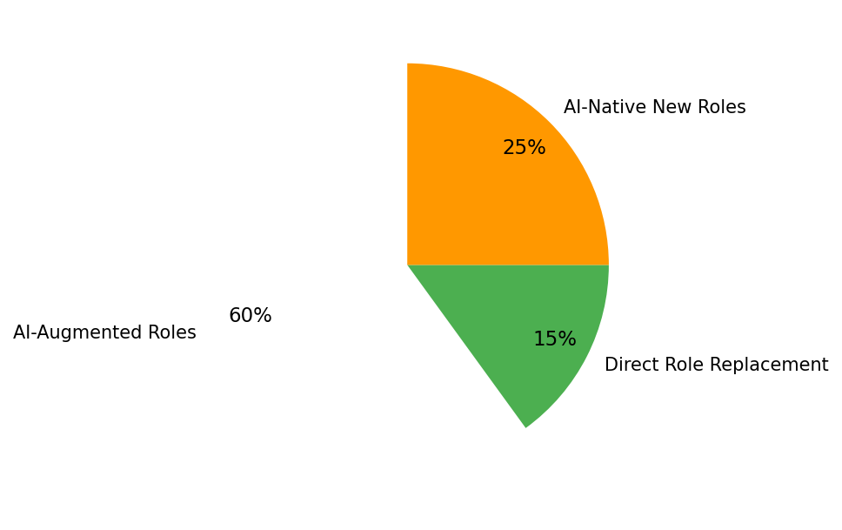
Synergistic Intelligence: Reimagining the Future of Work
Augmentation over Displacement: 60% of roles will be enhanced by AI, focusing human talent on strategy, empathy, and complex problem-solving.
Universal Impact: 80% of the modern workforce will see at least 10% of their daily tasks automated by Large Language Models (LLMs).
5

Slide 6

Silicon Scarcity: The Infrastructure Powering the AI Boom
Compute Deficit: Demand for high-performance AI GPUs currently exceeds global production capacity by a factor of 3x.
Processing Intensity: Training the next generation of multimodal models requires sustained compute power exceeding 10^25 FLOPs.
The Energy Challenge: AI data center power requirements are set to double by 2026, driving a massive surge in renewable energy demand.
Hardware Diversification: The market for custom AI-specific ASICs is growing at 20% annually to bypass traditional hardware bottlenecks.
6

Slide 7

Navigating the AI Frontier: Governance, Privacy, and Trust
Security Imperative: 55% of leaders identify data leakage and adversarial AI attacks as the primary barriers to deployment.
The Accuracy Gap: Hallucination rates in specialized technical domains persist at 3-5%, necessitating 'Human-in-the-Loop' verification.
Intellectual Property: A 400% increase in AI-related copyright litigation is forcing a global re-evaluation of data provenance and fair use.
Talent Scarcity: The lack of specialized AI engineering and prompt engineering talent remains the #1 inhibitor to enterprise scaling.
7

Slide 8


The Intelligence Imperative: Leading in an AI-Driven Future
In the era of autonomous intelligence, the only existential risk is failing to adapt to the AI-first economy.
8

