Slide 1




Governance of the Global Tech Hub: The Bruhat Bengaluru Mahanagara Palike (BBMP)
A Strategic Overview of Administrative Infrastructure, Fiscal Management, and Urban Development in India's Silicon Valley.
1

Slide 2


Managing a Megacity: BBMP’s Administrative Scale & Zonal Governance
Extensive Jurisdiction: Overseeing an expansive urban landscape spanning 714 sq. km, balancing high-density technology corridors with historic residential zones.
Demographic Pressure: Serving a hyper-growth population exceeding 12.5 million residents, necessitating agile and scalable civic response systems.
Decentralized Zonal Model: Administration streamlined through 8 strategic zones—including Mahadevapura and Bommanahalli—to address localized infrastructure needs.
Grassroots Representation: Recent restructuring to 243 wards to improve local accountability and ensure granular service delivery at the neighborhood level.
2

Slide 3

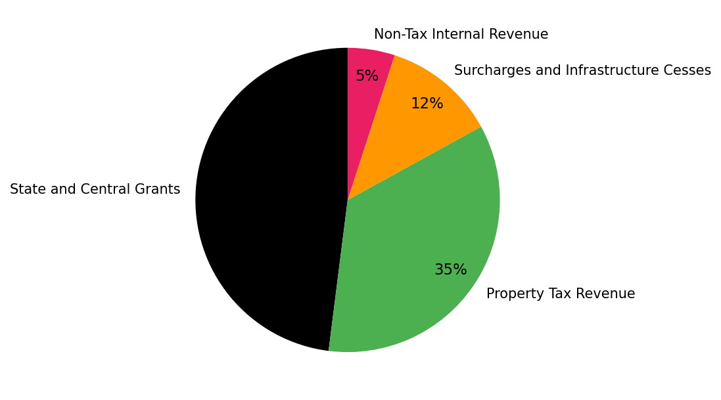

Fiscal Architecture: Revenue Streams Powering Bengaluru’s Development
3

Slide 4


The BBMP Scale of Impact: Operational Benchmarks and Asset Management
Solid Waste Management: Orchestrating the daily collection and scientific processing of 4,500+ metric tonnes of municipal solid waste.
Connectivity Matrix: Engineering and maintaining a massive 13,200 km road network, ranging from arterial highways to neighborhood lanes.
Ecological Stewardship: Direct management of 1,200+ public parks and the rejuvenation of 200+ lakes to enhance the city's climate resilience.
Public Healthcare Infrastructure: Operating a tiered network of 140+ Primary Health Centers and 6 major referral hospitals for affordable urban healthcare.
4

Slide 5
Brand Bengaluru: The Roadmap for a Resilient and Smart Future
Strategic Vision: The 'Brand Bengaluru' initiative focusing on multi-modal transport integration, waste-to-energy solutions, and expanded green cover.
Digital Transformation: Implementation of GIS-enabled property tax mapping and automated 'Namma Bengaluru' services for 100% transparency.
Climate Adaptation: Utilizing the Integrated Command and Control Centre (ICCC) for real-time flood monitoring and disaster response synchronization.
Infrastructure Longevity: Prioritizing 'White Topping' concrete surfacing on major corridors to reduce lifecycle maintenance costs and improve road durability.
5

