Slide 1
SWAMI KESHVANAND INSTITUTE OF TECHNOLOGY, MANAGEMENT & GRAMOTHAN, JAIPUR
Industrial Training & Major Project Presentation
EXIM 2D World Traders
Cloud-Native HR ERP & In-App AI Copilot Platform
SUBMITTED BY:
• Presenter 1 (Frontend & UI/UX Architecture)
• Presenter 2 (Backend, Database Systems & AI)
Department of Computer Science & Engineering
SUBMITTED TO:
Dr. Meenakshi Nawal
Associate Professor
Department of Computer Science & Engineering
SKIT, Jaipur

Slide 2
OVERVIEW
Table of Contents
01. Company & Business Domain
EXIM 2D Global Trade & Logistics
06. Executive HR Command Center
Workforce Telemetry & Global Hub Radar
02. Technology Stack Used
React 19, Node.js, Express, MongoDB, EXIM-AI
07. Attendance & Workforce Modules
Biometric Logs, Directory & Onboarding
03. Goal & Objectives of Training
Enterprise Full-Stack & Dual-Portal Architecture
08. Employee Self-Service (ESS)
Clock-In, Quota Balances & INR Payslips
04. System Architecture & Pipeline
Decoupled Client-Server & Security Guards
09. EXIM-AI Contextual Copilot
Role-Aware Assistant & Action Dispatcher
05. Sample Database Ingestion
Enterprise Indian Workforce Dataset (Kaggle)
10. Future Scope & Conclusion
IoT Geofencing, Banking APIs & Q&A
SKIT, JAIPUR | www.skit.ac.in | EXIM 2D World Traders HR ERP Platform

Slide 3
ORGANIZATION BACKGROUND
Company Introduction & Domain Context
• Company Profile: EXIM 2D World Traders is a premier international enterprise specializing in global import-export trade, maritime cargo logistics, container fleet management, and large-scale civil infrastructure projects.
• Key Operating Hubs: Major maritime terminals and project divisions including JNPT Port Mumbai, Mundra Port Gujarat, Chennai Port Hub, Kolkata Logistics Hub, and Delhi Corporate Headquarters.
• Workforce Demographics: Over 140+ multidisciplinary personnel comprising port logistics managers, customs clearance officers, civil site engineers, heavy equipment supervisors, and finance executives.
• Core Operational Challenge: Manual legacy spreadsheets and disparate tools led to shift communication gaps, attendance discrepancies, delayed leave approvals, and sluggish payroll disbursal across international hubs.
• The Strategic Solution: Development of a unified, cloud-native HR ERP system featuring dual-persona access (Executive HR & Staff ESS) combined with an integrated conversational AI Copilot (EXIM-AI).
SKIT, JAIPUR | www.skit.ac.in | EXIM 2D World Traders HR ERP Platform

Slide 4
SYSTEM ARCHITECTURE
Technology Stack Used
Frontend Architecture
• React 19: Modern UI library with concurrent rendering & modular component architecture.
• Vite 8: Next-gen lightning-fast HMR dev server and optimized production bundler.
• Tailwind CSS v4: Next-generation utility-first styling with glassmorphic backdrop-blur aesthetics.
• Framer Motion 12: Physics-based spring animations, ambient glowing orbs & smooth modal transitions.
• Recharts 3: Interactive SVG data visualizations for telemetry & weekly attendance analytics.
• React Router v7: Declarative client-side routing with protected route security guards.
Backend & Database Systems
• Node.js Runtime: Scalable asynchronous JavaScript server-side execution environment.
• Express.js API: RESTful routing controllers handling authentication, payroll, and employees.
• MongoDB (NoSQL): Flexible document store housing employee records, shifts, and leaves.
• JWT Stateless Auth: Signed JSON Web Tokens enforcing Role-Based Access Control (RBAC).
• Axios HTTP Client: Promise-based client-to-server API communication with bearer headers.
• Database Seeding: Automated ingestion pipeline populating verified enterprise HR datasets.
EXIM-AI Copilot Engine
• Role-Aware Intent Classifier: Contextually distinguishes between HR Executives and Field Staff inquiries.
• Conversational Interface: Instant parsing of natural language queries on leaves, shifts & ports.
• Deep-Linking Action Dispatcher: Dynamically injects actionable, one-click navigation CTA buttons in chat.
• In-Memory Grounding: Pre-loaded with accurate domain data (port operations, leave quotas, payroll).
• Sub-50ms Response: High-speed client-side intent execution delivering zero-latency assistance.
SKIT, JAIPUR | www.skit.ac.in | EXIM 2D World Traders HR ERP Platform

Slide 5
PROJECT OBJECTIVES
Goal & Core Objectives of Training
01. Hands-on Full-Stack Web Mastery
Develop real-world proficiency in engineering production-grade web platforms using modern decoupled architectures (React 19 + Node.js/Express + MongoDB).
02. Dual-Persona Enterprise Workflows
Architect and isolate secure, role-specific user journeys for Executive HR governance and Employee Self-Service (ESS) within a single Single Page Application.
03. Multi-Hub Data Modeling & Ingestion
Learn end-to-end data pipelines: transforming raw multi-location CSV datasets (JNPT Mumbai, Mundra Gujarat, Delhi HQ) into structured MongoDB schemas.
04. Intelligent Conversational Assistance
Conceptualize, build, and deploy an in-app AI Copilot (EXIM-AI) capable of parsing user queries and deep-linking directly to target application pages.
05. Engineering Best Practices & Git Workflow
Strengthen professional engineering habits—including Git branching, code reviews, version control, and GitHub repository deployment.
SKIT, JAIPUR | www.skit.ac.in | EXIM 2D World Traders HR ERP Platform

Slide 6
TECHNICAL BLUEPRINT
System Pipeline & Decoupled Architecture
1. Presentation Layer
React 19 + Vite
Role-switched SPA on Port 5173 rendering Executive HR and ESS portals with Tailwind CSS.
2. Security & Guard
JWT Route Protection
Interception of protected routes via useAuth hook verifying stateless bearer token & roles.
3. REST API Controllers
Express.js Services
Asynchronous endpoints handling auth, employee rosters, biometric logs & payroll calculations.
4. Data Persistence
MongoDB Collections
NoSQL document storage housing 140+ ingested records of staff, attendance & leave quotas.
5. Context AI Copilot
EXIM-AI Bridge
In-app natural language engine resolving queries with instant deep-link navigation shortcuts.
SKIT, JAIPUR | www.skit.ac.in | EXIM 2D World Traders HR ERP Platform

Slide 7
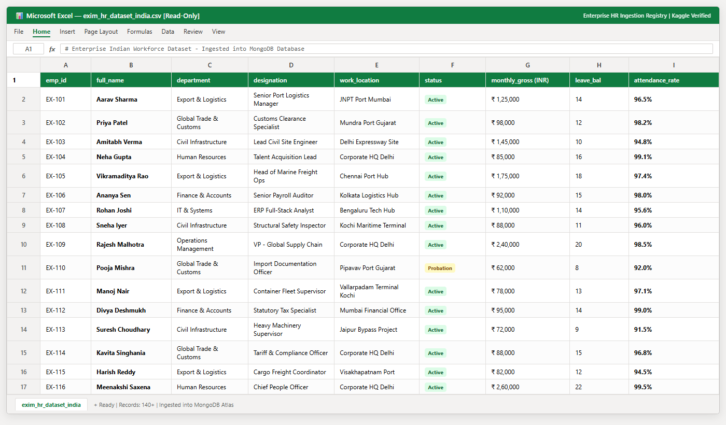
DATABASE LAYER
Sample HR Dataset Ingestion (Excel View)
KEY MODULE HIGHLIGHTS
• Verified Enterprise Source: Standard enterprise HR & trade logistics dataset sourced from Kaggle repository.
• Indian Workforce Grounding: 140+ structured records featuring Indian personnel (Aarav Sharma, Priya Patel, Amitabh Verma, Neha Gupta).
• National Trade Hubs: Personnel mapped across JNPT Mumbai, Mundra Gujarat, Chennai Port, Kolkata Hub & Delhi HQ.
• Automated Database Seeding: Transformed and ingested into MongoDB Atlas collections via custom seedData.js pipeline.
• INR Payroll & Metric Realism: Includes gross monthly salaries (INR), leave quotas, shift timings & biometric punctuality rates.
SKIT, JAIPUR | www.skit.ac.in | EXIM 2D World Traders HR ERP Platform

Slide 8
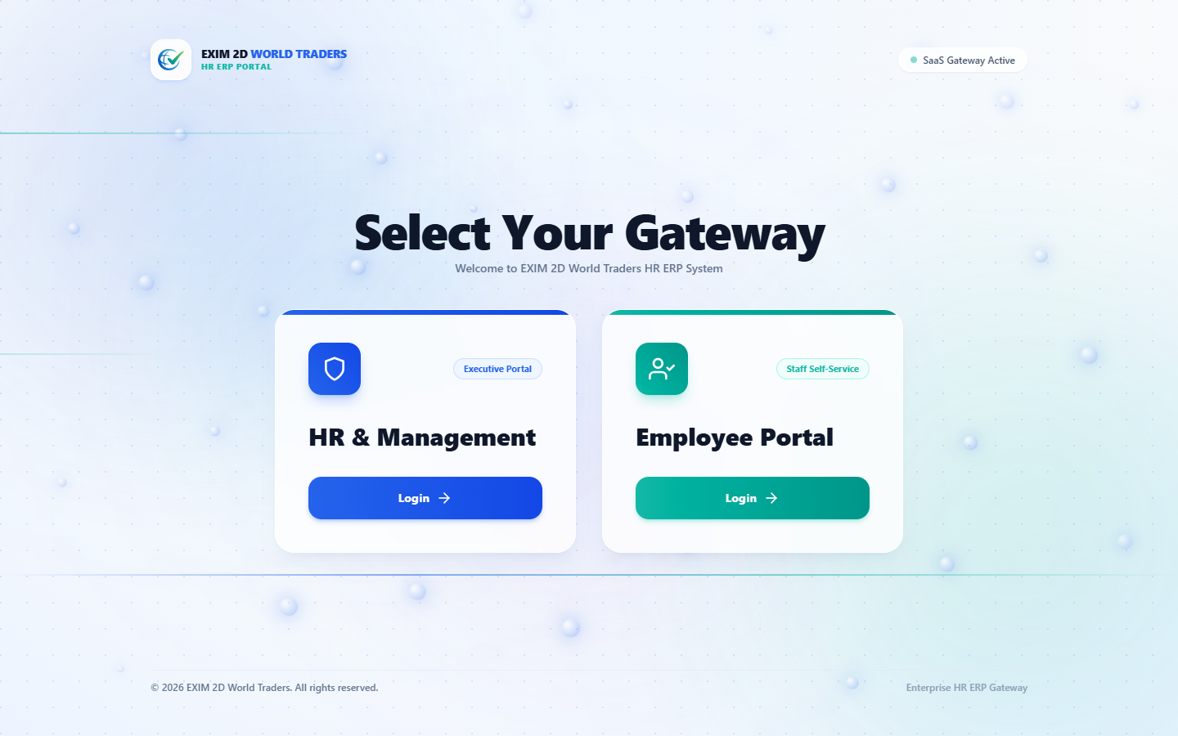
FRONTEND MODULE
Dual Gateway & Role-Based Authentication
KEY MODULE HIGHLIGHTS
• Gateway Selector: Intuitive home portal allowing personnel to route to Executive HR or Employee Self-Service.
• Modern Glassmorphism: Built with Tailwind CSS v4 featuring translucent frosted surfaces and ambient orbs.
• Credential Verification: Client-side validation with real-time error feedback and show/hide password toggles.
• Stateless Session Token: Upon successful login, a cryptographic JWT token and userRole are initialized in localStorage.
• Smooth Micro-Interactions: Fluid card hover and click physics powered by Framer Motion 12.
SKIT, JAIPUR | www.skit.ac.in | EXIM 2D World Traders HR ERP Platform

Slide 9
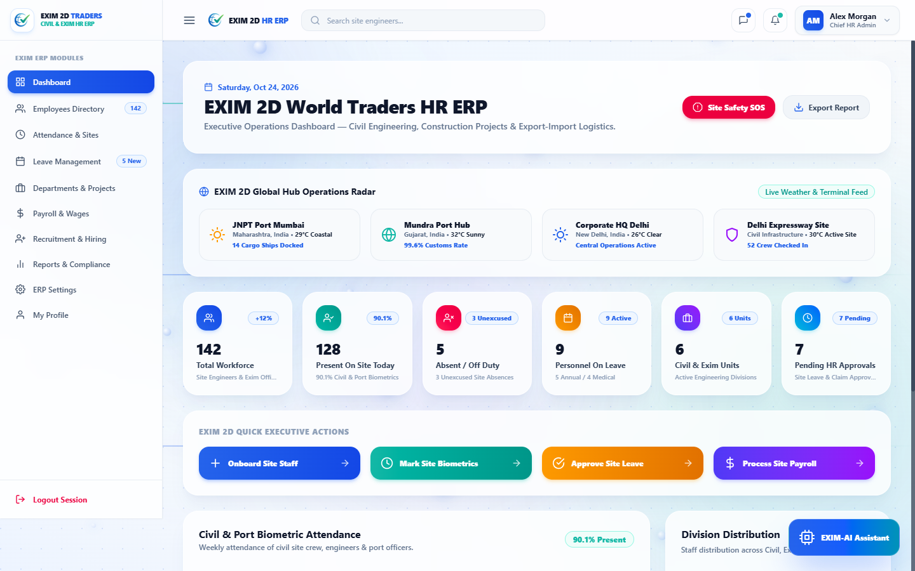
HR OPERATIONS
Executive HR Command Center & Radar
KEY MODULE HIGHLIGHTS
• Live Workforce Telemetry: Real-time counters for Total Workforce (142), Present on Site (90.1%), and Leaves (9).
• National Site Hub Radar: Monitors live weather, vessel dockings, and biometrics across JNPT, Mundra, Delhi HQ & Expressway.
• Interactive Recharts SVG: Weekly attendance trends and departmental headcounts visualized with responsive SVG graphs.
• One-Click Quick Actions: Direct shortcuts to onboard employees, mark biometrics, approve leaves, and disburse payroll.
• Responsive Collapse: Dynamic sidebar supporting desktop collapse and mobile drawer transformation.
SKIT, JAIPUR | www.skit.ac.in | EXIM 2D World Traders HR ERP Platform

Slide 10
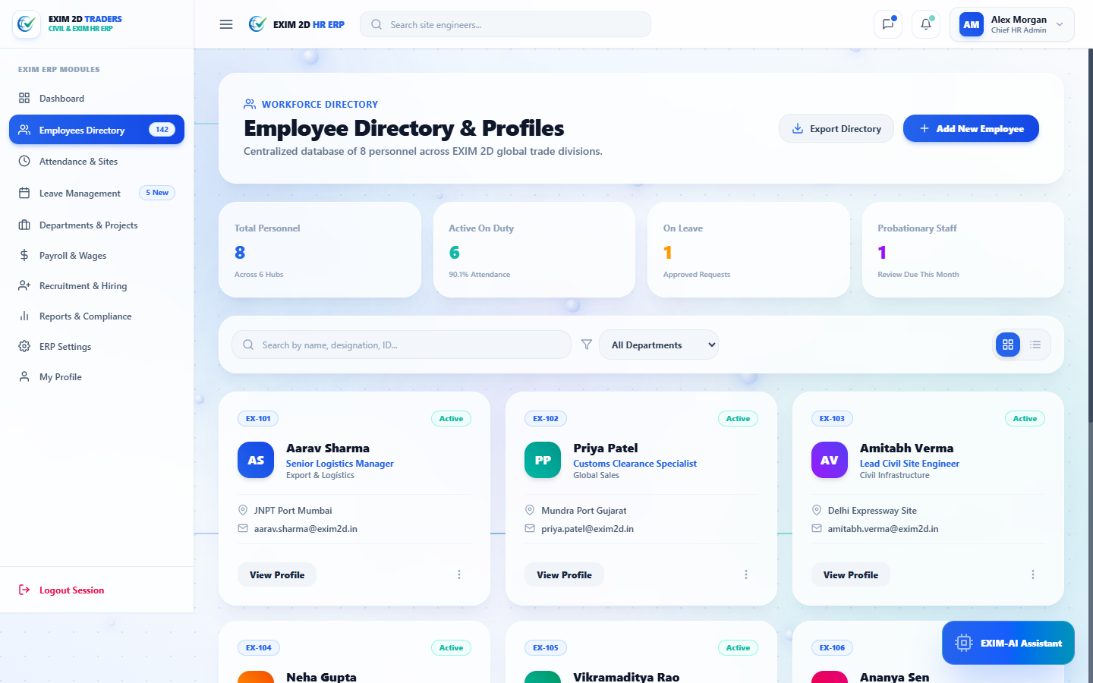
HR OPERATIONS
Workforce Directory & Onboarding Management
KEY MODULE HIGHLIGHTS
• Multi-Criteria Search: Instant keyword search across employee names, designations, and department tags.
• Department Filtering: Dynamic filter tabs for Logistics, Civil Infrastructure, Global Trade, IT & Finance.
• Grid & Table View Switcher: Seamless toggle between visual profile cards and compact enterprise tabular rows.
• Employee Status Indicators: Visual badge chips displaying Active, On Leave, and Probationary states.
• New Employee Onboarding: Interactive modal form with real-time validation to register incoming field engineers.
SKIT, JAIPUR | www.skit.ac.in | EXIM 2D World Traders HR ERP Platform

Slide 11
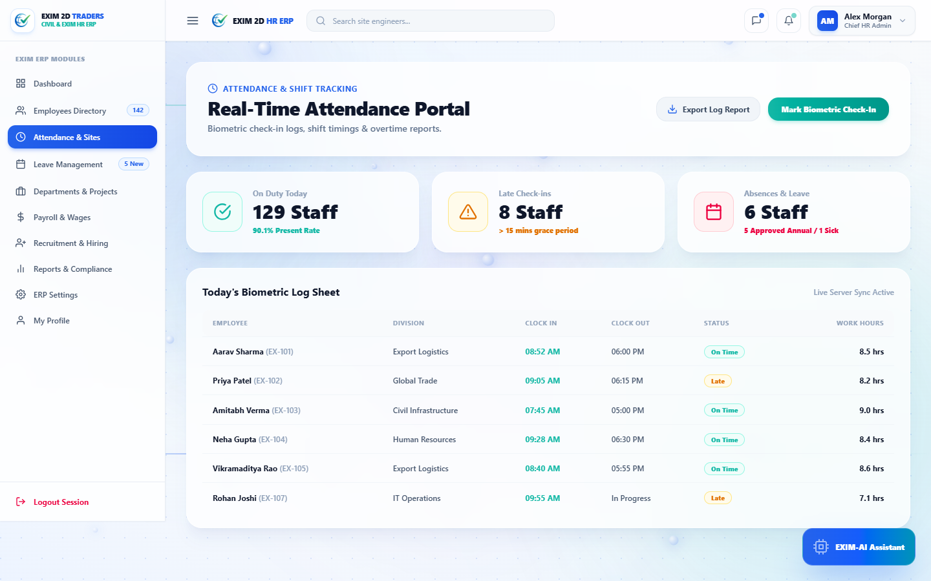
WORKFORCE GOVERNANCE
Biometric Attendance & Shift Tracking
KEY MODULE HIGHLIGHTS
• Biometric Clock Logs: Accurate records of morning, evening, and field shifts across maritime terminals.
• Punctuality Monitoring: Automatic tagging of On-Time and Late check-ins with exact hours logged.
• Field Terminal Sync: Simulated hardware sync capturing arrivals at JNPT Port, Mundra, and Delhi Expressway.
• Interactive Manual Check-In: Modal interface enabling supervisors to manually log field staff clock-ins with timestamps.
• Data Export Readiness: One-click export capability preparing attendance reports for monthly payroll processing.
SKIT, JAIPUR | www.skit.ac.in | EXIM 2D World Traders HR ERP Platform

Slide 12
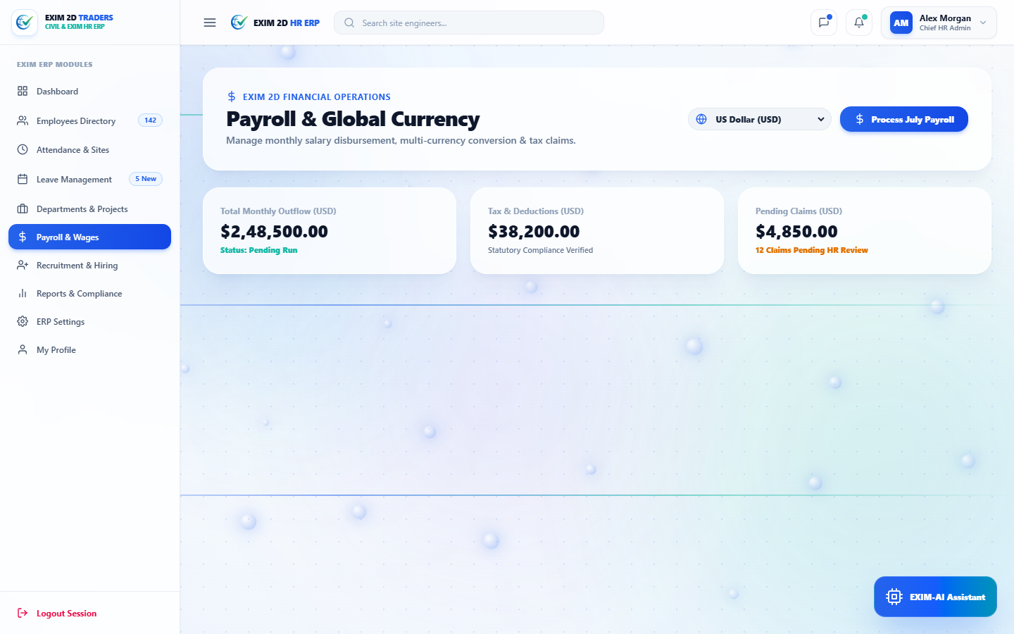
FINANCIAL GOVERNANCE
Enterprise Payroll & INR Disbursal
KEY MODULE HIGHLIGHTS
• Indian Rupee (INR) Base: Calculated on a total monthly workforce payroll outflow exceeding ₹2.07 Crores.
• Statutory Tax Compliance: Automated computation of EPF, ESI, professional tax, and standard deductions.
• One-Click Batch Disbursal: Simulated bulk bank transfer triggering instantaneous salary credits to 142 personnel.
• Global Currency Switcher: Built-in multi-currency conversion supporting INR, USD, EUR, SGD, and AED.
• Expense Claims Tracker: Live monitoring of pending travel and site reimbursement claims awaiting HR audit.
SKIT, JAIPUR | www.skit.ac.in | EXIM 2D World Traders HR ERP Platform

Slide 13
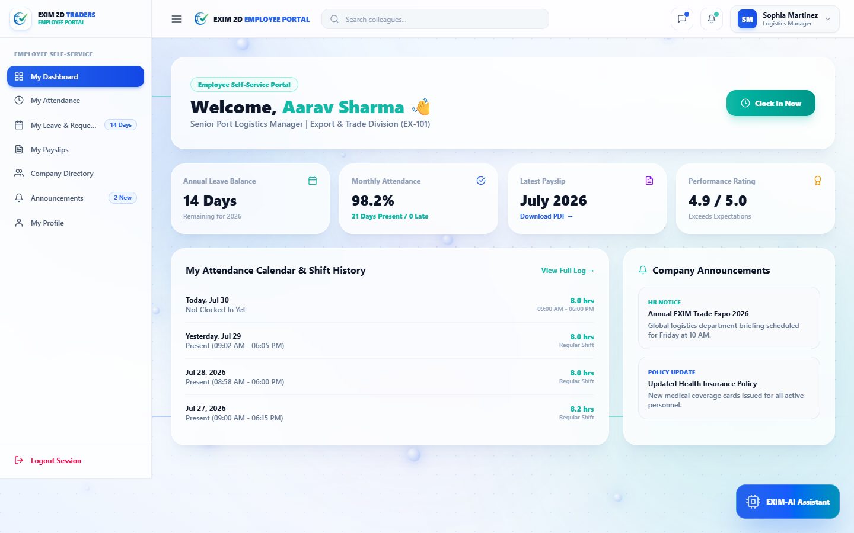
STAFF WORKFLOWS
Employee Self-Service (ESS) Portal
KEY MODULE HIGHLIGHTS
• Personalized Dashboard: Greets authenticated staff (e.g., Aarav Sharma - EX-101) with their role and unit overview.
• One-Click Shift Clock-In: Enables workers to record daily shift start and end times with automated clock stamps.
• Leave Quota Tracker: Real-time visibility into remaining Annual (14), Medical (9), and Casual (4) leave quotas.
• Direct Navigation Cards: Clean shortcuts to submit time-off requests, view attendance logs, and inspect payslips.
• Mobile-First Responsiveness: Optimized touch targets and fluid layout tailored for field tablets and smartphones.
SKIT, JAIPUR | www.skit.ac.in | EXIM 2D World Traders HR ERP Platform

Slide 14
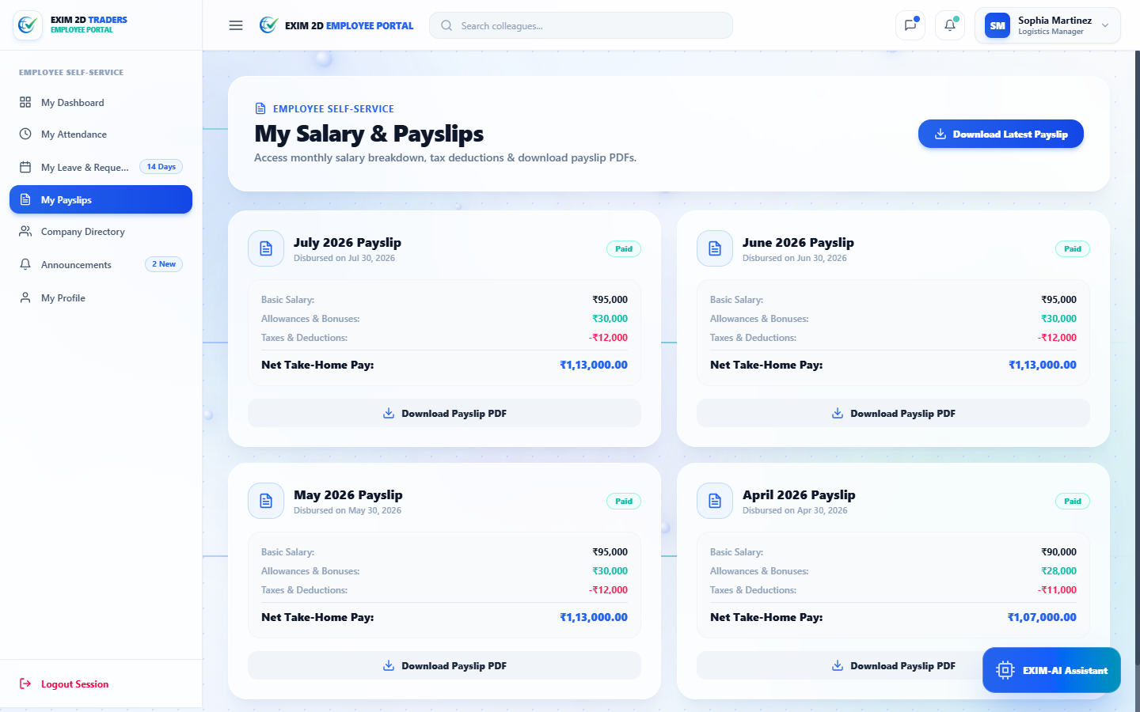
STAFF WORKFLOWS
Digital Payslip & Compensation Viewer
KEY MODULE HIGHLIGHTS
• Transparent Salary Breakdown: Itemized breakdown of Basic (₹95,000), Allowances (₹30,000), and Deductions (₹12,000).
• Net Take-Home Visibility: Displays verified monthly net take-home salary (₹1,13,000.00) disbursed via direct deposit.
• Historical Archive: Four-month historical payslip timeline (July, June, May, April) for tax and loan verification.
• PDF Generation Trigger: One-click simulated PDF download with instant toast confirmation alerts.
• Encrypted Access: Strictly isolated through session token verification to ensure confidentiality.
SKIT, JAIPUR | www.skit.ac.in | EXIM 2D World Traders HR ERP Platform

Slide 15
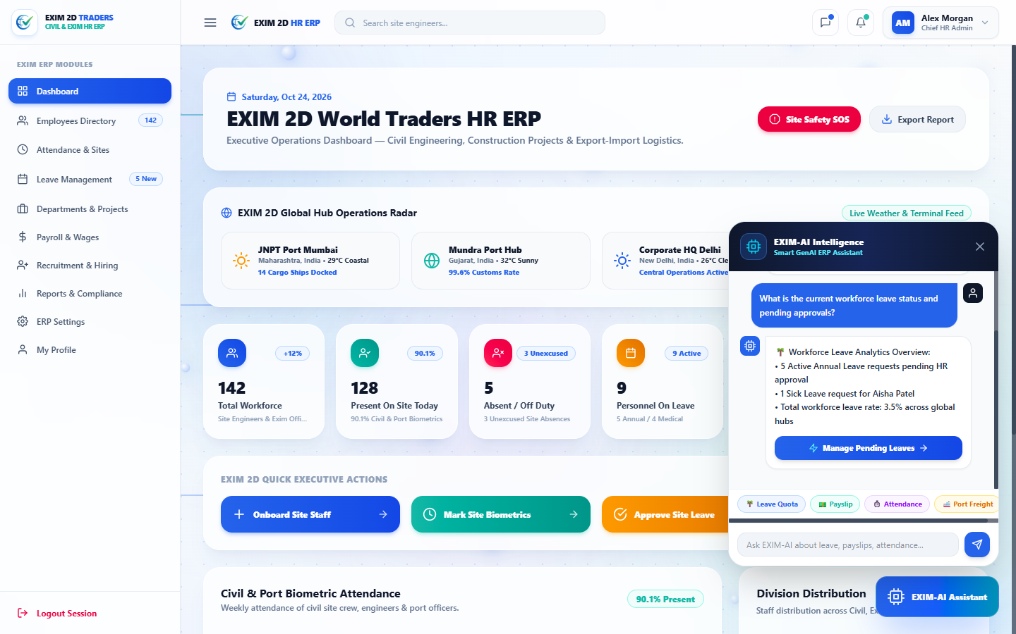
AI INNOVATION
EXIM-AI Contextual Copilot
KEY MODULE HIGHLIGHTS
• Role-Aware Intelligence: Dynamically tailors responses: returns personal leave balances to Employees, and pending approvals to HR.
• Natural Language Parsing: Accurately interprets user queries regarding leaves, salary, attendance, and port hubs.
• Actionable Deep-Linking: Generates interactive CTA buttons (e.g., 'Manage Pending Leaves') for one-click navigation.
• Domain Grounding: Pre-loaded with accurate Indian hub operational data (JNPT Mumbai, Mundra Gujarat, Delhi Expressway).
• Floating In-App Widget: Accessible across all authenticated pages with animated open/close physics.
SKIT, JAIPUR | www.skit.ac.in | EXIM 2D World Traders HR ERP Platform

Slide 16
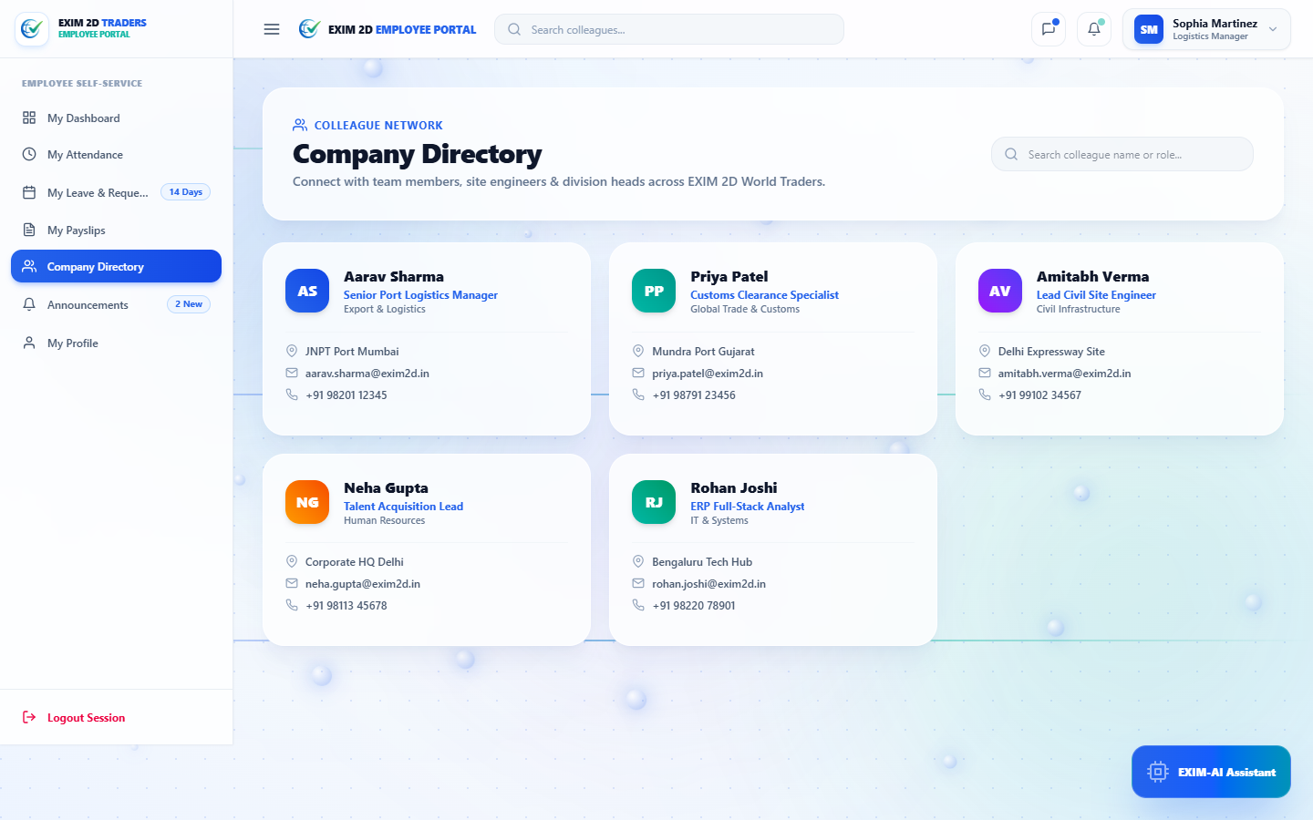
TEAM COLLABORATION
Company Colleague Network Directory
KEY MODULE HIGHLIGHTS
• Cross-Hub Networking: Enables employees to look up peers, site engineers, and division heads across all Indian hubs.
• Direct Contact Coordinates: Surfaces verified work emails (@exim2d.in) and mobile phone numbers for field coordination.
• Real-Time Filter Input: Instant debounce search filtering staff by name, department, or job role.
• Department Avatar Badges: Custom color-coded avatar initials for quick visual identification.
• Security Policy Compliance: Read-only interface preventing unauthorized tampering with corporate roster records.
SKIT, JAIPUR | www.skit.ac.in | EXIM 2D World Traders HR ERP Platform

Slide 17
SYSTEM EVOLUTION
Future Scope & Technological Roadmap
🚀 IoT Geofenced Punch-In
Automated GPS-backed mobile check-in logging shifts the moment workers enter container terminal perimeters.
🚀 Direct Banking API Integration
Direct integration with corporate banking gateways (NEFT/RTGS/SWIFT) for automated single-click salary disbursement.
🚀 LLM Compliance Policy Drafter
Generative AI models fine-tuned to draft customized cross-border trade contracts and occupational safety policies.
🚀 Predictive Attrition & Absence Modeling
Machine learning forecasting algorithms predicting seasonal labor shortages prior to peak trade quarters.
🚀 Biometric Hardware Terminal Sync
Direct MQTT/WebSocket communication syncing on-site fingerprint and facial scanners at port terminals into MongoDB.
SKIT, JAIPUR | www.skit.ac.in | EXIM 2D World Traders HR ERP Platform

Slide 18
QUESTIONS & ANSWERS
We are now open for evaluation questions and technical discussion.
Department of Computer Science & Engineering
Swami Keshvanand Institute of Technology, Management & Gramothan, Jaipur

Slide 19
THANK YOU!
EXIM 2D World Traders HR ERP & AI Copilot Platform
GitHub Repository: https://github.com/khushikmandal2005-commits/-hr-erp-
Presented By: [Friend's Name] & [Your Name]
SKIT, Jaipur • www.skit.ac.in

