Slide 1


Swami Keshvanand Institute of Technology, Management & Gramothan, Jaipur
(An Autonomous Institute Affiliated to Rajasthan Technical University, Kota)
Industrial Training Presentation
TOPIC: EXIM 2D HR ERP
Submitted To:
Name:- Dr. Meenakshi Nawal Associate Professor
Submitted By:
Name:- Khushi Kumari
Name:- Lakshay Chanwariya

Slide 2
Index
Company Introduction
Certificate
Technology Used
Goal of Training
Project Overview
Working Project
Future Scope
Q&A
SKIT, JAIPUR
www.skit.ac.in

Slide 3

Company Introduction
Exim 2D World Traders Pvt. Ltd. is a leading enterprise operating in global import-export trade, maritime cargo logistics, container fleet management, and large-scale highway civil infrastructure projects.
The company operates major logistics and field project hubs across India—including JNPT Port Mumbai, Mundra Port Gujarat, Chennai Port Hub, Kolkata Logistics Center, and Corporate Headquarters in New Delhi.
Exim 2D World Traders employs over 140+ multidisciplinary personnel comprising port logistics managers, customs clearance specialists, civil site engineers, and corporate management across multiple timezones.
The software & ERP division emphasizes digital workforce modernization, quality, and technology adoption, providing a strong platform for learning, skill development, and professional growth in modern Web Development.
SKIT, JAIPUR
www.skit.ac.in

Slide 4
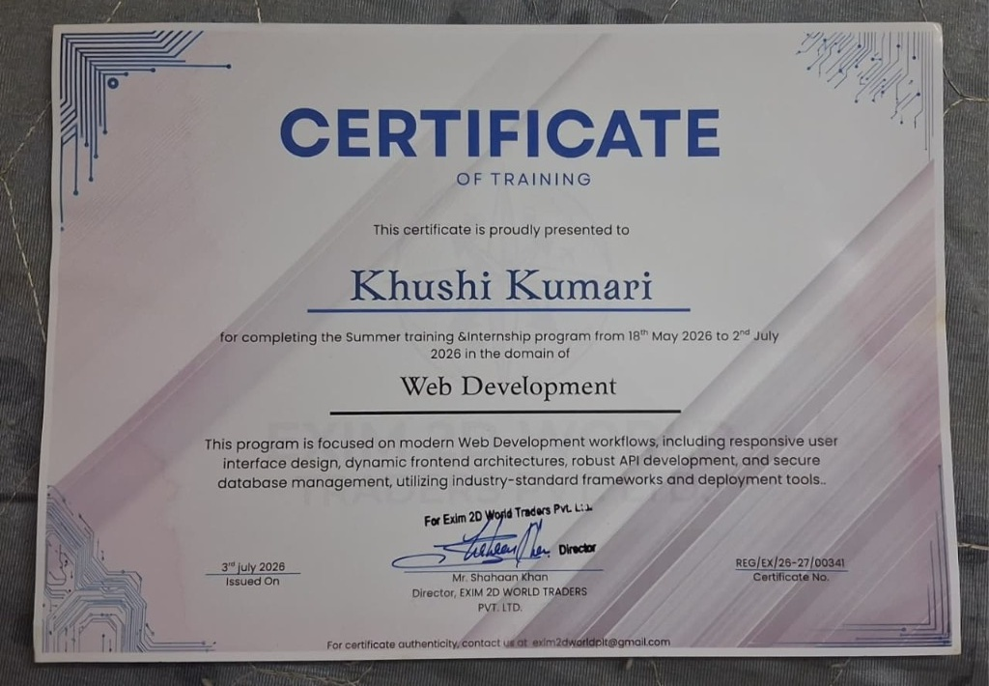

Slide 5
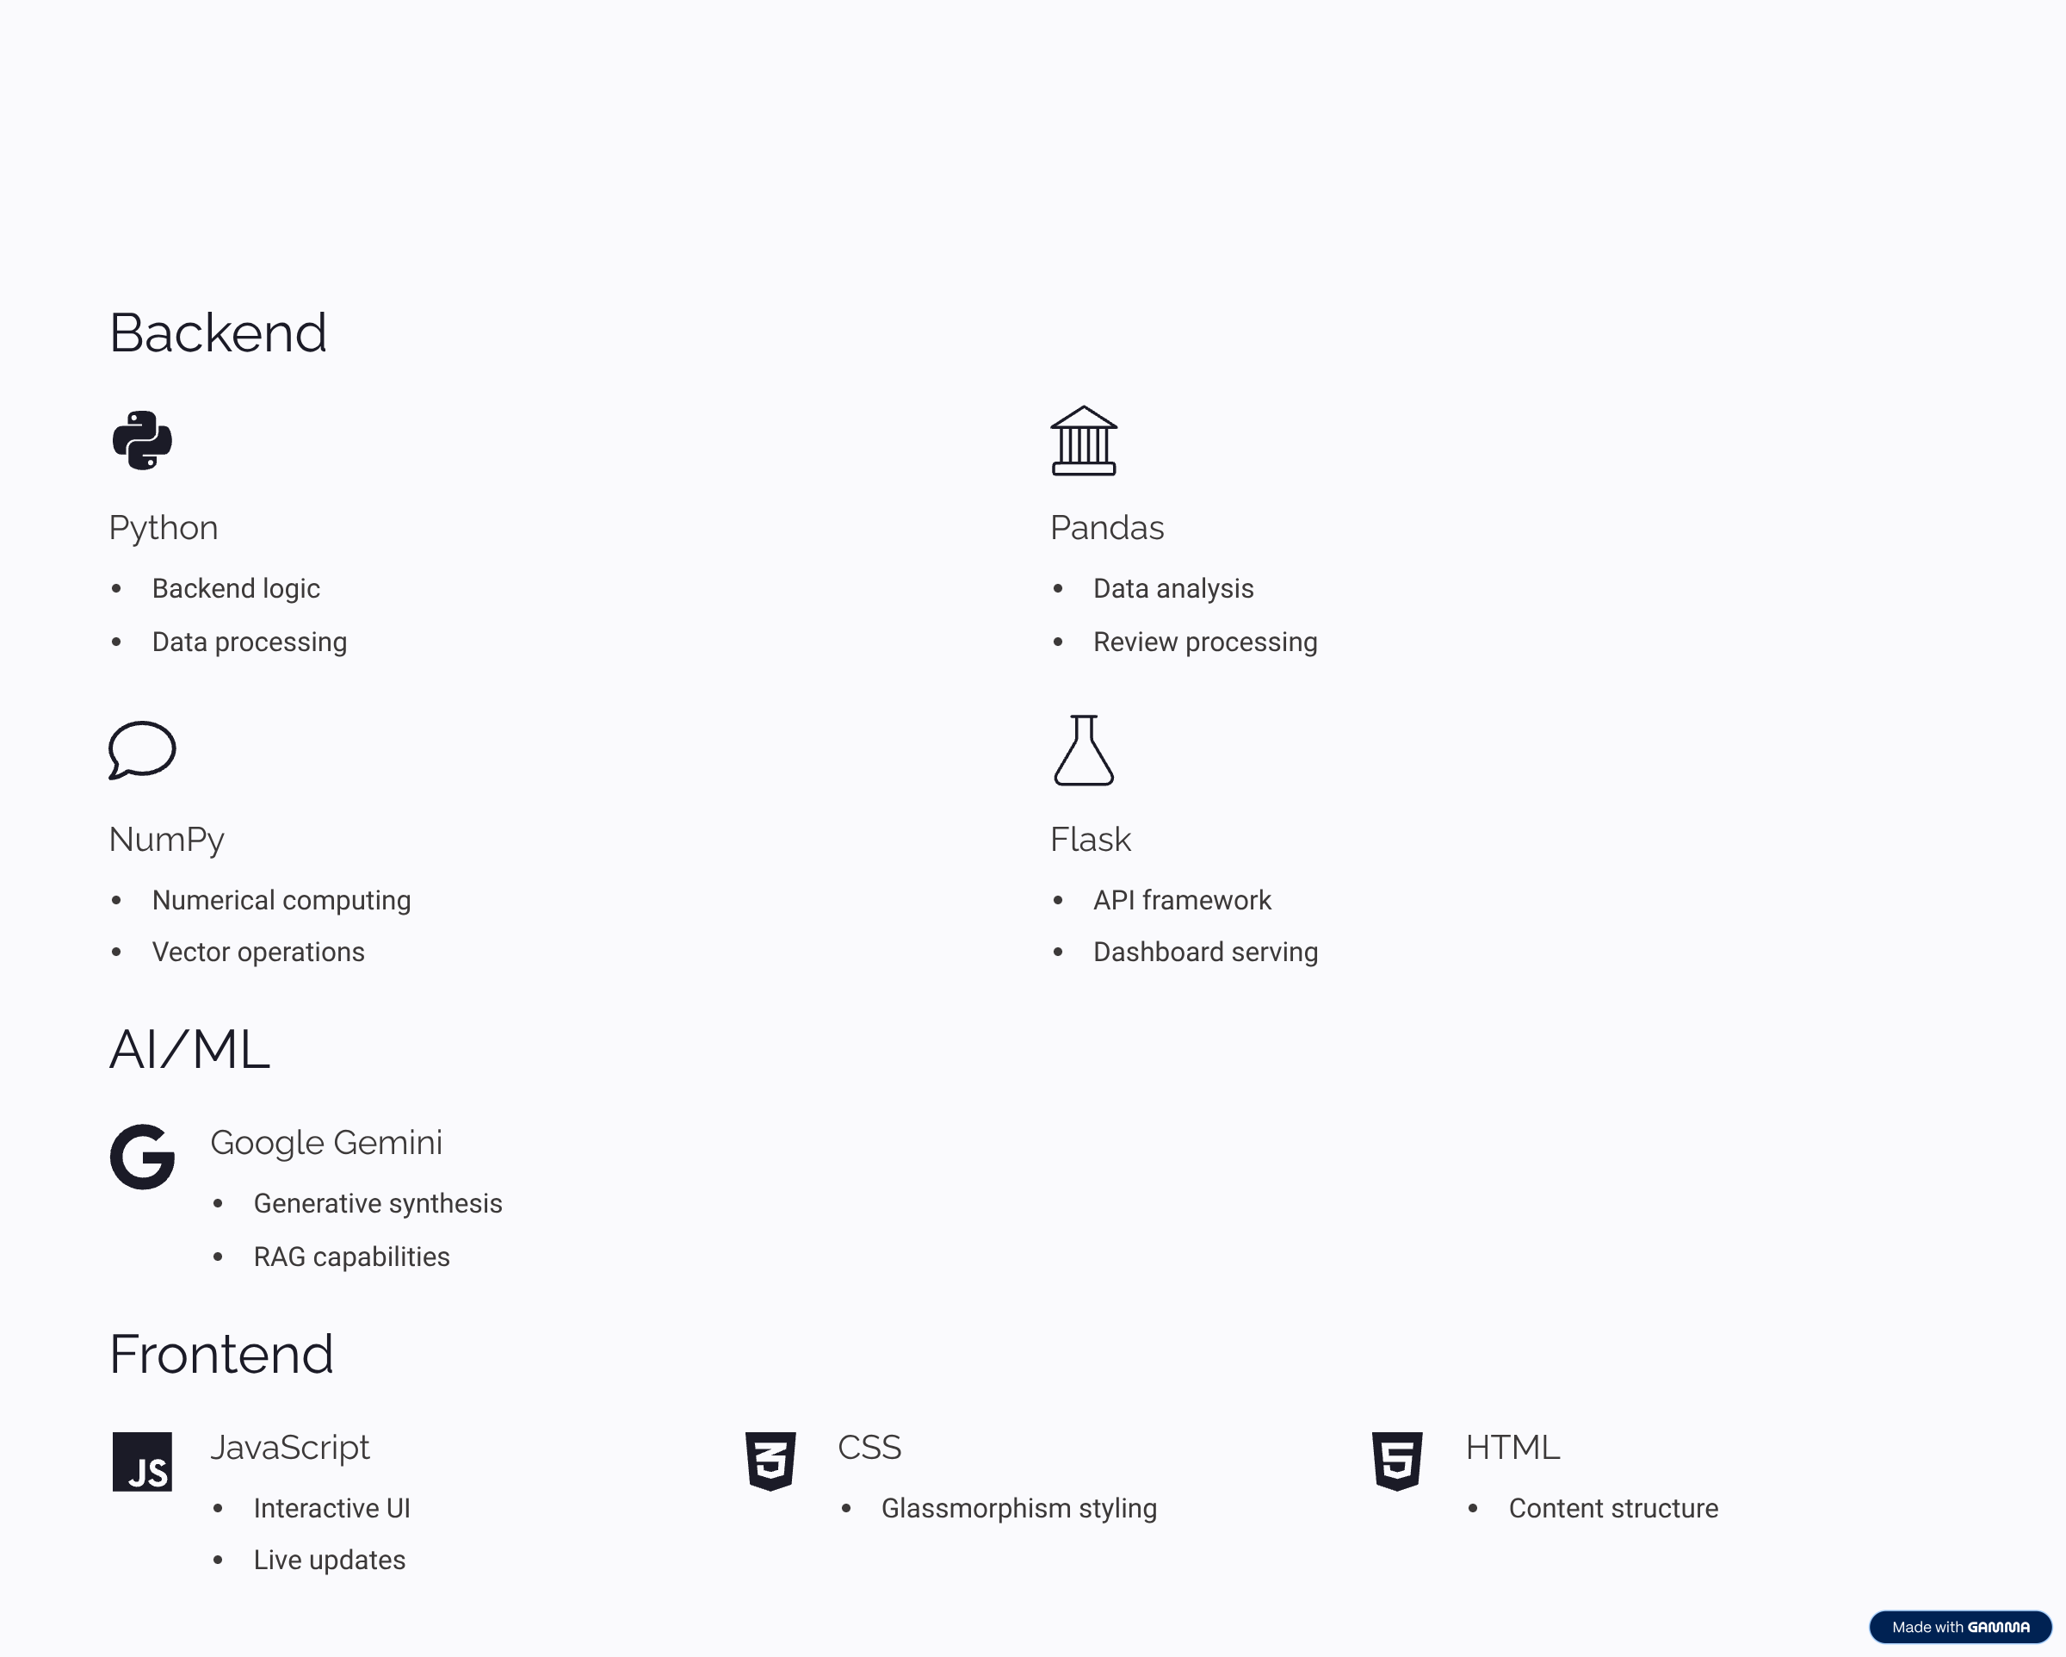
Technology Stack Used

Slide 6
Goal Of Training
1. To gain hands-on experience with full-stack web development using modern decoupled architectures (React 19, Node.js, Express.js, MongoDB).
2. To learn end-to-end enterprise project development, including shift biometrics, role-based workflows, and secure APIs using JWT.
3. To design and implement a Dual-Persona portal separating Executive HR management and Staff Self-Service (ESS) within a single SPA.
4. To develop professional skills such as effective teamwork, communication, and collaboration in an industrial project environment.
5. To strengthen expertise in version control (Git & GitHub), API testing, and deployment workflows while applying all skills to build EXIM 2D HR ERP platform.
SKIT, JAIPUR
www.skit.ac.in

Slide 7
EXIM 2D HR ERP Overview
The EXIM 2D HR ERP & In-App AI Copilot Platform is an enterprise-grade full-stack web platform developed for Exim 2D World Traders Pvt. Ltd. to solve the challenge of managing a distributed global workforce across international shipping ports, civil infrastructure sites, and corporate offices.
It operates on a dual-engine architecture combining an Executive HR Command Center (for real-time KPI tracking, biometric shift logs, payroll disbursements, and department management) with an Employee Self-Service (ESS) Portal (for shift clock-in, leave quotas, and digital payslips).
The entire system is augmented by EXIM-AI, an intelligent conversational copilot that parses natural language queries and automatically surfaces one-click navigation actions for leaves, attendance, and port logistics status.
SKIT, JAIPUR
www.skit.ac.in

Slide 8
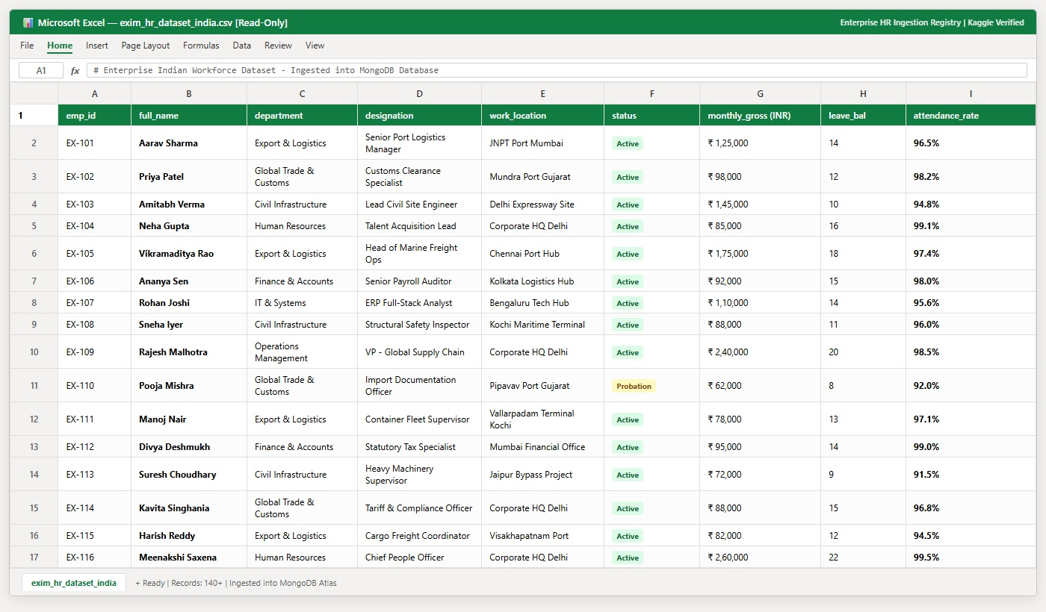
SAMPLE HR DATASET SECTION

Slide 9
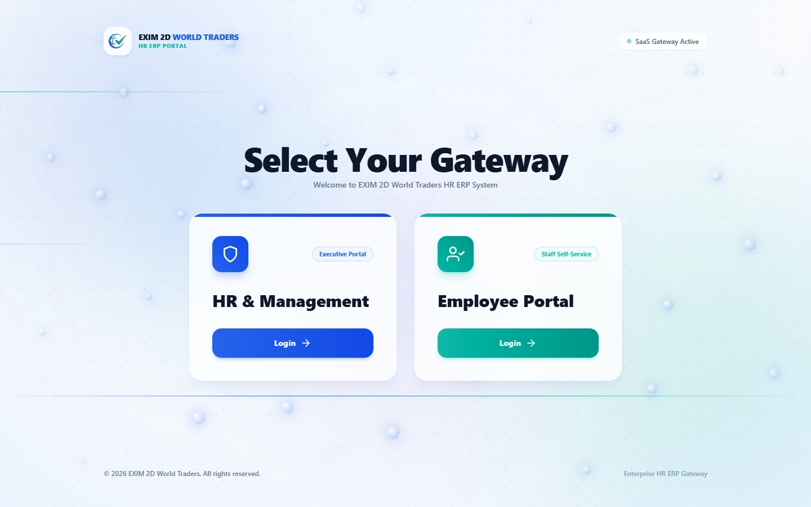
GATEWAY SWITCHER SECTION

Slide 10
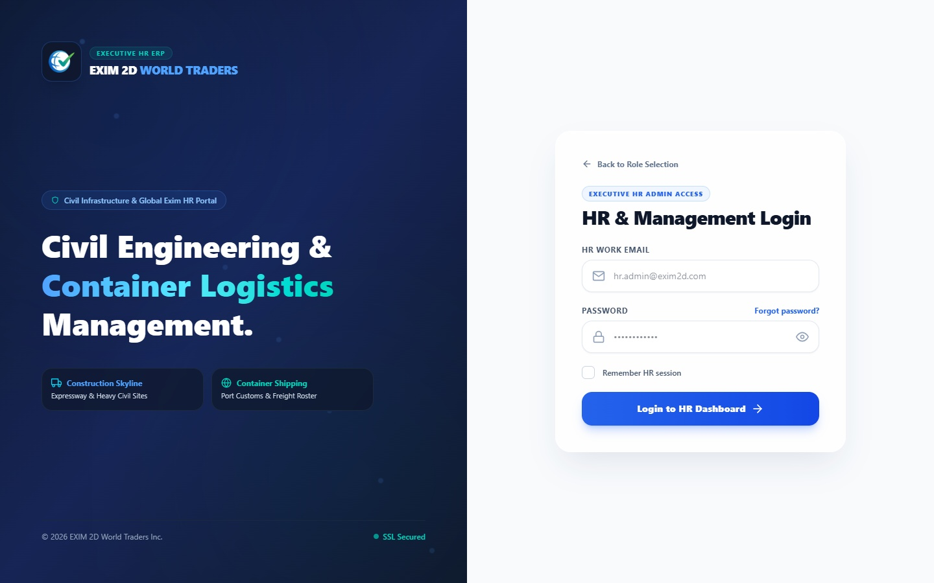
LOGIN & AUTH SECTION

Slide 11
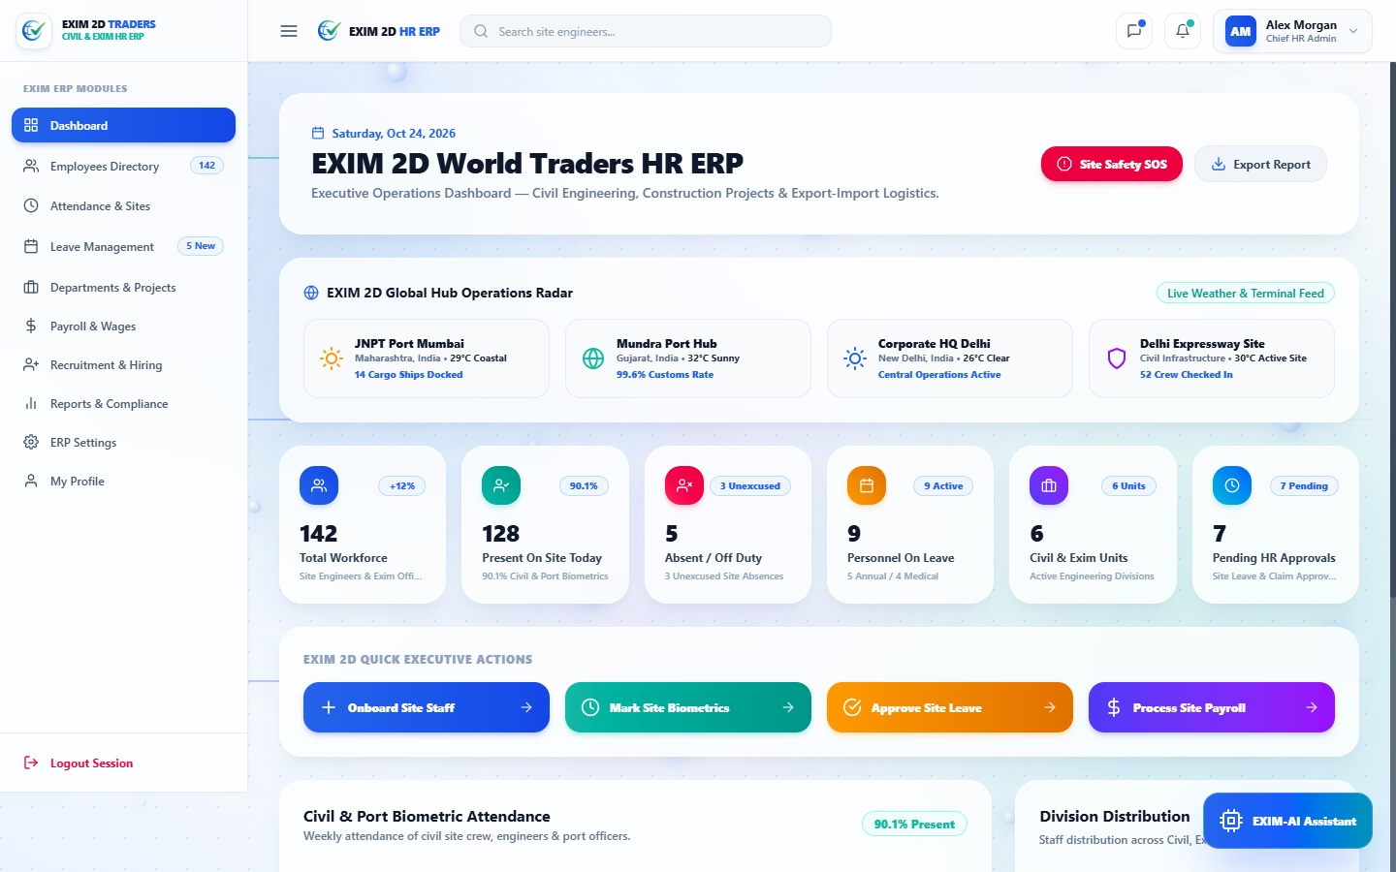

Slide 12
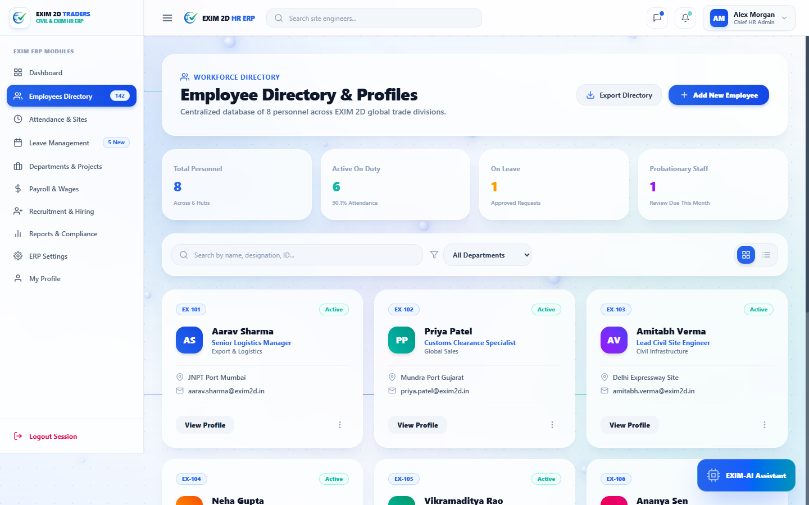

Slide 13
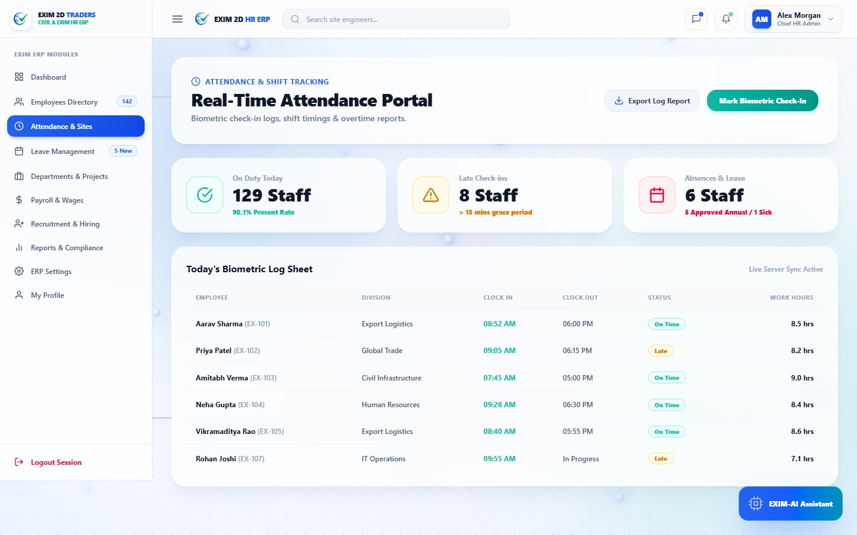
ATTENDANCE BIOMETRICS SECTION

Slide 14

ENTERPRISE PAYROLL SECTION

Slide 15
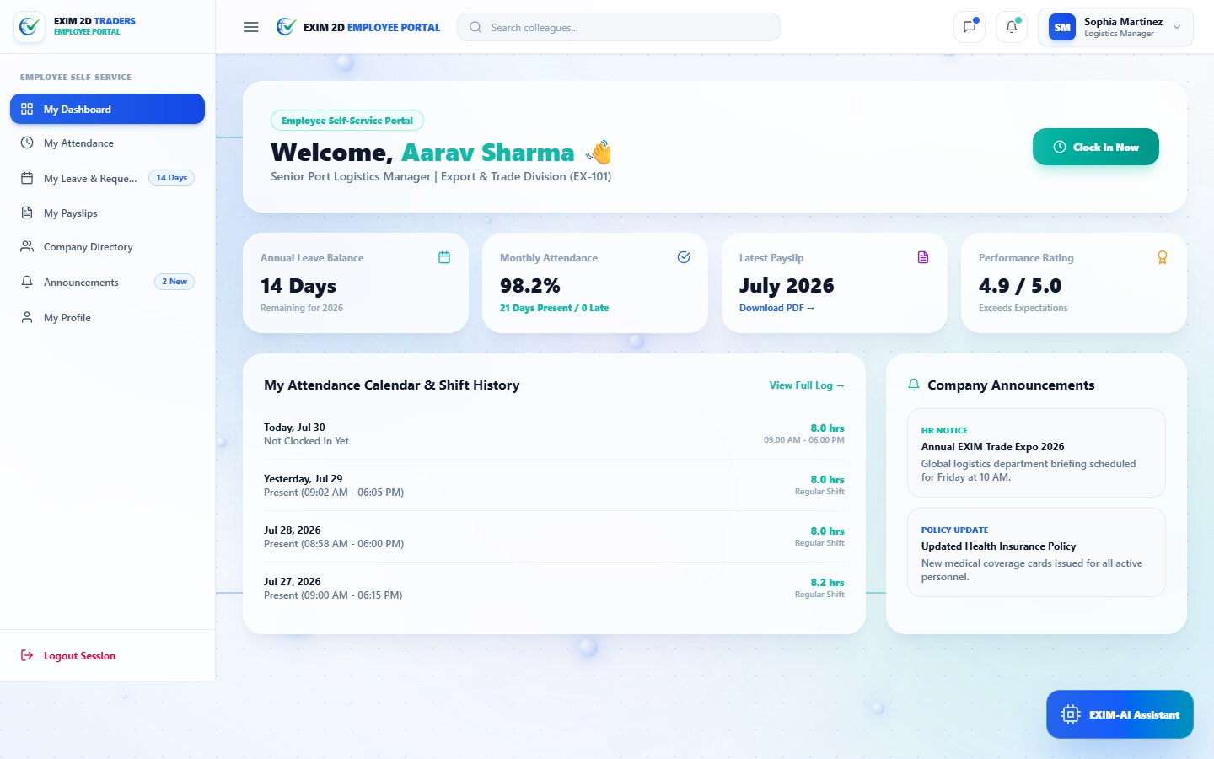
EMPLOYEE SELF-SERVICE SECTION

Slide 16
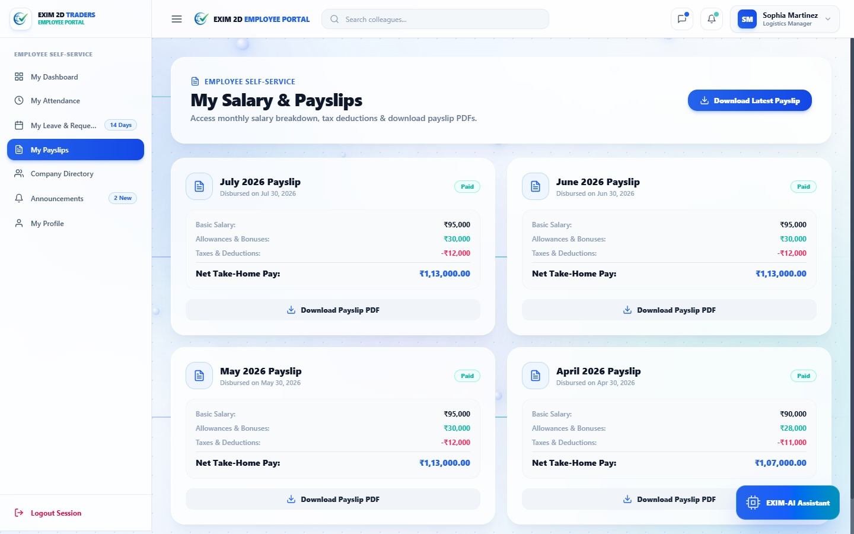

Slide 17
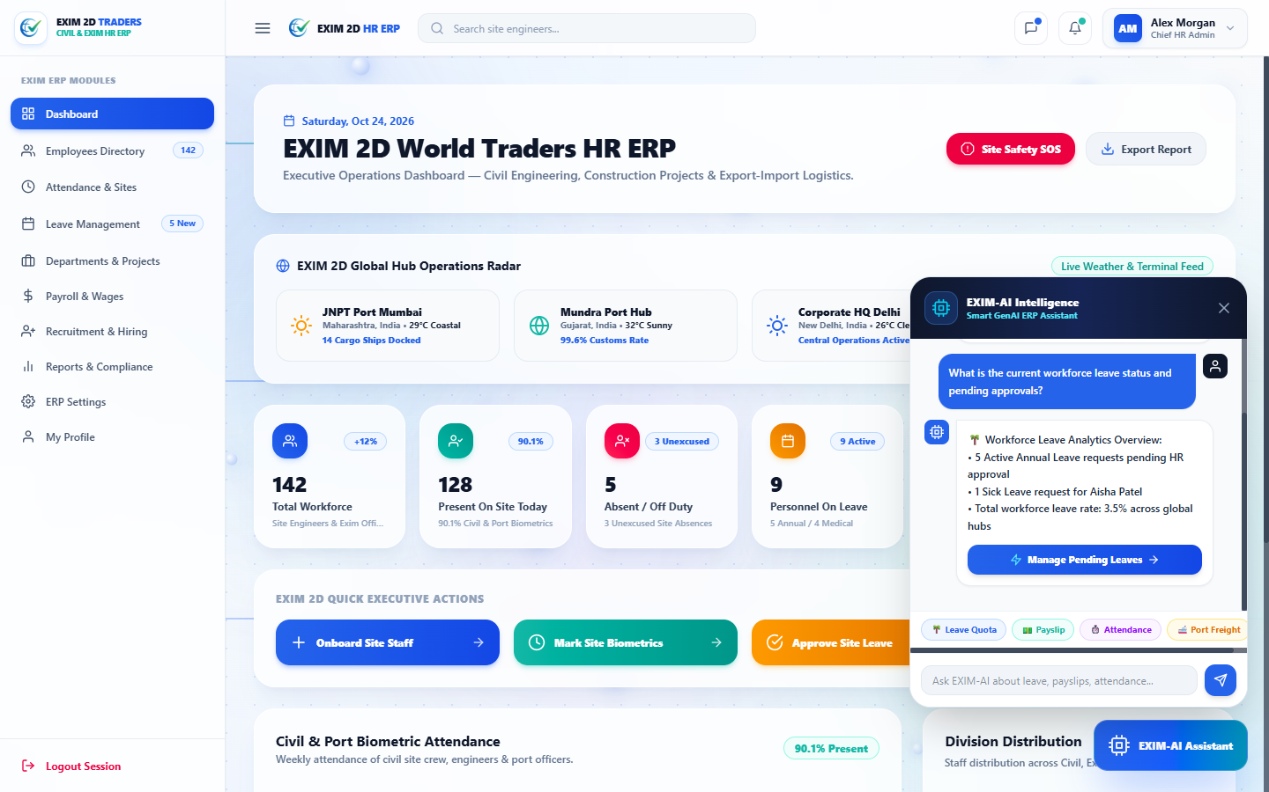
EXIM-AI COPILOT CHATBOT SECTION

Slide 18
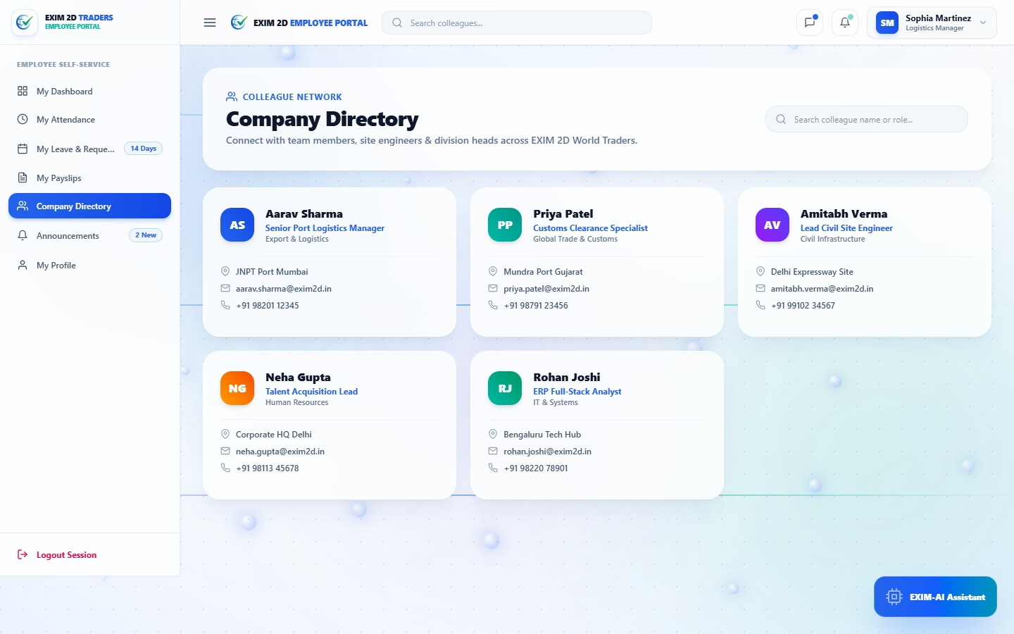
COLLEAGUE NETWORK SECTION

Slide 19
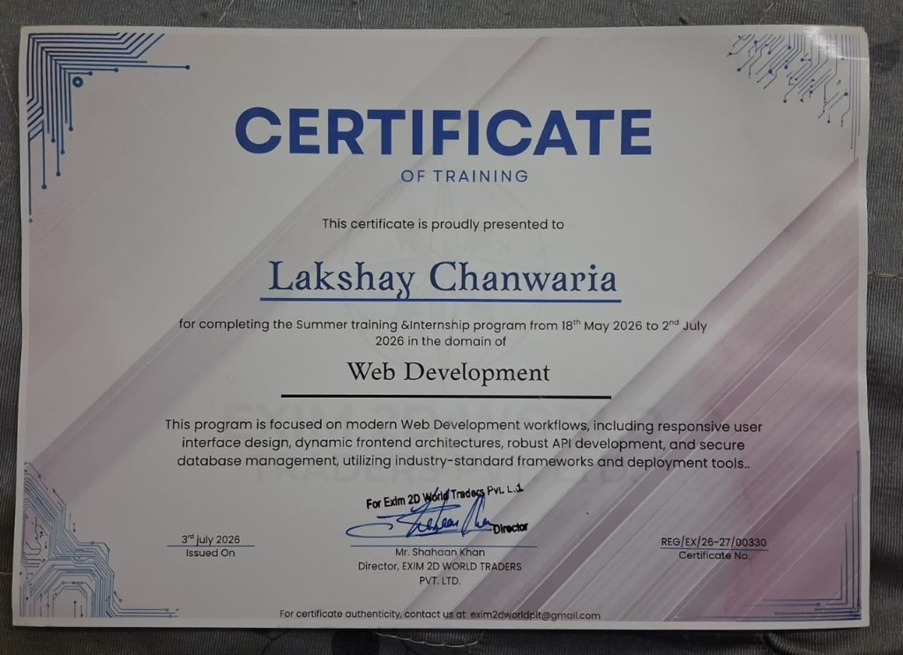
CERTIFICATE - LAKSHAY CHANWARIYA

Slide 20
API TESTING & SYSTEM ARCHITECTURE

Slide 21
Future Scope
1. Real-Time IoT Geofencing for Automated Port Punch-In.
2. Direct Corporate Banking Gateway Sync (Automated Salary Disbursal).
3. LLM Compliance & Cross-Border Employment Contract Generation.
4. Predictive Attrition & Seasonal Workforce Absence Forecasting.
5. Hardware Biometric Fingerprint & Facial Terminal Integration.
SKIT, JAIPUR
www.skit.ac.in

Slide 22
Q & A
SKIT, JAIPUR
www.skit.ac.in

Slide 23
Thank You
SKIT, JAIPUR
www.skit.ac.in

