Slide 1


Swami Keshvanand Institute of Technology, Management & Gramothan, Jaipur
(An Autonomous Institute Affiliated to Rajasthan Technical University, Kota)
Industrial Training
Presentation
TOPIC: EXIM 2D HR ERP
Submitted To:
Name:- Dr. Meenakshi Nawal
Associate Professor
Department of Computer Science & Engineering
Submitted By:
Name:- Khushi Kumari
Name:- Lakshay Chanwariya
Department of Computer Science & Engineering
SKIT, Jaipur

Slide 2
Index
1. Company Introduction
2. Certificate
3. Technology Used
4. Goal of Training
5. Project Overview
6. Working Project
7. Future Scope
8. Q&A
SKIT, JAIPUR
www.skit.ac.in

Slide 3
Company Introduction
Exim 2D World Traders Pvt. Ltd. is a prominent international enterprise specializing in global import-export trade, maritime cargo logistics, container fleet management, and large-scale civil infrastructure projects.
Corporate Operations: The company operates major logistics and field project hubs across India—including JNPT Port Mumbai, Mundra Port Gujarat, Chennai Port Hub, Kolkata Logistics Center, and Corporate Headquarters in New Delhi.
Multidisciplinary Workforce: Exim 2D World Traders employs over 140+ multidisciplinary personnel comprising port logistics managers, customs clearance specialists, civil site engineers, and corporate management across timezones.
Software & ERP Division: The company focuses on technology adoption, digital workforce modernization, and customer satisfaction, providing a rigorous and supportive platform for learning, skill development, and professional growth in modern Web Development.
SKIT, JAIPUR
www.skit.ac.in

Slide 4
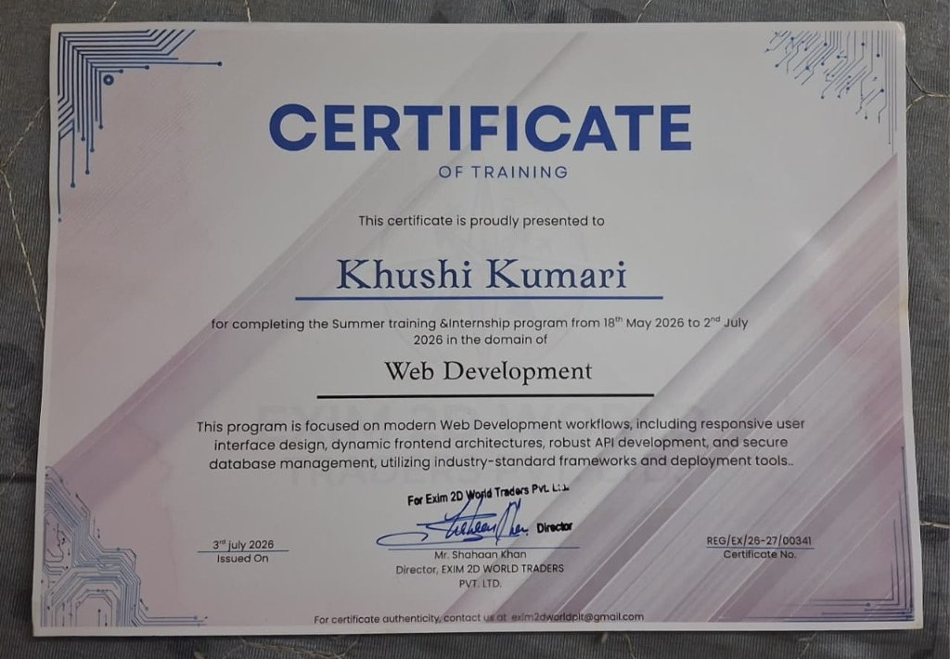
Certificate - Khushi Kumari
SKIT, JAIPUR
www.skit.ac.in

Slide 5
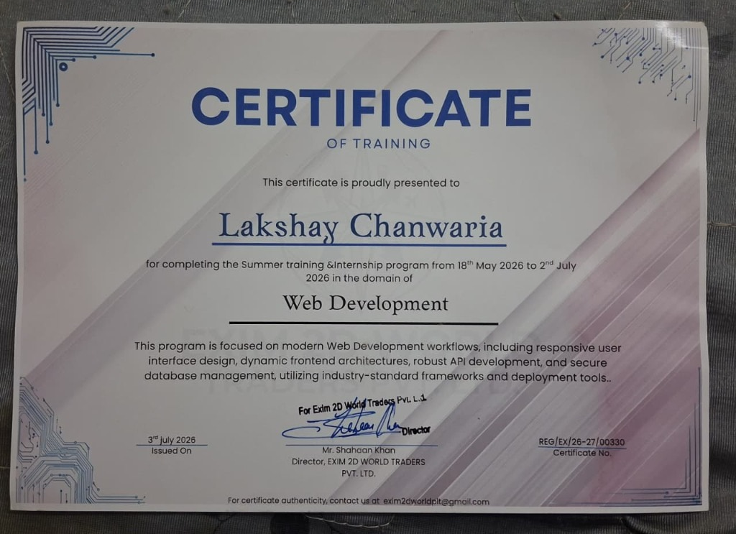
Certificate - Lakshay Chanwariya
SKIT, JAIPUR
www.skit.ac.in

Slide 6
Technology Stack Used
• Frontend Architecture: React 19, Vite 8, Tailwind CSS v4, Framer Motion 12, Recharts 3, React Router v7.
• Backend Services: Node.js, Express.js RESTful API framework, Axios HTTP Client.
• Database & Ingestion: MongoDB (NoSQL), Mongoose ODM, CSV/JSON Seeding Pipeline (seedData.js).
• Security & Authentication: Stateless JWT (JSON Web Tokens), bcrypt hashing, Role-Based Access Control (RBAC).
• AI & Intelligent Copilot: EXIM-AI Contextual Engine, Natural Language Intent Parser, Deep-Link Action Dispatcher.
SKIT, JAIPUR
www.skit.ac.in

Slide 7
Goal Of Training
1. To gain hands-on experience with full-stack web development using modern decoupled architectures (React 19, Node.js, Express.js, MongoDB).
2. To learn end-to-end enterprise project development, including shift biometrics, role-based workflows, and secure APIs using JWT and RBAC.
3. To design and implement a Dual-Persona portal separating Executive HR management and Staff Self-Service (ESS) within a single SPA.
4. To develop professional skills such as effective teamwork, communication, and collaboration in an industrial project environment.
5. To strengthen expertise in version control (Git & GitHub), API testing, and deployment workflows while applying all skills to build EXIM 2D HR ERP platform.
SKIT, JAIPUR
www.skit.ac.in

Slide 8
EXIM 2D HR ERP Overview
The EXIM 2D HR ERP Platform is an enterprise-grade full-stack web application developed for Exim 2D World Traders Pvt. Ltd. to streamline workforce governance across international shipping ports, civil infrastructure sites, and corporate offices.
Dual-Persona Portal Architecture: It operates on a decoupled architecture combining an Executive HR Command Center (for real-time KPI monitoring, biometric shift logs, payroll disbursements, and department management) with an Employee Self-Service (ESS) Portal (for shift clock-in, leave balances, and digital payslips).
Contextual AI Copilot (EXIM-AI): The platform is integrated with EXIM-AI, an intelligent conversational copilot that interprets natural language staff queries and provides automated one-click deep-link navigation actions for leaves, attendance, and port operations.
Enterprise Indian Workforce Grounding: The system is populated with realistic Indian workforce data across key maritime and trade hubs—including JNPT Port Mumbai, Mundra Port Gujarat, Chennai Port, Kolkata Logistics Hub, and Delhi Headquarters.
SKIT, JAIPUR
www.skit.ac.in

Slide 9
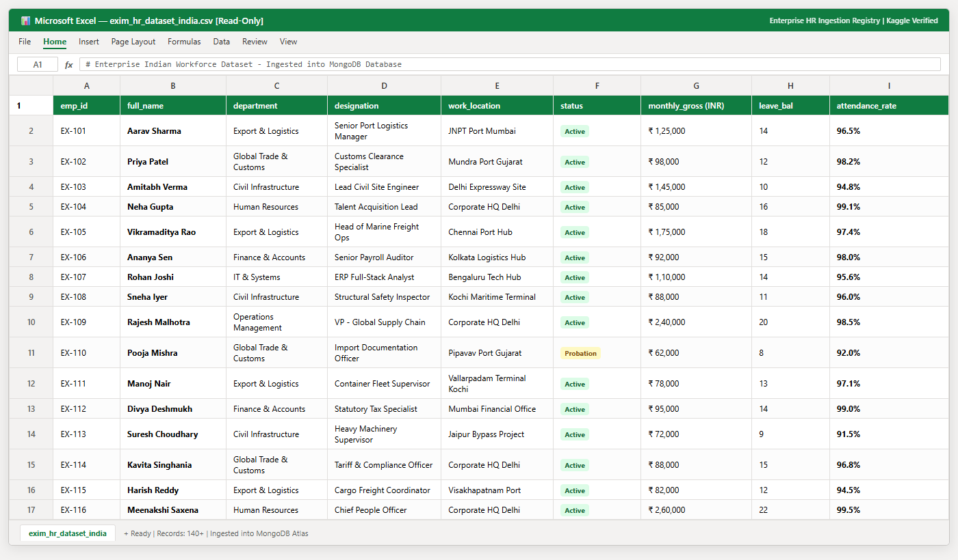
SAMPLE HR DATASET SECTION
SKIT, JAIPUR
www.skit.ac.in

Slide 10
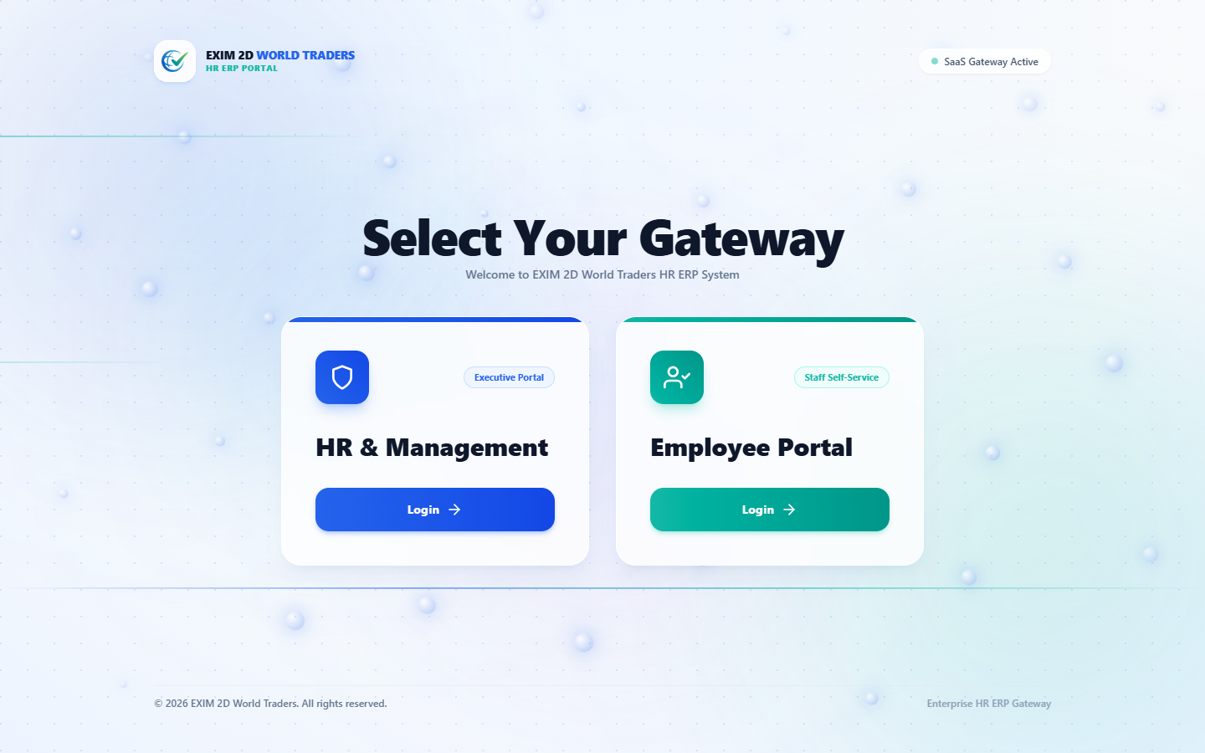
GATEWAY SWITCHER SECTION
SKIT, JAIPUR
www.skit.ac.in

Slide 11
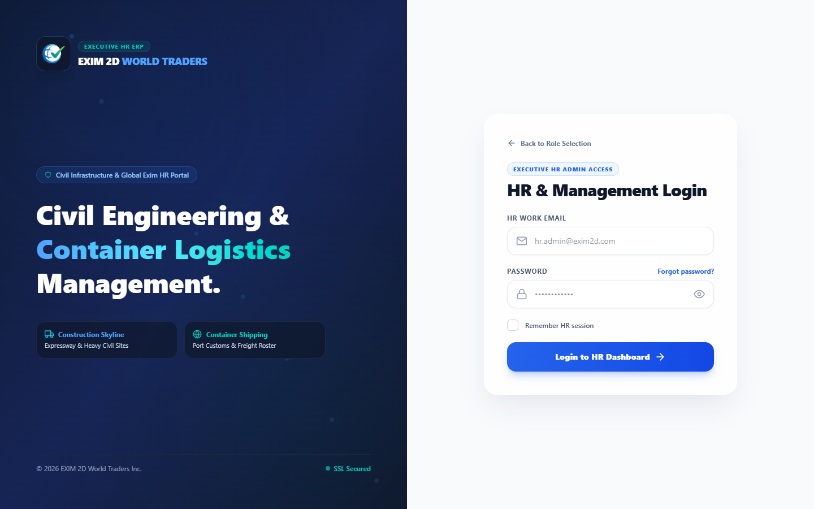
LOGIN SECTION
SKIT, JAIPUR
www.skit.ac.in

Slide 12
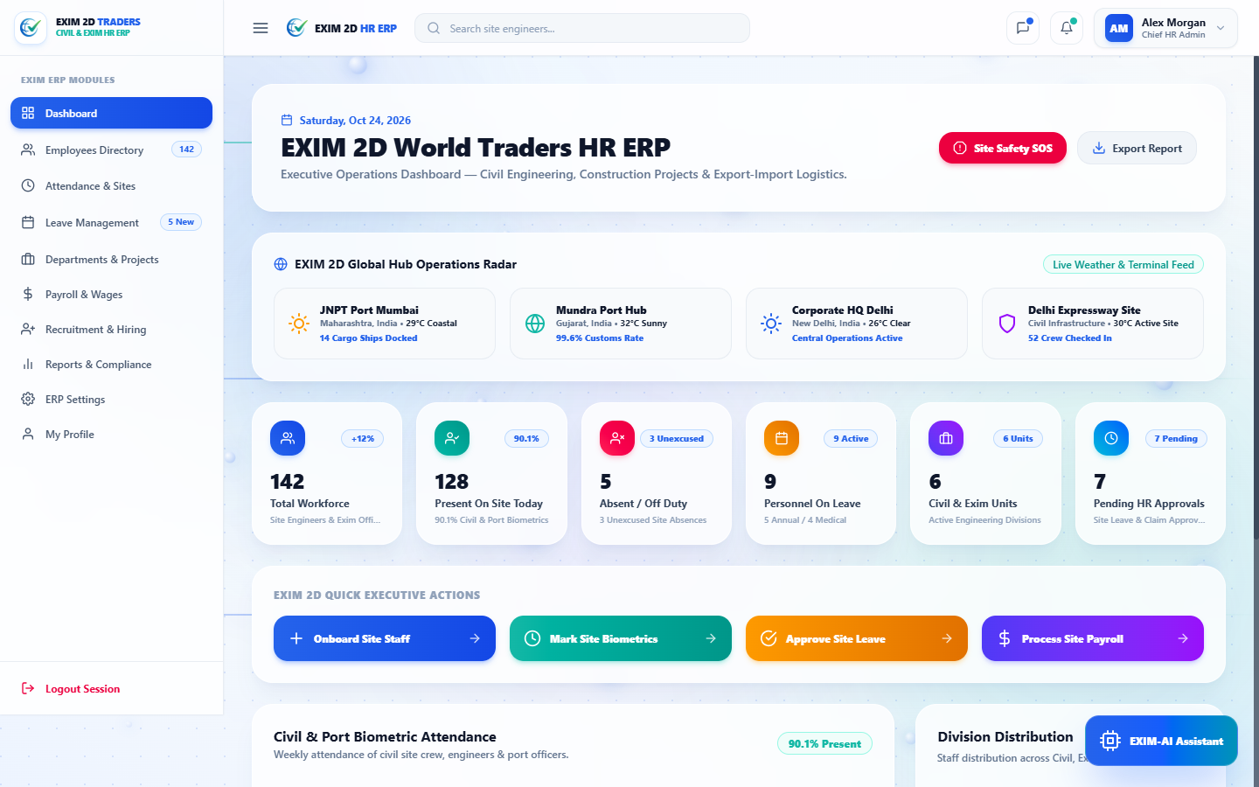
HR DASHBOARD & RADAR SECTION
SKIT, JAIPUR
www.skit.ac.in

Slide 13
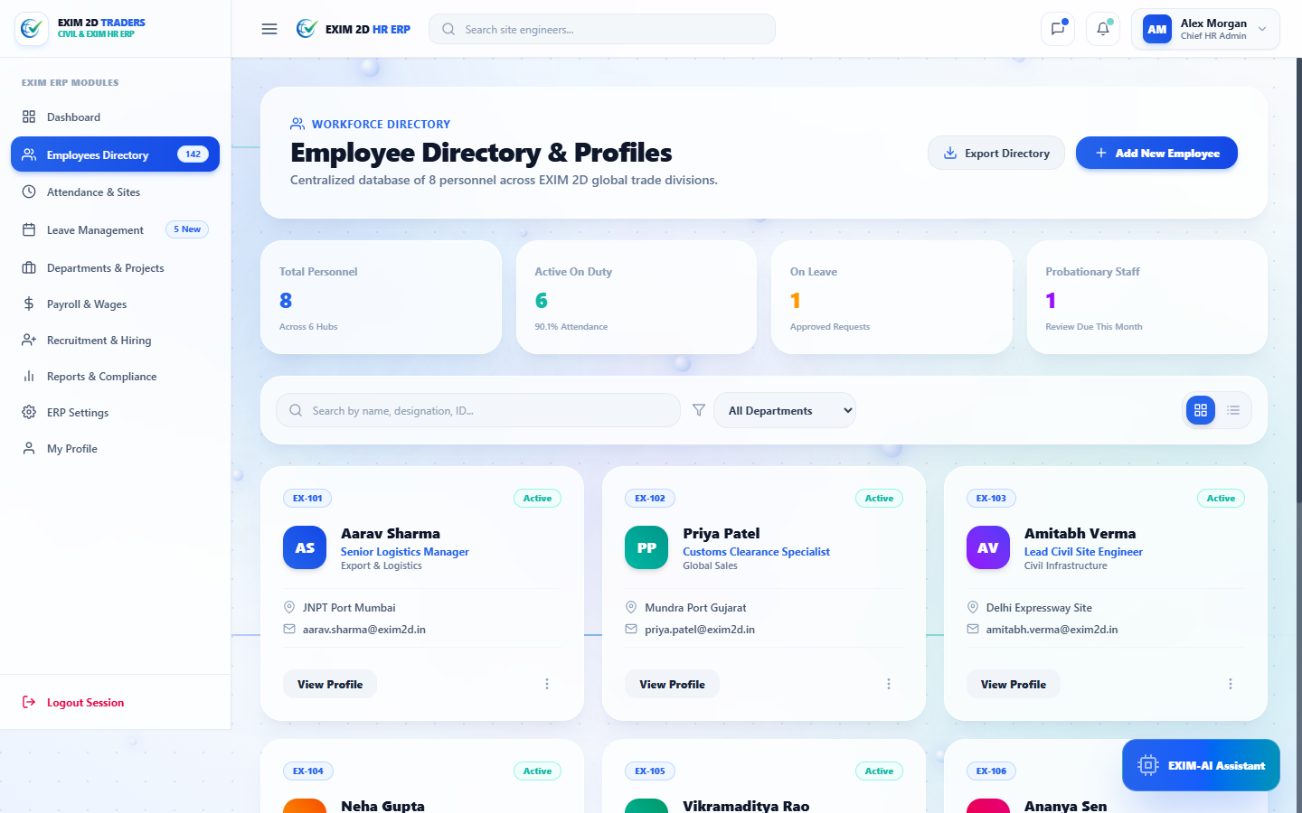
EMPLOYEES DIRECTORY SECTION
SKIT, JAIPUR
www.skit.ac.in

Slide 14
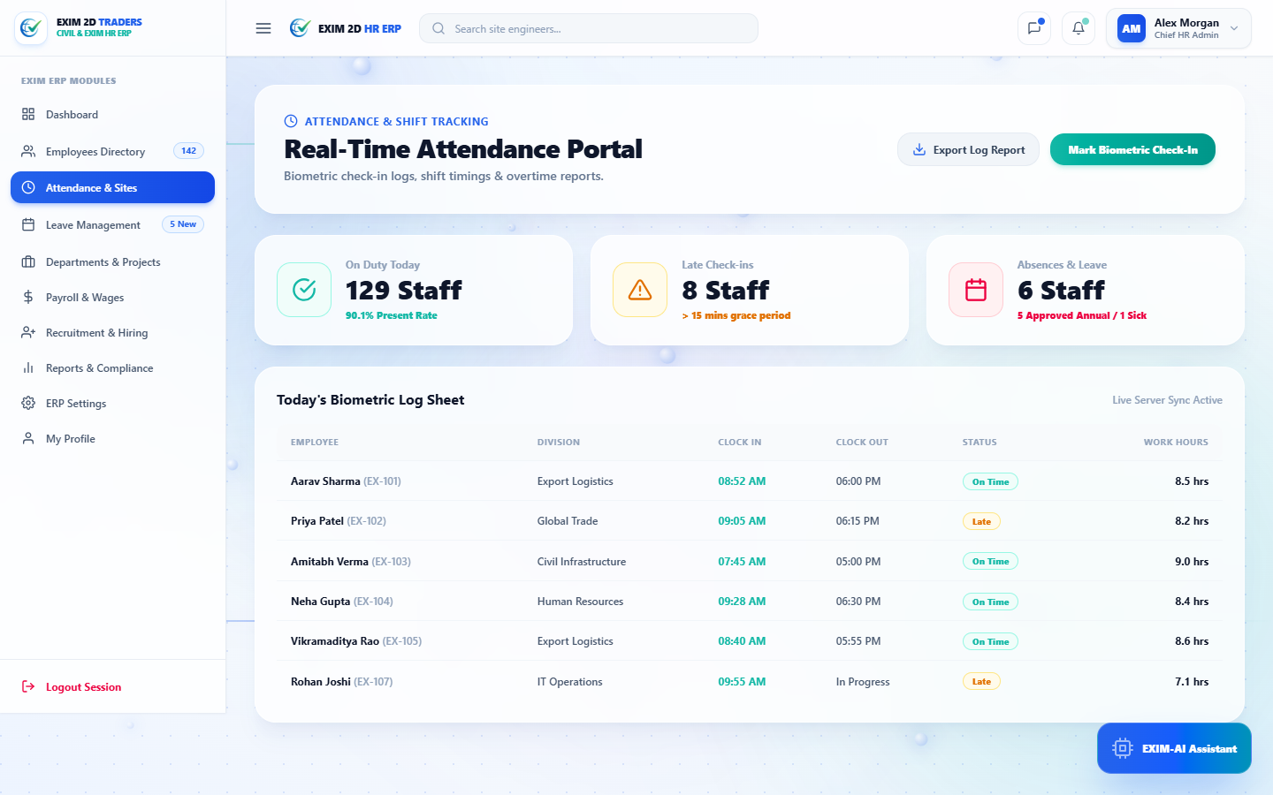
ATTENDANCE BIOMETRICS SECTION
SKIT, JAIPUR
www.skit.ac.in

Slide 15

ENTERPRISE PAYROLL SECTION
SKIT, JAIPUR
www.skit.ac.in

Slide 16
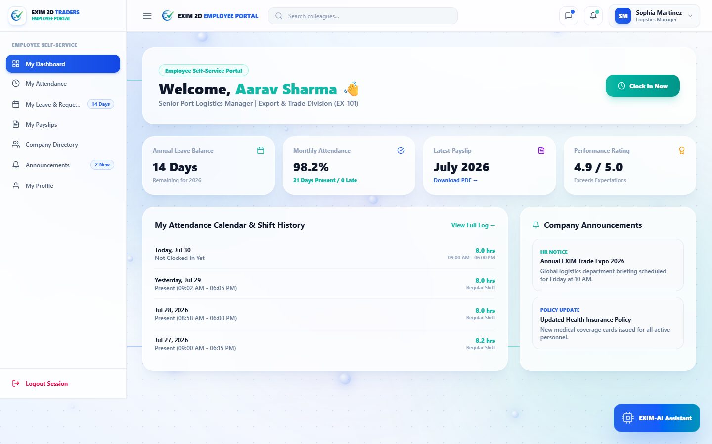
EMPLOYEE SELF-SERVICE SECTION
SKIT, JAIPUR
www.skit.ac.in

Slide 17
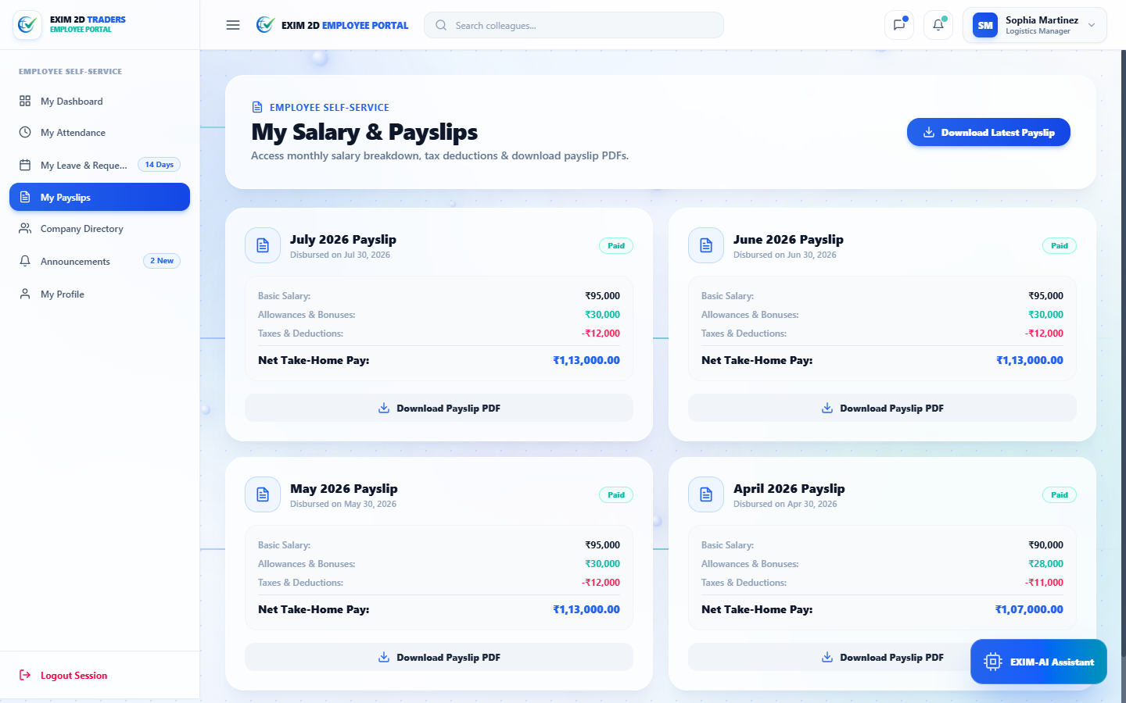
DIGITAL PAYSLIP SECTION
SKIT, JAIPUR
www.skit.ac.in

Slide 18
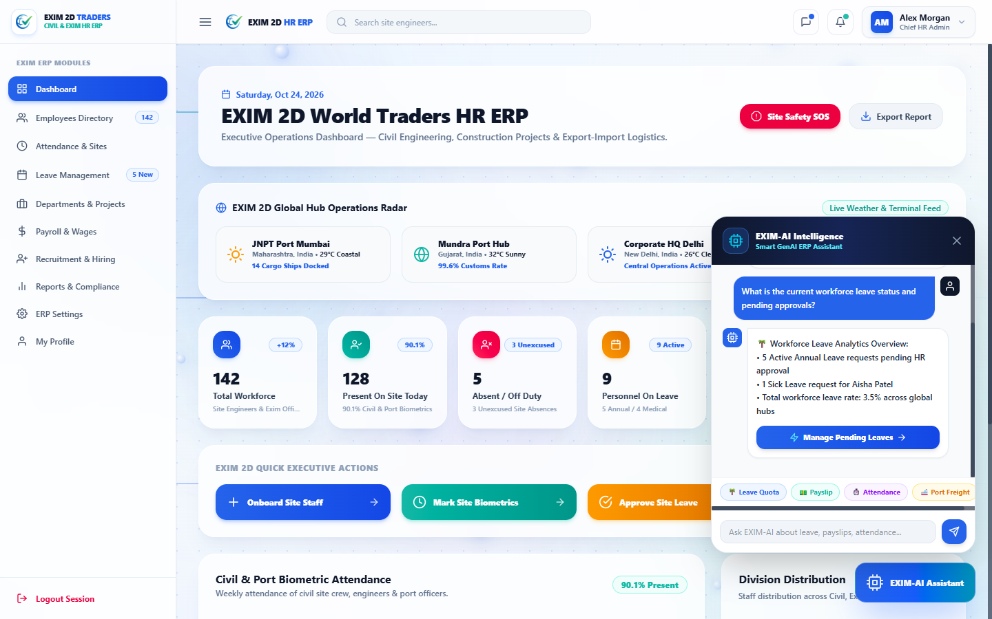
EXIM-AI COPILOT CHATBOT SECTION
SKIT, JAIPUR
www.skit.ac.in

Slide 19
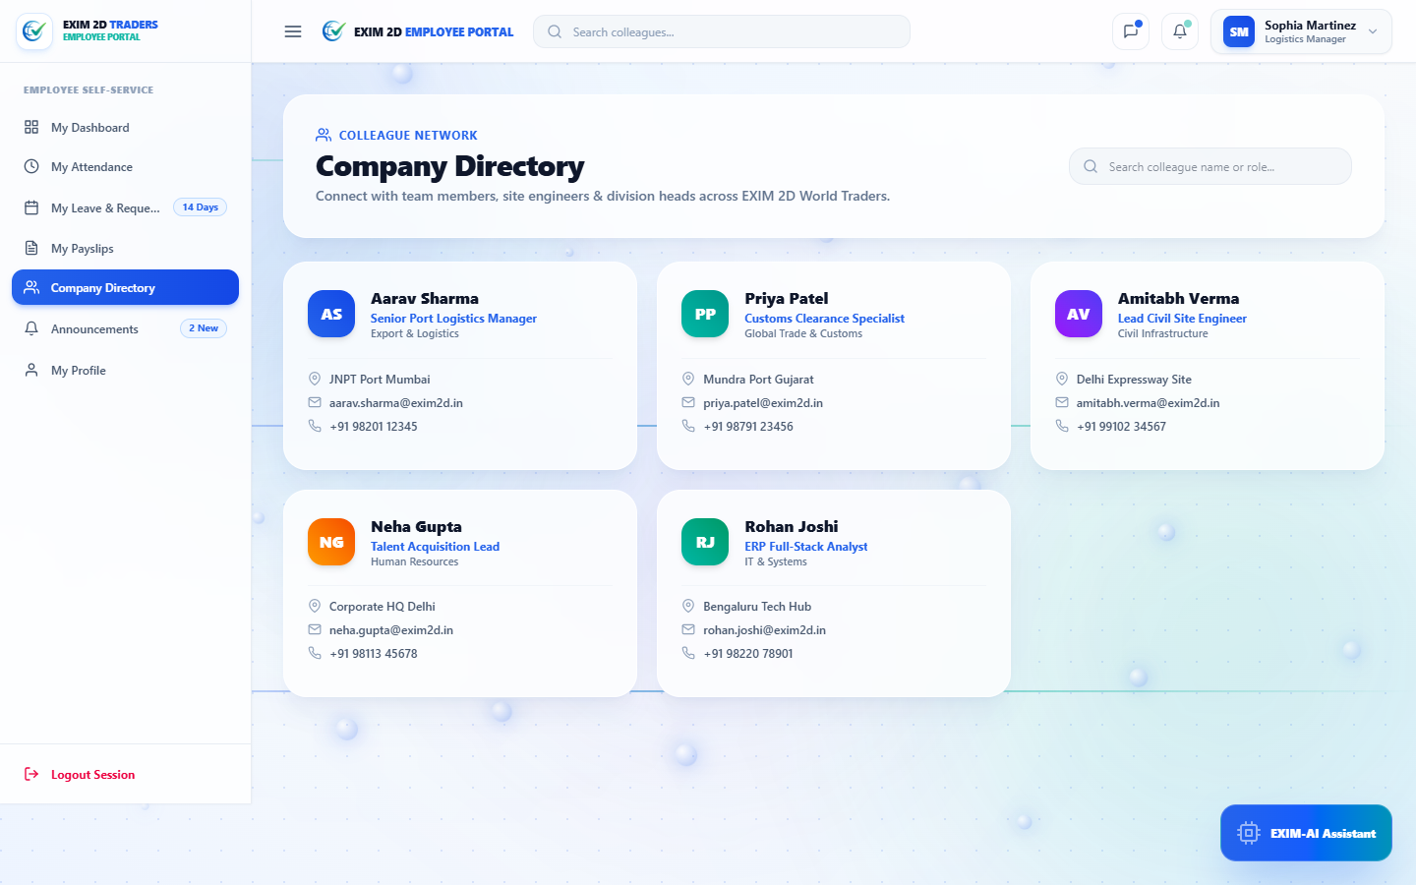
COLLEAGUE NETWORK SECTION
SKIT, JAIPUR
www.skit.ac.in

Slide 20
Future Scope
1. Real-Time IoT Geofencing for Automated Port Punch-In.
2. Direct Corporate Banking Gateway Integration (Automated Salary Disbursal).
3. LLM Compliance & Cross-Border Employment Contract Generation.
4. Predictive Attrition & Seasonal Workforce Absence Forecasting.
5. Hardware Biometric Fingerprint & Facial Terminal Integration.
SKIT, JAIPUR
www.skit.ac.in

Slide 21
Q & A
SKIT, JAIPUR
www.skit.ac.in

Slide 22
Thank
You
SKIT, JAIPUR
www.skit.ac.in

