Slide 1


Swami Keshvanand Institute of Technology, Management & Gramothan, Jaipur
(An Autonomous Institute Affiliated to Rajasthan Technical University, Kota)
Industrial Training Presentation
TOPIC: App Review Intelligence
Assistance
Submitted To:
Name:- Dr. Meenakshi Nawal Associate Professor
Submitted By:
Name:- Mahak Kataria
Roll No.:- 24ESKCS196

Slide 2
Index
Company Introduction
Certificate
Technology Used
Goal of Training
Project Overview
Working Project
Future Scope
Q&A
SKIT, JAIPUR
www.skit.ac.in

Slide 3

Company Introduction
Tecorb Technologies is a leading AI-driven software development and IT solutions company headquartered in Noida, Uttar Pradesh, India.This company specializes in AI & ML, Generative AI, Web and Mobile App Development, Cloud Solutions, DevOps, and Custom Software Development.Tecorb operates from its office at B-52, Sector 63, Noida, Uttar Pradesh – 201301 With a global presence, Tecorb serves startups, SMEs, and enterprises across various industries. The company focuses on innovation, quality, and customer satisfaction, providing a strong platform for learning, skill development, and professional growth.
SKIT, JAIPUR
www.skit.ac.in

Slide 4
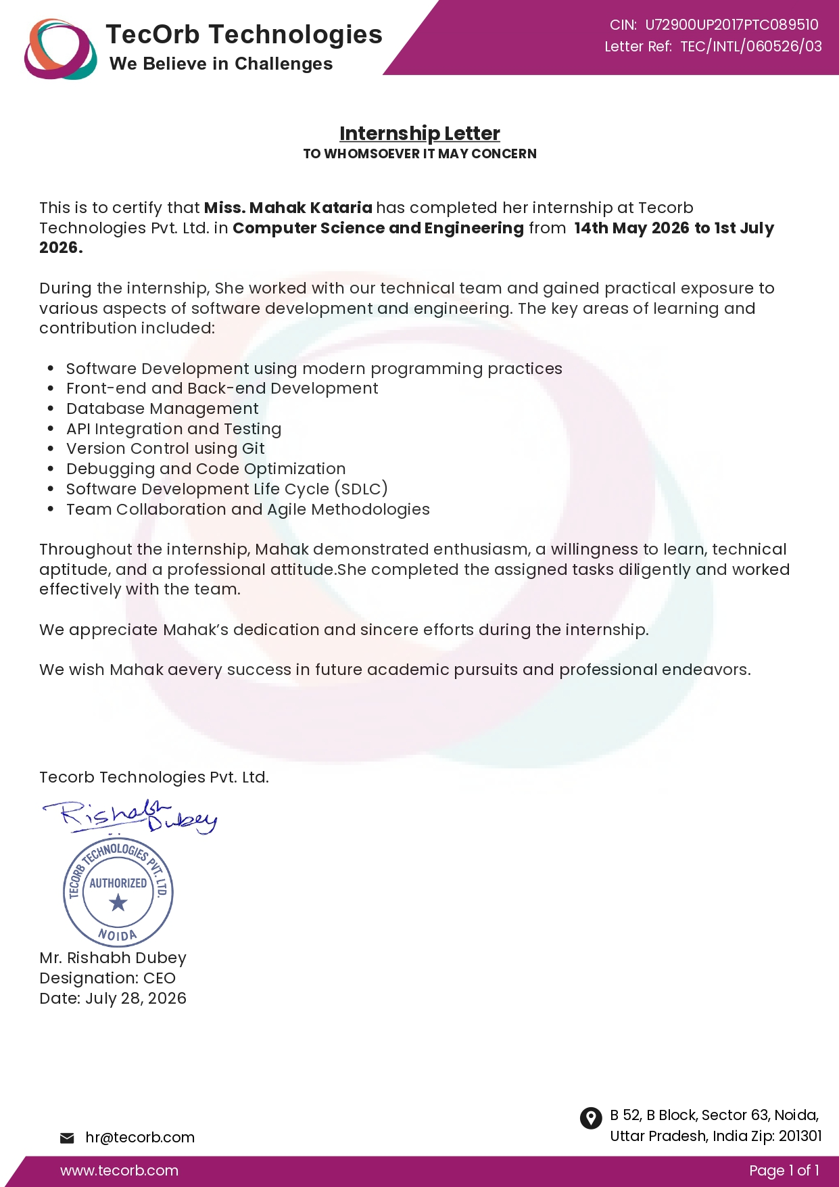

Slide 5
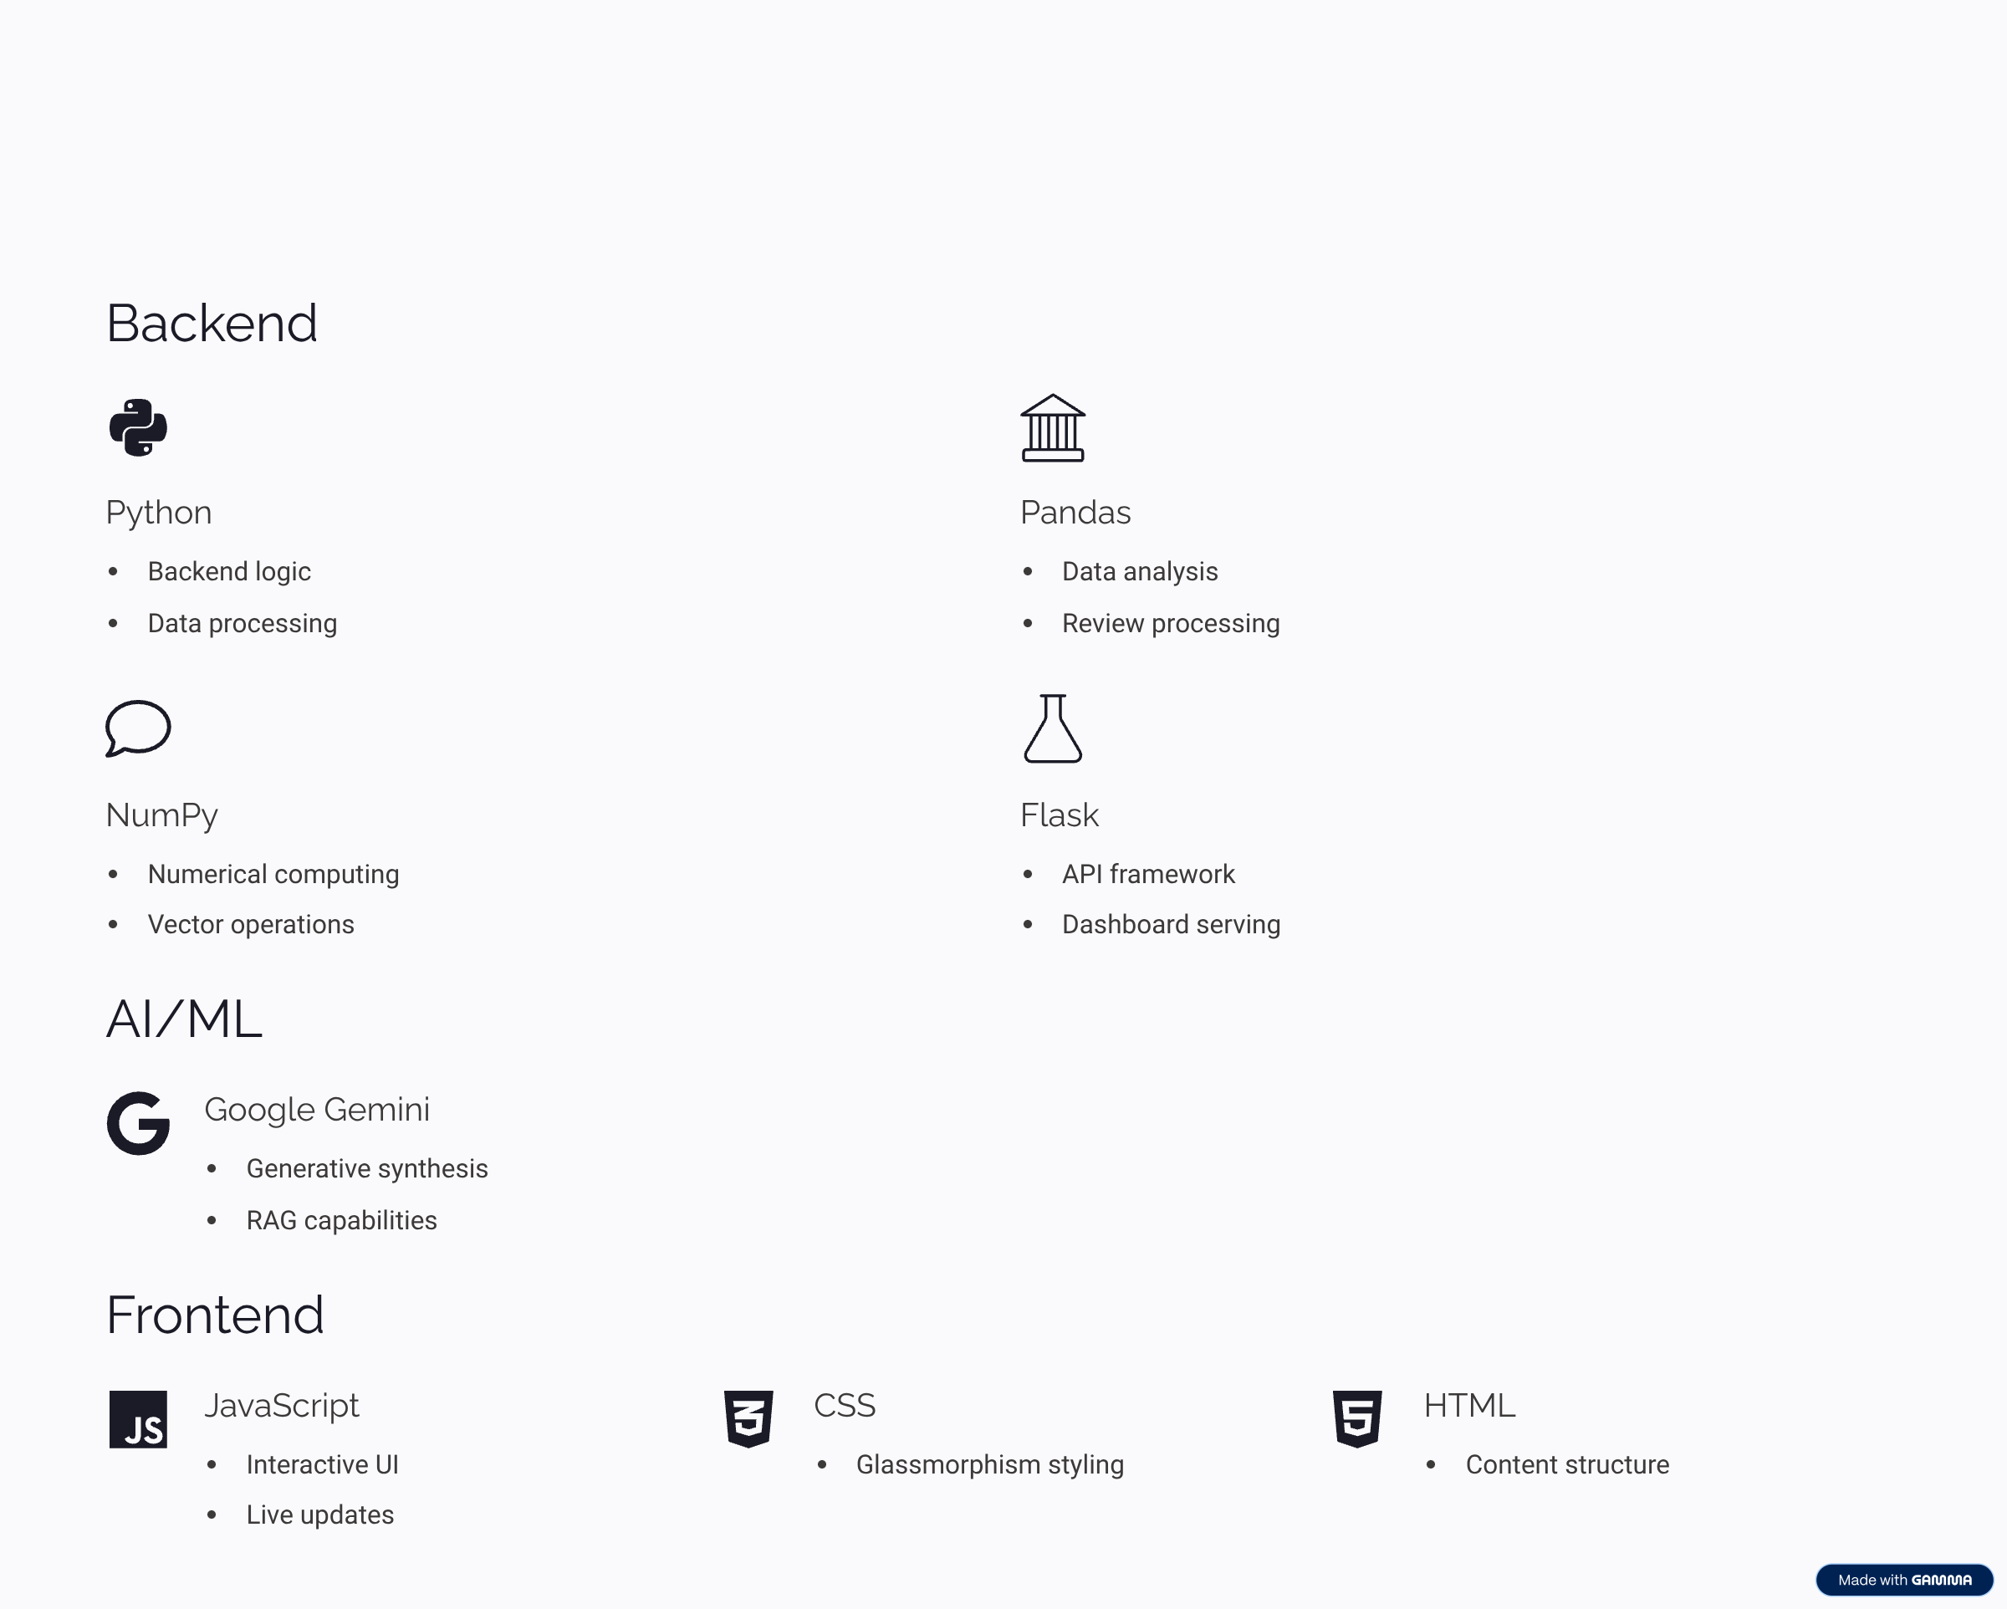
Technology Stack Used

Slide 6
Goal Of Training
To gain hands-on experience with full-stack web development
To learn end-to-end project development, including debugging, TecOrb Developer Onboarding: Built as an intensive training model for TecOrb Solutions Mobile Development to train new software engineers on building enterprise-grade Data Science & GenAI web products. Demonstrates practical mastery of Data Engineering (Pandas/NumPy) combined with Generative AI (RAG & LLMs)
To develop professional skills such as effective teamwork, communication, and collaboration in a project environment.
To strengthen expertise in version control, API testing, and deployment workflows while applying all skills to build DEVenue, a developer-focused networking platform.
SKIT, JAIPUR
www.skit.ac.in

Slide 7
App Review Overview
TThe TecOrb Mobile App Analytics & GenAI RAG Hardware Assistant is an enterprise-grade dual-engine web platform developed for TecOrb Solutions Mobile Development onboarding and academic evaluation to solve the challenge of analyzing massive, unstructured user review datasets and providing instant, context-grounded technical troubleshooting. It operates on a dual-engine architecture combining a Pandas & NumPy Analytics Engine with a GenAI RAG Engine that converts support documentation into a TF-IDF vector matrix for sub-15ms Cosine Similarity retrieval and grounds responses using Google Gemini AI.
SKIT, JAIPUR
www.skit.ac.in

Slide 8
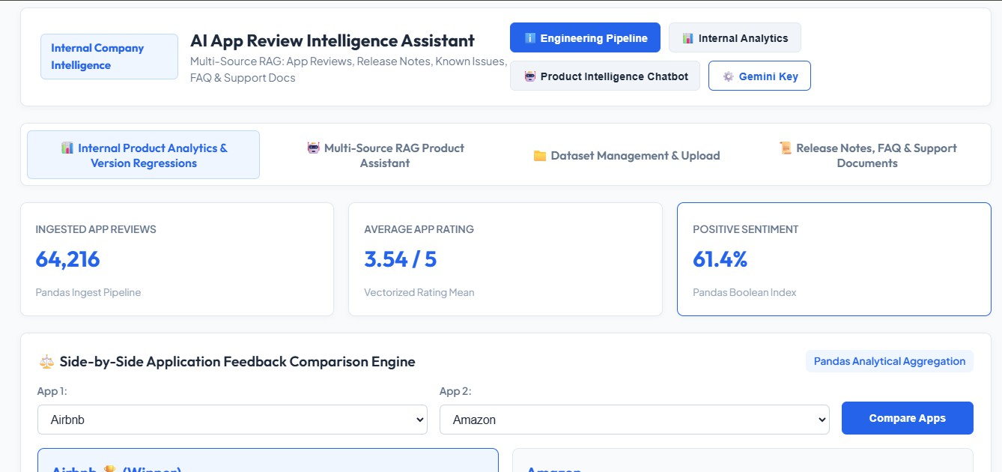
REVIEW SECTION

Slide 9
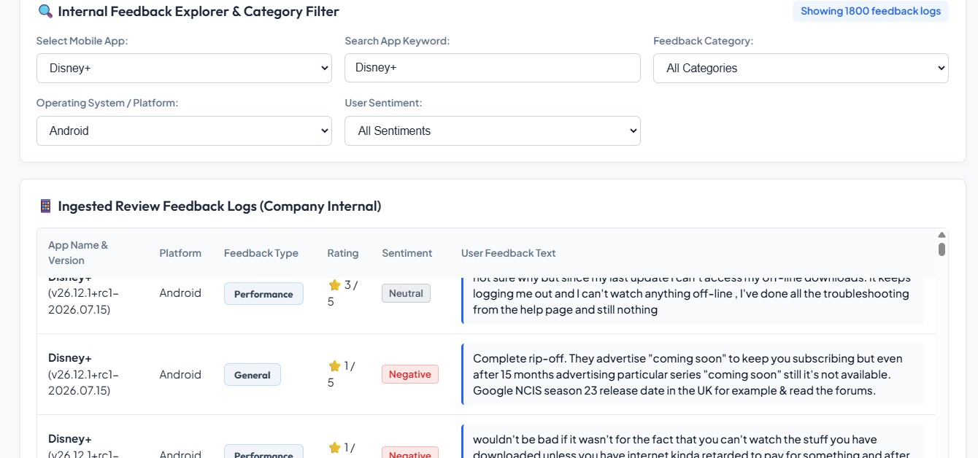
REVIEW SECTION

Slide 10
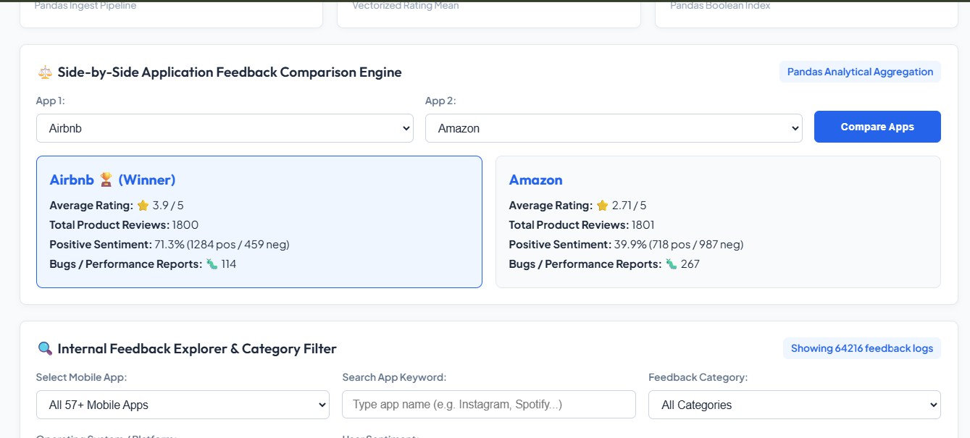
REVIEW SECTION

Slide 11
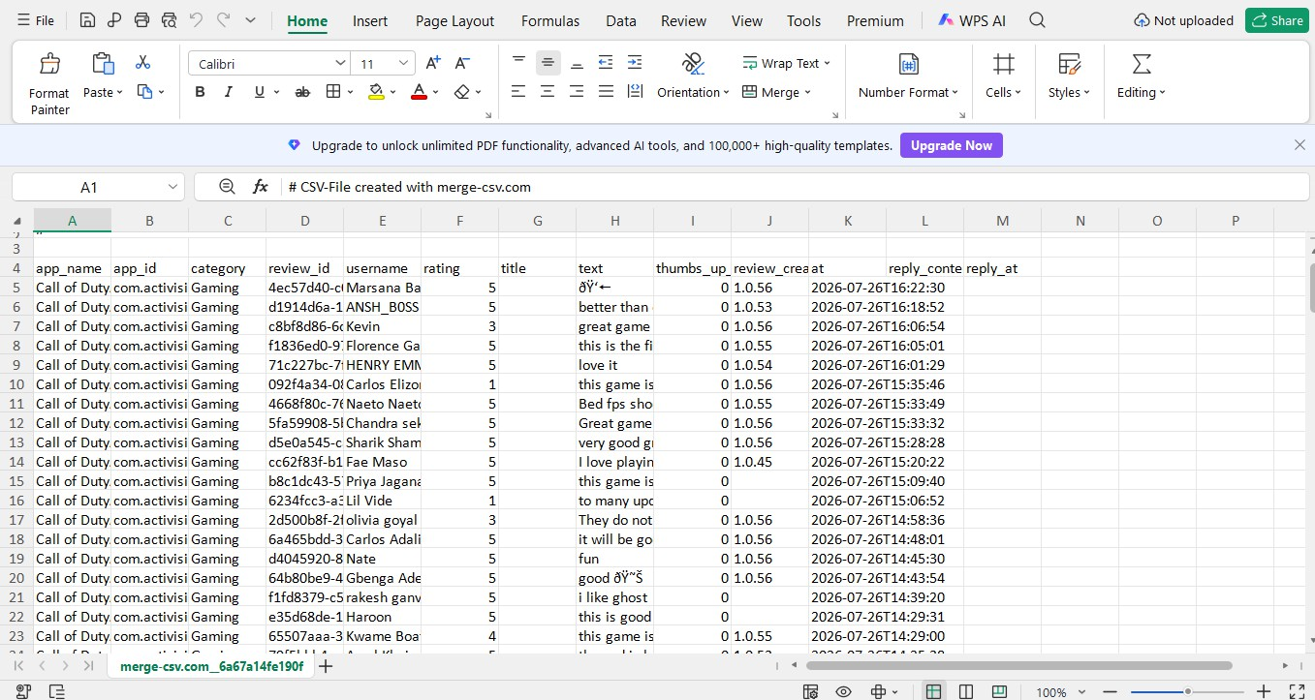

Slide 12
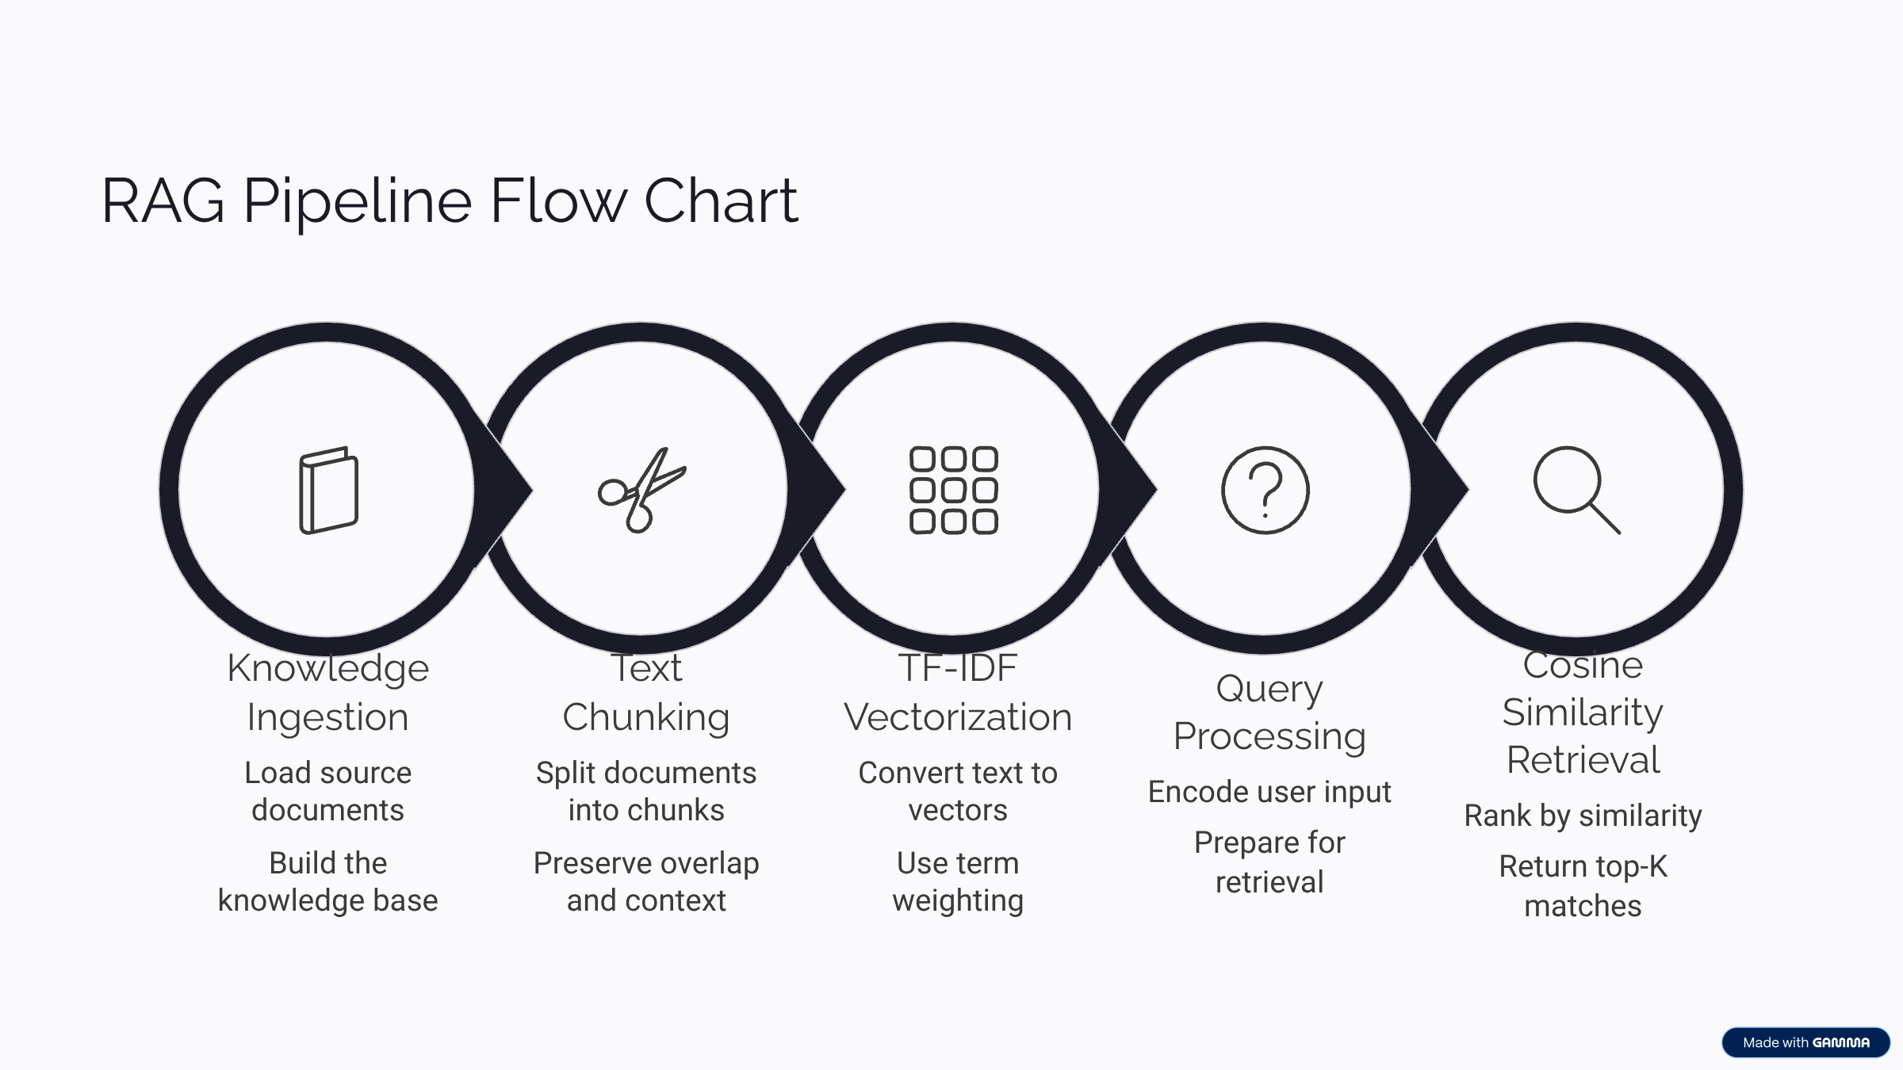

Slide 13
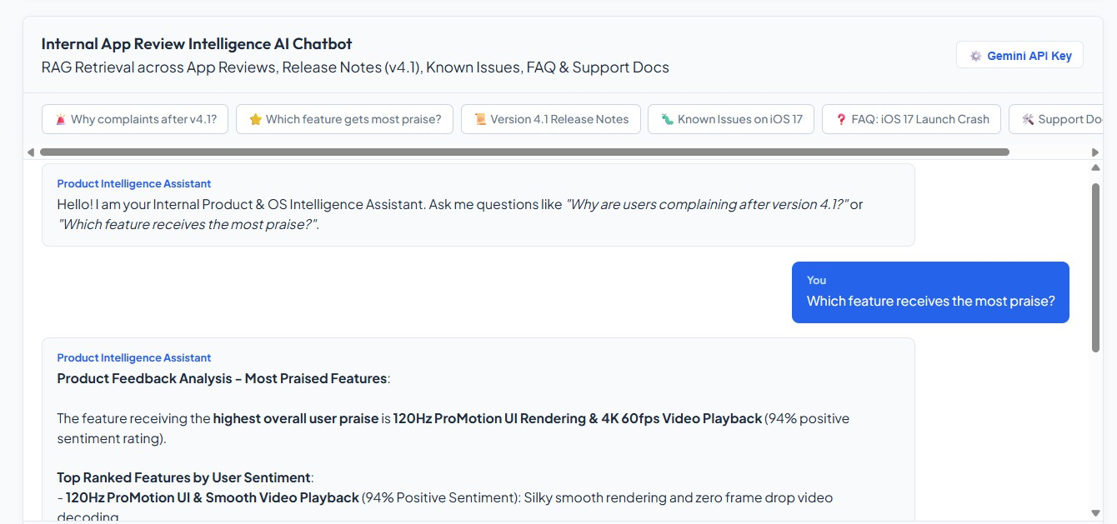
AI CHATBOT

Slide 14
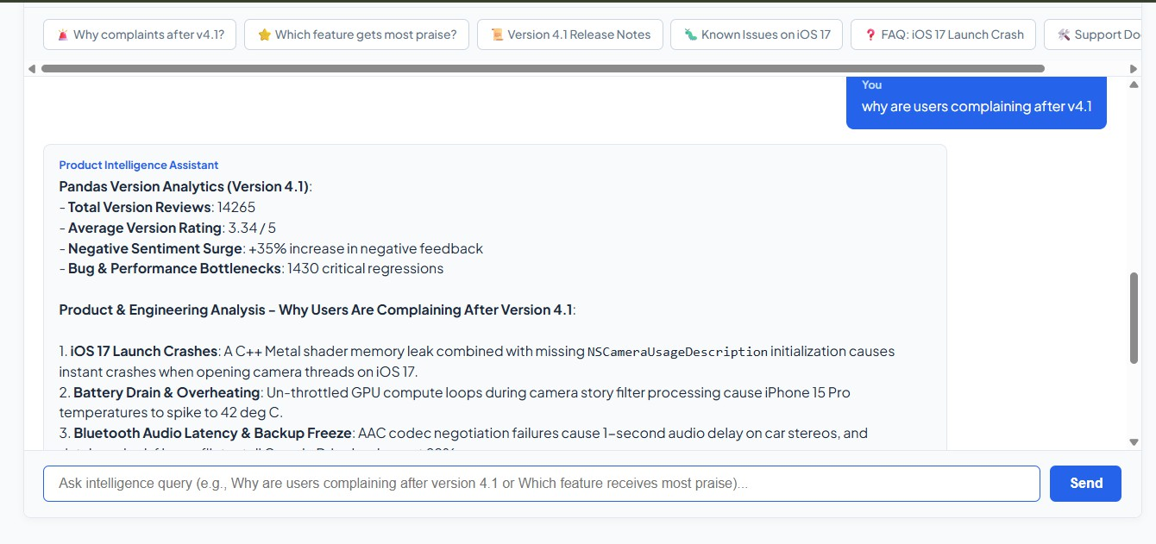
AI CHATBOT

Slide 15
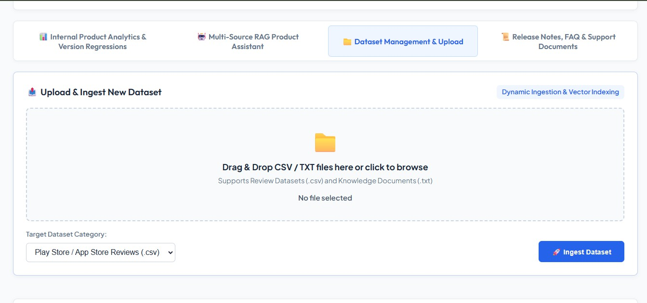
UPLOAD DATASET

Slide 16
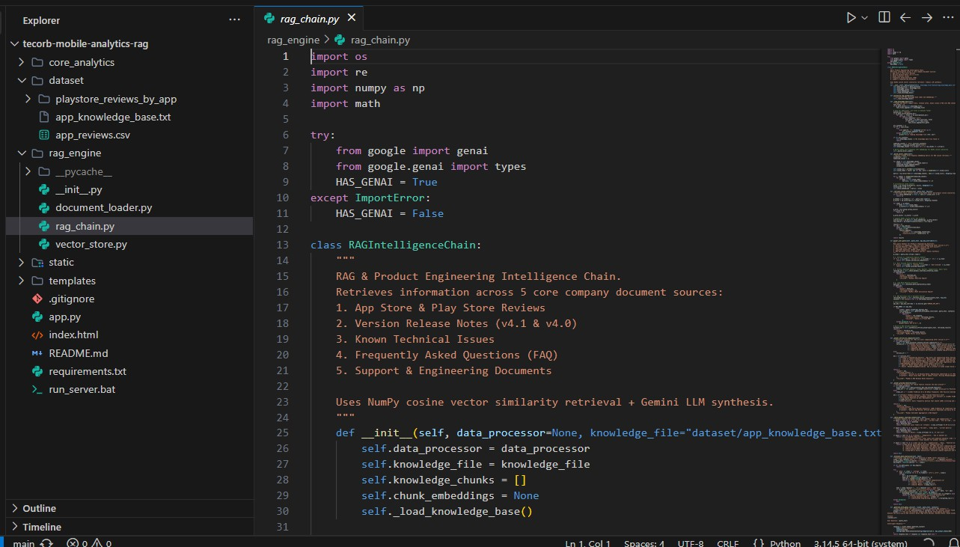

Slide 17
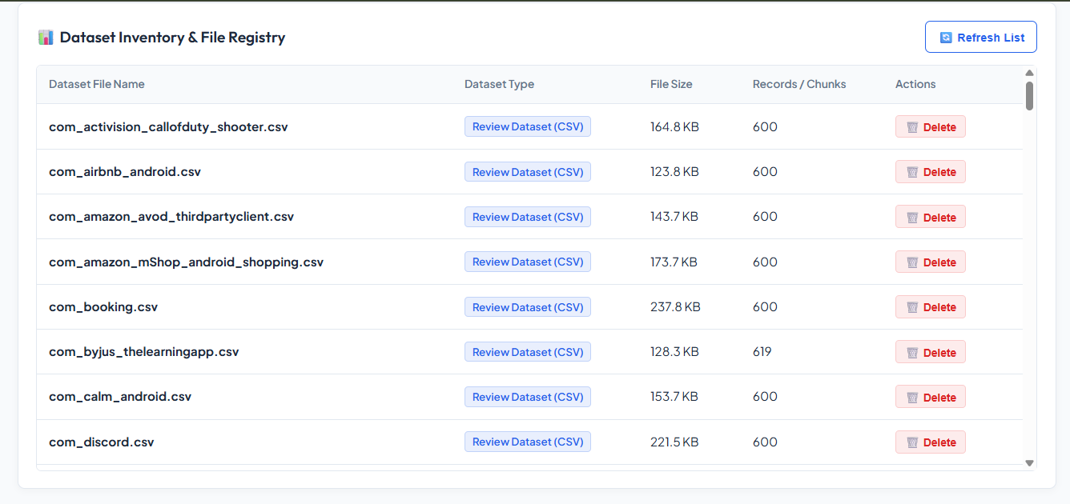
DATASET INVENTORY

Slide 18
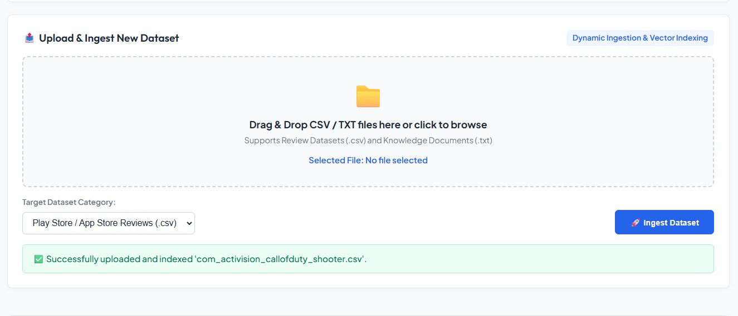
UPLOAD AND INGEST DATASET

Slide 19
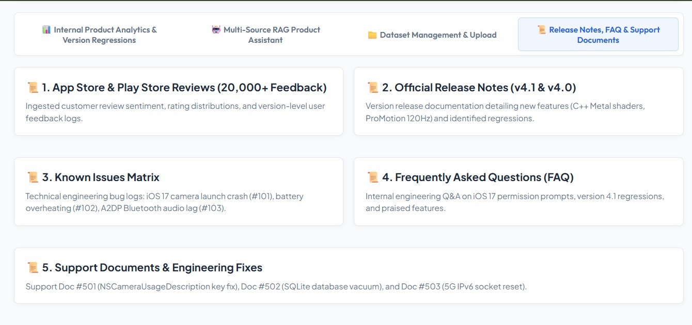
RELEASE NOTES

Slide 20
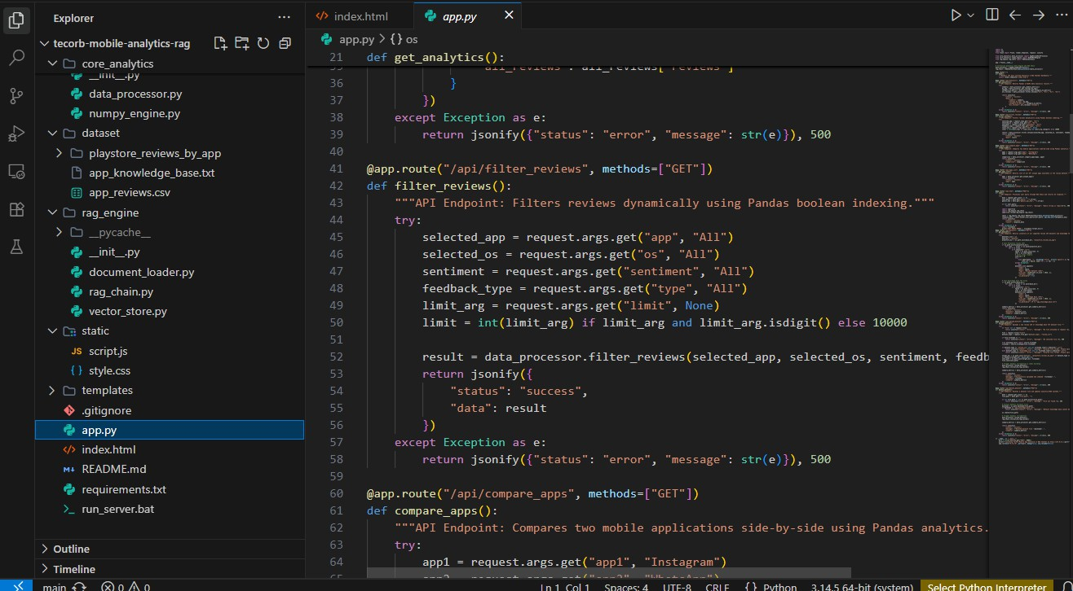
API TESTING

Slide 21
Future Scope
Real-Time Automated Data Scraping & Syncing.
Advanced Sentiment & Emotion Analysis.
Automated Developer Workflow Integrations.
Developer Portfolio & Project Showcase.
Community & Learning Hub.
SKIT, JAIPUR
www.skit.ac.in

Slide 22
Q & A
SKIT, JAIPUR
www.skit.ac.in

Slide 23
Thank You
SKIT, JAIPUR
www.skit.ac.in

