Slide 1
DEVOPS
Building Tools with DevOps
Designing, automating, and scaling the tools that power modern software delivery
Plan • Build • Test • Release • Operate • Monitor
Prepared for Engineering & Platform Teams

Slide 2




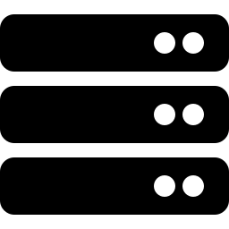




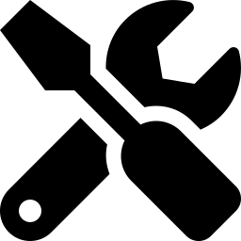
What Is DevOps, Really?
A culture of collaboration — expressed through tools
DevOps unifies software development (Dev) and IT operations (Ops) into one continuous, collaborative practice. It replaces siloed handoffs with shared ownership across the entire software lifecycle — from the first commit to production monitoring.
Continuous
The
DevOps
Loop
Integration, delivery, and feedback loops run constantly, not in batches.
Collaborative
Dev, QA, security, and Ops share goals, metrics, and responsibility.
Tool-Driven
Automation tools turn DevOps principles into repeatable daily practice.
BUILDING TOOLS WITH DEVOPS
2

Slide 3
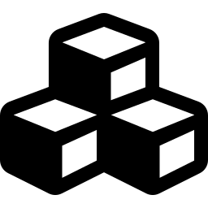

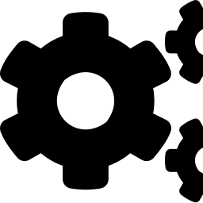
Why Build Custom DevOps Tools?
Off-the-shelf platforms cover the basics — but every engineering org hits gaps only custom tooling can close.
Fit Your Stack
Remove Toil
Surface the Right Signals
Glue together legacy systems, in-house services, and niche vendors that generic platforms don't integrate.
Automate the repetitive, manual steps engineers currently do by hand between commit and deploy.
Build dashboards and alerts tuned to the metrics that matter for your product, not a vendor's defaults.
Enforce Your Standards
Scale Efficiently
Improve Developer Experience
Bake security, compliance, and review policy directly into pipelines instead of relying on manual gatekeeping.
Purpose-built tools handle your team's exact scale and workflows, avoiding paid-tier bloat.
Internal tools shaped around real workflows cut friction and boost daily engineering velocity.
BUILDING TOOLS WITH DEVOPS
3

Slide 4
The DevOps Toolchain
Every stage of delivery has a category of tooling built to support it
Plan
Code
Build
Test
Release
Deploy
Operate
Monitor
Backlogs & roadmaps
Version control & review
Compile & package
Automated QA gates
CI/CD pipelines
Provisioning & rollout
Runtime management
Observability & alerts
Jira, Linear
Git, GitHub
Maven, Gradle, npm
Selenium, Jest
Jenkins, Actions
Terraform, ArgoCD
Kubernetes, Docker
Prometheus, Grafana
BUILDING TOOLS WITH DEVOPS
4

Slide 5
Category 1 — CI/CD Pipeline Tools
Continuous Integration / Continuous Delivery tools automatically build, test, and ship code the moment it's committed. A well-designed pipeline is the backbone of every DevOps toolchain — it turns "deploy day" into a non-event.
Jenkins
GitHub Actions
GitLab CI/CD
CircleCI
Open-source, highly extensible via 1,800+ plugins. Best for teams needing full pipeline control.
Native to GitHub repos; YAML workflows trigger on any repository event, fast to adopt.
Built into GitLab; single platform for code, pipelines, and container registry.
Cloud-first with fast parallelized builds and strong Docker-layer caching.
BUILDING TOOLS WITH DEVOPS
5

Slide 6
Category 2 — Build & Dependency Tools
Build tools compile source code, resolve dependencies, and package applications into deployable artifacts — consistently, on every machine, every time. They're the layer that turns raw code into something a pipeline can actually ship.
Maven
Gradle
npm / Yarn
Make / Bazel
XML-based build automation for Java. Declarative dependency management via a central repository and a standardized project lifecycle.
Groovy/Kotlin DSL build tool. Incremental, cache-friendly builds make it the default for Android and modern JVM projects.
Package managers for the JavaScript ecosystem. Install dependencies, run scripts, and lock versions across a team.
Language-agnostic automation. Bazel adds reproducible, cacheable builds that scale across large polyglot monorepos.
BUILDING TOOLS WITH DEVOPS
6

Slide 7
Category 3 — Infrastructure as Code
IaC tools let teams define servers, networks, and cloud resources as version-controlled code — making infrastructure reproducible, reviewable, and disposable, rather than hand-configured.
Terraform
Cloud-agnostic, the industry standard for declarative provisioning.
Provision cloud resources (AWS, Azure, GCP) from a single declarative config
Ansible
Agentless config management; simple YAML playbooks.
Track every infrastructure change through Git history and pull requests
Spin up identical dev, staging, and production environments on demand
Pulumi
Roll back infrastructure changes as easily as reverting a code commit
Define infrastructure using real programming languages.
AWS CloudFormation
Native, deeply integrated AWS-only provisioning.
BUILDING TOOLS WITH DEVOPS
7

Slide 8
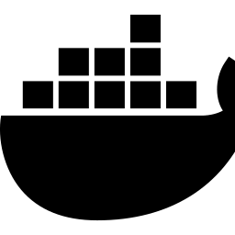
Category 4 — Containers & Orchestration
Containers package an application with everything it needs to run, while orchestrators manage those containers at scale — handling scheduling, scaling, networking, and self-healing automatically.
Docker
A Typical Container Stack
The de facto standard for building and running containers.
Application Code
Kubernetes
Container (Docker Image)
Automates deployment, scaling, and management of containerized apps.
Orchestrator (Kubernetes)
Helm
Package manager for Kubernetes — templated, reusable deployments.
Cloud / Bare-Metal Nodes
BUILDING TOOLS WITH DEVOPS
8

Slide 9
Category 5 — Monitoring & Observability
You can't fix what you can't see. Observability tooling collects metrics, logs, and traces so teams detect issues before users do — and diagnose root cause in minutes, not hours.
3
24/7
<5min
Prometheus
Time-series metrics collection with a powerful query language (PromQL).
Pillars: metrics,
logs & traces
Automated
alerting coverage
Target time to
detect an incident
Grafana
Visualization layer for dashboards across Prometheus, logs, and more.
Together these tools close the feedback loop back to Plan and Code — the defining trait of mature DevOps practice.
ELK Stack
Elasticsearch, Logstash & Kibana — centralized log search and analysis.
Datadog
Unified SaaS platform for metrics, traces, logs, and APM.
BUILDING TOOLS WITH DEVOPS
9

Slide 10


Best Practices for Building DevOps Tools
Start with the Workflow, Not the Tool
Design for Self-Service
Map the manual process first. Automate the actual pain point, not an assumed one.
Let engineers use the tool without filing a ticket — CLIs, APIs, and clear docs.
Build in Security Early
Make It Idempotent
Bake secret management, access control, and scanning into the pipeline from day one.
Running a tool twice should be as safe as running it once — critical for automation.
Instrument Everything
Treat Internal Tools as Products
Every custom tool should emit its own metrics and logs — dogfood your observability stack.
Gather user feedback, version releases, and maintain them like anything customer-facing.
BUILDING TOOLS WITH DEVOPS
10

Slide 11

Common Challenges & How to Solve Them
CHALLENGE
SOLUTION
Tool sprawl across teams
Maintain a shared internal catalog; standardize on a small, approved toolset.
CHALLENGE
SOLUTION
Security gaps in automation
Centralize secrets management and require pipeline security scans by default.
CHALLENGE
SOLUTION
Low developer adoption
Co-design tools with end users; prioritize simple onboarding and clear docs.
CHALLENGE
SOLUTION
Maintenance burden grows over time
Assign clear ownership and treat internal tools like production software.
BUILDING TOOLS WITH DEVOPS
11

Slide 12
Key Takeaways
DevOps is a loop, not a phase
Tools codify culture
Plan, build, test, release, operate, and monitor feed back into one another continuously.
The right tooling turns DevOps values — automation, collaboration, ownership — into daily habit.
Cover every category
Build tools like products
Build tools, CI/CD, IaC, containers, and observability together form a complete toolchain.
Internal tools succeed when they're designed for the people who use them every day.
BUILDING TOOLS WITH DEVOPS
12

Slide 13
Thank You
Let's build tools that make great engineering the path of least resistance.
Questions & Discussion

