Slide 1
Customer Retention AI
An End-to-End Machine Learning System for Telecom Customer Churn Prediction, Diagnosis, Categorization & Subscription Recommendation
Capstone Project | Khushi Kumari | M.Sc. Computer Science | 2026

Slide 2
AGENDA
What We'll Cover
1
Introduction & Problem Statement
Why churn matters and what problem this project solves
2
Literature Review / Existing Systems
How churn is typically handled today, and the gap
3
Proposed Architecture & Methodology
Data pipeline, models, and system design
4
Implementation Details
Tools, technologies, and how the app was built
5
Results & Performance Evaluation
Model scores, live app screenshots, comparisons
6
Conclusion & Future Scope
What was achieved and what's next

Slide 3
01
Introduction & Problem Statement
Why customer churn is a business-critical problem for telecom providers

Slide 4
INTRODUCTION
Why Churn Matters
Losing a customer costs 5–7x more than keeping one — churn directly eats into revenue.
Telecom customers can switch providers easily, so competition for loyalty is constant.
Companies generate huge amounts of customer data — but most of it goes unused for prediction.
Old approach: wait for a customer to cancel, then offer a discount. Too late, too generic.
New approach (this project): predict who's at risk before they leave, explain why, and offer the right fix.
5–7x
More expensive to acquire a new customer than to keep an existing one

Slide 5
INTRODUCTION
The Problem, In Three Questions
1
2
3
Who is likely to leave?
Why are they leaving?
What do we offer instead?
Most companies don't know until it's too late.
Price? Bad service? A competitor's offer? No one asks.
Retention teams often give generic discounts, not a real fix.

Slide 6
INTRODUCTION
Project Objectives
Clean and prepare a real telecom dataset of 6,418 customers for machine learning.
Build and compare multiple ML models to predict which customers will churn.
Explain WHY a customer is at risk, not just give a probability score.
Group customers into categories (High-Risk, Loyal, Premium-Ready, etc.) for targeted action.
Recommend the best subscription plan to keep an at-risk customer happy.
Package everything into one easy-to-use streamlit web application.
6
Clear objectives — from data cleaning to a deployed, working app

Slide 7
02
Literature Review / Existing System
How churn prediction and retention are typically approached today

Slide 8
LITERATURE REVIEW
How Churn Is Usually Handled Today
Simple statistics (Logistic Regression) — easy to understand, but misses complex patterns.
Modern systems use tree-based models like Random Forest and XGBoost for better accuracy.
Most companies react only after a cancellation request — the 'save desk' model.
Customer segmentation is usually done separately using basic rules or manual clustering.
Recommendation engines are common in shopping apps, but rarely used for retention offers.
0
Systems today that combine prediction + diagnosis + recommendation in one tool

Slide 9
LITERATURE REVIEW
The Gap — and How This Project Closes It
Most Existing Systems
CustomerRetention AI
Predict churn only
No explanation of 'why'
Segmentation done separately
No connected retention offer
Predicts churn AND explains why
Diagnoses the likely reason
Categorizes customers automatically
Recommends a specific plan to retain them

Slide 10
03
Proposed Architecture & Methodology
From raw data to a four-part intelligent web application

Slide 11
METHODOLOGY
System Architecture — How Data Flows Through the System
Raw Telecom
Data (CSV)
Cleaning &
Feature Engineering
Model Training
(3 algorithms per task)
Best Model
Selected & Saved
Streamlit
Web App
The system follows a complete data-science lifecycle: business understanding → data cleaning → feature engineering → model training & comparison → live web app.

Slide 12
METHODOLOGY
The Dataset
6,418
32
27.0%
3
Customer Records
Original Attributes
Overall Churn Rate
Customer Groups
(Stayed / Churned / Joined)
Demographics: Age, Gender, Marital Status, State, Referrals
Services: Internet type, phone lines, streaming and security add-ons
Billing: Contract type, monthly charge, total revenue, payment method
Outcome: Customer status, churn category, churn reason

Slide 13
METHODOLOGY
Data Cleaning & Feature Engineering
Missing values filled using business logic, not guesses — e.g. no internet service = 'No' for add-ons, not blank.
Fixed data-entry errors, like negative monthly charges (replaced with the median).
Created 13 new features, including: Tenure Bucket, Total Add-on Services, Average Monthly Revenue, and High Spender flag.
Built two new target labels: Churn Label (will they leave?) and Customer Category (what type of customer are they?).
Result: 37 clean, model-ready features from the original 32 raw columns.
13
New engineered features added on top of the original 32 columns

Slide 14
METHODOLOGY
Key Insights from Exploratory Analysis
Contract type is the #1 churn signal
Month-to-Month customers churn at 46.5% vs just 2.7% for Two-Year contracts.
Risk is highest early on
Churn rate peaks around 7–12 months, then steadily declines with tenure.
Competitors are the top reason customers leave
43.9% of churned customers left for a competitor — more than price (11.3%).
More add-ons = more loyalty
Customers with 3+ active services churn far less than those with 0–1.

Slide 15
METHODOLOGY
Predicting Churn & Categorizing Customers
Churn Prediction: a Yes/No question — will this customer leave? Trained 3 algorithms and picked the best.
Customer Categorization: a 4-way question — is this customer High-Risk, Medium-Risk, Loyal, or Premium-Ready? Also trained 3 algorithms.
Same fair process for both: 80% of data used for training, 20% held back for testing.
Class imbalance (fewer churners than stayers) handled using balanced class weighting, not fake synthetic data.
A third model was trained only on churned customers, to guess the likely reason they left.
3+3
Algorithms compared for churn prediction and for customer categorization

Slide 16
METHODOLOGY
Recommending the Right Subscription Plan
The original dataset had no subscription catalogue — so a custom one was built by hand: 52 example cases mapped to 26 real plan options.
Each plan directly addresses a real complaint type, e.g. a 'Value Saver' plan for price-sensitive customers.
One algorithm (Random Forest) does two jobs: picks the best plan, and estimates its price.
Because the catalogue is small, 5-fold cross-validation was used to get a fair, reliable score.
A statistical test (Chi-Squared) confirmed the complaint really does drive the recommendation — not random chance.
26
Real subscription plans in the custom recommendation catalogue

Slide 17
04
Implementation Details
The tools, technologies, and code behind the system

Slide 18
IMPLEMENTATION
Technologies & Tools Used
Data & ML
Visualization
Deployment
Python
Pandas / NumPy
Scikit-learn
XGBoost
SciPy (statistics)
Plotly Express
Plotly Graph Objects
Interactive charts & gauges
Streamlit (web app)
Joblib (model saving)
Single-process Python app

Slide 19
IMPLEMENTATION
Model Training Approach
Logistic Regression
Simple, explainable baseline — shows which features push risk up or down.
Random Forest
Many decision trees voting together — handles complex, real-world patterns well.
XGBoost
Trees built one after another, each fixing the last one's mistakes — very strong performance.
All three algorithms were trained on the same data split and compared side by side — the best one (by multiple metrics) was chosen for the live app.

Slide 20
IMPLEMENTATION
The Web App — Four Working Sections
1
Churn Prediction & Diagnosis
Pick or enter a customer → see churn probability + reasons why
2
Customer Categorization
See which retention category a customer falls into
3
Recommendation Engine
Get the best subscription plan for that customer
4
Interactive Dashboard
Explore churn, revenue, and subscription trends

Slide 21
IMPLEMENTATION
Bringing It All Together
All trained models are saved as .pkl files using Joblib — loaded once when the app starts.
Streamlit's caching keeps the app fast even with multiple predictions per session.
Sidebar navigation lets users switch between all 4 sections without reloading.
Every section supports two modes: pick an existing customer, or type in a new profile.
The result: one single, easy-to-use application — not four separate scripts or spreadsheets.
4-in-1
Predict, diagnose, categorize, and recommend — all in one deployed Streamlit app

Slide 22
05
Results & Performance Evaluation
How well the models actually performed — and what the live app looks like

Slide 23
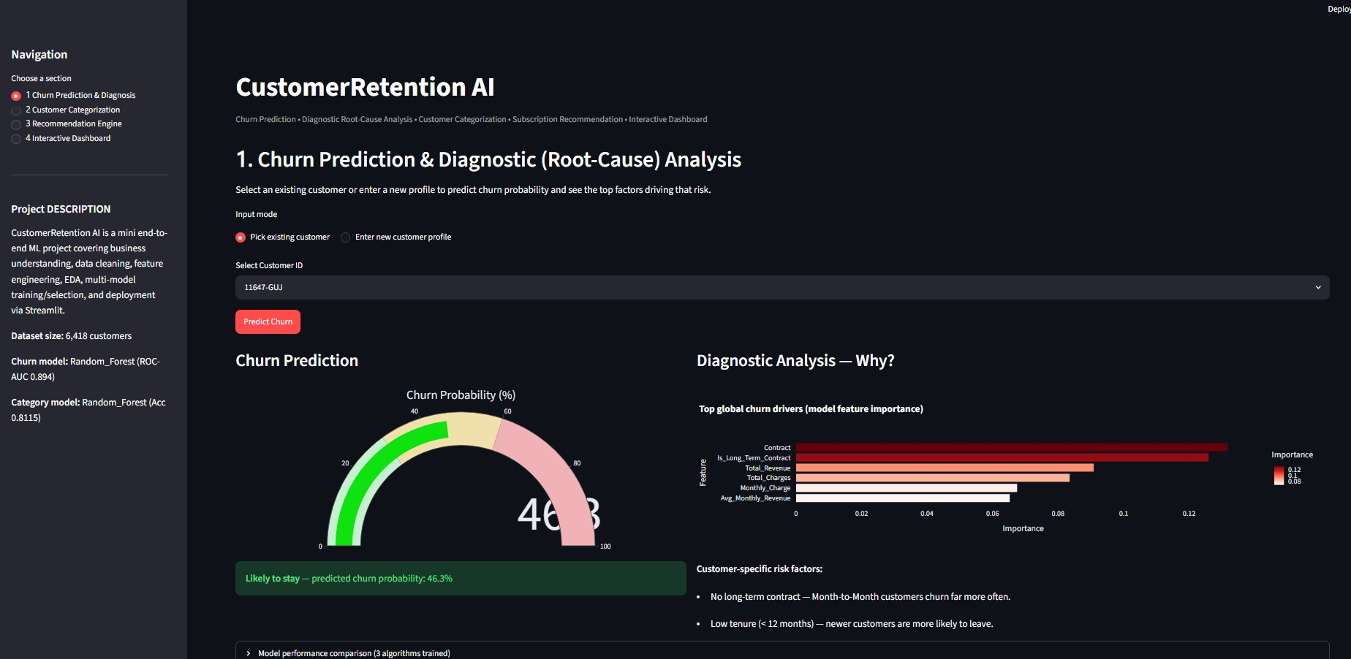
RESULTS
Churn Prediction — Live App
Sample customer scored at 46.3% churn probability, with top risk-driving factors shown alongside.

Slide 24
RESULTS
Churn Prediction — Model Comparison
83.8%
0.894
76.4%
70.1%
Accuracy
(Random Forest)
ROC-AUC
(Random Forest — best)
Recall
(catches 3 in 4 churners)
Precision
(few false alarms)
Model
Accuracy
ROC-AUC
Logistic Regression
76.8%
0.858
Random Forest (Best model)
83.8%
0.894
XGBoost
83.5%
0.890

Slide 25
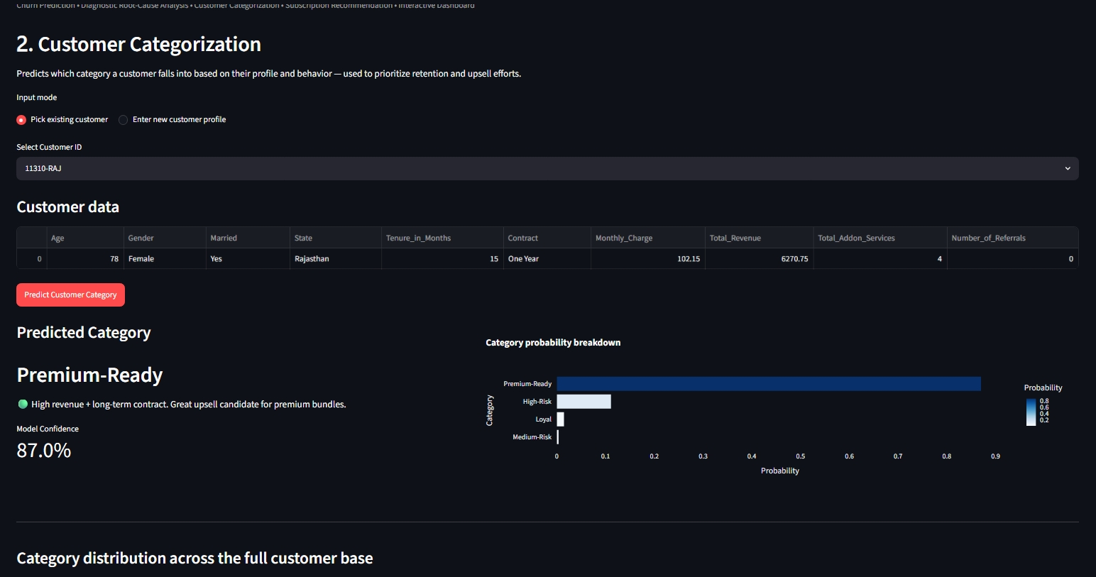
RESULTS
Customer Categorization — Live App
A 78-year-old customer with high revenue and a One-Year contract is classified 'Premium-Ready' at 87% confidence.

Slide 26
RESULTS
Customer Categorization — Model Comparison
Logistic Regression
71.0%
Decision Tree
76.8%
Random Forest (Best model)
81.2%
Random Forest wins on both tasks — tree-based ensembles capture the real, non-linear patterns in customer behavior far better than a simple linear model.

Slide 27
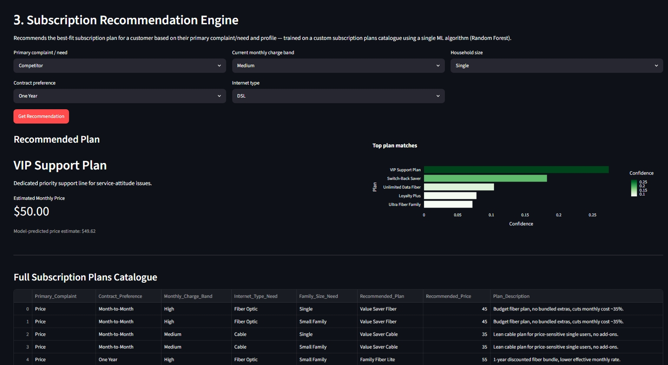
RESULTS
Recommendation Engine — Live App
A 'Competitor' complaint customer is matched to the 'VIP Support Plan' ($50/mo), with 5 ranked alternatives shown.

Slide 28
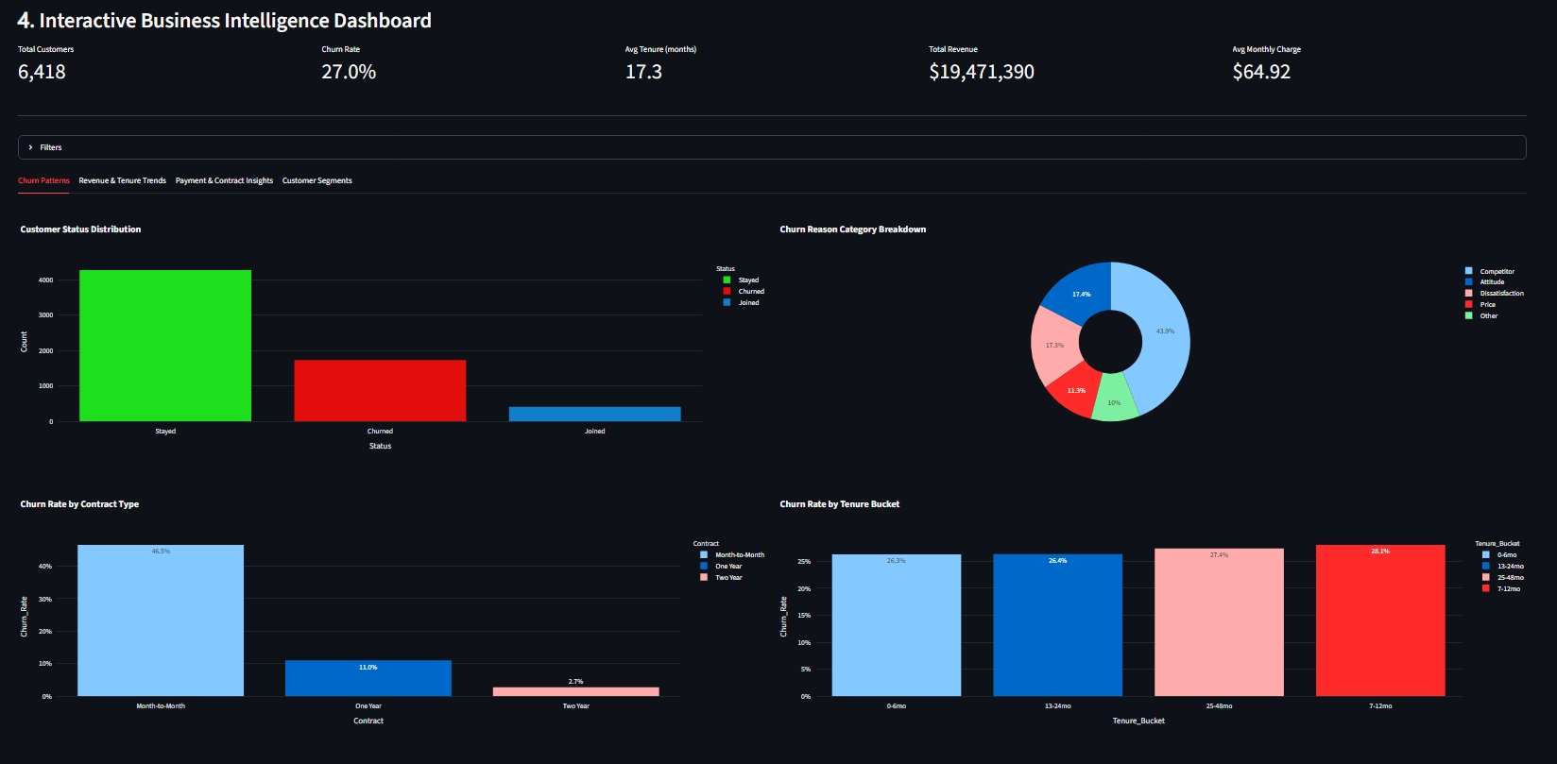
RESULTS
Interactive Dashboard — Live App
6,418 customers | 27.0% churn rate | $19.47M total revenue — explored live via filterable Plotly charts.

Slide 29
CONCLUSION
What This Project Achieved
0.894
81.2%
p < 0.0001
Churn ROC-AUC
(target: 0.85)
Categorization Accuracy
(target: 75%)
Complaint–Plan Link
(highly significant)
Built a complete pipeline: business understanding → cleaning → modeling → deployment.
Random Forest was the best model for both churn prediction and customer categorization.
All 4 goals delivered in one working app: predict, diagnose, categorize, recommend.
Every success target set at the start of the project was met or exceeded.

Slide 30
Future Scope
Add real signup dates for true month-by-month trend tracking.
Grow the recommendation catalogue using real retention-offer outcomes.
Add SHAP explanations for fully personalized, per-customer reasoning.
Connect to a live CRM/billing system for real-time scoring.
Deploy on the cloud with secure, role-based access for retention teams.
Thank You
Khushi Kumari | CustomerRetention AI | M.Sc. Computer Science

