Slide 1
CAPSTONE PROJECT
SQL
SQL
Name : Khushi Manoj Ojha
Id : S9730

Slide 2
03
TITLE OF THE PROJECT
04
BUSINESS PROBLEM AND OBJECTIVE
LIST OF CONTENTS
05
DATASET OVERVIEW
06
TOOLS & METHOD
07-33
QUERY ANALYSIS & RESULT
34
KEY INSIGHTS
35
RECOMMENDATIONS
36
CONCLUSION

Slide 3

introducing
“SALES DECODED”

Slide 4
BUSINESS PROBLEM:
Amazon operates multiple branches with diverse products, but identifying key factors driving sales success across branches, product lines, and customer segments remains challenging
OBJECTIVE:
Product Analysis
Sales Analysis
Customer Analysis

Slide 5
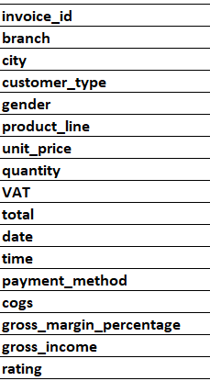
DATASET OVERVIEW
This dataset contains sales transactions from three different branches
of Amazon, respectively located in Mandalay, Yangon and Naypyitaw.
The data contains 17 columns and 1000 rows
APPROACH USED
Data Wrangling
Feature Engineering
Exploratory Data Analysis

Slide 6


TOOLS & METHOD
Tools: MySQL Workbench, Excel (for preparation).
Techniques: SQL queries (GROUP BY, JOIN, AGGREGATE FUNCTION,
SUBQUERIES, CASE etc.).

Slide 7
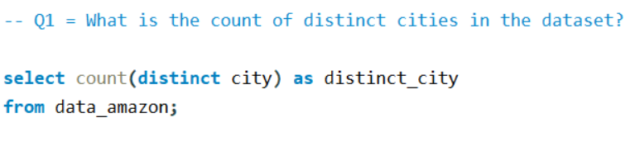

QUERY ANALYSIS & RESULT

Slide 8
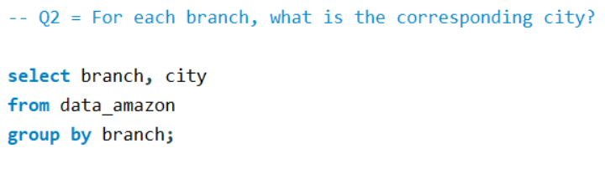
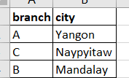

Slide 9
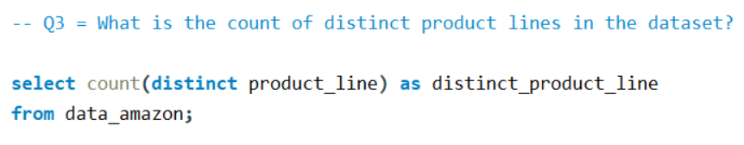


Slide 10
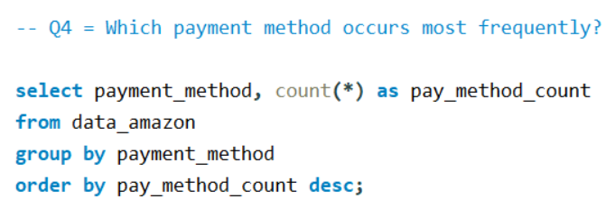
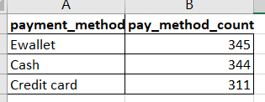

Slide 11
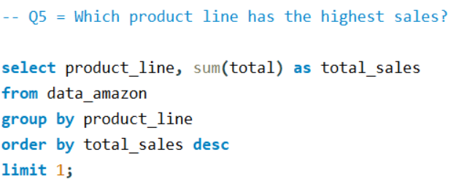
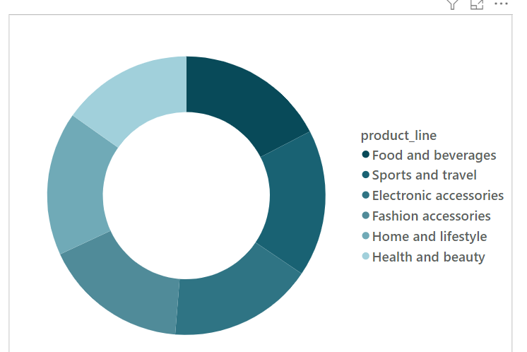


Slide 12
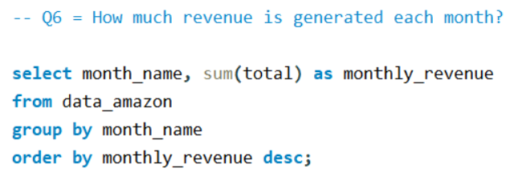
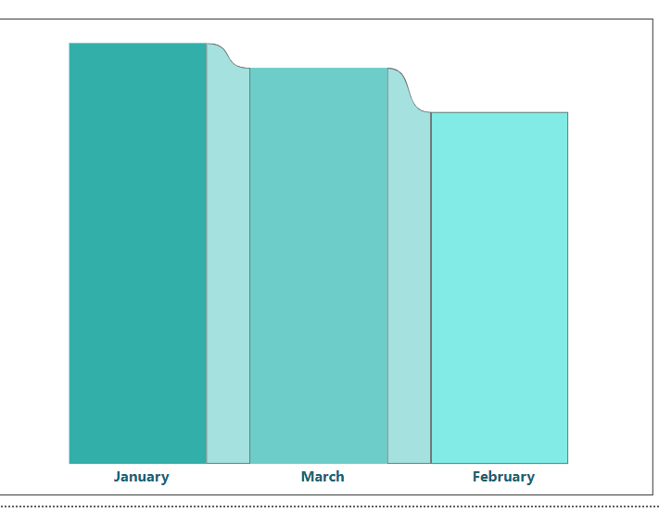
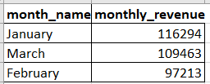

Slide 13
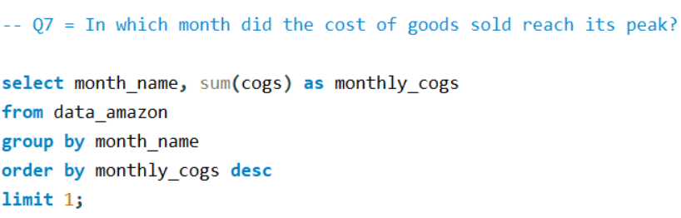
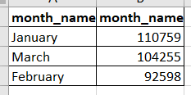


Slide 14
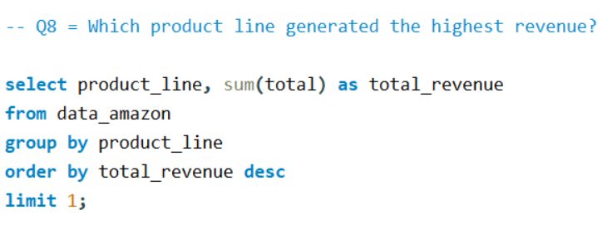
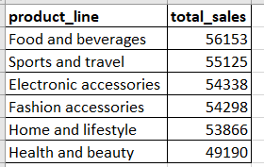


Slide 15
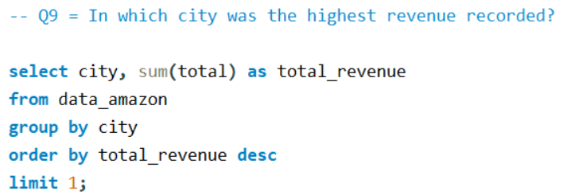
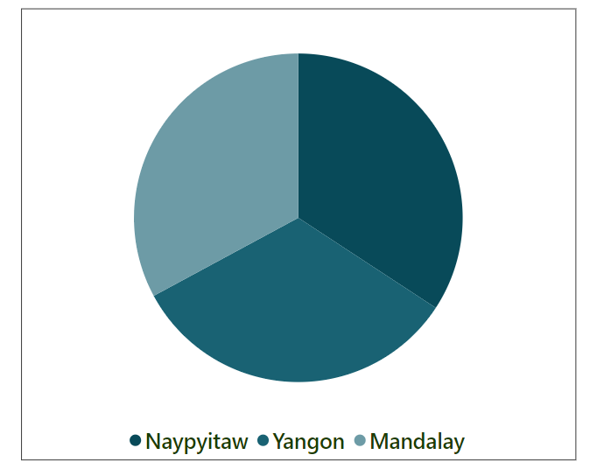

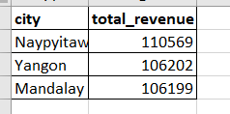

Slide 16
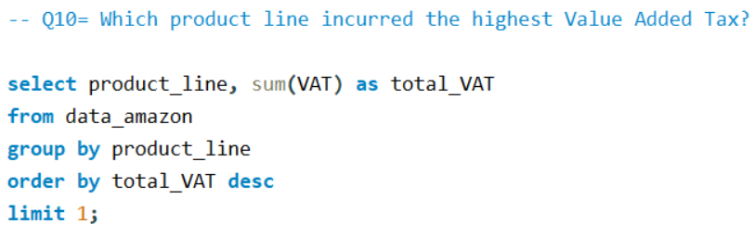

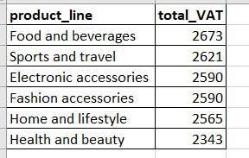

Slide 17
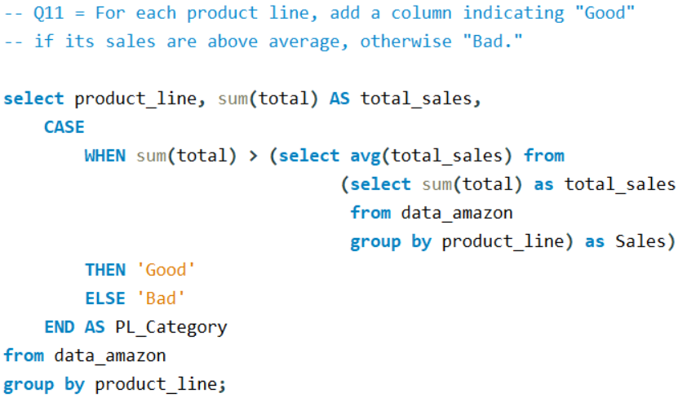
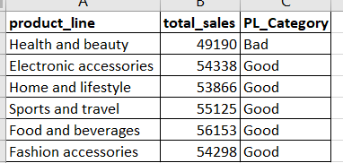

Slide 18
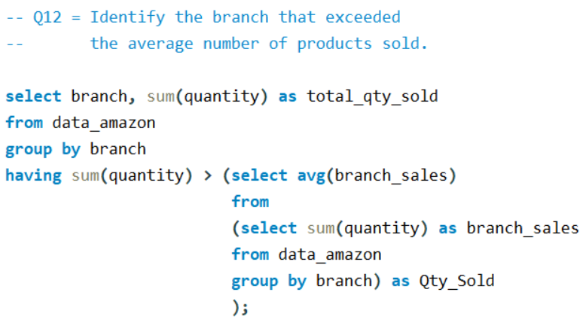


Avg Branch Sales :

Slide 19
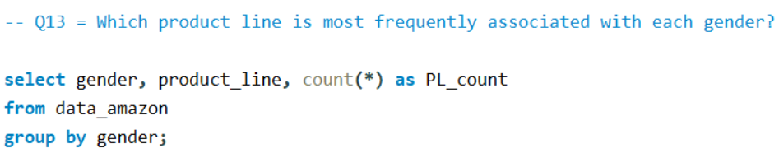


Slide 20
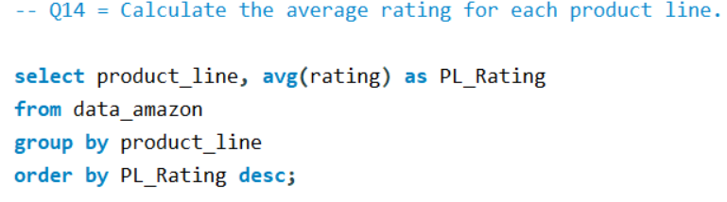
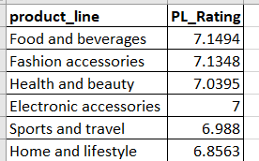

Slide 21
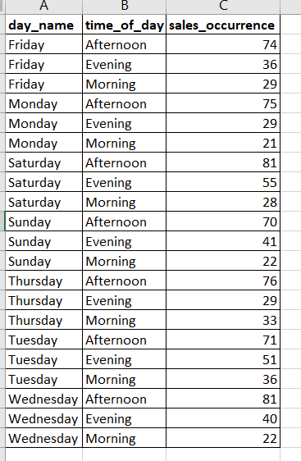
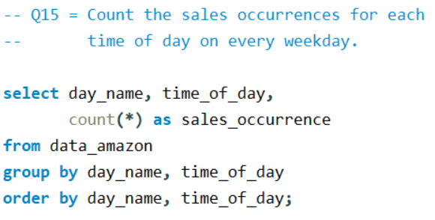

Slide 22
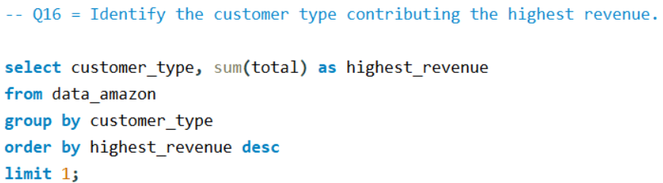


Slide 23
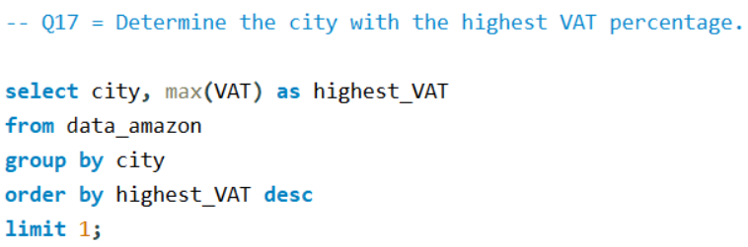


Slide 24
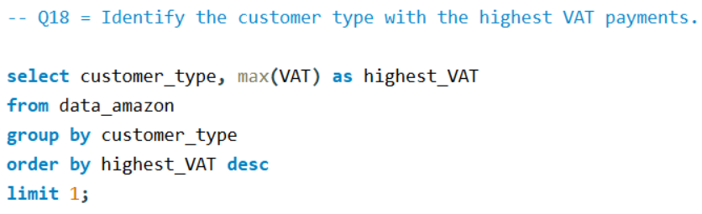


Slide 25
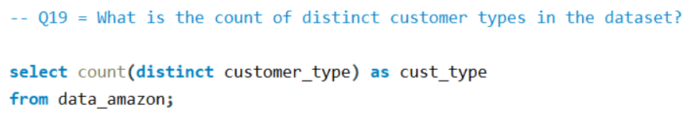

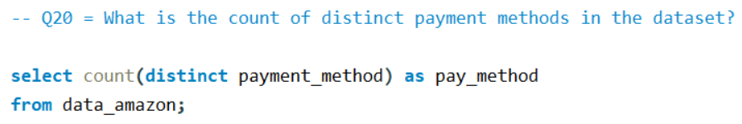


Slide 26
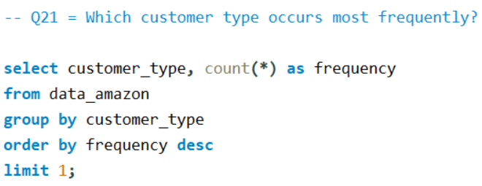


Slide 27
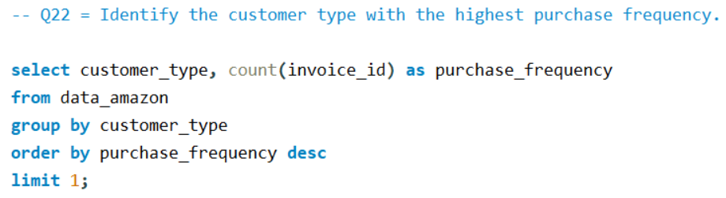


Slide 28
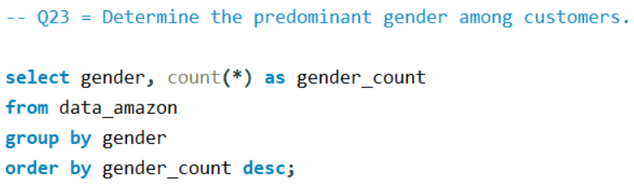


Slide 29
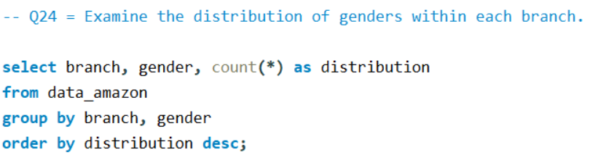
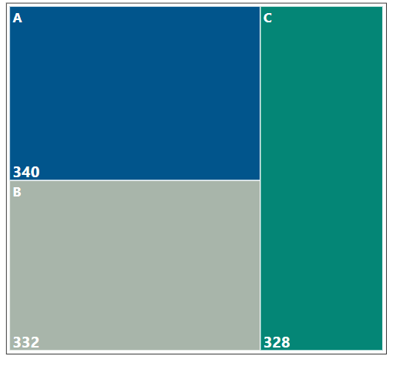
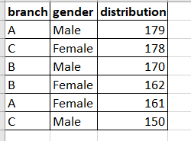

Slide 30
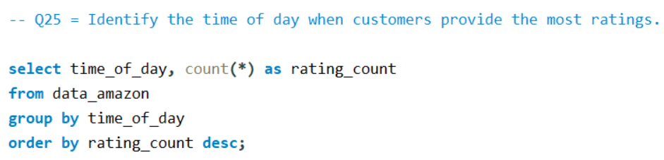
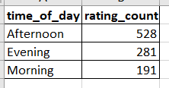

Slide 31
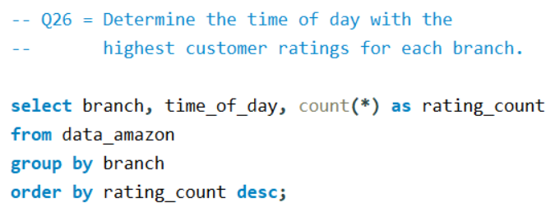
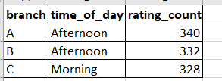

Slide 32
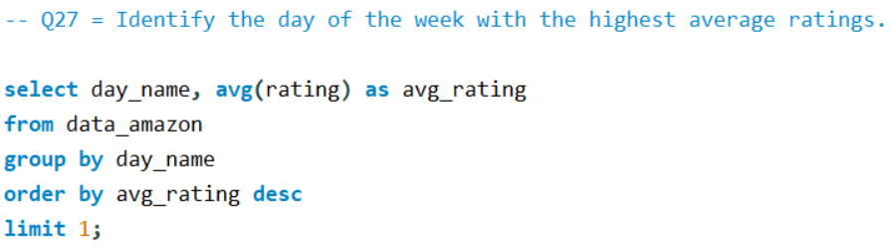
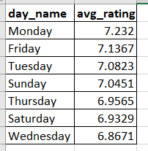


Slide 33
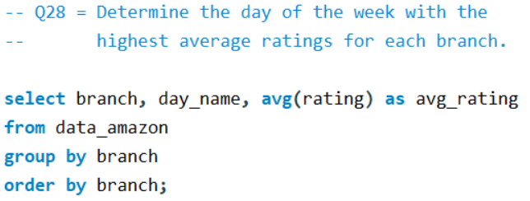
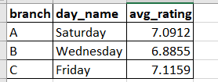

Slide 34
KEY INSIGHTS
The product line “Food and beverages” generated the highest revenue, indicating strong customer demand.
The sales data reveals that “Mandalay ”branch consistently outperforms others in total sales.
Customer type “Member” is the most frequent buyer, contributing significantly to overall sales.
The month of “January” sees peak sales activity, aligning with seasonal trends or promotions.
Branch “A” has recorded the highest number of products sold, showcasing its strong sales performance and customer demand.

Slide 35
RECOMMENDATIONS
Focus marketing efforts on promoting the “Home and Lifestyle” product line to further capitalize on its popularity.
Allocate more resources to “C” branch to maximize its sales potential
Introduce time-specific offers during “Afternoon” to boost sales during peak hours.

Slide 36
CONCLUSION
By addressing underperforming areas and leveraging high-performing segments through this analysis, Amazon can achieve greater profitability.
Optimizing operations based on these insights will enhance efficiency and customer satisfaction.
Understanding customer behavior and sales trends empowers Amazon to make data-driven decisions that drive growth.

Slide 37
THANK YOU FOR YOUR TIME!

