Slide 1

sql
CAPSTONE PROJECT
CAPSTONE PROJECT
POWER BI
POWER BI
Name : Khushi Manoj Ojha
Id : S9730

Slide 2
List of Contents
03
TITLE OF THE PROJECT
04
PROJECT OVERVIEW
05
BUSINESS PROBLEM AND OBJECTIVE
06
DATASET AND APPROACH USED
07
TOOLS AND METHODS
08-09
OVERVIEW OF PROJECT
10
KEY INSIGHTS
11
CONCLUSION

Slide 3

introducing
“THE ART OF BREWING”

Slide 4
Project Overview
This project leverages the Coffee Quality Institute (CQI) dataset to analyze factors that contribute to coffee quality, focusing on sensory evaluation, defects, and processing methods.
The goal is to understand the key determinants of coffee quality and their relationships with processing methods, origin regions, and defects.
The analysis aims to improve decision-making in coffee production and processing to enhance overall coffee quality.
CONTINUE

Slide 5
Business Problem
Inconsistent coffee quality due to varying sensory attributes, processing methods, and defects challenges the coffee industry. Understanding these factors is crucial for improving quality control and meeting consumer expectations.
Objective
Sensory attributes Analysis
Defects Analysis
Analysis on Processing Methods and Origin of Regions
CONTINUE

Slide 6
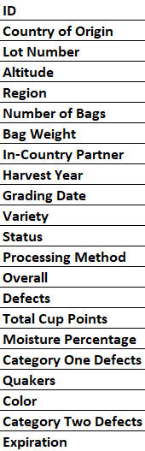
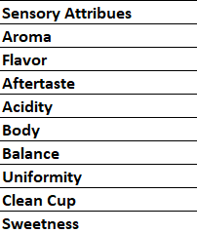
Dataset Overview
The dataset consist of Coffee Quality Institute (CQI) data consisting of 31 rows and 208 columns from the
Approach Used
Data Cleaning and Preprocessing
Exploratory Data Analysis (EDA)
Visualization
CONTINUE

Slide 7


Tools &
Methods
Tools: Power BI Desktop, Excel (for preparation).
Service One

Slide 8
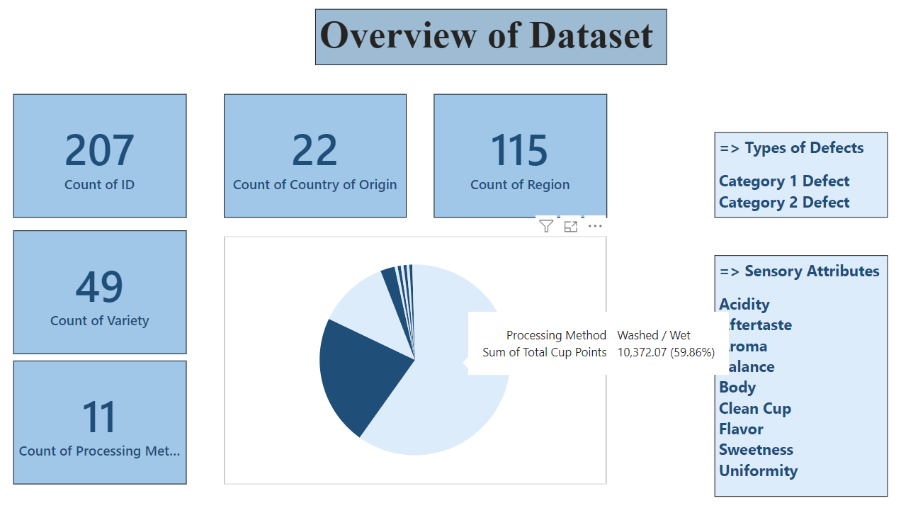

Slide 9
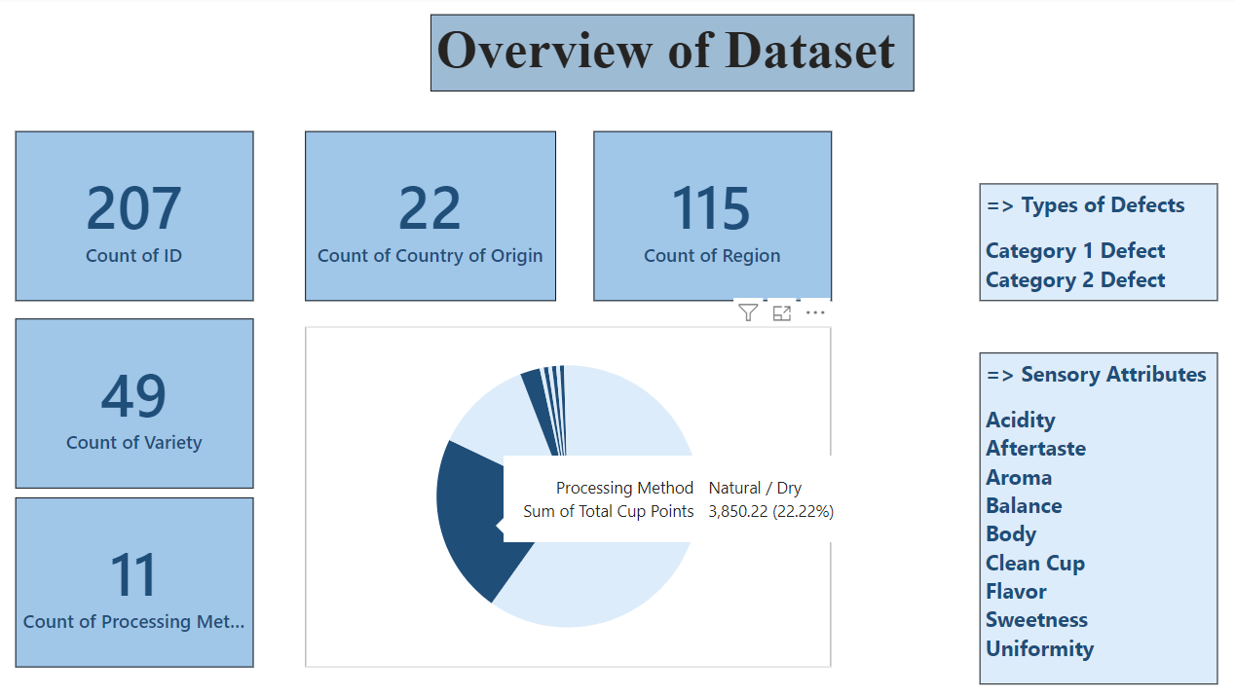

Slide 10
Key Insights
Flavor is the most significant factor influencing coffee quality, followed by Aroma and Acidity.
In 2022, there was a higher occurrence of Category Two defects.
Category One defects, which are visually perceptible (such as black or insect-damaged beans), were found to be equally present in both 2022 and 2023.
Category Two defects, being more difficult to detect visually, may lead to a more significant negative impact on sensory attributes

Slide 11
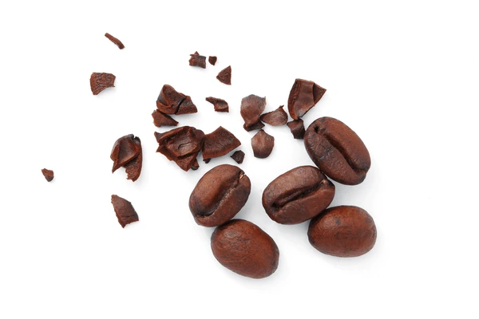


Conclusion
These insights provide a comprehensive view of the factors affecting coffee quality and can guide improvements in coffee production, processing, and quality control practices.

Slide 12
Thank you for your time!

