Slide 1
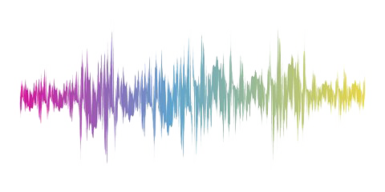
Music Genre Classification
RNS INSTITUTE OF TECHNOLOGY
BENGALURU - 98
DEPARTMENT OF COMPUTER SCIENCE & ENGINEERING
AI/ML INTERNSHIP (NASTECH)
Presented by
KHUSHI PAI
1RN19CS065
MOONISAH BATOOL
1RN19CS081

Slide 2
AGENDA
Abstract
About the Company
Introduction
Literature Survey
Requirements
Feature Extraction Using MFCCs
Working of KNN Algorithm
Detailed Design
Implementation
Results
Conclusion and Future Enhancements
References
Q & A

Slide 3
ABSTRACT
Genre classification is an important task with many real world applications.
As the quantity of music being released on a daily basis continues to sky-rocket, especially on internet platforms such as Soundcloud and Spotify, being able to instantly classify songs in any given playlist or library by genre is an important functionality for any music streaming/purchasing service.
The particular model designed is aimed at performing the classification of the music genre in the most efficient way possible with the help of a specific dataset that consists of ten main genres: blues , classical ,jazz ,metal ,rock ,pop , hip-hop ,reggae , country and disco.

Slide 4
ABOUT THE COMPANY
NASTECH – New Age Solutions & Technologies
NASTECH is formed with the purpose of bridging the gap between Academia and Industry.
Nastech is one of the leading Global Certification and Training service providers for technical and management programs for educational institutions.
They collaborate with educational institutes to understand their requirements and form a strategy in consultation with all stakeholders to fulfill those by skilling , reskilling and upskilling the students and faculties on new age skills and technologies.
Industry and project oriented student training programs.
Certification programs mapped to Global Certification Exams from Microsoft/EC- Council/Google/AWS/ Adobe).

Slide 5
INTRODUCTION
Today, music is a very important and perhaps inseparable part of people's daily life. There are many genres of music and these genres are different from each other, resulting in people to have different preferences of music.
As a result, it is an important and up-to-date issue to classify music and to recommend people new music in music listening applications and platforms. Classifying music by their genre is one of the most useful techniques used to solve this problem.
Through this project, we proposed a music genre classifier that takes the data and audio samples from the popular GTZAN Dataset that contains 10 genres with 100 audio files each.
We decided on using the K-Nearest Neighbors Algorithm for training the classifier model as the algorithm tested to have a better accuracy score at predicting the result .

Slide 6
LITERATURE SURVEY
[1] Tzanetakis and Cook pioneered the work on music genre classification using machine learning technique. They created the GTZAN dataset and is to date considered as a standard for genre classification.
[2] Changsheng Xu et al. have shown how to use support vector machines (SVM) for this task. Authors used supervised learning approaches for music genre classification.
[3] Scaringella et al. gives a comprehensive survey of both features and classification techniques used in the music genre classification.
[4] Riedmiller used unsupervised learning creating a dictionary of features.

Slide 7
REQUIREMENTS
HARDWARE REQUIREMENTS
Processor : Any Processor above 500 MHz
RAM : 512Mb
Hard Disk : 4 GB
Input device : Standard Keyboard and Mouse
Output device : High Resolution Monitor
SOFTWARE REQUIREMENTS
Operating system : Windows 10 and above.
IDE : Visual Studio Code
Tools/Technologies : Python, MFCC, sklearn Module, Scipy, Streamlit Numpy library

Slide 8
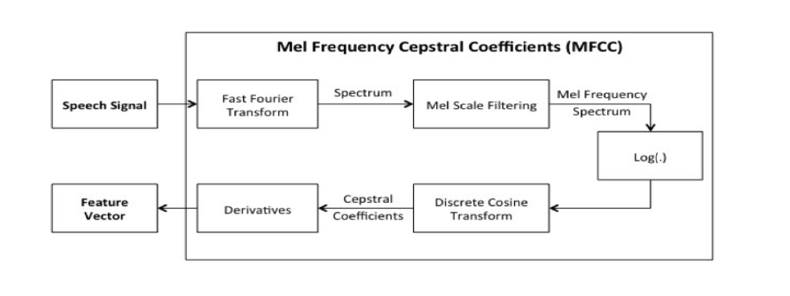
FEATURE EXTRACTION USING MFCCs
The five features extracted are –
Mel Frequency Cepstral Coefficients
Chroma Frequencies
Spectral Centroid
Spectral Roll-Off
Zero-crossing rate

Slide 9
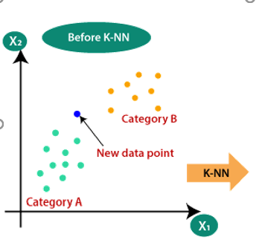
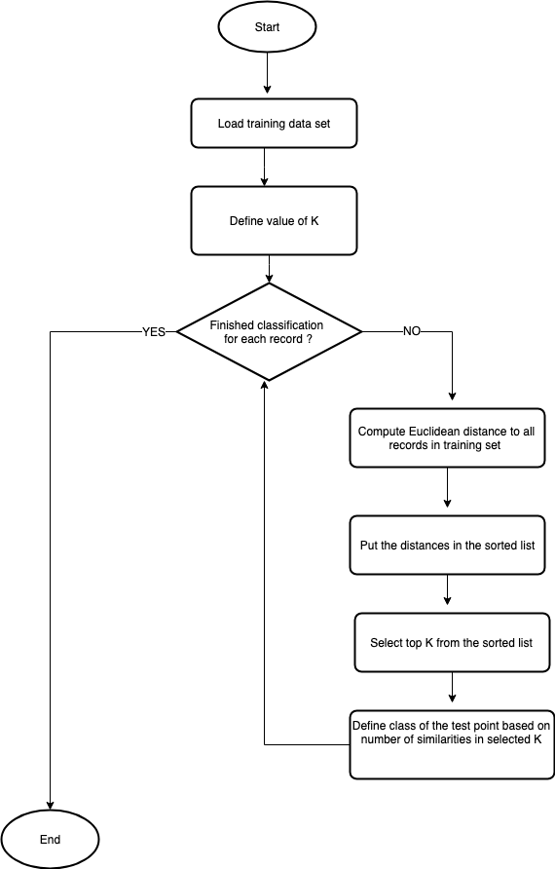
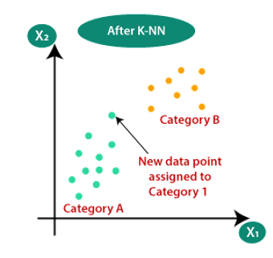
HOW KNN ALGORITHM ACTUALLY WORKS

Slide 10
DETAILED DESIGN
FUNCTIONAL MODULES
The entire project is divided into two important phases:
Training the model
Testing the model
Training the model:
This is the first phase of our project, it deals with loading the data set and training the model.
Testing the model:
This is the second phase of our project, here we load the previously trained model to test it by feeding an audio file.

Slide 11
IMPLEMENTATION
TRAINING CODE
# map labels to index
label_index = dict()
index_label = dict()
for i, x in enumerate(df.label.unique()):
label_index[x] = i
index_label[i] = x
# shuffle samples
df_shuffle = df.sample(frac=1, random_state=seed).reset_index(drop=True)
# remove irrelevant columns
df_shuffle.drop(['filename', 'length'], axis=1, inplace=True)
df_y = df_shuffle.pop('label')
df_X = df_shuffle
# split into train dev and test
X_train, X_test, y_train, y_test= skms.train_test_split(df_X, df_y, train_size=0.7, random_state=seed, stratify=df_y)
from sklearn.preprocessing import StandardScaler
scaler = StandardScaler()
scaler.fit(X_train)
X_train = scaler.transform(X_train)
X_test = scaler.transform(X_test)
from sklearn.neighbors import KNeighborsClassifier
classifier = KNeighborsClassifier(n_neighbors=5)
classifier.fit(X_train, y_train)
y_pred = classifier.predict(X_test)

Slide 12
IMPLEMENTATION
TESTING CODE
import joblib
joblib.dump(classifier,'classifier')
model = joblib.load('classifier') st.set_page_config(page_title="Music Genre Classification", layout="wide")
title = "Music Genre Classification"
st.title(title)
filename = st.file_uploader("Upload File",type=".wav")
if filename is not None:
st.write("filename")
try:
audio, sample_rate = librosa.load(filename, res_type='kaiser_fast')
mfccs_features = librosa.feature.mfcc(y=audio, sr=sample_rate, n_mfcc=57)
mfccs_scaled_features = np.mean(mfccs_features.T,axis=0)
mfccs_scaled_features=mfccs_scaled_features.reshape(1,-1)
except Exception as e:
print('Got an exception:')
if st.button('Predict'): predicted_label=model.predict(mfccs_scaled_features)
st.write("The predicted genre is: {}".format(predicted_label))

Slide 13
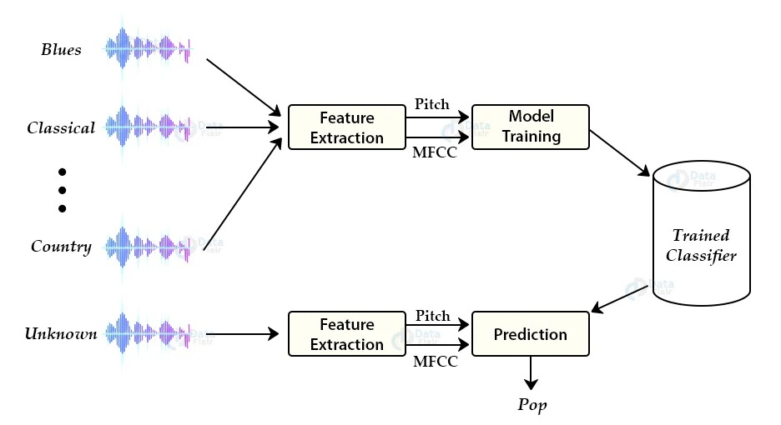
RESULTS
It is observed that the accuracy of the KNN model :
The accuracy of the model is 87%.

Slide 14
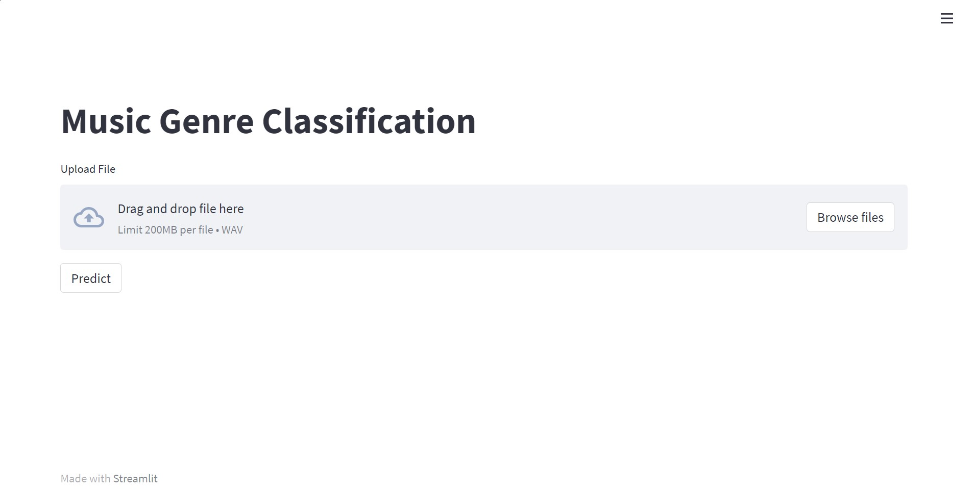
RESULTS
Front End
Using
Streamlit
← Landing Page

Slide 15
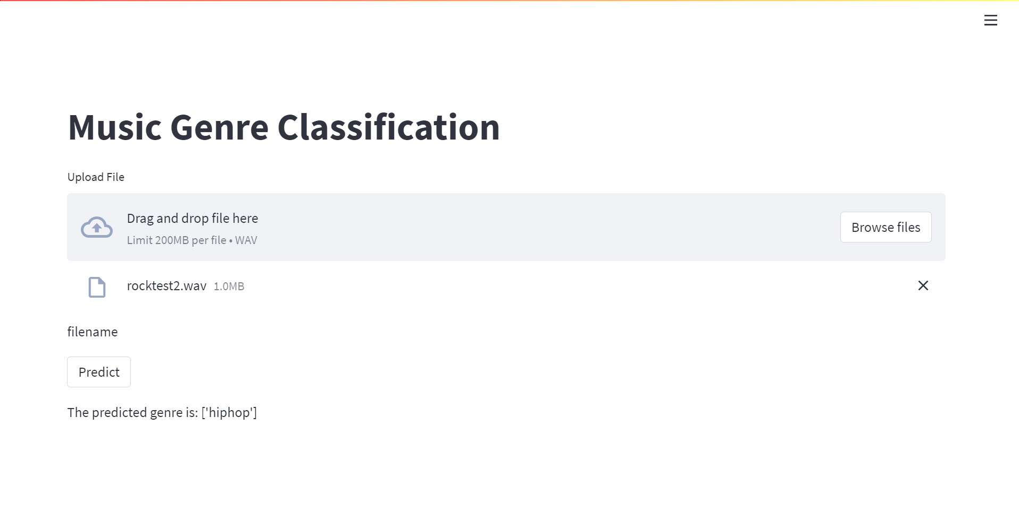
RESULTS
Front End
Using
Streamlit
← Predicted result

Slide 16
CONCLUSIONS
We implemented the KNN machine learning technique to classify music genres using GTZAN dataset.
The model’s test accuracy is 87%.
In real application, a new music track can turn into features the same way as we mentioned, and applying our machine learning model we can predict its genre.
To further improve the accuracy, we definitely need more music data to train our model and consequently the prediction accuracy is sure to increase.

Slide 17
LIMITATIONS
The prediction is limited to one genre.
The file up loader takes only .wav extension files.
The files must be imported from the device only, web cannot be accessed.
With background noise the model might not give accurate results.
Our model predicts based on a static dataset hence may not be accurate for real time database.

Slide 18
FUTURE ENHANCEMENTS
Gathering more data for genres with less data currently to balance data distribution
Model ensembling: combining classifiers by voting or averaging to improve performance
Feature refining: add other musically relevant features for better classification results
Real application: input new music tracks and transform them into features the same way as we mentioned, and apply our machine learning models to predict its genre.

Slide 19
REFERENCES
[1] G. Tzanetakis, P. Cook, ―Musical genre classification of audio signals‖, IEEE Transactions on Speech and Audio Processing, Vol. 10, Issue 5, July 2002.
[2] Chandsheng Xu, Mc Maddage, Xi Shao, Fang Cao, and Qi Tan, ―Musical genre classification using support vector machines‖, IEEE Proceedings of International Conference of Acoustics, Speech, and Signal Processing, Vol. 5, pp. V-429-32, 2003.
[3] N. Scaringella, G. Zoia, and D. Mlynek, ―Automatic genre classification of music content: a survey‖, IEEE Signal Processing Magazine, Vol. 23, Issue 2, pp. 133–141, 2006.
[4] Jan Wülfing and Martin Riedmiller, ―Unsupervised learning of local features for music classification‖ ISMIR, pp. 139–144, 2012.
[5] Sox.sourceforge.net. Sox - sound exchange— homepage, 2015.
[6] https://ijcert.org/ems/ijcert_papers/V4I206.pdf
[7] http://marsyas.info/downloads/datasets.html

Slide 20


Slide 21
ANY QUESTIONS?

