Slide 1
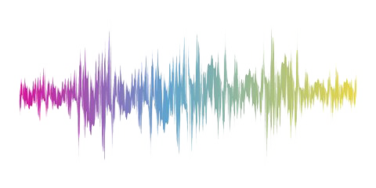
Music Genre Classification
RNS INSTITUTE OF TECHNOLOGY
BENGALURU - 98
DEPARTMENT OF COMPUTER SCIENCE & ENGINEERING
AI/ML INTERNSHIP (NASTECH)
Presented by
KHUSHI PAI
1RN19CS065
MOONISAH BATOOL
1RN19CS081

Slide 2
AGENDA
Abstract
About the Company
Introduction
Literature Survey
Requirements
Detailed Design
Implementation
Results
Conclusion and Future Enhancements
References
Q & A

Slide 3
ABSTRACT
Genre classification is an important task with many real world applications.
As the quantity of music being released on a daily basis continues to sky-rocket, especially on internet platforms such as Soundcloud and Spotify, being able to instantly classify songs in any given playlist or library by genre is an important functionality for any music streaming/purchasing service.
The particular model designed is aimed at performing the classification of the music genre in the most efficient way possible with the help of a specific dataset that consists of ten main genres: blues , classical ,jazz ,metal ,rock ,pop , hip-hop ,reggae , country and disco.

Slide 4
ABOUT THE COMPANY
NASTECH – New Age Solutions & Technologies
NASTECH is formed with the purpose of bridging the gap between Academia and Industry.
Nastech is one of the leading Global Certification and Training service providers for technical and management programs for educational institutions.
They collaborate with educational institutes to understand their requirements and form a strategy in consultation with all stakeholders to fulfill those by skilling , reskilling and upskilling the students and faculties on new age skills and technologies.
Industry and project oriented student training programs.
Certification programs mapped to Global Certification Exams from Microsoft/EC- Council/Google/AWS/ Adobe).

Slide 5
INTRODUCTION
Today, music is a very important and perhaps inseparable part of people's daily life. There are many genres of music and these genres are different from each other, resulting in people to have different preferences of music.
As a result, it is an important and up-to-date issue to classify music and to recommend people new music in music listening applications and platforms. Classifying music by their genre is one of the most useful techniques used to solve this problem.
Through this project, we proposed a music genre classifier that takes the data and audio samples from the popular GTZAN Dataset that contains 10 genres with 100 audio files each.
We decided on using the K-Nearest Neighbors Algorithm for training the classifier model as the algorithm tested to have a better accuracy score at predicting the result .

Slide 6
LITERATURE SURVEY
[1] Tzanetakis and Cook pioneered the work on music genre classification using machine learning technique. They created the GTZAN dataset and is to date considered as a standard for genre classification.
[2] Changsheng Xu et al. have shown how to use support vector machines (SVM) for this task. Authors used supervised learning approaches for music genre classification.
[3] Scaringella et al. gives a comprehensive survey of both features and classification techniques used in the music genre classification.
[4] Riedmiller used unsupervised learning creating a dictionary of features.

Slide 7
REQUIREMENTS
HARDWARE REQUIREMENTS
Processor : Any Processor above 500 MHz
RAM : 512Mb
Hard Disk : 4 GB
Input device : Standard Keyboard and Mouse
Output device : VGA and High Resolution Monitor
SOFTWARE REQUIREMENTS
Operating system : Windows 10
IDE : Visual Studio Code
Tools/Technologies : Python, MFCC, sklearn Module, Scipy, Streamlit Numpy library

Slide 8
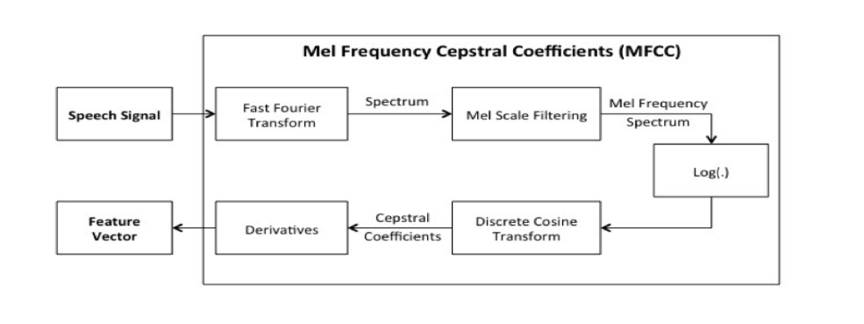
FEATURE EXTRACTION USING MFCCs
The five features extracted are –
Mel Frequency Cepstral Coefficients
Chroma Frequencies
Spectral Centroid
Spectral Roll-Off
Zero-crossing rate

Slide 9
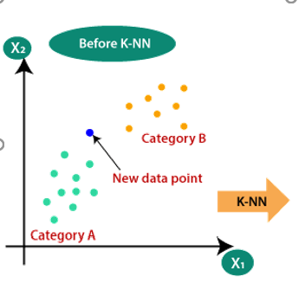
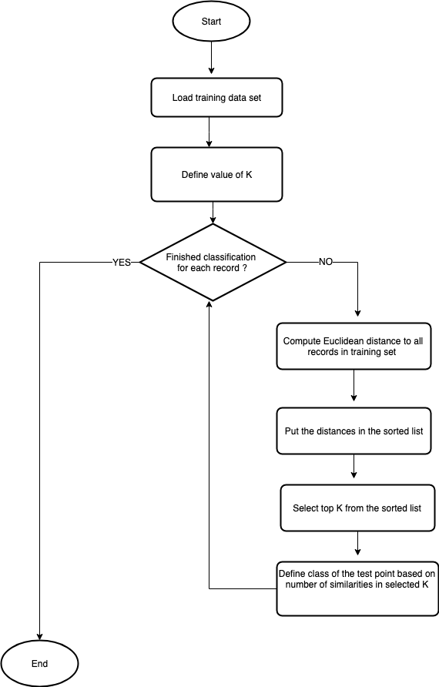
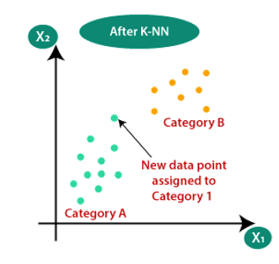
HOW KNN ALGORITHM ACTUALLY WORKS

Slide 10
DETAILED DESIGN
FUNCTIONAL MODULES
The entire project is divided into 3 modules:
Face Detection
Face Tracking
Face Mask Detection
Face Detection:
This module takes input from the camera and tries to detect a face in the video input. The detection of the face is achieved through the Haar classifiers mainly, the Frontal face cascade classifier.
The face is detected in a rectangle format. Face detection is accomplished by the OpenCV algorithm proposed by Paul Viola and Michael Jones in 2001.
2. Face tracking
Due to the real-time nature of the project, the faces need to be tracked continuously for any form of distraction. Hence the faces are continuously detected during the entire time.
If faces are found, it returns the positions of detected faces as rect(x,y,w,h). Once these locations are returned, we can draw a rectangular box around the location that would depict the region of interest( ROI) for the face .

Slide 11
IMPLEMENTATION
TRAINING CODE
# map labels to index
label_index = dict()
index_label = dict()
for i, x in enumerate(df.label.unique()):
label_index[x] = i
index_label[i] = x
# shuffle samples
df_shuffle = df.sample(frac=1, random_state=seed).reset_index(drop=True)
# remove irrelevant columns
df_shuffle.drop(['filename', 'length'], axis=1, inplace=True)
df_y = df_shuffle.pop('label')
df_X = df_shuffle
# split into train dev and test
X_train, X_test, y_train, y_test= skms.train_test_split(df_X, df_y, train_size=0.7, random_state=seed, stratify=df_y)
from sklearn.preprocessing import StandardScaler
scaler = StandardScaler()
scaler.fit(X_train)
X_train = scaler.transform(X_train)
X_test = scaler.transform(X_test)
from sklearn.neighbors import KNeighborsClassifier
classifier = KNeighborsClassifier(n_neighbors=5)
classifier.fit(X_train, y_train)
y_pred = classifier.predict(X_test)

Slide 12
IMPLEMENTATION
TESTING CODE
import joblib
joblib.dump(classifier,'classifier')
model = joblib.load('classifier') st.set_page_config(page_title="Music Genre Classification", layout="wide")
title = "Music Genre Classification"
st.title(title)
filename = st.file_uploader("Upload File",type=".wav")
if filename is not None:
st.write("filename")
try:
audio, sample_rate = librosa.load(filename, res_type='kaiser_fast')
mfccs_features = librosa.feature.mfcc(y=audio, sr=sample_rate, n_mfcc=57)
mfccs_scaled_features = np.mean(mfccs_features.T,axis=0)
mfccs_scaled_features=mfccs_scaled_features.reshape(1,-1)
except Exception as e:
print('Got an exception:')
if st.button('Predict'): predicted_label=model.predict(mfccs_scaled_features)
st.write("The predicted genre is: {}".format(predicted_label))

Slide 13
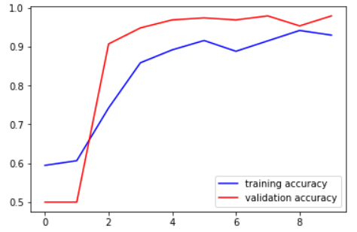
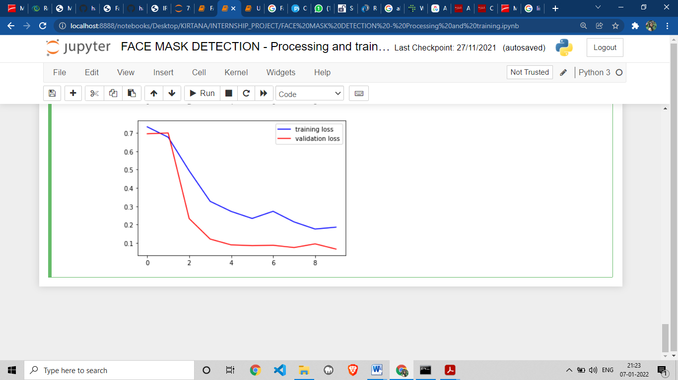
RESULTS
It can also be observed in the accuracy loss graph obtained below:
The accuracy of the model is 92%.
The loss value is below 0.1.
It can be observed that with every iteration of the model training, the loss is getting gradually decreased and the accuracy is getting increased.

Slide 14
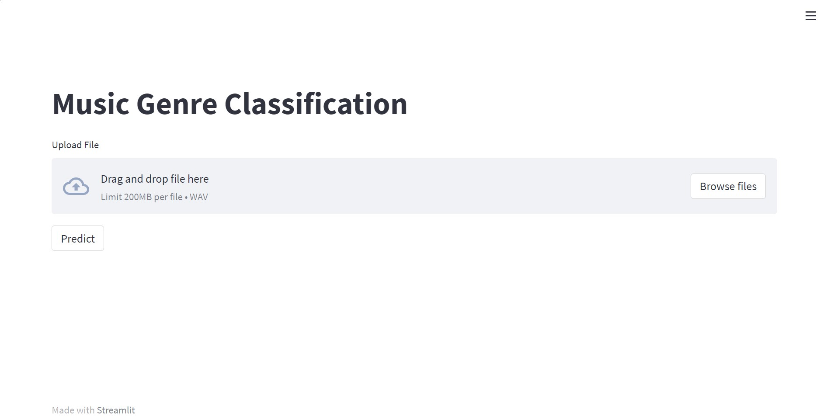
RESULTS
Front End
Using
Streamlit
← Landing Page

Slide 15
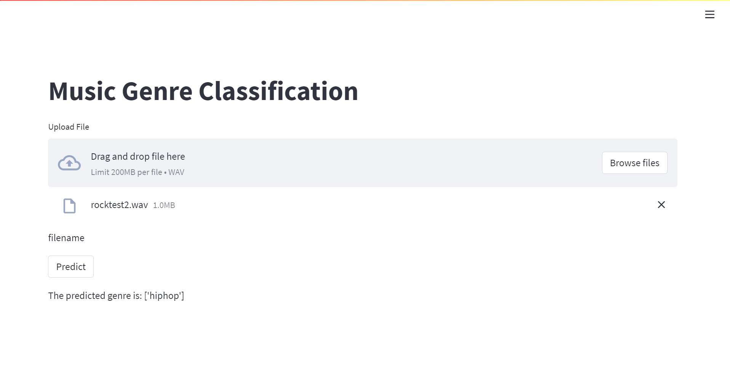
RESULTS
Front End
Using
Streamlit
← Predicted result

Slide 16
CONCLUSIONS
As is evident nowadays that face mask detection is very crucial, given the current scenario of the Covid-19 pandemic, this project was an attempt in creating a simple face mask detetctor..
In this project, a deep learning model for face mask detection was developed with the help of Convolutional Neural Networks using Python, Keras, and OpenCV.
The observed model proved to be 92% accurate in the detection of the presence of masks on the person’s face.
Face Mask Detection has found its application in various places such in airports, hospitals, offices and other likely public places.

Slide 17
LIMITATIONS
The system has difficulty detecting certain faces when wearing a mask.
This problem is due to the fact that initially, the Open CV Deep Learning based face detector was being used and it is not designed to detect faces with masks.
It could also be observed that the face recognition stage is not robust when the detected face presents a certain angle of inclination.
However, this is not a problem of great impact, as this application is oriented to access control and at this point, the person must maintain a firm and straight posture in front of the device that acquires the image.

Slide 18
FUTURE ENHANCEMENTS
To circumvent aforementioned issue, we can train a two-class object detector that consists of a with_mask class and without_mask class. Combining an object detector with a dedicated with_mask class will allow improvement of the model in two respects.
First, the object detector will be able to naturally detect people wearing masks that otherwise would have been impossible for the face detector to detect due to too much of the face being obscured.
Secondly, this approach reduces our computer vision pipeline to a single step — rather than applying face detection and then our face mask detector model, all we need to do is apply the object detector to give us bounding boxes for people both with_mask and without_mask in a single forward pass of the network.
Not only is such a method more computationally efficient, it’s also more “elegant” and end-to-end.

Slide 19
REFERENCES
[1] G. Tzanetakis, P. Cook, ―Musical genre classification of audio signals‖, IEEE Transactions on Speech and Audio Processing, Vol. 10, Issue 5, July 2002.
[2] Chandsheng Xu, Mc Maddage, Xi Shao, Fang Cao, and Qi Tan, ―Musical genre classification using support vector machines‖, IEEE Proceedings of International Conference of Acoustics, Speech, and Signal Processing, Vol. 5, pp. V-429-32, 2003.
[3] N. Scaringella, G. Zoia, and D. Mlynek, ―Automatic genre classification of music content: a survey‖, IEEE Signal Processing Magazine, Vol. 23, Issue 2, pp. 133–141, 2006.
[4] Jan Wülfing and Martin Riedmiller, ―Unsupervised learning of local features for music classification‖ ISMIR, pp. 139–144, 2012.
[5] Sox.sourceforge.net. Sox - sound exchange— homepage, 2015.
[6] https://ijcert.org/ems/ijcert_papers/V4I206.pdf
[7] http://marsyas.info/downloads/datasets.html

Slide 20


Slide 21
ANY QUESTIONS?

