Slide 1

Library Management

Slide 2
Khushi S. Pillay
Background : BSc Computer Science Graduate
Work experience : NA
linkedin url : https://www.linkedin.com/in/khushi-pillay-65a459294
Github url : https://github.com/khushipillay2301-ctrl/
Priyanshu B. Manke
Background : BSc Computer Science Graduate
Work experience : NA
linkedin url : https://www.linkedin.com/in/priyanshu-manke-680960227/
Github url : https://github.com/PriyanshuManke

Slide 3
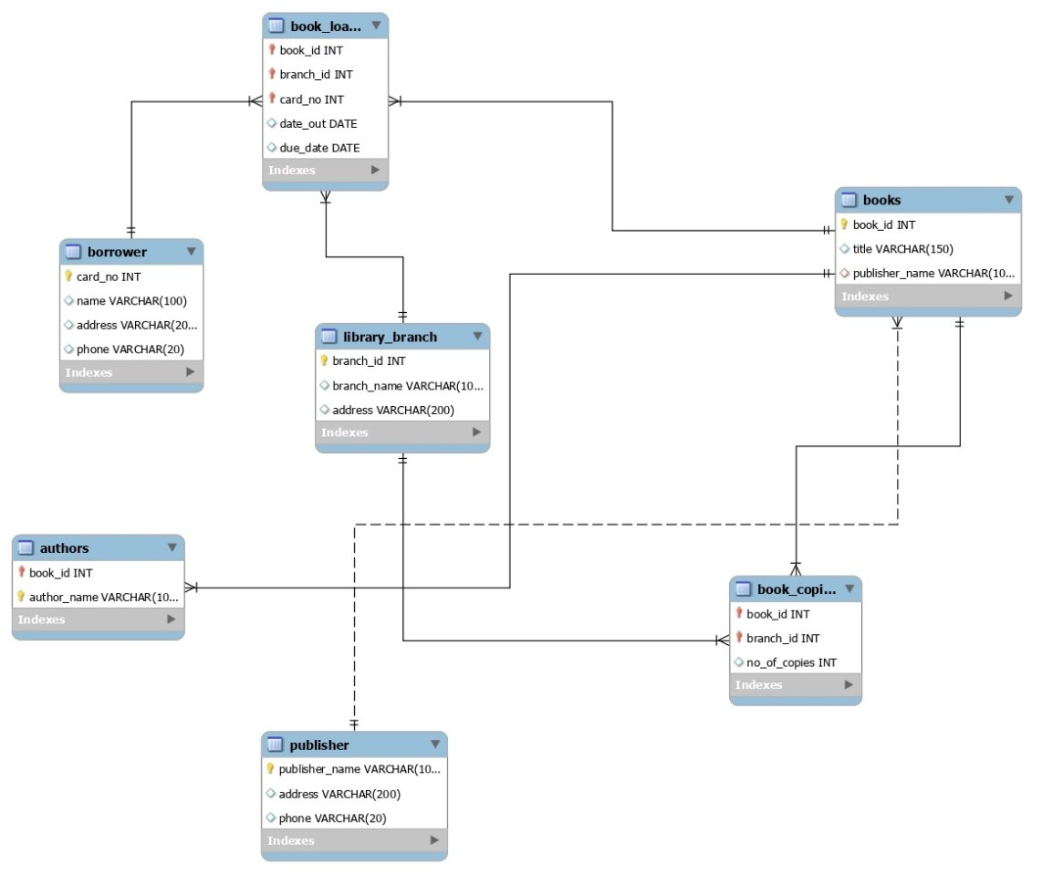
Entity Relationship (ER) Diagram

Slide 4
Entities & Attributes:-
BOOK: BookID (PK), Title, PublisherName
BOOK_AUTHORS: BookID (FK), AuthorName
LIBRARY_BRANCH: BranchID (PK), BranchName, Address
BOOK_COPIES: BookID (FK), BranchID (FK), No_of_Copies
BORROWER: CardNo (PK), Name, Address, Phone
BOOK_LOANS: BookID (FK), BranchID (FK), CardNo (FK), DateOut, DueDate
Relationships
BOOK → BOOK_AUTHORS
One book can have one or more authors
BOOK → BOOK_COPIES → LIBRARY_BRANCH
Each book has multiple copies across branches
BORROWER → BOOK_LOANS → BOOK
A borrower can loan multiple books
LIBRARY_BRANCH → BOOK_LOANS
Each branch issues multiple book loans

Slide 5
Database Overview
Database Name: Library Management System
Main Tables Used:
BOOK
BOOK_AUTHORS
BOOK_COPIES
BOOK_LOANS
LIBRARY_BRANCH
BORROWER
Purpose: To efficiently manage book records, copies per branch, loan details, and borrower information.

Slide 6
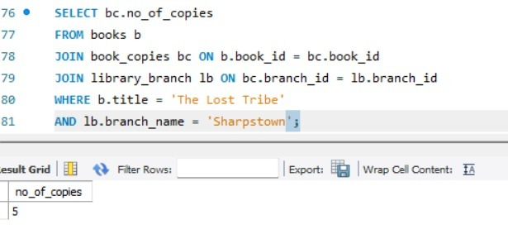
Question 1: How many copies of the book titled "The Lost Tribe" are owned by the library branch "Sharpstown"?
SQL Query Used:
This query returns the total number of copies of The Lost Tribe available specifically at the Sharpstown branch.

Slide 7
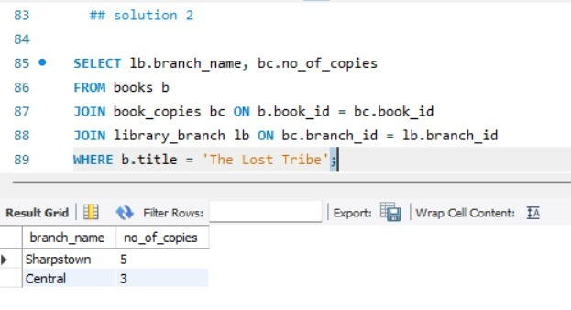
Question 2: How many copies of the book titled "The Lost Tribe" are owned by each library branch?
SQL Query Used:
This query lists each library branch along with the number of copies of The Lost Tribe owned by that branch.

Slide 8
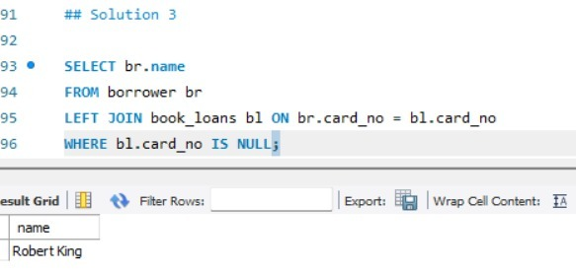
Question 3: Retrieve the names of all borrowers who do not have any books checked out.
SQL Query Used:
This query displays borrowers who currently have no active book loans.

Slide 9
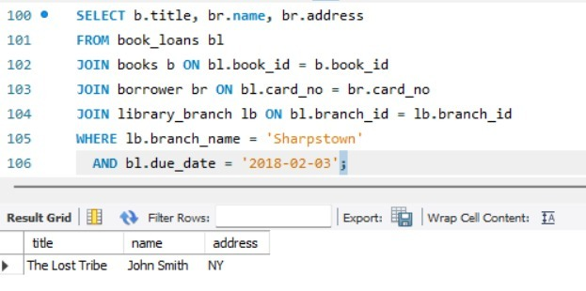
Question 4: For books loaned from "Sharpstown" branch with DueDate = 2/3/18, retrieve book title, borrower name, and address.
SQL Query Used:
This query shows:
Book Title
Borrower Name
Borrower Address
for books issued from Sharpstown and due on 2 Feb 2018.

Slide 10
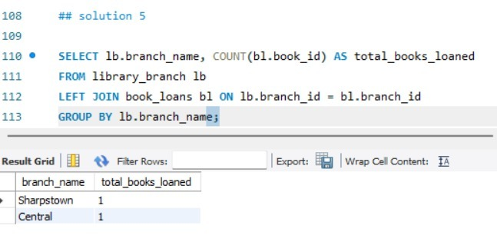
Question 5: For each library branch, retrieve branch name and total number of books loaned out.
SQL Query Used:
This query returns the total number of books issued from each library branch.

Slide 11
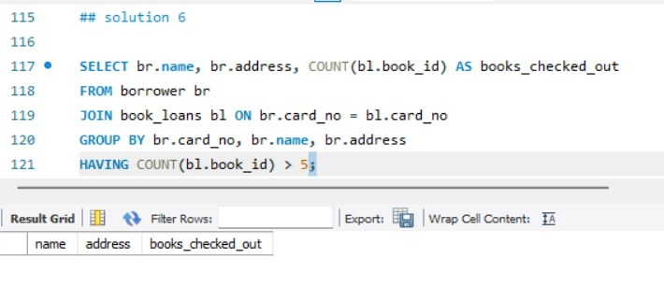
Question 6: Retrieve borrowers who have more than 5 books checked out.
SQL Query Used:
This query lists:
Borrower Name
Address
Number of Books Issued
for borrowers who have checked out more than five books.

Slide 12
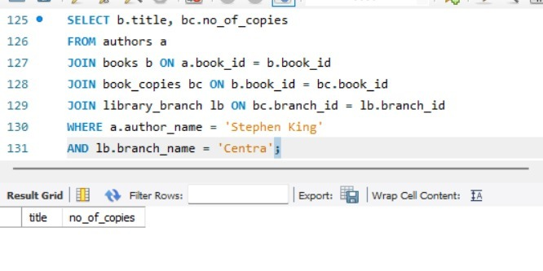
Question 7: For books authored by "Stephen King", retrieve title and number of copies owned by "Central" branch.
SQL Query Used:
This query shows Stephen King books and how many copies are available at the Central branch.

Slide 13
Conclusion:-
Project Summary:
Implemented JOINs, GROUP BY, HAVING, and subqueries
Retrieved real-world insights from a relational database
Demonstrated strong understanding of SQL querying and database design
Key Learning Outcomes:
Data retrieval using complex SQL queries
Practical understanding of Library Management Systems
Improved analytical and problem-solving skills

Slide 14

THANK YOU

