Slide 1



HACK MATRIX HACKATHON
PROJECT TITLE : Campus Lost & Found Board – LostLink
TEAM NAME : Dev Duo
TEAM MEMBERS :
Khushi Purwar (25BCE10021)
Shekhar Rajput(25BMR10013)

Slide 2

PROBLEM STATEMENT
Problem
Students generally lose important stuffs like ID cards, keys, wallets, and other items in campus.
Currently, people who lose stuff depends on unorganized WhatsApp groups or word-of-mouth.
Text notices get buried in chats and are difficult to track or search and may never found it.
There is no proper system to search or segregate lost and found items.
Sometimes for fun fake leads are given for the lost items.
Who is affected ??
People who lost their personal stuff.
People who find lost items but cannot find it's owner
New students who doesn't know about campus communication channels
Overall campus community, as WhatsApp groups get spammed with lost-and-found messages, due to which important messages to be missed
Why is solution needed?
Person who has lost stuff suffers from stress and disrupts their daily life.
A lot of time is wasted in search through chats or asking people
Chances of getting the lost item is less due to poor system
Creates unnecessary confusion and miscommunication
Proper system can improve efficiency and make the recovery of lost item easy

Slide 3
EXISTING SOLUTIONS AND GAPS
List of existing Solutions (if any)
WhatsApps groups and community are used to posting lost and found items.
Enquiring about lost stuff to security guards, staff, and workers.
Trying to search through friends or social media.
Limitations
The WhatsApp groups and community notices are filled with messages, which causes missing of important announcements.
It's not well-maintained or organized, and doesn't even have a search function or filter
There is no proper monitoring or tracking can be done even if an item is found in this process.
Gaps can be covered by our plateform
It is a platform which is centralized website for all campus lost-and-found matters.
It is provides fast search and filter, with simple matching of found items with lost items.
It establishes a structured and secure process for posting, claiming items with verification.

Slide 4
PROPOSED SOLUTION
Solution
A web application that serves as a lost and found service for the campus community
Users can post lost or found notices with photos, descriptions, and location information.
The platform offers a category sytem where user can filter through and search for items easily.
List key features
User can login using college ID
The post of lost item with photo and lost item details.
The post of lost item are search and filtered by category and location.
Lost item is finded using smart matching of similar lost and found items
Claims of lost items are requsted and can be claimed through user to user contact system
Verification system makes sure that the item is returned to the real owner.
How solution solves the problem ?
It provides a structured platform which replaces unorganized WhatsApp groups and communities.
Filtering and categorization makes the process less confusing and easy to use.
There are greater chances that an item can be recovered with smart matching
It ensures secure and genuine claims through the verification process.

Slide 5
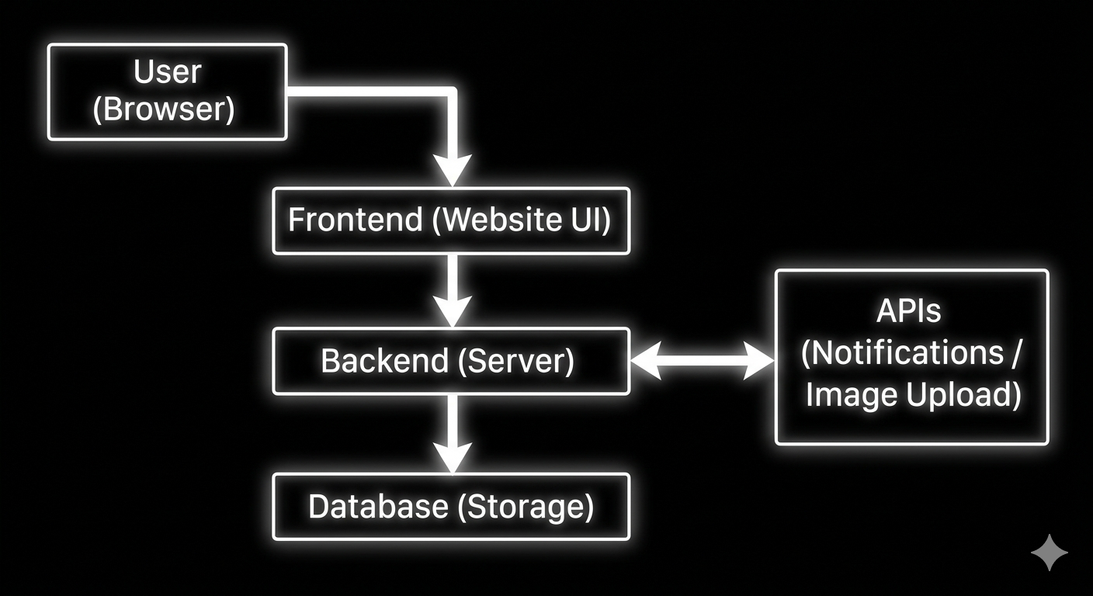
System Architecture
Main components (Frontend, Backend, Database, APIs)
Frontend
User interface built using React
Allows users to post, search, and view the lost and found items
Backend
Handles application logic and requests made by the user
Manages posting, searching, and the claim process
Database
Stores user details and item information
Maintains lost and found records
APIs
Used for image upload and notifications
Helps in smooth communication between components
Explain data flow briefly
User interacts with frontend (website)
Frontend sends request to backend
Backend processes and stores data in database
Response is sent back to frontend and displayed to user

Slide 6
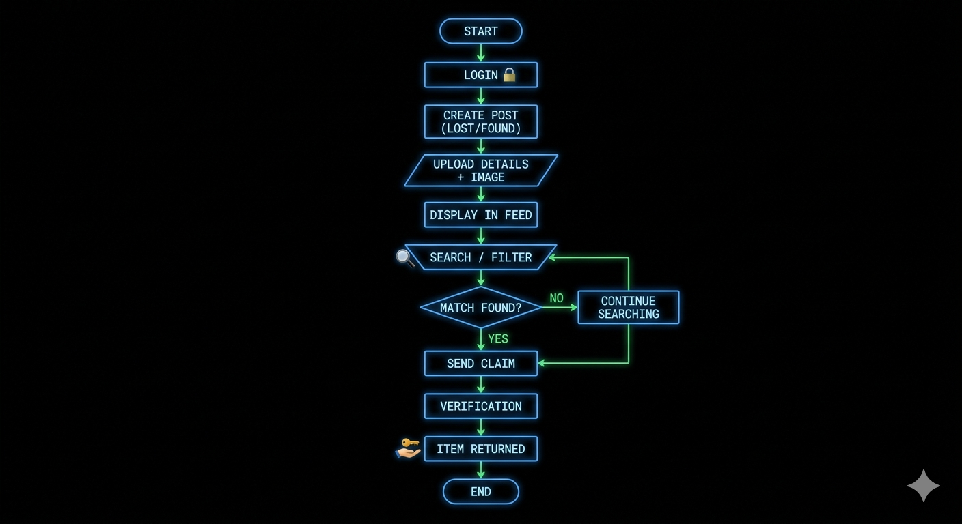
FLOWCHART / WORKING PROCESS
Show step-by-step working
User logs in using college id instead of email id.
The user then makes a post for a lost or found item
User adds image and details of the item.
Post is visible on the general feed.
Other users can search and filter items.
System recommends corresponding items.
User submits a claim request.
Verification takes place prior to handover.
Item is returned to the owner.
Include user flow or system flow
User Interaction with the platform
System extracts and displays the corresponding information
Users establish connections via claim requests to one another
Verification guarantees the safe exchange of items

Slide 7
TECH STACK
Frontend technologies
HTML, CSS, JavaScript – Build the user interface; structure, style, and interactive for user.
Backend technologies
Node.js (Express) – Handles requests, processes data, and communicates with the database.
Database
MongoDB (Atlas) – Stores all lost/found items, users, and claim requests securely.
Tools and APIs used and reason for choosing each (1 line each)
GitHub – To manage code and track team commits.
Fetch API / Axios – Allows frontend to communicate with backend.

Slide 8
IMPLEMENTATION PLAN
Development Steps
Design UI screens – Login page, Lost/Found form, Feed, Search, Claim request.
Setup Backend server – Node.js server with API routes for login, post, search, claim.
Connect Database – MongoDB Atlas to store users, items, and claims.
Integrate Frontend & Backend – Use API calls (Fetch/Axios) to connect forms, feed, and search.
Add Features – Posting items, searching/filtering, claim requests, notifications.
Testing & Debugging – Ensure all modules work correctly and fix issues.
Final Touches & Deployment – Update PPT, add screenshots, deploy live (optional).
Modules / Features Breakdown
Description
Login Module
Secure login with college ID for students/faculty.
Post Lost/Found Item
Upload item details, photo, date, and location.
Feed Module
Centralized display of all lost/found posts.
Search & Filter
Search by category, location, date, and keywords.
Claim Request
Users request ownership of items.
Notifications
Real-time updates on new items and claim approvals.

Slide 9
EXPECTED OUTCOME / IMPACT
Expected results of the project
Faster recovery of lost items on campus.
Organized, centralized platform for all lost and found item notice.
Reduced time and stress in locating items.
Functional prototype demonstrating all key features (login, post, search, claim, notifications).
Benefits to users
Users can quickly report or find lost items.
Easy-to-use interface with search and filter options.
Real-time updates and notifications for matched items or claim approvals.
Secure and reliable system with ownership verification.
Real-world impact
Reduces loss of valuable items like ID cards, gadgets, and keys.
Improves campus safety and efficiency.
Provides a scalable solution that can be extended to other campuses.
Demonstrates tech-driven problem solving for everyday campus issues.

Slide 10
FUTURE SCOPE AND CONCLUSION
Future improvements
Notification alerts for matching lost/found items.
AI-based matching to suggest the possible owner of the item.
Using database of college ID system for faster verification.
Mobile app for easy acesses.
Analytics dashboard to track lost/found trends on campus.
Final summary
Campus Lost & Found system provides a simple and effective solution to a common problem.
Easy to use, secure, and organized for students and faculty.
Demonstrates innovation, scalability, and real-world impact.
Ready to deploy and expand for broader campus adoption.
Scalability of the project
Node.js + npm (Backend)
Download from: https://nodejs.org/en/download⁠�
Install LTS version (stable)
Verify installation in terminal:
Bash
node -v
npm -v

