Slide 1

Ecommerce Website Design
Name Khushi
2110992029 G19

Slide 2
Introduction
Welcome to our cutting-edge e-commerce platform designed to provide you with an exceptional online shopping experience. Our website offers a wide range of high-quality products, each meticulously crafted to meet your needs and desires. Explore our extensive catalog of products, from the latest fashion trends to innovative gadgets, and enjoy a seamless shopping journey. Discover detailed product information, add items to your cart with ease, and breeze through our secure and convenient checkout process.

Slide 3
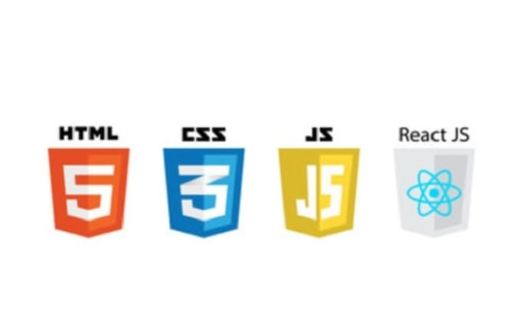
Technology Used: Innovation at its Core
1
HTML
2
CSS
3
JavaScript
4
React

Slide 4
Key Components: Powering Your Success
User-Friendly Interface
Flexible Inventory Management
Personalized Recommendations
Seamless Checkout Process
Navigate through the website effortlessly with an intuitive user interface.
Efficiently manage your inventory with real-time tracking and inventory optimization tools.
Boost sales with personalized product recommendations based on user behavior and preferences.
Streamline the buying process with a one-click checkout and secure payment options.

Slide 5
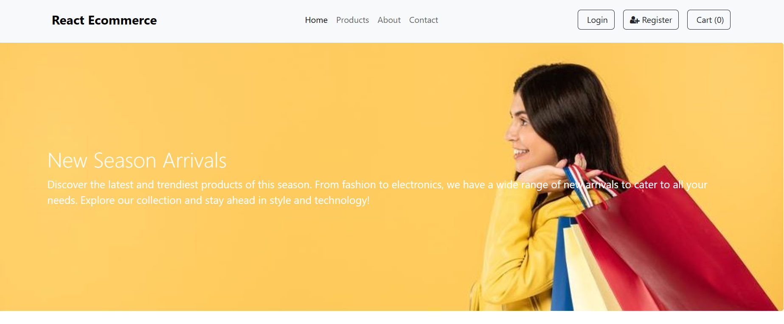
Screen Shorts
Get a glimpse of intuitive interface, seamless navigation, and impactful product display.

Slide 6
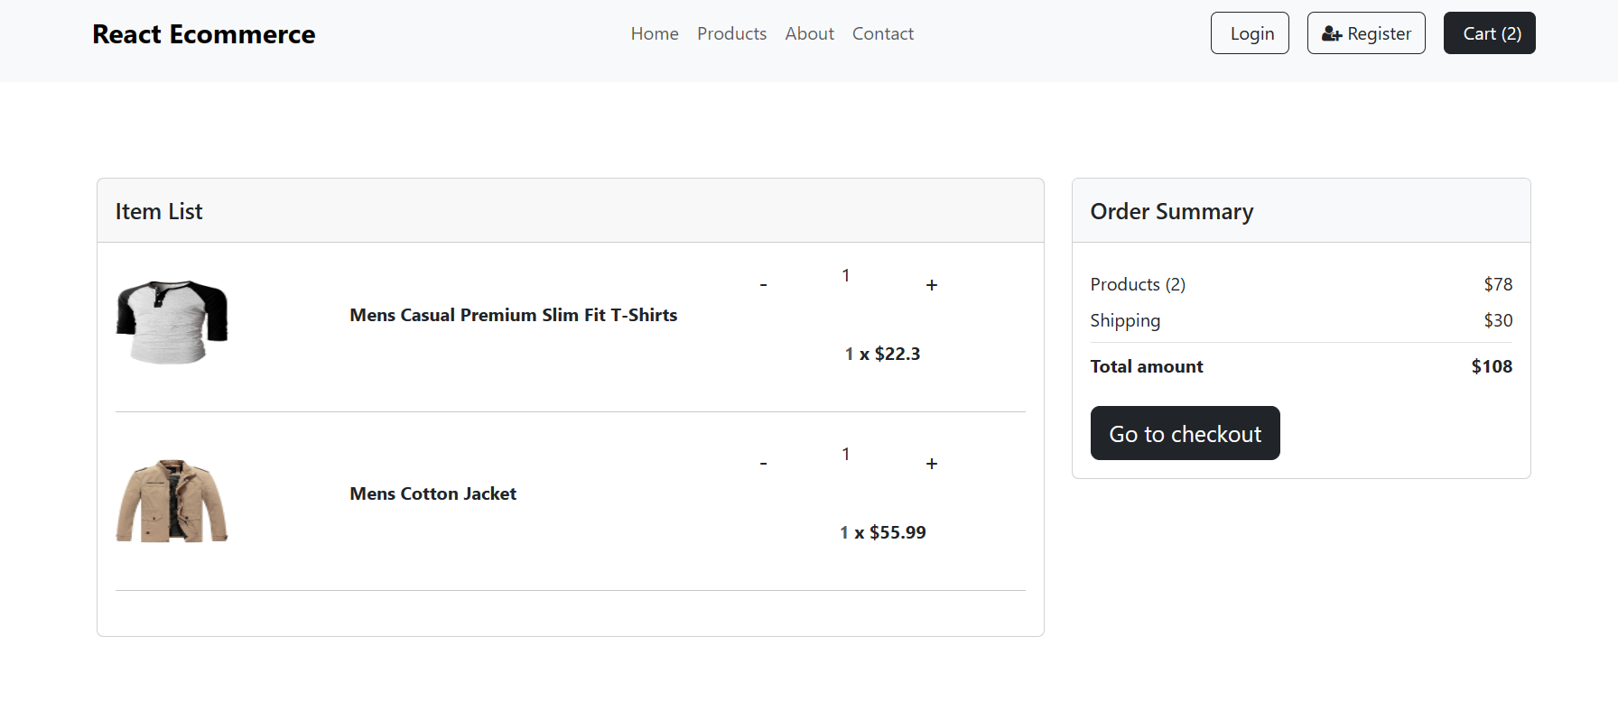
Easy And Simple Cart Option help you to check if everything is there that you want to order Or Not.

Slide 7
Conclusion
In summary, our e-commerce website is a dynamic and user-friendly platform that embraces modern technology to provide a convenient and enjoyable shopping experience. Built using React, Redux, Bootstrap, and Font Awesome, it offers responsive design and efficient state management. Our website reflects our commitment to the evolving world of online retail, and we are dedicated to exceeding user expectations. We invite you to explore our extensive product catalog and provide feedback as we continue to improve and enhance your online shopping journey. Thank you for choosing us as your e-commerce destination.

