Slide 1

BRAINWARE UNIVERSITY
Department of Computational Science
Student Name
AI StudyMate
Khushi Shaw
Programme
BCA
AI-Powered Student Performance Predictor & Personalized Learning Recommendation System
Department
Computational Science
Subject Name
Machine learning______________
Project Presentation | BCA
Subject Code
_______BCA57205(P)________

Slide 2
Introduction
BCA, B.Tech CSE and MCA students handle many subjects, but a raw mark says little on its own.
AI StudyMate is a web app that turns marks into guidance in a few seconds: expected mark, percentile rank, performance label, study plan and learning resources.
Built with Python, Flask and scikit-learn, with a single-page HTML/CSS/JS interface.
3
18
Courses
ML models
1,000
90
Students per cohort
Learning resources

Slide 3
Problem Statement
1
No peer comparison – raw marks do not show a student’s position in class
2
No expected level – hard to tell if a mark is weak for that student
3
Guesswork study time – hours are not divided by priority
4
Scattered resources – good material must be searched manually
5
Late feedback – results arrive only after the exams

Slide 4
Objectives
Instant feedback
ML prediction
Action plan
Subject-wise comparison with a reference cohort
Compare regression models for expected marks
Hour split, 7-day plan and learning resources
REST + SPA
Modular code
Expected outcome
Flask API with a responsive page, no reloads
Add courses, subjects and resources easily
A clear, actionable path to better academic performance

Slide 5
Scope of the Project
Coverage
Target users
Limitations
3 courses: BCA, BTech CSE, MCA
6 subjects each, 18 models
Percentile, targets, plan, resources
BCA, B.Tech and MCA students
Faculty and mentors for quick academic diagnosis
Synthetic reference cohorts
Predictions are estimates, not guarantees
No login or session history

Slide 6
Literature Review / Existing System
Aspect | Grade card | Spreadsheet | AI StudyMate
Peer comparison | None | Manual formulas | Percentile vs 1,000 students
Expected vs actual | Not available | Not available | ML-predicted mark and gap
Study plan | None | None | 7-day plan + hour split
Resources | None | None | Curated links by priority
Feedback speed | After results | Depends on user | Instant, one request
Research background
Educational Data Mining and Learning Analytics (Romero & Ventura, 2020)
Linear Regression vs Random Forest (Breiman, 2001)
Gap: marks without context or next steps
Existing approaches stop at the number: no benchmark, no plan, no resources.

Slide 7
Proposed System
1
Percentile rank
2
Expected mark
Against a 1,000-student cohort
Regression model per subject
3
Labels and targets
4
Study-hour split
Needs Improvement, Average, Good
Weights 3 : 2 : 1 by priority
5
7-day study plan
6
Learning resources
Built from the 3 weakest subjects
90 curated links by priority

Slide 8
Project Methodology
Generate cohort data
▶
Train and select models
▶
Serve via Flask API
▶
Render in browser
Backend
Machine learning
Data handling
Python 3.10+, Flask 3
scikit-learn, joblib
pandas, NumPy
Frontend
Storage
Visualisation
HTML5, CSS3, vanilla JS
CSV cohorts, .pkl models
matplotlib, seaborn

Slide 9
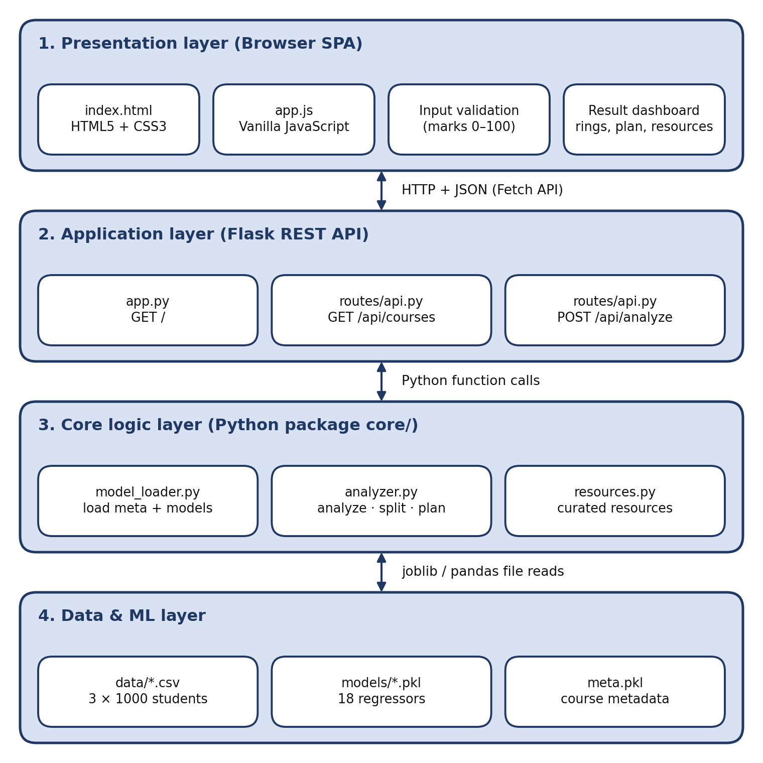
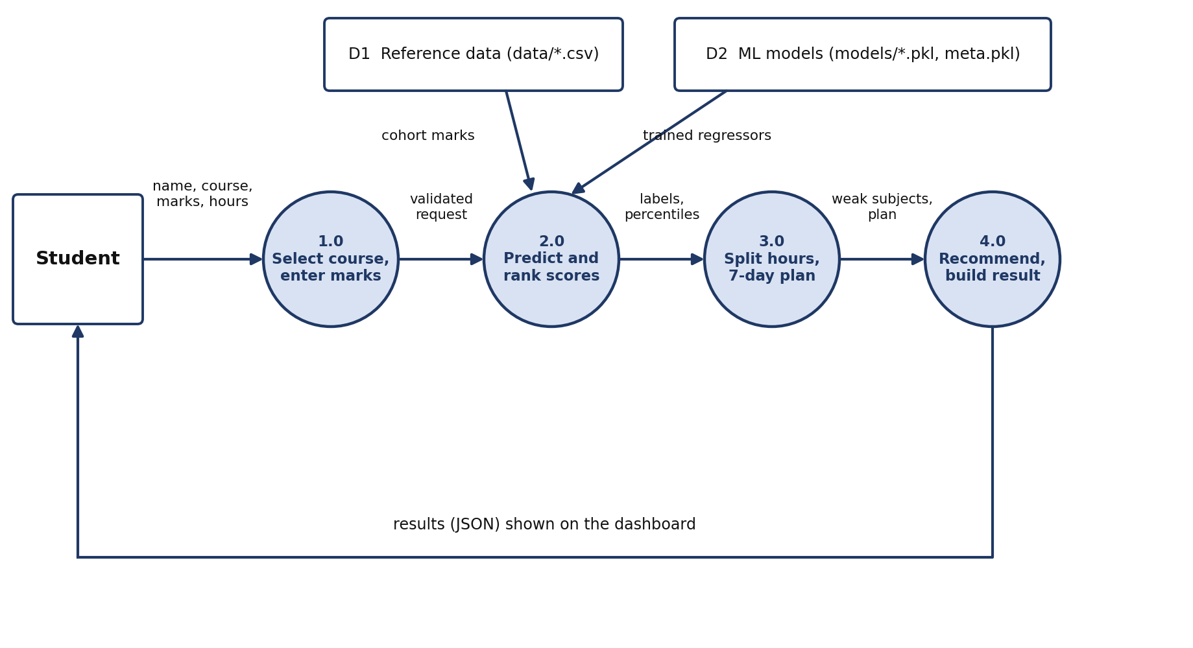
Project Internal Structure
Fig 3.4 DFD Level 1
Modules: Course & Subject, Marks Input, Prediction & Ranking, Study Planner, Resource Recommender, Training
Fig 3.1 Layered architecture

Slide 10
Implementation
core/analyzer.py
REST endpoints
expected = float(models[s].predict(row)[0])
pct = float((ref[s] < marks[s]).mean() * 100)
target = min(100.0, max(marks[s] + 5,
float(ref[s].quantile(0.70))))
label = label_from_percentile(pct)
GET / – HTML page
GET /api/courses
POST /api/analyze – full JSON result
core/
routes/
static/ + templates/
model loading, analysis, plan, resources
Flask blueprint with API endpoints
form, validation, SVG rings, Fetch API

Slide 11
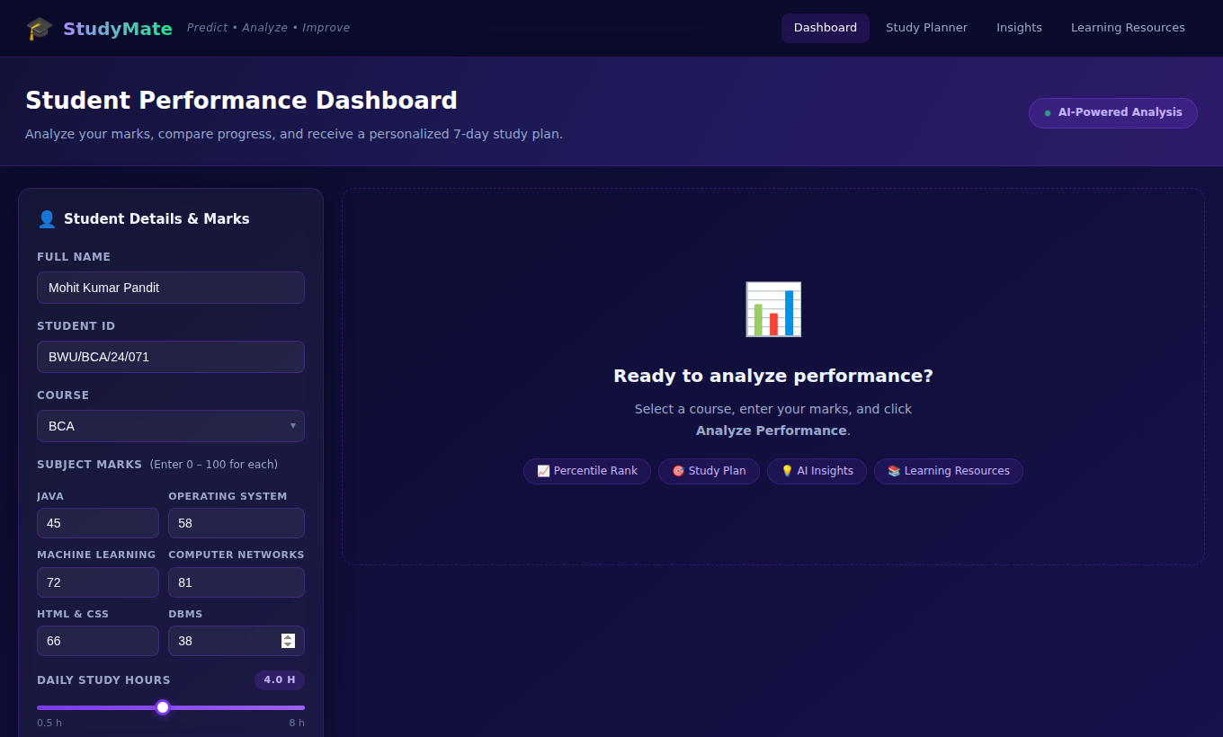
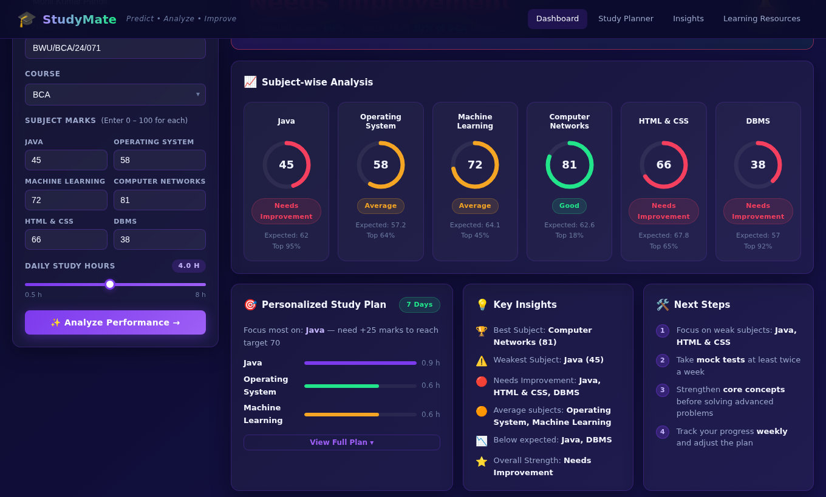
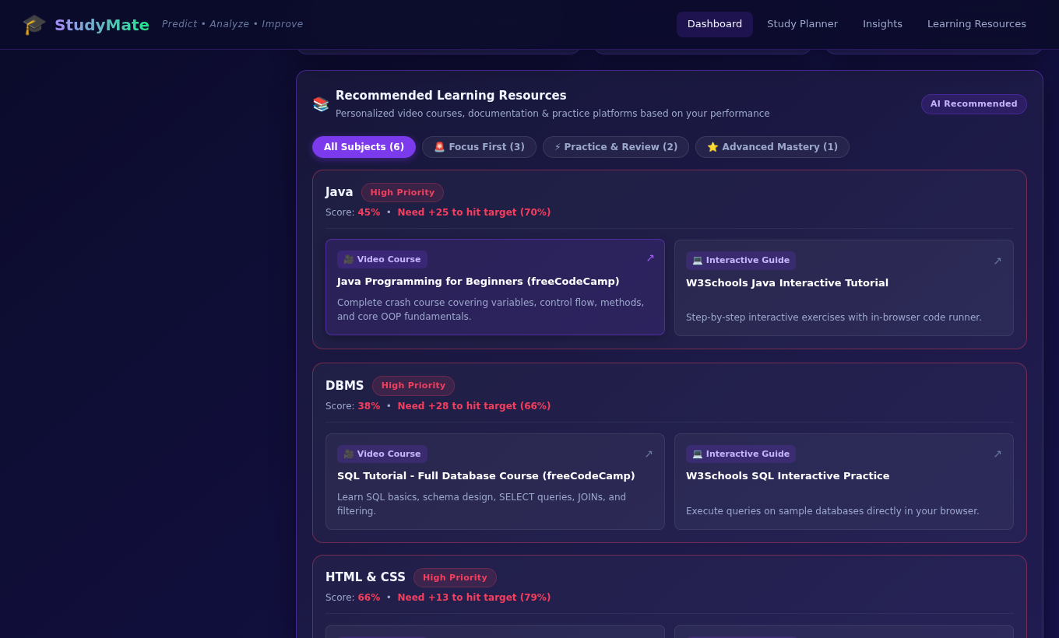
Implementation: Interface Screenshots
Input form
Analysis dashboard
Resources
Course, six marks and study-hours slider
Score rings, plan, insights, next steps
Priority badges with filter tabs
Also built: overall result banner, expandable 7-day plan and a responsive mobile layout.

Slide 12
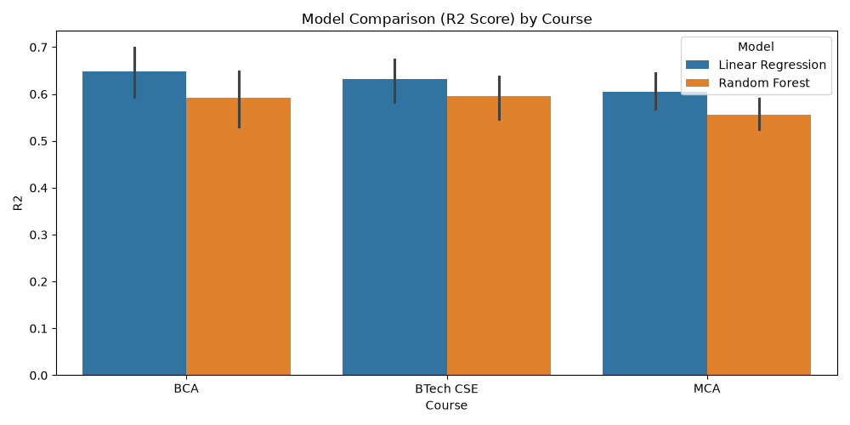
Testing and Results
15 / 15
0.63
6.9
test cases passed
mean R² (Linear Regression)
mean absolute error (marks)
Unit, integration, system and boundary tests
Input validation blocks blank and out-of-range marks
Linear Regression beat Random Forest in all 18 models
Fig 4.2 Model comparison (R²) by course

Slide 13
Conclusion
AI StudyMate turns a list of marks into guidance: in one page and one request, a student sees how each subject compares with 1,000 peers, what to study first and which resources to use.
✓
Instant subject-wise feedback delivered
✓
Regression models trained and compared
✓
Hour split, 7-day plan and resources added
✓
REST API with a no-reload interface built
✓
Modular code ready for new courses

Slide 14
Future Scope
01
Real data, better models
02
Server-side validation
Real student marks, more features, tuned models
HTTP 400 errors and automated tests
03
Accounts and history
04
Smarter study plans
Login and a database to track progress
Full daily hours and topic-level advice
05
PDF export, reminders
06
Interface upgrades
Download plan; e-mail or SMS reminders
Mobile menu, cohort charts, light theme

Slide 15
References
Python Documentation
docs.python.org/3/
Flask Framework
flask.palletsprojects.com
scikit-learn (Pedregosa et al., 2011)
scikit-learn.org
Breiman, Random Forests, 2001
doi.org/10.1023/A:1010933404324
pandas and NumPy
pandas.pydata.org | numpy.org
joblib, matplotlib, seaborn
joblib.readthedocs.io | matplotlib.org
MDN Web Docs
developer.mozilla.org
Romero & Ventura, EDM and Learning Analytics, 2020
wires.onlinelibrary.wiley.com
Students Performance in Exams (Kaggle)
kaggle.com/datasets/spscientist
Class notes, Brainware University

