Slide 1
‘Fedora’ The Voice Assistant
The one who is there to help you when you are alone or need some help.
Presented by :-
Khushi Shukla

Slide 2
Index
Introduction
Objective
Technology
Modules
Code
Credit

Slide 3
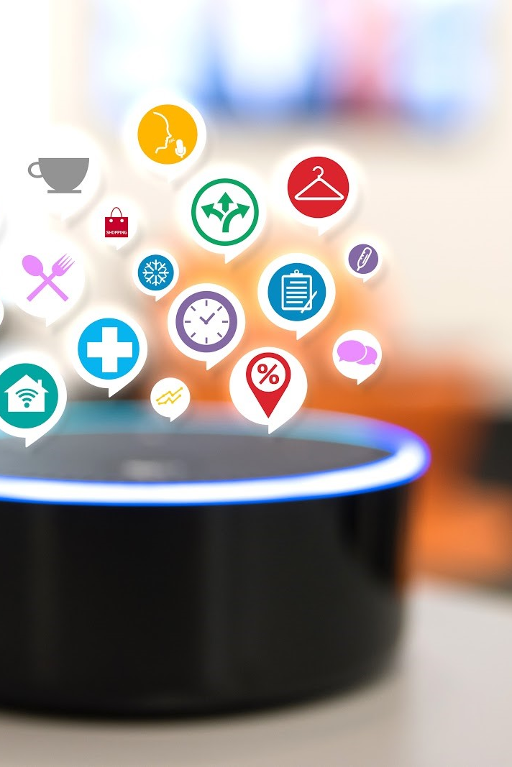
Voice Assistant
A voice assistant allow user ,using it by a single voice commands.
A voice assistant use the power of Natural language processing(NLP), voice recognition technology and speech synthesis.
A voice assistant is a automated software Application or platform.

Slide 4
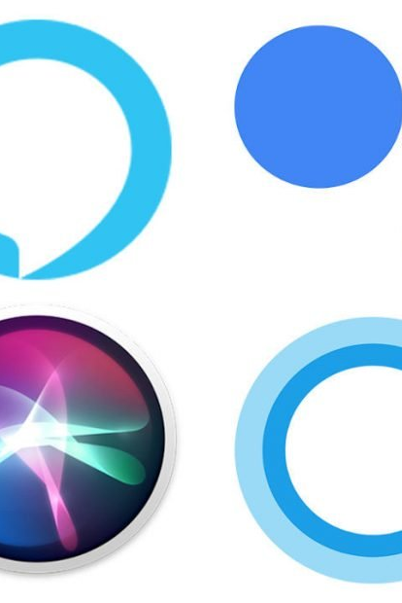
Common uses Voice Assistant
Create a smart home or office.
Manage times and productivity.
Run a TV or smart appliances.
Make life easier with “skills”.
Drive hand-free.
Get information about daily news, weather and traffic.
Have random fun.

Slide 5
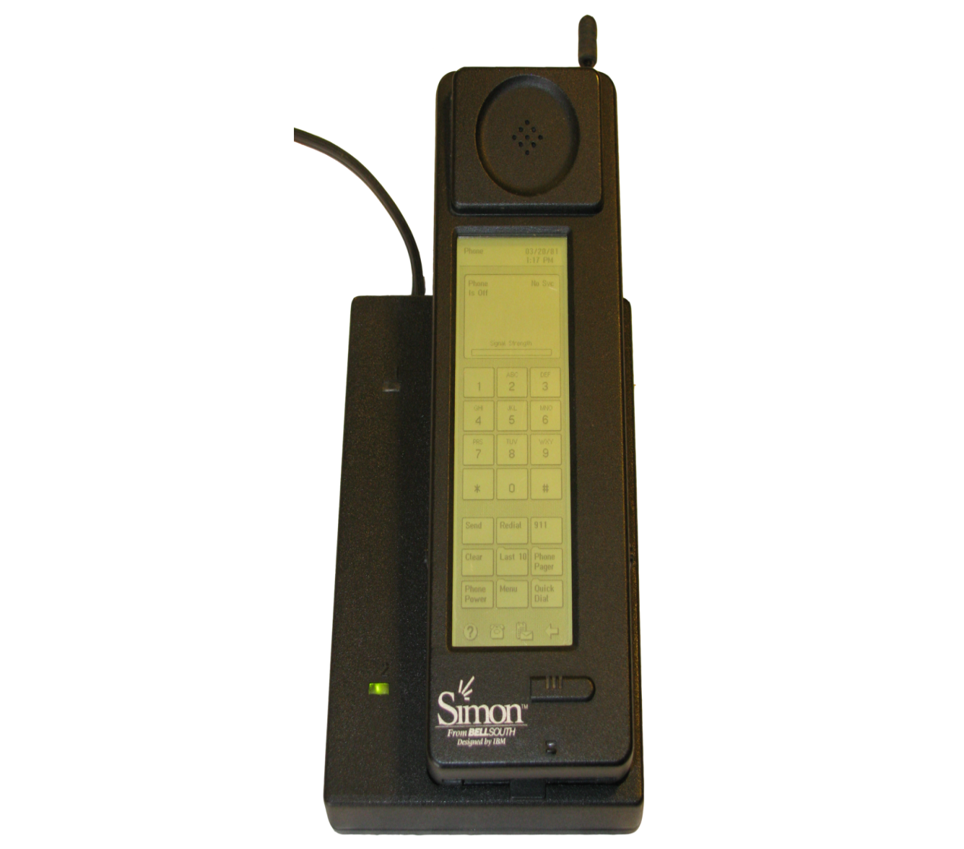
First Voice Assistant. (IBM Simon)
IBM Simon was created in 1994 by IBM.
It was the first smartphone in the history.
It laid the foundation for smart virtual assistant as we know them today.
Simon was the first touchscreen and handheld PDA.

Slide 6

Benefits of Voice Assistant.
Some examples of what a Voice Assistant can do include:
•Check the time, date
•Plays the song
•Tells Joke
•Can access Wikipedia
•Resolve some of the common Queries
•Can access all the types of Web-Browser
•It Entertains
•Time Efficient
•Cost Efficient
•Quick Learning Curve

Slide 7
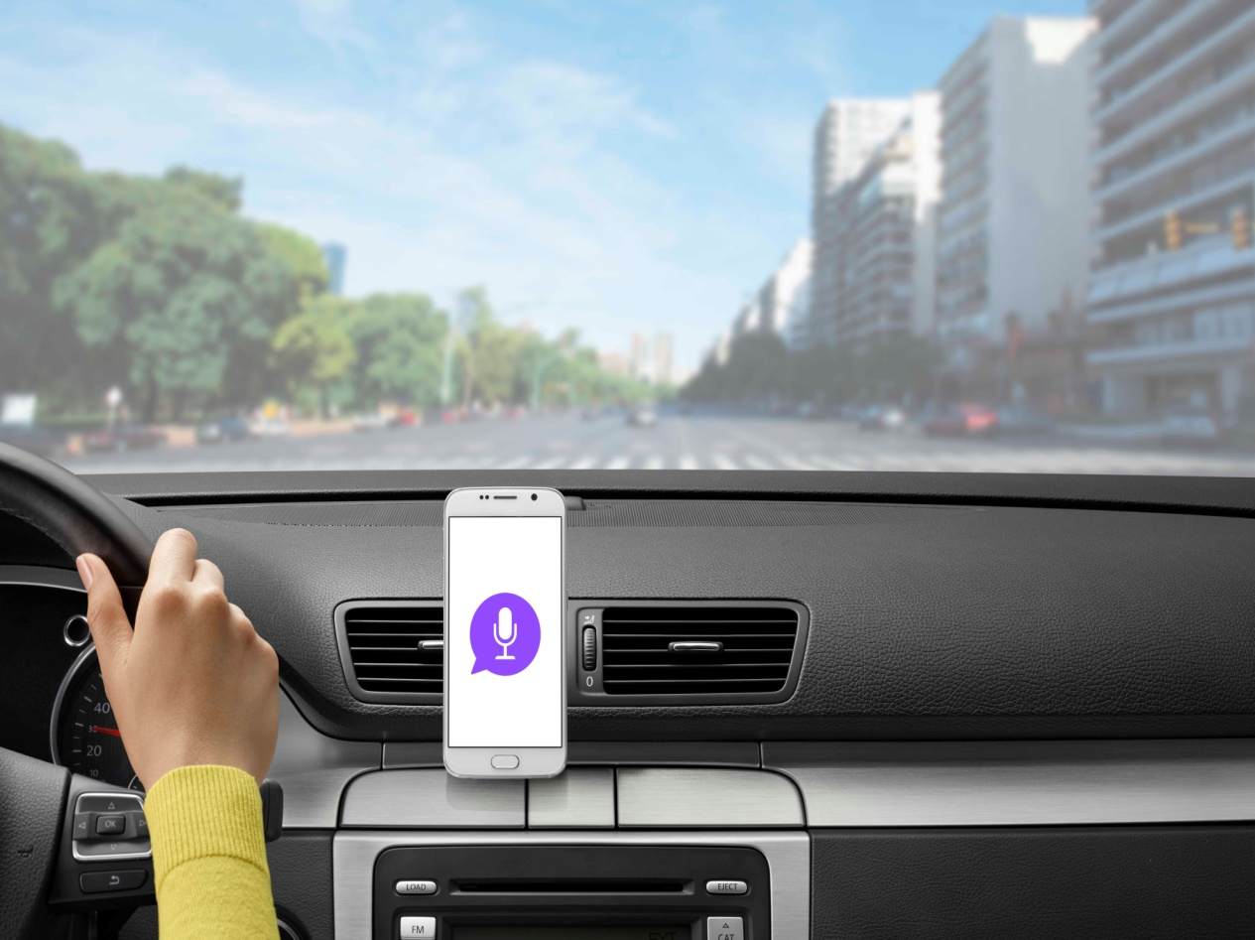
When and Why to use Fedora.
There are many use cases for using a voice assistant in todays’ world.
For example, when your hands are full and you are unable to use a touch screen or keyboard, or when you are driving. Let’s say you are driving and you need to change your music, you could just ask a voice assistant, “play my driving playlist”. This leads to a safer driving experience, and helps avoid the risk of distracted driving.

Slide 8
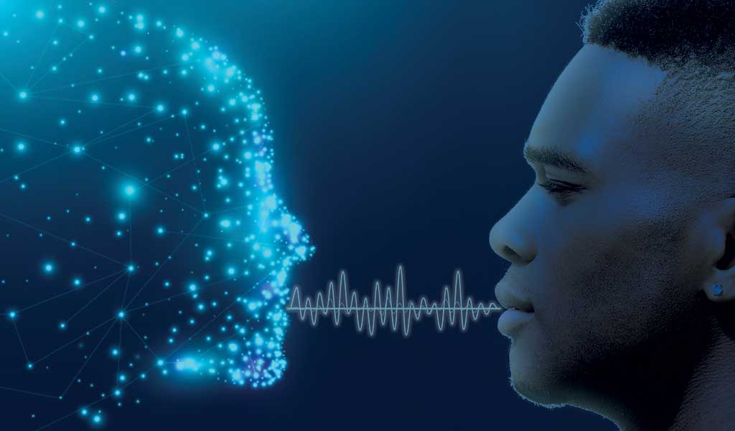
Artificial Intelligence.
In 1950, Alan Turing (The namesake of our company) published his paper “Computing Machinery and Intelligence” that first asked the question, can machines think? Alan Turing then went on to develop the Turing Test, a method of evaluating a computer to test its capability of thinking like a human. There were four approaches later developed that defined AI, Thinking humanly/rationally, and acting humanly/rationally. While the first two deal with reasoning, the second two deal with actual behavior. Modern AI is typically seen as a computer system designed to accomplish tasks that typically require human interaction. These systems can improve upon themselves using a process known as machine learning.

Slide 9
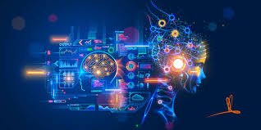
Machine Learning
Machine learning refers to the subset of Artificial Intelligence where programs are created without the use of human coders manually creating the program. Instead of writing out the complete program on their own, programmers gives the AI “patterns” to recognize and learn from and then gives the AI large amounts of data to sift through and study. So instead of having specific rules to abide by, the AI searches for patterns within this data and uses it to improve its already existing functions. One way machine learning can be helpful for Voice AI, is by feeding the algorithm hours of speech from various accents and dialects.

Slide 10
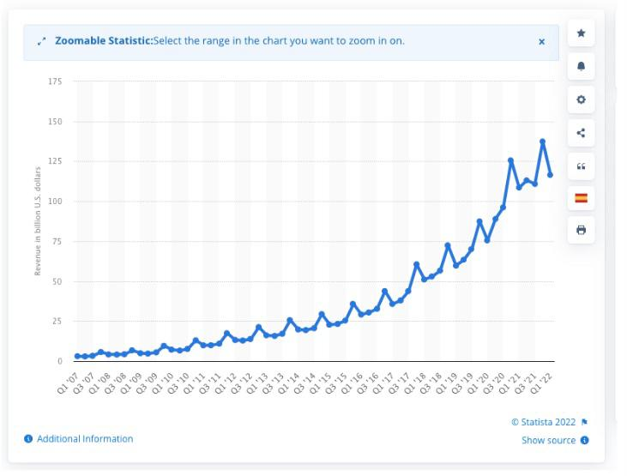
Present Market of Voice Assistant.
The global voice recognition market is set to touch $27.16 billion by 2025 from $10.7 billion in 2020. A report by google also show that almost 27% of the online global population uses voice search on their phones. With the growing popularity of Alexa and siri, voice assistants have revamped how people use technology and connect with brands conveniently.

Slide 11
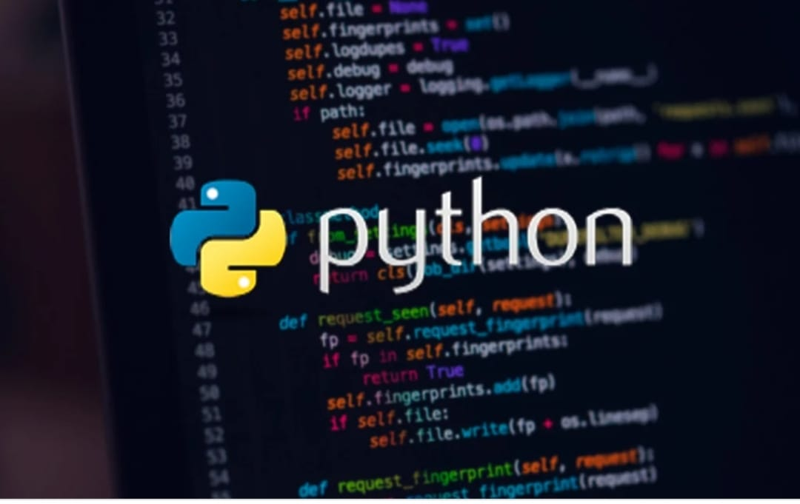
Python Modules.
SpeechRecognition
pyttsx3
datetime
wikipedia
pyjokes
os
webbrowser

