Slide 1
Key_Shield --Shelter to your data..!
Don’t be fool, Use proper tool….. Zero Compromise towards safety.
Designed by--
Khushi Shukla

Slide 2
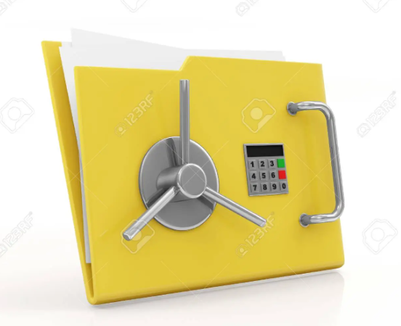
Our Goal—Zero HarM..!!

Slide 3
Introduction
Key_shield is a mechanism that restricts access to a computer file or a folder, by allowing only the user or process to modify or delete it.
It is a technique that ensures that a file in use by the authenticated user only and is made unavailable to others.
In-short, we can say that it is a subset of information security, data security and keeping it safe and secure.

Slide 4
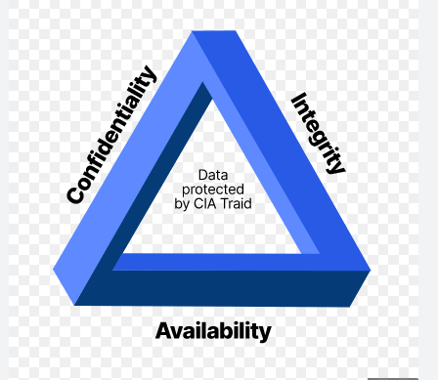
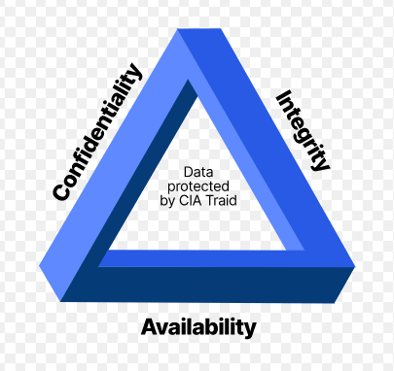

Slide 5
Existing _Applications !
Some of the existing applications for protecting folders include :-
Gilisoft file lock pro, Secret Folder, Hidden dir, etc....
The above applications are used to hide, protect your Folders butt....there are some flaws such as: the applications asks for the password to enter when that particular folder is approached which alerts an individual, that it may contain some confidential data, which the user wants to hide and therefore itself invites for the theft.

Slide 6
Objectives…….
Helps with privacy by separating sensitive data and normal data.
Sensitive data is not accessible outside of Secure Folder.
Key_shield protects your private content and apps, such as photos and contacts, from being accessed by others.
You can keep your important content and apps secure even when the device is unlocked.

Slide 7
Why do we need Key_shield..!?
It's vital to have a secure system in place for storage and processing of your information.
To protect your files and important documents, key_shield designed by python is useful.
Locking is the best way to guarantee that nobody accidentally or intentionally gets access to your Confidential information.
It allows user to secure and hide folders or files with a security password.

Slide 8
Python modules
Os :
It provides functions for creating and removing a directory (folder), fetching its contents, changing and identifying the current directory, etc.
Shutil :
It offers operations on a file like a copy, create, and remote operation on the file.

Slide 9
Conclusion
I have learnt python language and working with its various libraries. Get to learn about how to make folder of the same name at the same place, transfer of file and data to other file using few lines of python code securing confidential data as it is quite helpful and useful in our daily life, which has been accomplished in improving and protecting folders.
It will provide the accessibility to the user or authenticated individual only and for others will make that folder worthless.

Slide 10
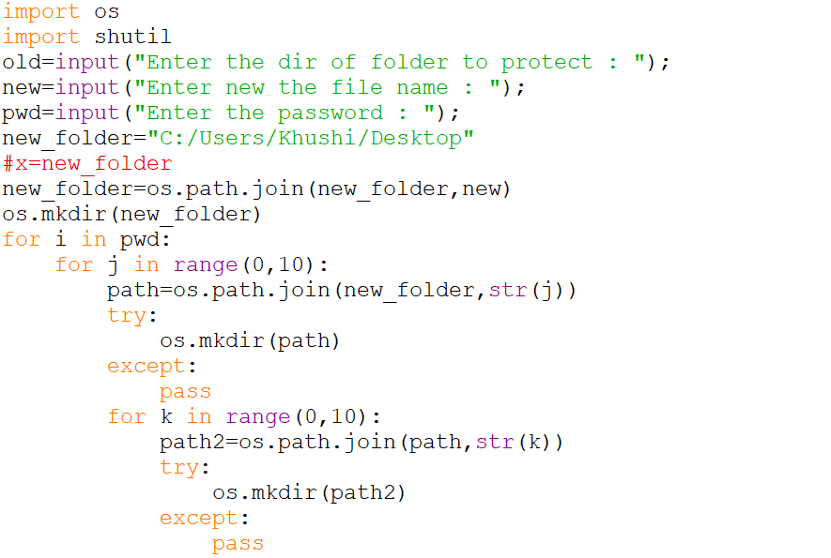

Slide 11
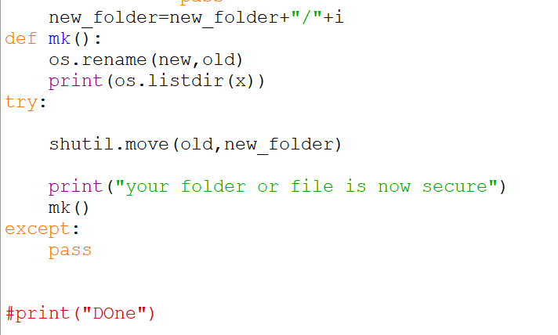

Slide 12
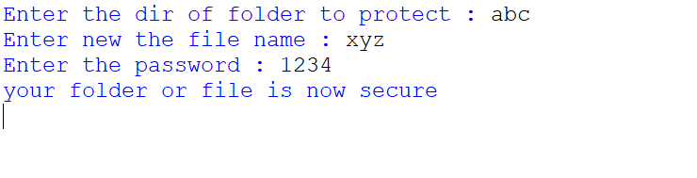
Console Window

