Slide 1
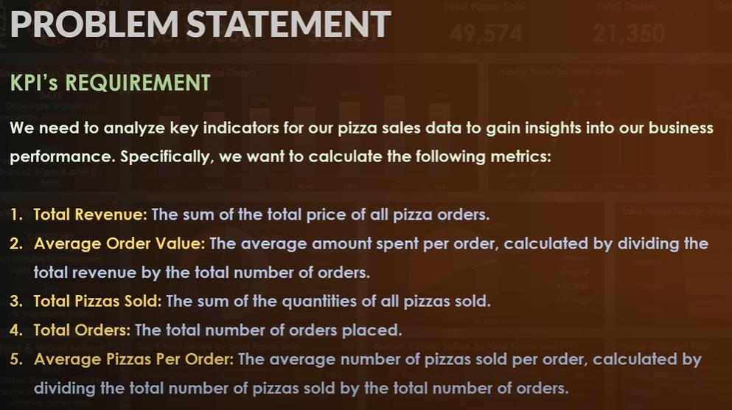
OBJECTIVE

Slide 2
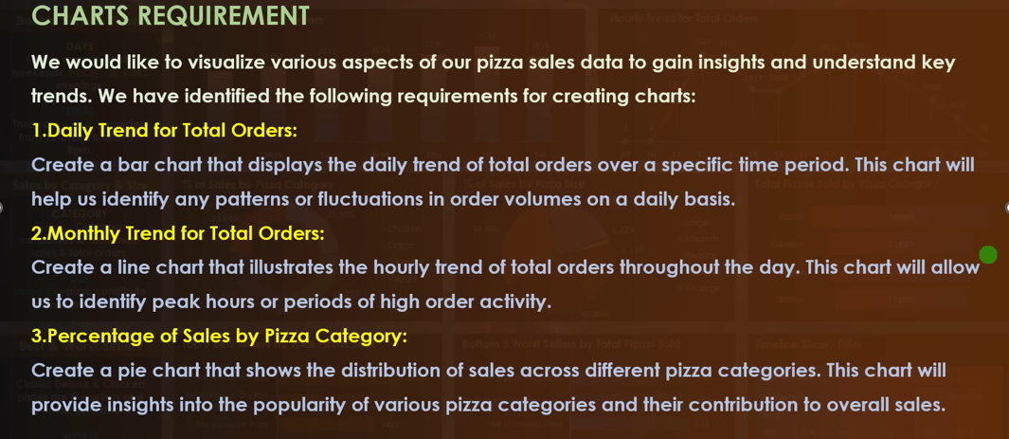
REQUIREMENT GATHERING

Slide 3
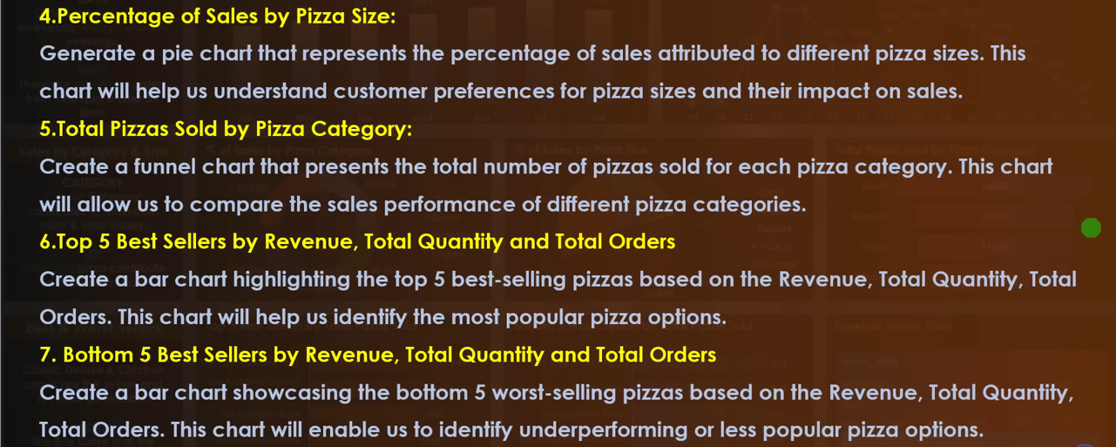
REQUIREMENT GATHERING

