Slide 1
FINAL YEAR PROJECT
Online Shopping Zone
A multi-category PHP + MySQL shopping platform
From login → product browsing → session cart → billing
Presented by Shiya Antala - 92400527243
Jeny Kotadiya - 92400527223
Vishwa Monpara - 92400527222
Marwadi University

Slide 2
02 | TEAM
Project Team
Shiya Antala
Jeny Kotadiya
Vishwa Monpara
•
Enrollment No. 92400527243
•
Enrollment No. 92400527223
•
Enrollment No. 92400527222
•
Marwadi University
•
Marwadi University
•
Marwadi University
ShopZone • PHP + MySQLi • Multi-category shopping platform

Slide 3
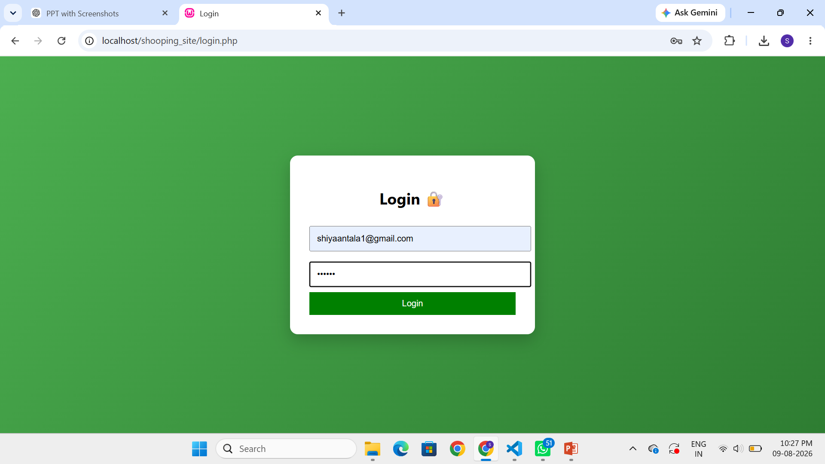
03 | INTRODUCTION
Why we built it
What is ShopZone?
•
To understand how an e-commerce flow works from front end to back end.
•
To practice PHP forms, sessions, database connectivity and page navigation.
Project in simple words
•
•
To create a consistent shopping journey across different categories.
Shopping Zone is a web-based shopping platform built using PHP and MySQLi.
•
It combines multiple product categories inside one website.
•
To learn how cart and billing logic can be implemented in a web application.
•
Users can register/login, browse products and add products to one shared cart.
•
The billing page calculates item-wise subtotals and the grand total.
•
The current cart is session-based rather than stored in a MySQL cart table.
ShopZone • PHP + MySQLi • Multi-category shopping platform

Slide 4
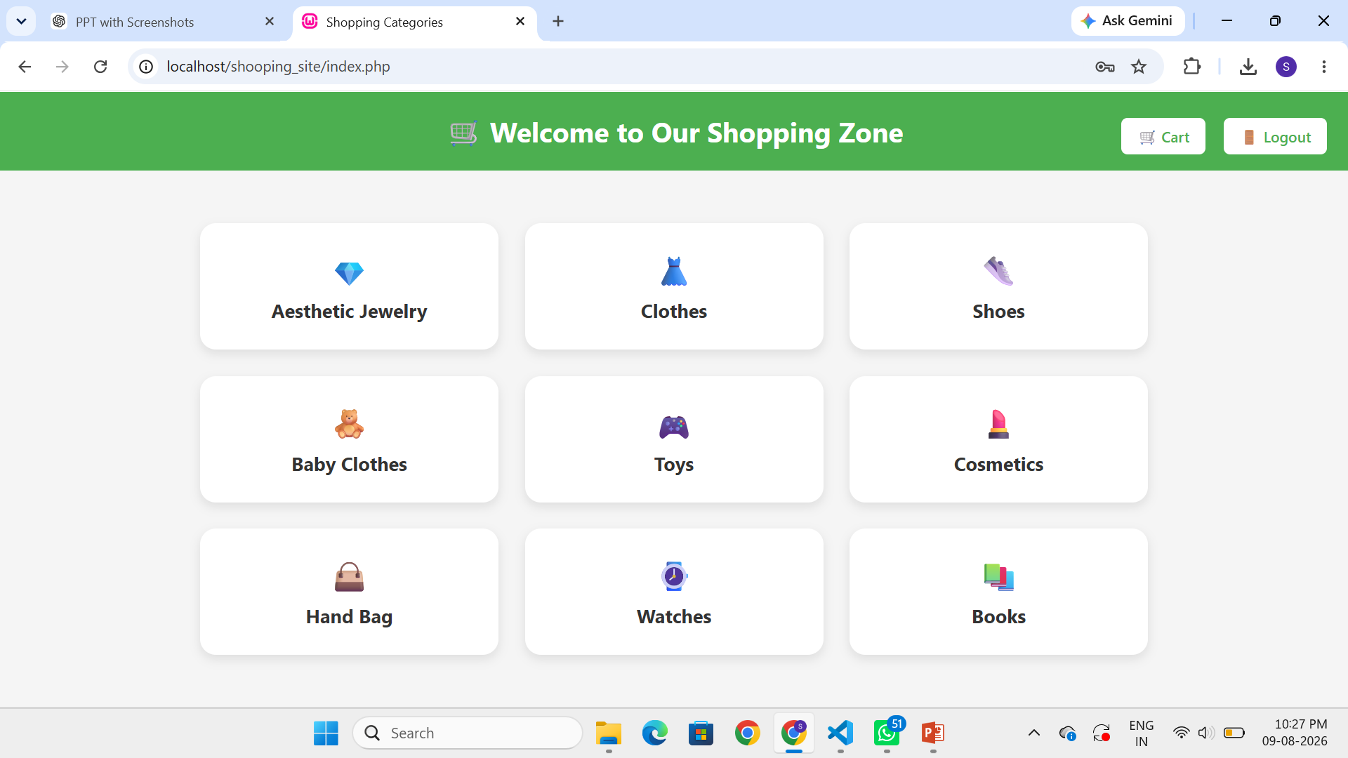
04 | PROBLEM
2. Disconnected flow
3. No common cart
Problem Statement
•
Login, browsing and cart logic can become inconsistent when implemented separately.
•
Without a shared cart, products selected from different categories cannot be reviewed together.
•
Users need one simple journey.
1. Scattered shopping
•
Billing becomes less convenient.
•
Different product types may be offered through separate stores or pages.
•
Users have to move between different shopping experiences.
ShopZone • PHP + MySQLi • Multi-category shopping platform

Slide 5
05 | SOLUTION
Proposed Solution
ShopZone connects the complete basic shopping journey in one website.
Login / Register
Browse Categories
Select Product
Session Cart
Billing
One user journey • nine category pages • one shared session cart • one billing summary.
ShopZone • PHP + MySQLi • Multi-category shopping platform

Slide 6
06 | OBJECTIVES
Project Objectives
Authentication
Product Categories
Cart Management
•
Provide login and registration using PHP sessions and the MySQL users table.
•
Create nine dedicated category pages with product images, names and prices.
•
Allow users to add, remove and clear products from the shared cart.
Billing
Responsive UI
Learning Goal
•
Calculate quantity × price for each item and produce a grand total.
•
Use grid layouts that adapt for desktop and smaller screens.
•
Understand the connection between HTML forms, PHP logic, sessions and MySQL.
ShopZone • PHP + MySQLi • Multi-category shopping platform

Slide 7
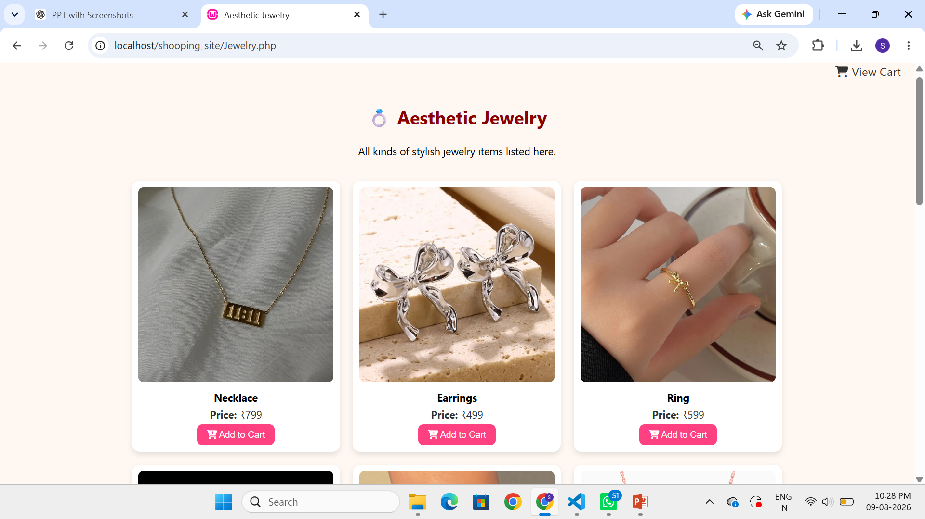
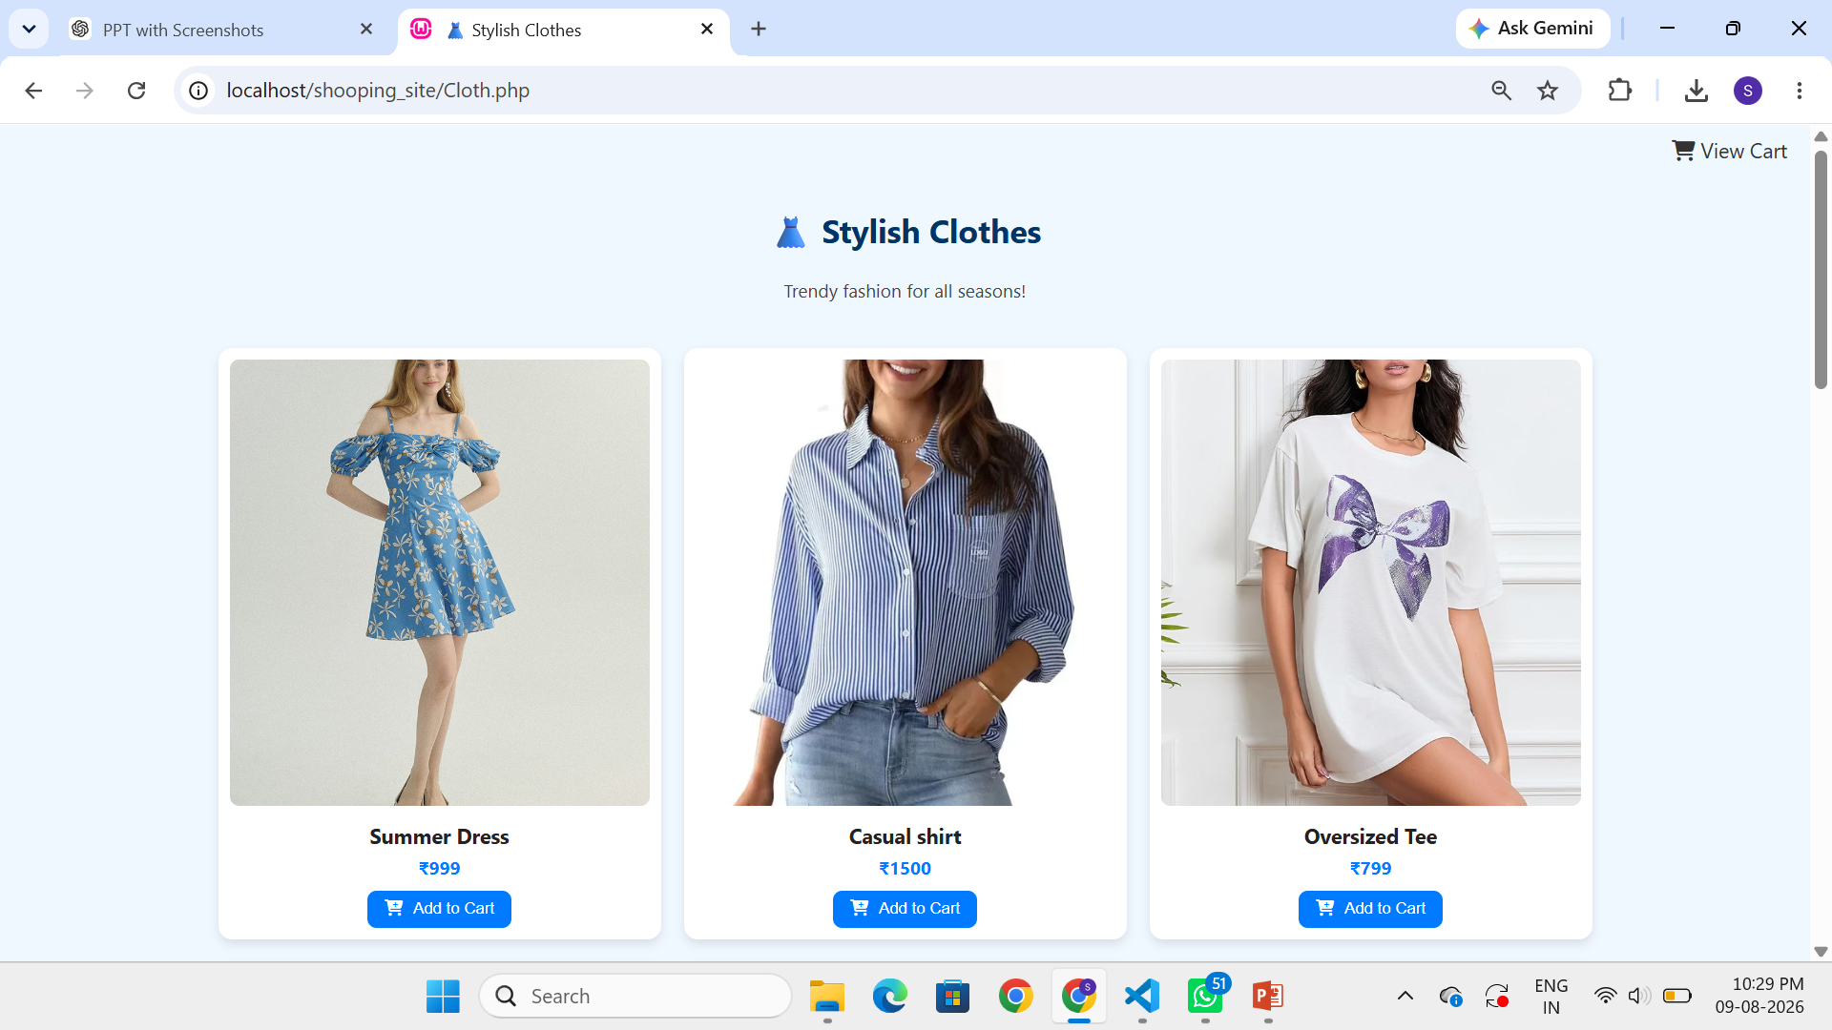
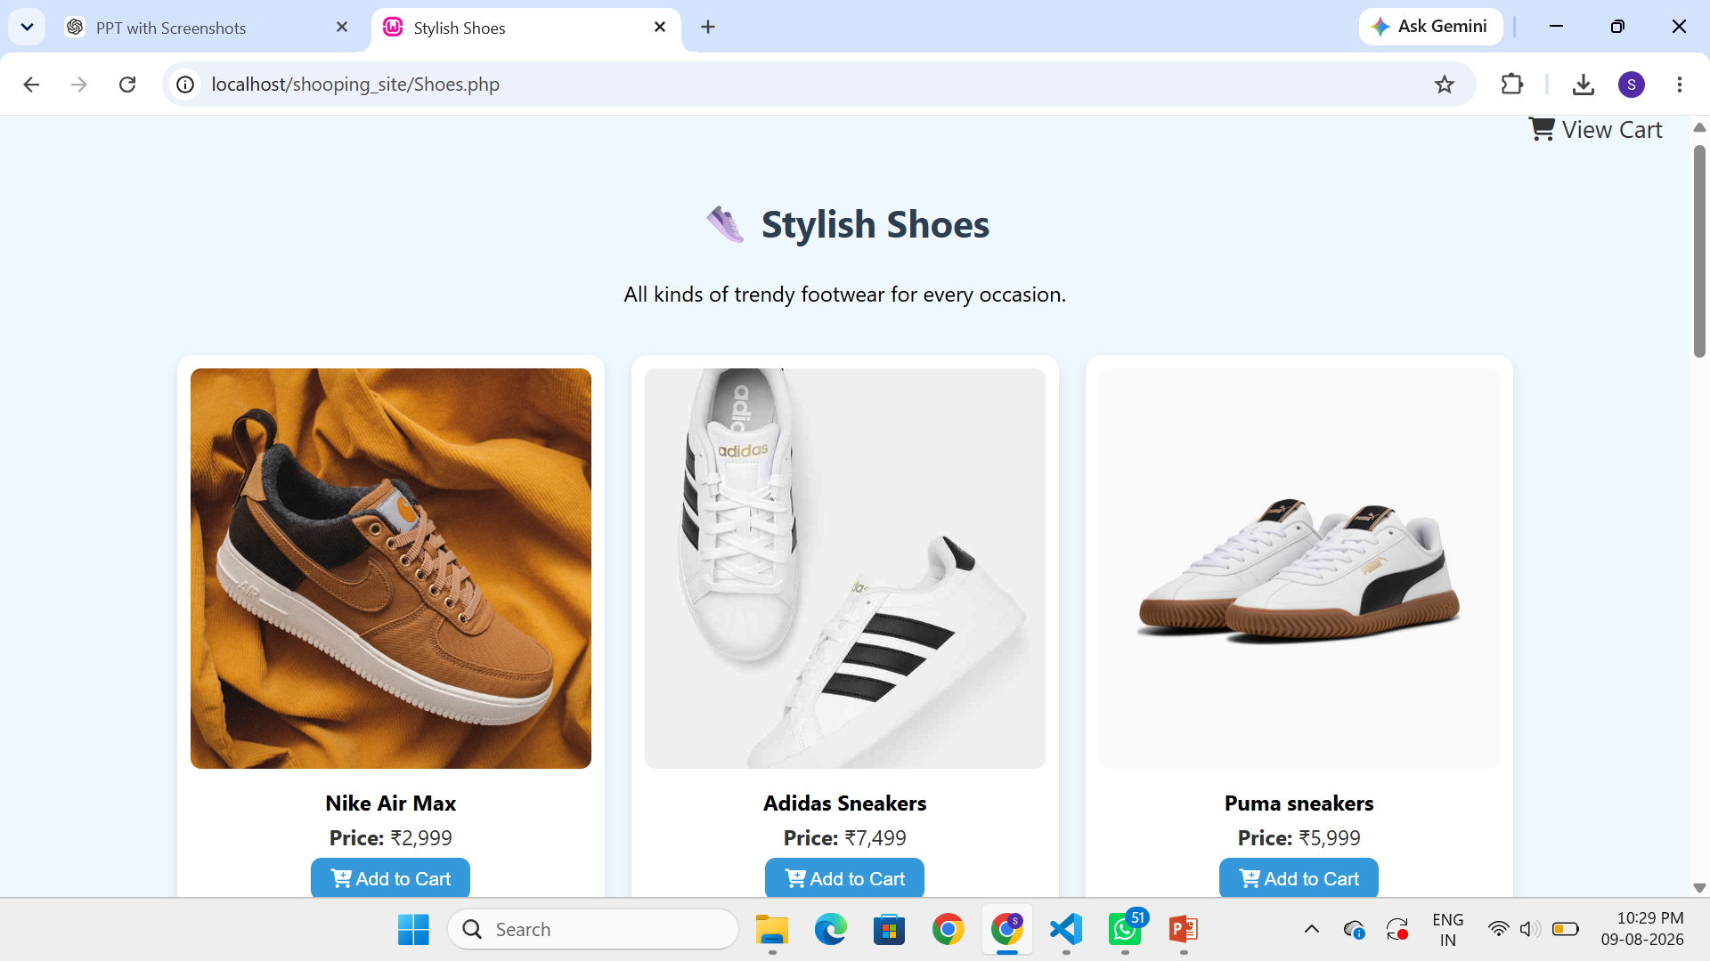
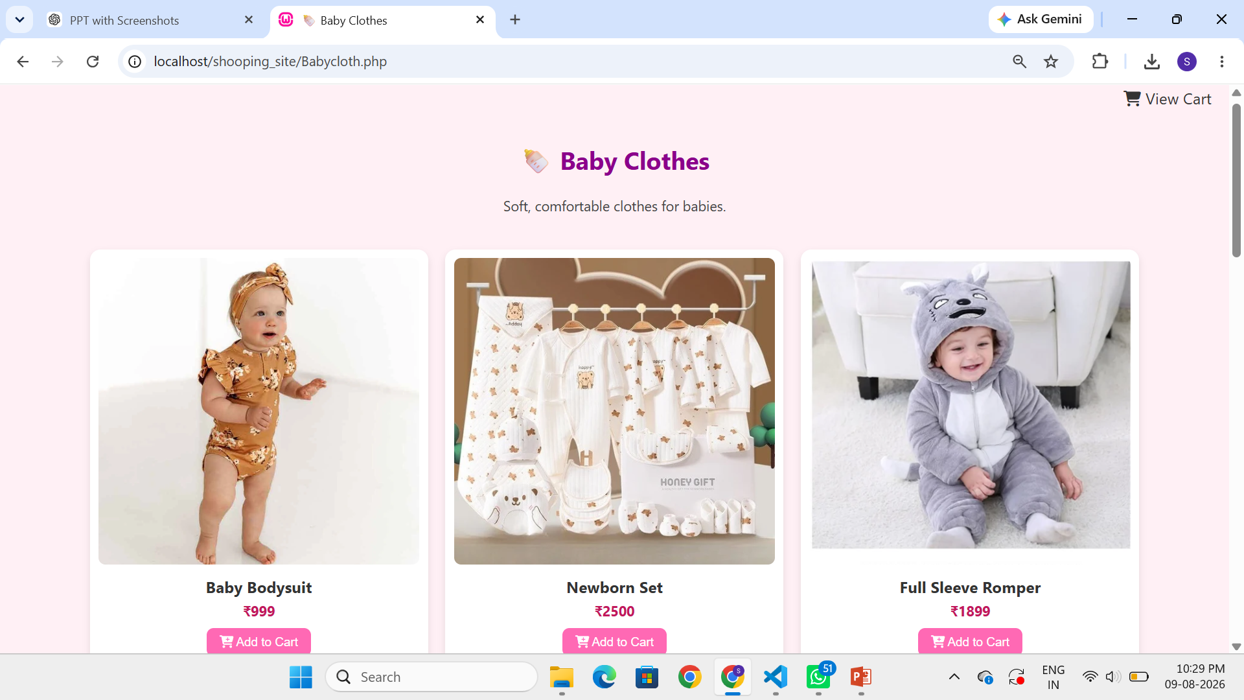
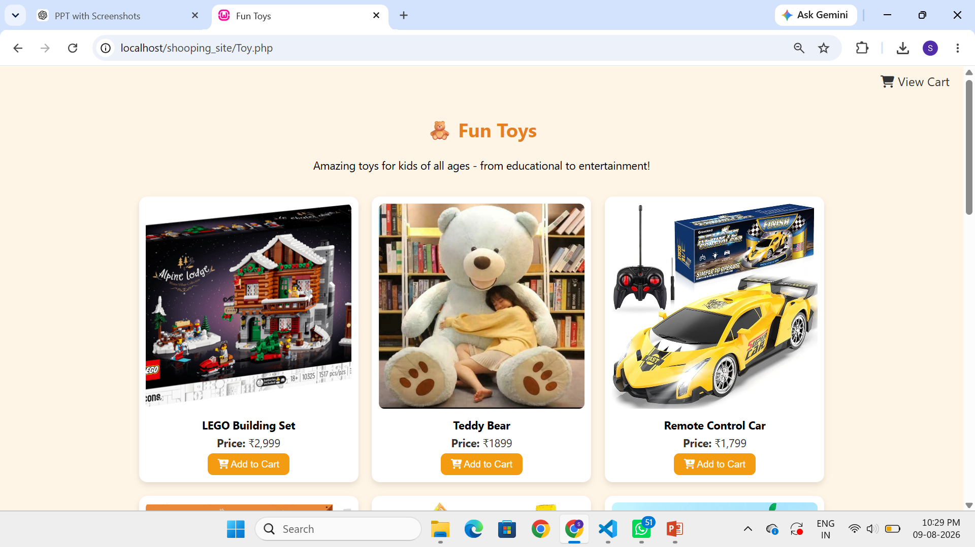
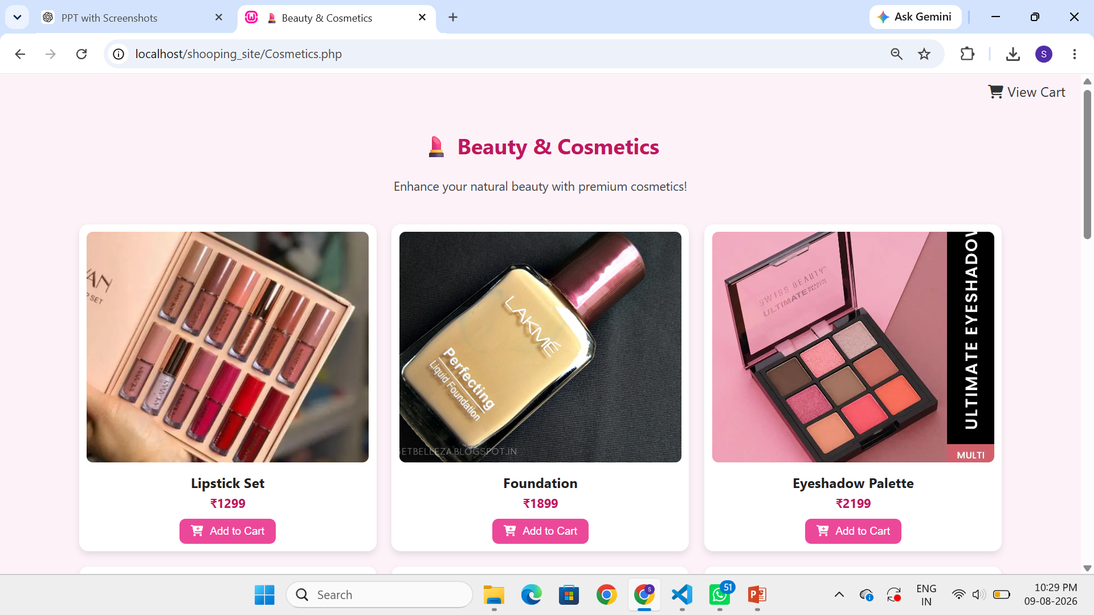
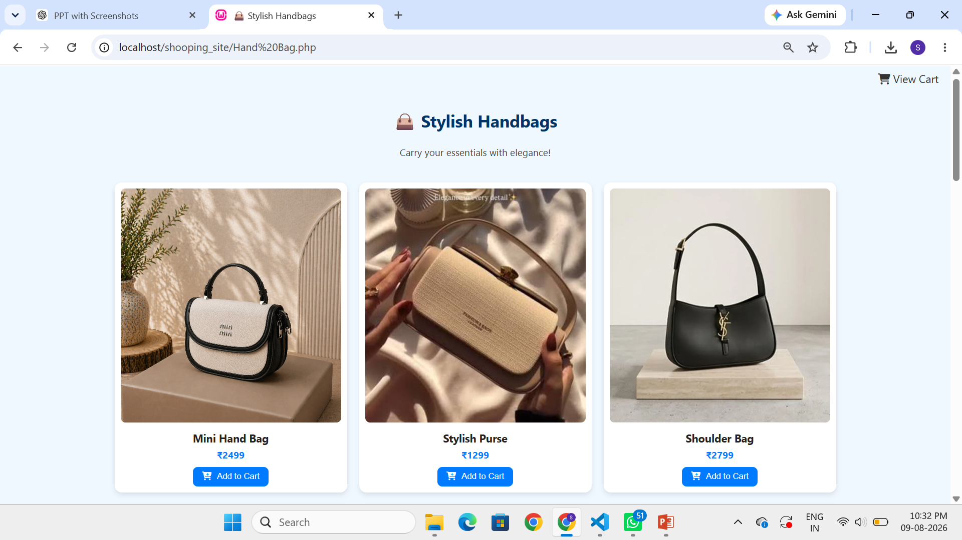
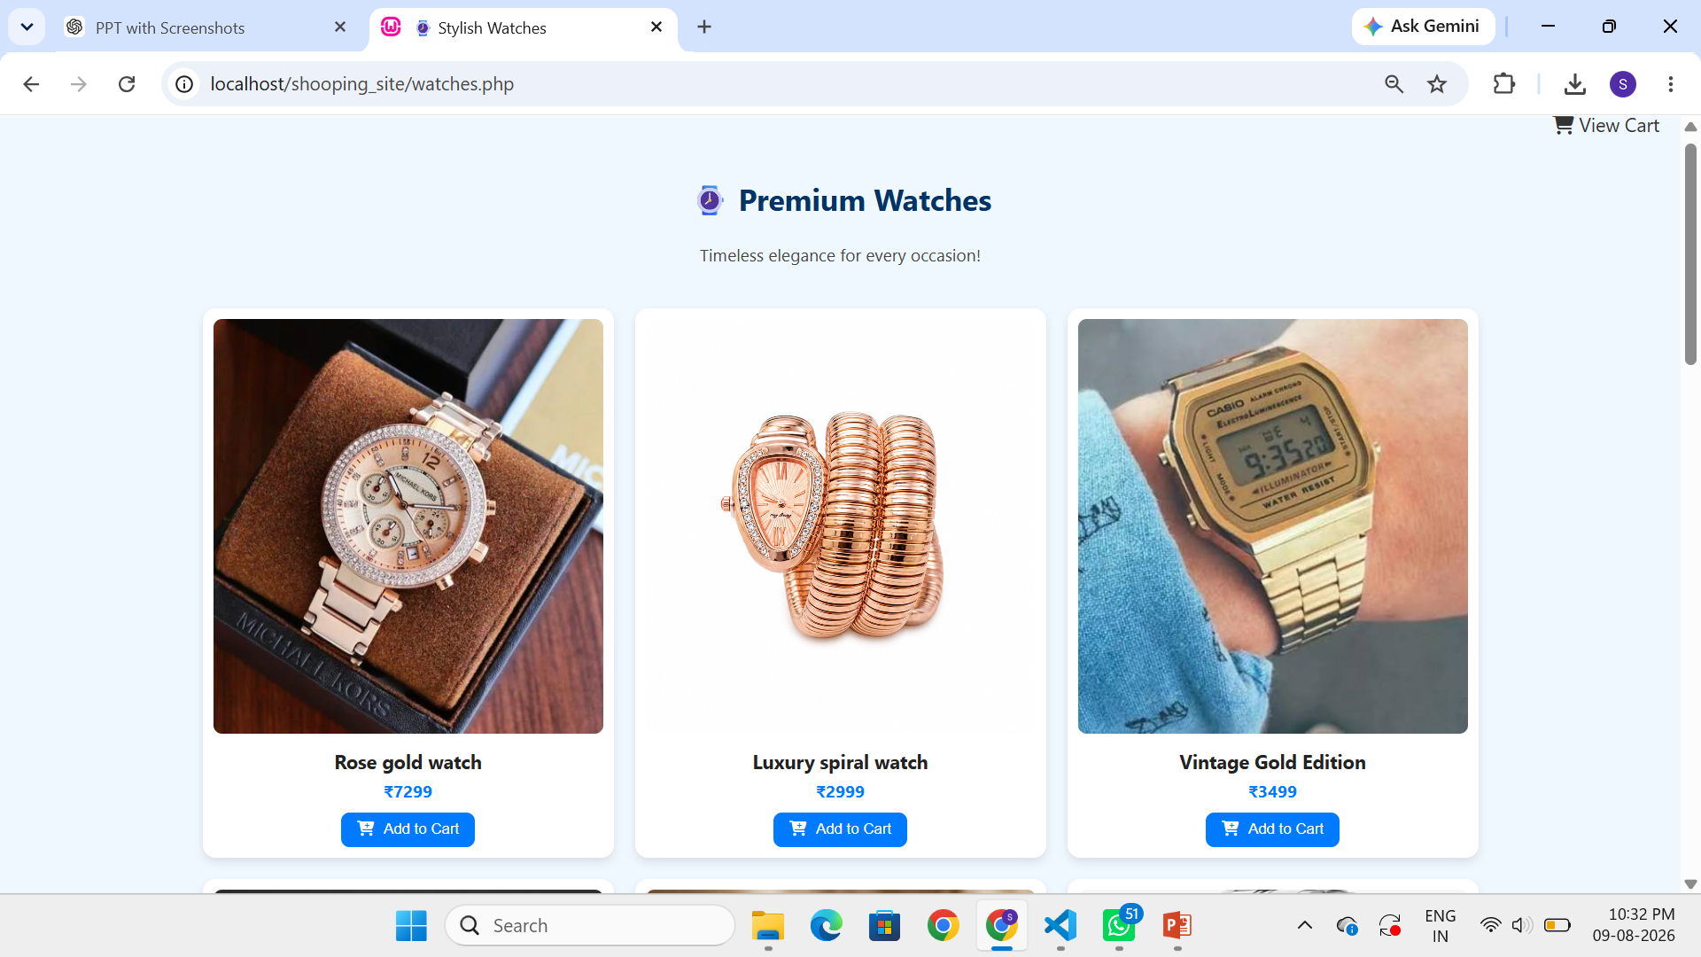
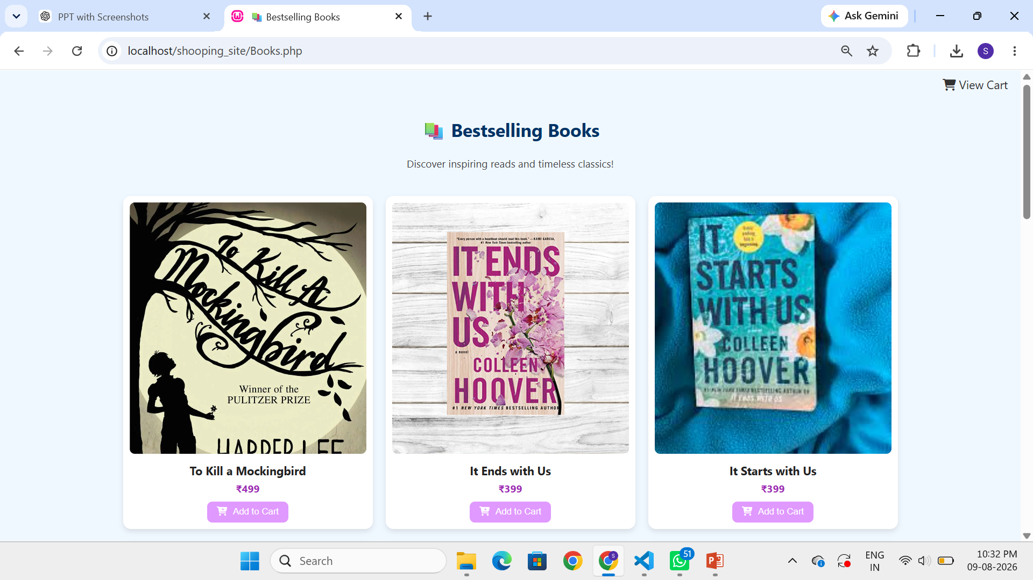
07 | FEATURES
Product Categories
Jewelry
Clothes
Shoes
Dedicated PHP
product page
Dedicated PHP
product page
Dedicated PHP
product page
Baby Clothes
Toys
Cosmetics
Dedicated PHP
product page
Dedicated PHP
product page
Dedicated PHP
product page
Hand Bags
Watches
Books
Dedicated PHP
product page
Dedicated PHP
product page
Dedicated PHP
product page
ShopZone • PHP + MySQLi • Multi-category shopping platform

Slide 8
08 | TECHNOLOGY
Technology Stack
HTML5
CSS3
•
Structure of web pages and forms
•
Layout, cards, responsive styling and hover effects
PHP + MySQLi
MySQL
•
Server-side logic, sessions and database operations
•
User account data and authentication support
Font Awesome
Laragon
•
Icons used in product/cart interfaces
•
Local Apache + phpMyAdmin development environment
VS Code
Git & GitHub
•
Code editing and project development
•
Version control
ShopZone • PHP + MySQLi • Multi-category shopping platform

Slide 9
09 | ARCHITECTURE
System Architecture
A request moves from the browser to PHP; PHP uses session state and MySQL where required.
USER BROWSER
PHP APPLICATION
PHP SESSION
MYSQL DATABASE
Requests / forms
Business logic
Cart state
User records
Key point
•
The current project does not store cart items in a MySQL cart table; the cart is maintained in the PHP session.
ShopZone • PHP + MySQLi • Multi-category shopping platform

Slide 10
10 | AUTHENTICATION
Login & Registration Flow
Open Login / Register
Enter User Details
Check / Store Account
Start PHP Session
Access Protected Pages
login.php
register.php / signup.php
•
Checks the users table by email and password, then starts a session when a match is found.
•
The source contains two sign-up paths: register.php uses MySQL, while signup.php stores account data in the session. This should be unified later.
ShopZone • PHP + MySQLi • Multi-category shopping platform

Slide 11
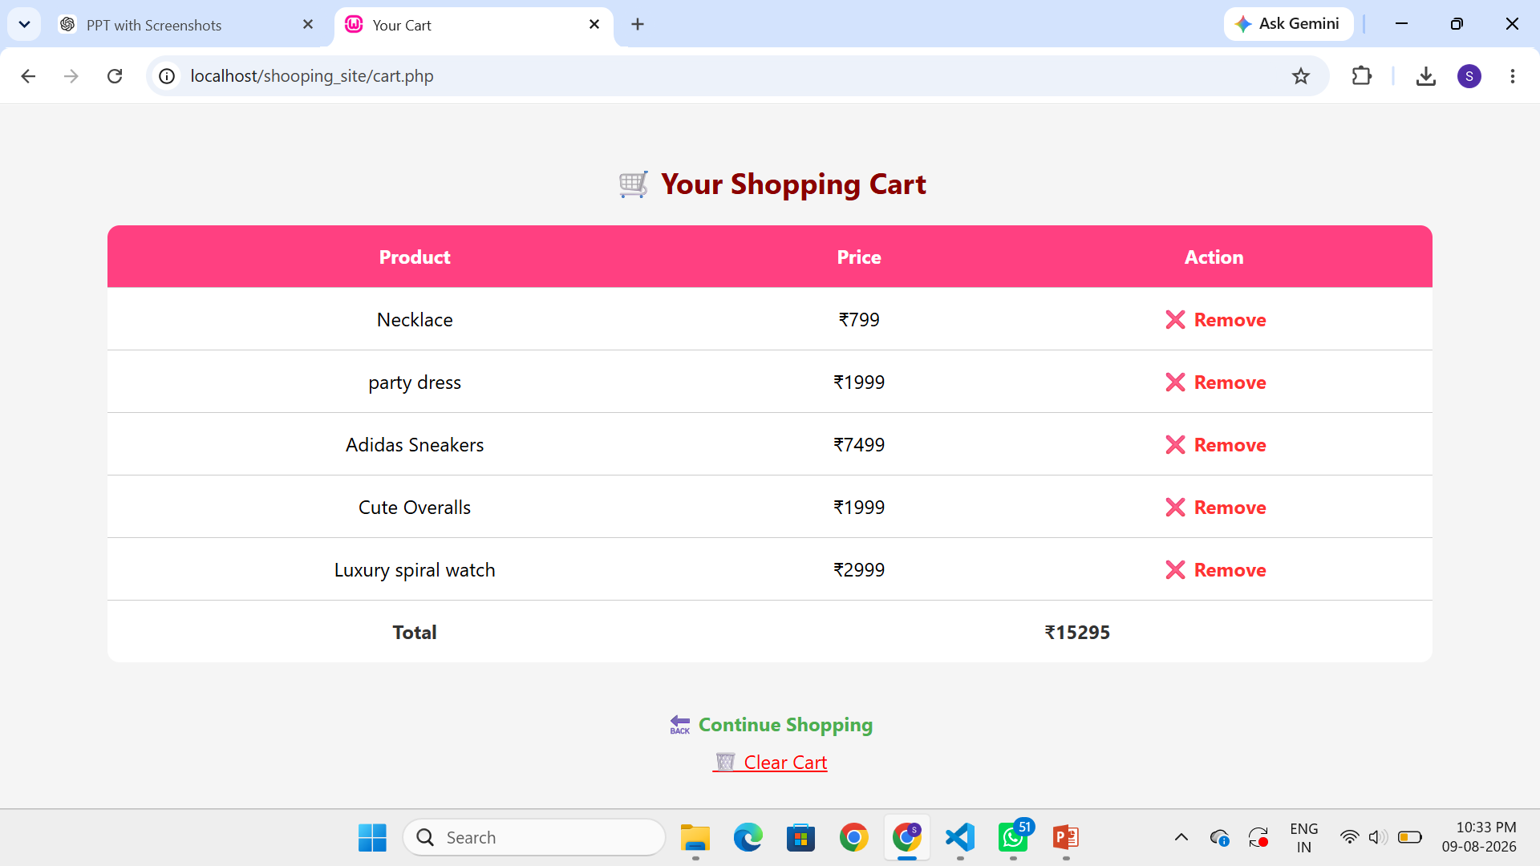
11 | FEATURES
How Product Browsing Works
Step 1 — Category Grid
Step 2 — Product Gallery
Step 3 — Add to Cart
•
index.php shows a 3-column grid.
•
Each category page shows product cards.
•
The product form sends item data to the cart handler.
•
Nine category tiles link to their own PHP pages.
•
Cards contain product image, product name and price.
•
The user is redirected back to the category page.
•
Hover effects and icons make the interface easier to navigate.
•
Font Awesome icons support cart/rating cues.
•
The same cart can receive items from different categories.
ShopZone • PHP + MySQLi • Multi-category shopping platform

Slide 12
12 | CART
Session-Based Cart Process
Select product
POST item data
$_SESSION['cart']
View cart.php
Remove / Clear
What the cart supports
Important limitation
•
Add items, remove one item, clear the whole cart and maintain a running total during the browser session.
•
There is no persistent cart/order table in MySQL in the current version. Closing the session loses the cart state.
ShopZone • PHP + MySQLi • Multi-category shopping platform

Slide 13
13 | CHECKOUT
Billing Calculation
For each selected item:
Then:
SUBTOTAL = PRICE × QUANTITY
GRAND TOTAL = Σ ALL SUBTOTALS
billing.php
•
It accepts item name, price and quantity arrays, calculates each line-item subtotal, and adds them together to produce the final amount.
ShopZone • PHP + MySQLi • Multi-category shopping platform

Slide 14
14 | STRUCTURE
Main Page & File Structure
Authentication
Navigation
Shopping
•
login.php
•
index.php
•
Jewelry.php
•
register.php
•
cloth.php
•
signup.php
•
shoes.php
More Categories
Checkout
•
logout.php
•
babycloth.php
•
cosmetics.php
•
cart.php
•
toy.php
•
Hand Bag.php
•
billing.php
•
watches.php
•
books.php
ShopZone • PHP + MySQLi • Multi-category shopping platform

Slide 15
15 | DESIGN
UI & Styling Approach
Card-Based Layout
Responsive Design
Visual Elements
•
Product galleries use CSS grid layouts.
•
Layouts are designed to adapt from desktop to smaller screens.
•
Font Awesome provides interface icons.
•
Cards have rounded corners and shadows.
•
Grids collapse from 3 columns to 2 and then 1.
•
Emoji are used for category accents.
•
Hover effects improve interaction.
•
Breakpoints are described at 768px and 500px.
•
Each PHP page currently contains its own inline CSS.
ShopZone • PHP + MySQLi • Multi-category shopping platform

Slide 16
16 | DATA FLOW
Data Flow Diagram
CUSTOMER
PHP PAGES
SESSION STORE
MYSQL
RESULT
Requests
Logic
Cart state
User data
Easy explanation
•
The customer interacts with PHP pages; PHP manages session-based cart state and communicates with MySQL for user-related database operations.
ShopZone • PHP + MySQLi • Multi-category shopping platform

Slide 17
17 | LEARNING
Challenges & Key Learnings
Challenge 1
Challenge 2
What we learned
•
Keeping nine category pages visually consistent.
•
Handling sessions correctly across pages.
•
PHP form handling and sessions.
•
Managing one shared cart across multiple pages.
•
Validating and sanitizing form input.
•
MySQL connectivity and user records.
•
Testing add/remove/clear and billing behavior.
•
Understanding how PHP and MySQL communicate.
•
Building an end-to-end shopping workflow.
•
Importance of security and maintainable code.
ShopZone • PHP + MySQLi • Multi-category shopping platform

Slide 18
18 | SECURITY
Current Limitations
Plaintext Passwords
SQL Injection Risk
•
The current source stores and compares passwords as plain text. A production system should use password_hash() and password_verify().
•
Some queries concatenate POST values directly. Prepared statements should be used with mysqli or PDO.
Two Authentication Paths
No Persistent Orders
•
register.php writes to MySQL while signup.php stores data in session. These approaches should be unified.
•
Checkout totals are not saved to an orders table, so completed orders do not persist after the session.
ShopZone • PHP + MySQLi • Multi-category shopping platform

Slide 19
19 | FUTURE
Future Enhancements
1
Secure Authentication
2
Order Database
3
Unified Signup
Password hashing + prepared statements
orders and order_items tables
One MySQL-backed registration flow
4
Admin Panel
5
Shared CSS
6
Payment Gateway
Add, edit and delete products
Move repeated inline styles to style.css
Connect billing to a real gateway
ShopZone • PHP + MySQLi • Multi-category shopping platform

Slide 20
20 | CONCLUSION
Conclusion & Demonstration
What we achieved
Final message
•
Built a multi-category shopping website using PHP and MySQLi.
•
ShopZone demonstrates how separate web technologies work together.
•
Created authentication, category browsing, session cart and billing.
•
The current version is a learning project, not a production-ready store.
•
Connected the user interface with server-side PHP logic.
•
Future work focuses on security, persistent orders, admin management and payments.
•
Used the project to understand a basic e-commerce workflow.
•
Live demonstration can show the complete user journey.
ShopZone • PHP + MySQLi • Multi-category shopping platform

Slide 21
THANK YOU
Presented by Shiya Antala • Jeny Kotadiya • Vishwa Monpara
Marwadi University

