Slide 1
UNIT-5

Slide 2
What is Q-Learning?
Q-learning is a model-free, value-based, off-policy algorithm that will find the best series of actions based on the agent's current state.
The “Q” stands for quality. Quality represents how valuable the action is in maximizing future rewards.
The model-based algorithms use transition and reward functions to estimate the optimal policy and create the model.
In contrast, model-free algorithms learn the consequences of their actions through the experience without transition and reward function.

Slide 3
The value-based method trains the value function to learn which state is more valuable and take action.
On the other hand, policy-based methods train the policy directly to learn which action to take in a given state.
In the off-policy, the algorithm evaluates and updates a policy that differs from the policy used to take an action.
Conversely, the on-policy algorithm evaluates and improves the same policy used to take an action.

Slide 4
Key Terminologies in Q-learning
Before we jump into how Q-learning works, we need to learn a few useful terminologies to understand Q-learning's fundamentals.
States(s): the current position of the agent in the environment.
Action(a): a step taken by the agent in a particular state.
Rewards: for every action, the agent receives a reward and penalty.
Episodes: the end of the stage, where agents can’t take new action. It happens when the agent has achieved the goal or failed.
Q(S_{t+1}, a): expected optimal Q-value of doing the action in a particular state.
Q(S_{t}, A_{t}): it is the current estimation of Q(S_{t+1}, a).
Q-Table: the agent maintains the Q-table of sets of states and actions.
Temporal Differences(TD): used to estimate the expected value of Q(S_{t+1}, a) by using the current state and action and previous state and action.

Slide 5
How Does Q-Learning Work?
We will learn in detail how Q-learning works by using the example of a frozen lake. In this environment, the agent must cross the frozen lake from the start to the goal, without falling into the holes.
The best strategy is to reach goals by taking the shortest path.

Slide 7
Q-Table
The agent will use a Q-table to take the best possible action based on the expected reward for each state in the environment.
In simple words, a Q-table is a data structure of sets of actions and states, and we use the Q-learning algorithm to update the values in the table.
Q-Function
The Q-function uses the Bellman equation and takes state(s) and action(a) as input. The equation simplifies the state values and state-action value calculation.

Slide 8
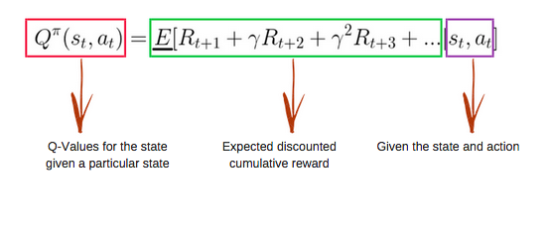

Slide 9
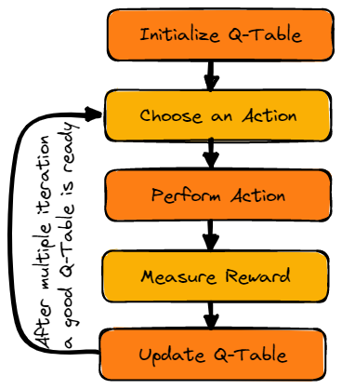
Q-learning algorithm

Slide 10
Initialize Q-Table
We will first initialize the Q-table. We will build the table with columns based on the number of actions and rows based on the number of states.
In our example, the character can move up, down, left, and right. We have four possible actions and four states(start, Idle, wrong path, and end). You can also consider the wrong path for falling into the hole. We will initialize the Q-Table with values at 0.

Slide 11
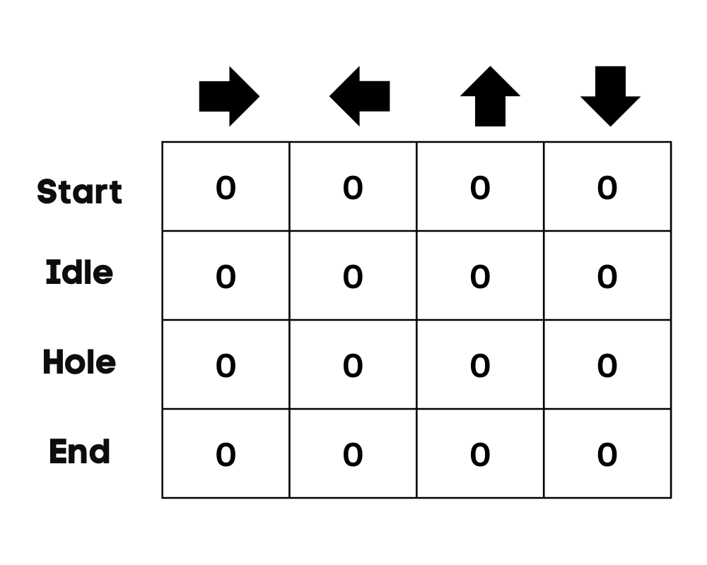

Slide 12
Choose an Action
The second step is quite simple. At the start, the agent will choose to take the random action(down or right), and on the second run, it will use an updated Q-Table to select the action.
Perform an Action
Choosing an action and performing the action will repeat multiple times until the training loop stops. The first action and state are selected using the Q-Table. In our case, all values of the Q-Table are zero.
Then, the agent will move down and update the Q-Table using the Bellman equation. With every move, we will be updating values in the Q-Table and also using it for determining the best course of action.

Slide 13
Initially, the agent is in exploration mode and chooses a random action to explore the environment. The Epsilon Greedy Strategy is a simple method to balance exploration and exploitation. The epsilon stands for the probability of choosing to explore and exploits when there are smaller chances of exploring.
At the start, the epsilon rate is higher, meaning the agent is in exploration mode. While exploring the environment, the epsilon decreases, and agents start to exploit the environment. During exploration, with every iteration, the agent becomes more confident in estimating Q-values

Slide 14
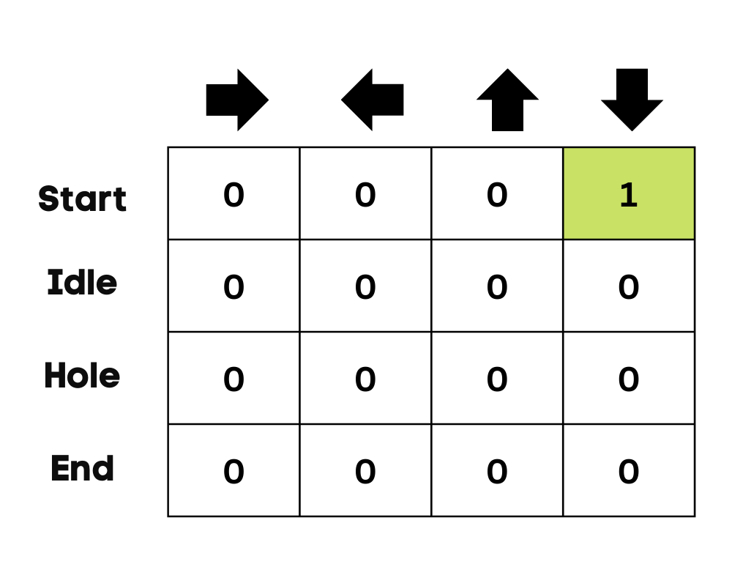

Slide 15
In the frozen lake example, the agent is unaware of the environment, so it takes random action (move down) to start. As we can see in the above image, the Q-Table is updated using the Bellman equation.
Measuring the Rewards
After taking the action, we will measure the outcome and the reward.
The reward for reaching the goal is +1
The reward for taking the wrong path (falling into the hole) is 0
The reward for Idle or moving on the frozen lake is also 0.

Slide 16
Update Q-Table
We will update the function Q(S_{t}, A_{t}) using the equation. It uses the previous episode’s estimated Q-values, learning rate, and Temporal Differences error. Temporal Differences error is calculated using Immediate reward, the discounted maximum expected future reward, and the former estimation Q-value.
The process is repeated multiple times until the Q-Table is updated and the Q-value function is maximized.

Slide 17
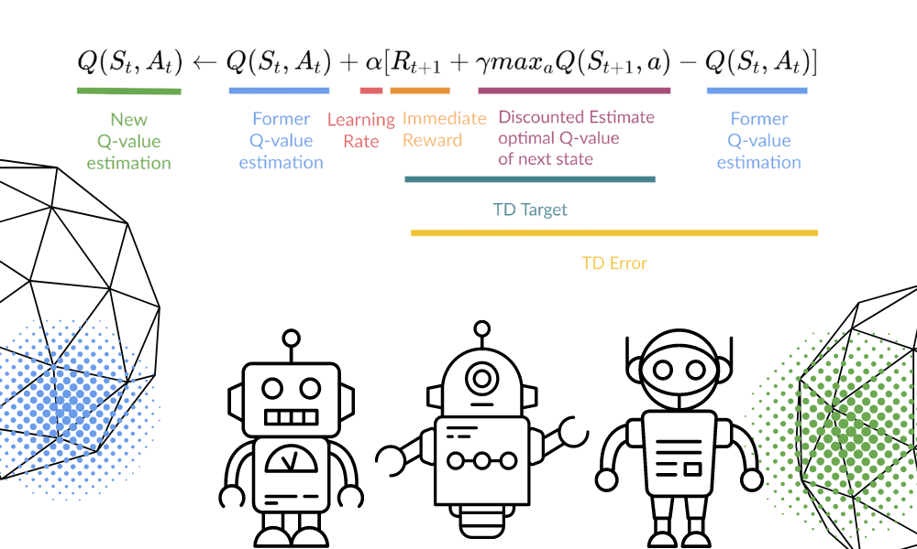

Slide 18
At the start, the agent is exploring the environment to update the Q-table. And when the Q-Table is ready, the agent will start exploiting and start taking better decisions.

Slide 19
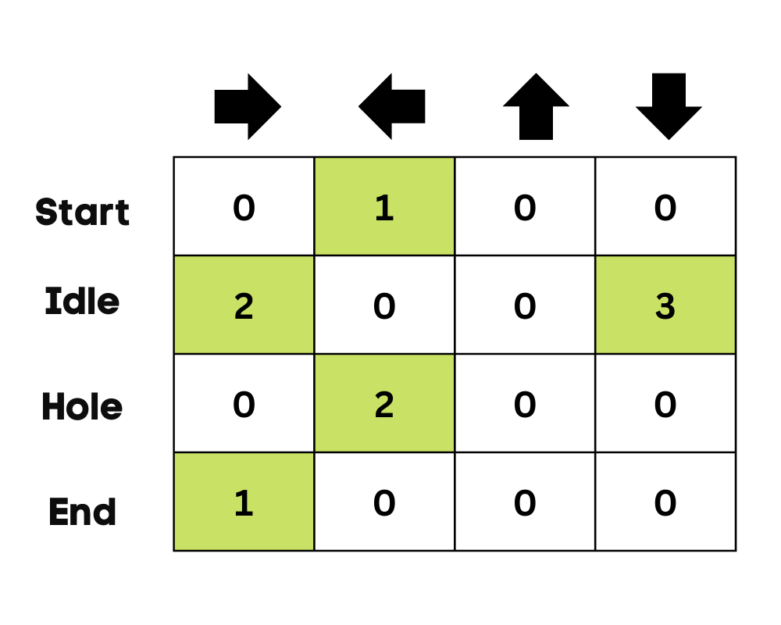

Slide 20
In the case of a frozen lake, the agent will learn to take the shortest path to reach the goal and avoid jumping into the holes.

Slide 21
Q-learning Algorithm: Brief Overview
Q-learning is a model-free reinforcement learning algorithm used to find the optimal action-selection policy for an agent interacting with an environment. It aims to learn the best actions to take under certain conditions to maximize the cumulative reward.

Slide 22
Key Components:
Agent: The decision-maker.
Environment: The world with which the agent interacts.
State (S): A specific situation in the environment.
Action (A): The moves the agent can take.
Reward (R): Feedback from the environment based on the agent's action.
Q-value (Q): The expected cumulative reward of taking an action in a given state.

Slide 23
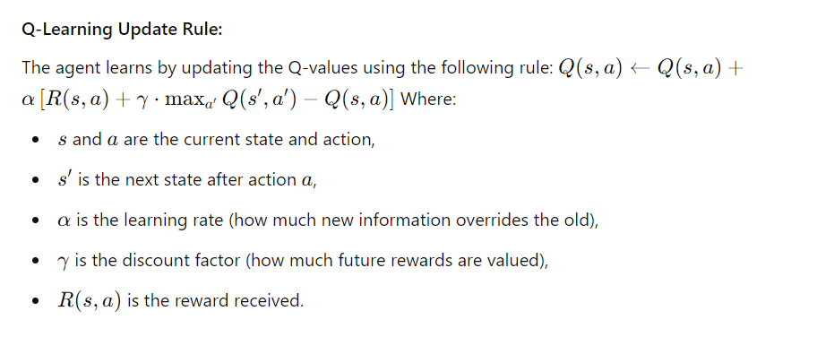

Slide 24
Benefits:
Model-Free: It does not require a model of the environment, making it versatile.
Simple Implementation: Easy to implement in discrete action spaces.
Convergence: It converges to the optimal policy when using proper learning parameters.
Uses:
Robotics: Q-learning is used to teach robots how to navigate environments autonomously.
Game AI: It is commonly applied in video games for AI agents to learn optimal strategies.
Finance: Q-learning can be used to optimize trading strategies by learning from historical data.

Slide 25
Game-Based Example:
A popular use case is training a Pac-Man agent:
States: The grid locations of Pac-Man and the ghosts.
Actions: Moving up, down, left, or right.
Rewards: Positive for eating dots and negative for being caught by ghosts.
The agent learns the best policy to maximize its score while avoiding ghosts.

Slide 26
Evaluation:
Q-learning is evaluated by:
Cumulative Rewards: Measuring how much reward the agent accumulates over episodes.
Policy Performance: Checking the optimality of the learned policy (whether it selects actions that maximize long-term rewards).

Slide 27
Numerical Problem Example:
Consider a simple environment where:
3 states: S1, S2, S3
2 actions: A1 (left), A2 (right)
Transition and reward matrix:
From S1, taking A1 moves to S2 with reward +5; A2 moves to S3 with reward 0.
From S2, taking A1 moves to S1 with reward 0; A2 moves to S3 with reward +10.
From S3, both actions lead to terminal state with no reward.
Assume learning rate α=0.5, discount γ=0.9, and initial Q-values as 0.

Slide 28
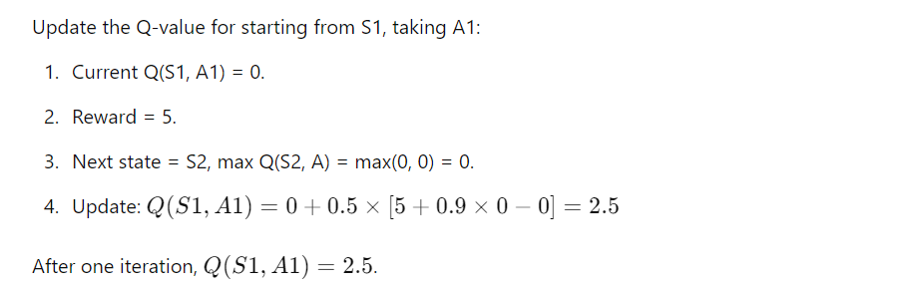

Slide 29
Advantages of Q-Learning:
Model-Free:
Q-learning does not require a model of the environment, meaning the agent doesn't need to know the environment's dynamics beforehand. This makes it highly versatile for different types of environments.
Guaranteed Convergence:
Given infinite exploration and a suitable learning rate, Q-learning will converge to an optimal policy. This is a significant advantage when searching for the best action-selection policy over time.
Simple Implementation:
The algorithm is relatively simple and easy to implement, especially in discrete state-action spaces. It requires only a Q-table and simple updates.

Slide 30
Exploration-Exploitation Balance:
Q-learning naturally supports the exploration-exploitation trade-off, allowing the agent to explore the environment and gradually learn the optimal strategy.
Off-Policy Learning:
Q-learning is off-policy, meaning it can learn from actions taken outside the current policy. This makes it more flexible and allows it to learn from different sources (like simulated experiences or another agent's actions).
Widely Applicable:
Q-learning can be applied to a variety of domains, including robotics, game AI, finance, and more. It is effective in situations where learning from trial and error is necessary.

Slide 31
Disadvantages of Q-Learning:
High Memory Usage for Large State Spaces:
Q-learning uses a Q-table to store values for every state-action pair. In large or continuous state spaces, this leads to high memory consumption. The algorithm doesn't scale well for very large environments.
Slow Convergence:
In complex environments with many states and actions, Q-learning may take a long time to converge to an optimal policy, especially if the agent needs to explore many different paths.
Lack of Generalization:
Since Q-learning assigns a specific value to each state-action pair, it does not generalize well. Small changes in states (e.g., nearby grid cells in a game) are treated independently, leading to inefficiencies.
Sensitive to Parameter Tuning:
The performance of Q-learning depends heavily on the selection of parameters like the learning rate (α), discount factor (γ), and exploration rate (ϵ). Poor choices can result in suboptimal learning or slow convergence.

Slide 32
Inefficient in Continuous Action Spaces:
In environments with continuous actions, Q-learning struggles since it needs to maintain and update Q-values for all possible action-state pairs. This leads to inefficiencies, and alternative methods like Deep Q-Networks (DQN) are preferred in such cases.
Exploration vs. Exploitation Balance:
While Q-learning addresses the exploration-exploitation dilemma, balancing them effectively over time is still challenging. Excessive exploration can slow down learning, while too little exploration might result in a suboptimal policy.

Slide 33
Note: Q-learning is an efficient and effective algorithm for small to medium-sized problems, but it faces scalability issues in larger, more complex environments.
It’s also sensitive to the right hyperparameter settings, which requires careful tuning for successful learning

Slide 34
Neural Network Refinement in Q-Learning (Deep Q-Networks - DQNs)
Neural Network Refinement in Q-Learning enhances the original Q-learning algorithm by replacing the Q-table with a neural network.
This approach is particularly useful for environments with large or continuous state spaces, such as video games or robotic control systems, where maintaining a Q-table is infeasible.

Slide 35
Key Components of Neural Network Refinement in Q-Learning:
Q-Network: A neural network (NN) is used as a function approximator to estimate the Q-values. The NN takes the current state as input and outputs the Q-values for all possible actions. This helps the agent determine the best action for any given state.
Experience Replay: Experience replay stores the agent's experiences (state, action, reward, next state) in a buffer. Random batches of experiences are sampled to train the neural network, breaking the correlation between consecutive experiences and improving stability.
Target Network: A second, slower-updating target network is used to provide stable Q-value updates. This prevents oscillations and divergence during training. The weights of the target network are updated less frequently than the primary Q-network.
Loss Function: The neural network is trained by minimizing a loss function that measures the difference between the predicted Q-values and the target values derived from the Bellman equation:

Slide 36
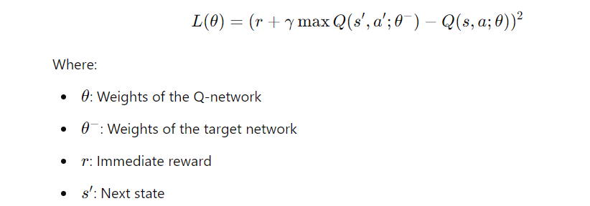

Slide 37
Example: Deep Q-Network in Games
Consider a game like Atari Breakout, where the agent (a paddle) learns to hit a ball to break blocks. The agent observes the game's frame (image) as the state and must decide whether to move left or right. The neural network helps the agent learn which actions will lead to higher scores, improving its performance over time by updating Q-values for each action in each game state.
Advantages of Using Neural Networks in Q-Learning:
Scalability: It can handle large or continuous state spaces.
Generalization: Neural networks can generalize across unseen states, improving learning efficiency.
Experience Replay: It helps in stabilizing training by using random past experiences.

Slide 38
Disadvantages:
Training Instability: Without techniques like target networks or experience replay, training can become unstable.
Resource Intensive: Requires more computational power and memory than traditional Q-learning.
Note: Neural Network Refinement in Q-learning, such as with DQNs, is a powerful extension of the Q-learning algorithm that scales to complex tasks, offering better learning capabilities for environments with large state-action spaces.

Slide 39
Advantages:
Scalability:
Traditional Q-learning struggles with large or continuous state spaces, but Deep Q-Networks (DQNs) can handle such environments efficiently. The neural network approximates Q-values, allowing the algorithm to scale to more complex tasks like video games or robotic control.
Generalization:
Neural networks generalize across similar states, which enables better performance in unseen environments. This is especially beneficial in environments where similar states may lead to the same optimal actions.
Stabilized Learning:
With techniques like experience replay and target networks, the learning process in DQNs becomes more stable compared to basic Q-learning. Experience replay avoids overfitting by training on a variety of past experiences, while target networks help reduce fluctuations during updates.
Continuous Actions:
Neural networks allow for Q-learning to be extended to environments with continuous action spaces, a major limitation of basic Q-learning. Techniques such as Deep Deterministic Policy Gradient (DDPG) enable the use of continuous actions.

Slide 40
Disadvantages:
High Computational Cost:
Training a deep neural network can be resource-intensive, requiring substantial computational power and memory, which can be prohibitive for real-time or embedded applications.
Training Instability:
Without careful tuning (learning rate, exploration-exploitation balance, etc.), neural network-based Q-learning can be prone to instability, oscillations, or divergence in the Q-values.
Longer Training Time:
DQNs often require a longer time to converge compared to simpler algorithms due to the complexity of neural networks and the large number of training episodes needed to update weights effectively.
Hyperparameter Sensitivity:
Neural network-based algorithms are sensitive to hyperparameters such as learning rate, discount factor, and exploration parameters, making fine-tuning critical for optimal performance.

Slide 41
A common real-world application of Deep Q-Learning is in Atari Games. Google DeepMind’s DQN was famously used to achieve human-level performance on a variety of Atari games.
The neural network takes raw pixel input (game screens), processes it through convolutional layers, and outputs Q-values for each possible action (e.g., moving left, right, or firing).
Over time, the network learns to master the game by updating its Q-values to maximize rewards, like breaking bricks in Breakout or eating pellets in Pac-Man.
Another use case is in robotics, where DQNs can help robots navigate, grasp objects, or perform other tasks in complex environments by learning from interaction rather than being explicitly programmed.

Slide 42
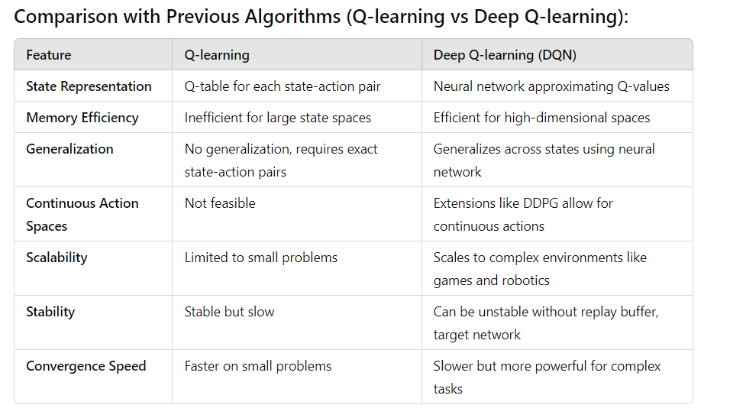

Slide 43
Note: Neural Network Refinement in Q-learning, especially using Deep Q-Networks (DQNs), significantly enhances the original algorithm's ability to handle complex environments with large or continuous state spaces.
While this method is resource-intensive and requires careful tuning, it has proven highly effective in tasks like gaming, robotics, and navigation, achieving state-of-the-art results where traditional Q-learning falls short.

Slide 44
Greedy Policy Refinement in Q-Learning
In Q-Learning, the greedy policy refers to a strategy where the agent selects actions based on the maximum Q-value for the current state.
This ensures the agent exploits the best-known action according to its learned Q-values.
However, the basic greedy approach may fail in cases where the agent needs to explore the environment to discover better actions.
To address this, refinements like epsilon-greedy or softmax exploration are often used.

Slide 45
1. Epsilon-Greedy Policy:
In epsilon-greedy refinement, the agent follows the greedy policy most of the time but occasionally takes random actions to explore the environment. The policy is refined to balance exploration and exploitation:
With probability ϵ, the agent explores by choosing a random action.
With probability 1−ϵ, it exploits by selecting the action with the highest Q-value.
Over time, ϵ decays, so the agent explores less and focuses more on exploiting the learned policy.

Slide 46
2. Advantages:
Exploration: Ensures the agent explores the environment and doesn't get stuck in local optima by selecting random actions at times.
Simplicity: Easy to implement and tune with a decaying ϵ\epsilonϵ value over time.
Efficiency: Works well with smaller environments where optimal actions can be found through exploration.

Slide 47
3. Disadvantages:
Suboptimal Behavior: During the early phases of training, the random actions might lead to suboptimal rewards.
Fixed Exploration: Even with epsilon decay, the exploration might not be sufficient for large state spaces. A fixed decay rate might be inappropriate for some environments.
Inefficiency in Large State Spaces: In environments with large or continuous state spaces, random exploration becomes less efficient as the chance of finding optimal actions decreases.

Slide 48
Neural Networks extract identifying features from data, lacking pre-programmed understanding. Network components include neurons, connections, weights, biases, propagation functions, and a learning rule. Neurons receive inputs, governed by thresholds and activation functions.
Connections involve weights and biases regulating information transfer. Learning, adjusting weights and biases, occurs in three stages: input computation, output generation, and iterative refinement enhancing the network’s proficiency in diverse tasks.

Slide 49
These include:
The neural network is simulated by a new environment.
Then the free parameters of the neural network are changed as a result of this simulation.
The neural network then responds in a new way to the environment because of the changes in its free parameters.

Slide 50
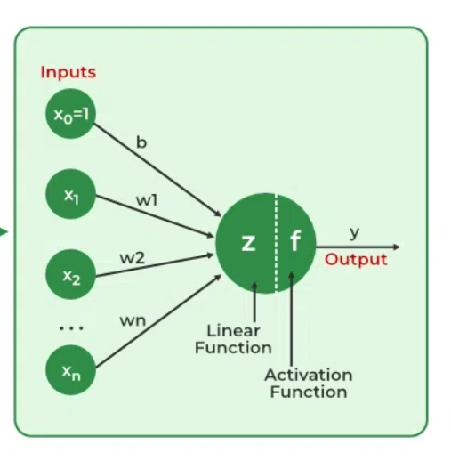

Slide 51
Importance of Neural Networks
The ability of neural networks to identify patterns, solve intricate puzzles, and adjust to changing surroundings is essential. Their capacity to learn from data has far-reaching effects, ranging from revolutionizing technology like natural language processing and self-driving automobiles to automating decision-making processes and increasing efficiency in numerous industries.
The development of artificial intelligence is largely dependent on neural networks, which also drive innovation and influence the direction of technology.

Slide 52
Working of a Neural Network
Neural networks are complex systems that mimic some features of the functioning of the human brain. ‘
It is composed of an input layer, one or more hidden layers, and an output layer made up of layers of artificial neurons that are coupled. The two stages of the basic process are called backpropagation and forward propagation.

Slide 53
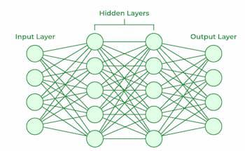

Slide 54
Forward Propagation
Input Layer: Each feature in the input layer is represented by a node on the network, which receives input data.
Weights and Connections: The weight of each neuronal connection indicates how strong the connection is. Throughout training, these weights are changed.
Hidden Layers: Each hidden layer neuron processes inputs by multiplying them by weights, adding them up, and then passing them through an activation function. By doing this, non-linearity is introduced, enabling the network to recognize intricate patterns.
Output: The final result is produced by repeating the process until the output layer is reached.

Slide 55
Backpropagation
Loss Calculation: The network’s output is evaluated against the real goal values, and a loss function is used to compute the difference. For a regression problem, the Mean Squared Error (MSE) is commonly used as the cost function.
Gradient Descent: Gradient descent is then used by the network to reduce the loss. To lower the inaccuracy, weights are changed based on the derivative of the loss with respect to each weight.
Adjusting weights: The weights are adjusted at each connection by applying this iterative process, or backpropagation, backward across the network.
Training: During training with different data samples, the entire process of forward propagation, loss calculation, and backpropagation is done iteratively, enabling the network to adapt and learn patterns from the data.
Actvation Functions: Model non-linearity is introduced by activation functions like the rectified linear unit (ReLU) or sigmoid. Their decision on whether to “fire” a neuron is based on the whole weighted input.

Slide 56
Types of Neural Networks
There are seven types of neural networks that can be used.
Feedforward Neteworks: A feedforward neural network is a simple artificial neural network architecture in which data moves from input to output in a single direction. It has input, hidden, and output layers; feedback loops are absent. Its straightforward architecture makes it appropriate for a number of applications, such as regression and pattern recognition.
Multilayer Perceptron (MLP): MLP is a type of feedforward neural network with three or more layers, including an input layer, one or more hidden layers, and an output layer. It uses nonlinear activation functions.

Slide 57
Convolutional Neural Network (CNN): A Convolutional Neural Network (CNN) is a specialized artificial neural network designed for image processing. It employs convolutional layers to automatically learn hierarchical features from input images, enabling effective image recognition and classification. CNNs have revolutionized computer vision and are pivotal in tasks like object detection and image analysis.
Recurrent Neural Network (RNN): An artificial neural network type intended for sequential data processing is called a Recurrent Neural Network (RNN). It is appropriate for applications where contextual dependencies are critical, such as time series prediction and natural language processing, since it makes use of feedback loops, which enable information to survive within the network.
Long Short-Term Memory (LSTM): LSTM is a type of RNN that is designed to overcome the vanishing gradient problem in training RNNs. It uses memory cells and gates to selectively read, write, and erase information.

Slide 58
Advantages of Neural Networks
Neural networks are widely used in many different applications because of their many benefits:
Adaptability: Neural networks are useful for activities where the link between inputs and outputs is complex or not well defined because they can adapt to new situations and learn from data.
Pattern Recognition: Their proficiency in pattern recognition renders them efficacious in tasks like as audio and image identification, natural language processing, and other intricate data patterns.
Parallel Processing: Because neural networks are capable of parallel processing by nature, they can process numerous jobs at once, which speeds up and improves the efficiency of computations.
Non-Linearity: Neural networks are able to model and comprehend complicated relationships in data by virtue of the non-linear activation functions found in neurons, which overcome the drawbacks of linear models.

Slide 59
Disadvantages of Neural Networks
Neural networks, while powerful, are not without drawbacks and difficulties:
Computational Intensity: Large neural network training can be a laborious and computationally demanding process that demands a lot of computing power.
Black box Nature: As “black box” models, neural networks pose a problem in important applications since it is difficult to understand how they make decisions.
Overfitting: Overfitting is a phenomenon in which neural networks commit training material to memory rather than identifying patterns in the data. Although regularization approaches help to alleviate this, the problem still exists.
Need for Large datasets: For efficient training, neural networks frequently need sizable, labeled datasets; otherwise, their performance may suffer from incomplete or skewed data.

Slide 60
Example:
Image Recognition (e.g., Google Photos)
Neural networks, particularly Convolutional Neural Networks (CNNs), are widely used in image recognition tasks like Google Photos automatically classifying and organizing images based on the objects or people in them.
How it works:
Convolutional layers scan the image to detect features like edges, textures, and colors.
As data moves through deeper layers of the CNN, more abstract features like faces or objects (e.g., dogs, trees) are detected.
The final output layer classifies the image into predefined categories (e.g., cat, car, person).
Training: The network is trained on millions of labeled images, learning the patterns that distinguish between different categories.
Application: Google Photos uses this to automatically tag images with objects and even suggest groupings based on people’s faces.

Slide 61
Self-Driving Cars (e.g., Tesla Autopilot)
Self-driving cars, such as Tesla’s Autopilot, use Deep Neural Networks (DNNs) and CNNs to interpret and understand their surroundings, make driving decisions, and navigate safely.
How it works:
Cameras, radar, and sensors on the car feed visual and environmental data into a CNN, which processes the information.
CNNs are used to detect objects on the road (pedestrians, other vehicles, traffic signs) and lane markings.
The system also uses Reinforcement Learning to learn driving strategies (e.g., when to change lanes, adjust speed) based on continuous feedback from driving conditions.
Training: The model is trained on large datasets collected from driving in various environments, including city streets, highways, and parking lots.
Application: The neural network helps the car navigate, avoid obstacles, maintain lanes, and follow traffic rules, enabling semi-autonomous or fully autonomous driving.

Slide 62
Fraud Detection (e.g., Banking Systems)
Banks and credit card companies use neural networks, especially Feedforward Neural Networks and Autoencoders, to detect fraudulent transactions.
How it works:
Transaction data, such as the time, location, amount, and user behavior, is fed into a neural network.
The network has learned patterns of typical (legitimate) transactions and can identify anomalies that might indicate fraud (e.g., an unusual purchase in a foreign country).
The output is a probability score, indicating whether a transaction is fraudulent.
Training: The network is trained on historical data that includes both legitimate and fraudulent transactions. It learns to differentiate between them by recognizing patterns.
Application: This system flags suspicious transactions for further investigation, potentially preventing unauthorized access to funds.

Slide 63
Healthcare (e.g., Disease Diagnosis)
Neural networks are being used to assist doctors in diagnosing diseases such as cancer by analyzing medical images (e.g., X-rays, MRIs) and patient data.
How it works:
A CNN can process medical images to detect features such as abnormal growths, which might indicate cancer or other diseases.
For other types of data, such as patient history or lab results, Feedforward Neural Networks analyze structured data and predict the likelihood of a certain disease.
Training: The neural network is trained on medical images or patient data labeled by doctors (e.g., positive/negative cases of a disease).
Application: This technology can assist radiologists in identifying tumors more quickly and accurately, leading to early detection and improved treatment plans.

Slide 64
Personalized Recommendations (e.g., Netflix, Amazon)
Recommendation Systems used by platforms like Netflix and Amazon rely heavily on neural networks to suggest content or products based on a user’s past behavior.
How it works:
A Collaborative Filtering model, often using Neural Networks, analyzes user behavior (what they watch or buy) and predicts what they may be interested in next.
The network learns the preferences of millions of users and uses this data to find similarities between users and items.
Training: The model is trained on historical user data, including what content or products users have interacted with.
Application: Netflix suggests shows and movies based on viewing history, while Amazon recommends products you are likely to purchase based on past shopping behavior.

