Slide 1
UNIT-4
Reinforcement Learning-I

Slide 2
What is Reinforcement Learning?
Reinforcement Learning is a feedback-based Machine learning technique in which an agent learns to behave in an environment by performing the actions and seeing the results of actions. For each good action, the agent gets positive feedback, and for each bad action, the agent gets negative feedback or penalty.
In Reinforcement Learning, the agent learns automatically using feedbacks without any labeled data, unlike supervised learning.
Since there is no labeled data, so the agent is bound to learn by its experience only.
RL solves a specific type of problem where decision making is sequential, and the goal is long-term, such as game-playing, robotics, etc.

Slide 3
Terms used in Reinforcement Learning
Agent(): An entity that can perceive/explore the environment and act upon it.
Environment(): A situation in which an agent is present or surrounded by. In RL, we assume the stochastic environment, which means it is random in nature.
Action(): Actions are the moves taken by an agent within the environment.
State(): State is a situation returned by the environment after each action taken by the agent.
Reward(): A feedback returned to the agent from the environment to evaluate the action of the agent.
Policy(): Policy is a strategy applied by the agent for the next action based on the current state.
Value(): It is expected long-term retuned with the discount factor and opposite to the short-term reward.
Q-value(): It is mostly similar to the value, but it takes one additional parameter as a current action (a).

Slide 4
The agent interacts with the environment and explores it by itself. The primary goal of an agent in reinforcement learning is to improve the performance by getting the maximum positive rewards.
The agent learns with the process of hit and trial, and based on the experience, it learns to perform the task in a better way. Hence, we can say that "Reinforcement learning is a type of machine learning method where an intelligent agent (computer program) interacts with the environment and learns to act within that." How a Robotic dog learns the movement of his arms is an example of Reinforcement learning.

Slide 5
It is a core part of Artificial intelligence, and all AI agent works on the concept of reinforcement learning. Here we do not need to pre-program the agent, as it learns from its own experience without any human intervention.

Slide 6
Example: Suppose there is an AI agent present within a maze environment, and his goal is to find the diamond. The agent interacts with the environment by performing some actions, and based on those actions, the state of the agent gets changed, and it also receives a reward or penalty as feedback.

Slide 7
The agent continues doing these three things (take action, change state/remain in the same state, and get feedback), and by doing these actions, he learns and explores the environment.
The agent learns that what actions lead to positive feedback or rewards and what actions lead to negative feedback penalty. As a positive reward, the agent gets a positive point, and as a penalty, it gets a negative point.

Slide 8
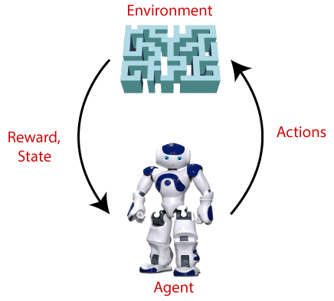

Slide 9
Key Features of Reinforcement Learning
In RL, the agent is not instructed about the environment and what actions need to be taken.
It is based on the hit and trial process.
The agent takes the next action and changes states according to the feedback of the previous action.
The agent may get a delayed reward.
The environment is stochastic, and the agent needs to explore it to reach to get the maximum positive rewards.

Slide 10
Elements of Reinforcement Learning
There are four main elements of Reinforcement Learning, which are given below:
Policy
Reward Signal
Value Function
Model of the environment

Slide 11
1) Policy: A policy can be defined as a way how an agent behaves at a given time. It maps the perceived states of the environment to the actions taken on those states. A policy is the core element of the RL as it alone can define the behavior of the agent. In some cases, it may be a simple function or a lookup table, whereas, for other cases, it may involve general computation as a search process. It could be deterministic or a stochastic policy:

Slide 12
2) Reward Signal: The goal of reinforcement learning is defined by the reward signal. At each state, the environment sends an immediate signal to the learning agent, and this signal is known as a reward signal. These rewards are given according to the good and bad actions taken by the agent. The agent's main objective is to maximize the total number of rewards for good actions. The reward signal can change the policy, such as if an action selected by the agent leads to low reward, then the policy may change to select other actions in the future.

Slide 13
3) Value Function: The value function gives information about how good the situation and action are and how much reward an agent can expect. A reward indicates the immediate signal for each good and bad action, whereas a value function specifies the good state and action for the future. The value function depends on the reward as, without reward, there could be no value. The goal of estimating values is to achieve more rewards.

Slide 14
4) Model: The last element of reinforcement learning is the model, which mimics the behavior of the environment. With the help of the model, one can make inferences about how the environment will behave. Such as, if a state and an action are given, then a model can predict the next state and reward.
The model is used for planning, which means it provides a way to take a course of action by considering all future situations before actually experiencing those situations. The approaches for solving the RL problems with the help of the model are termed as the model-based approach. Comparatively, an approach without using a model is called a model-free approach.

Slide 15
How does Reinforcement Learning Work?
To understand the working process of the RL, we need to consider two main things:
Environment: It can be anything such as a room, maze, football ground, etc.
Agent: An intelligent agent such as AI robot.

Slide 16

2. The Return in Reinforcement Learning
The Return (G) is the total accumulated reward that the agent receives starting from a specific state. It's calculated based on immediate and future rewards. In the discounted return formula, future rewards are multiplied by a discount factor γ\gammaγ (gamma) to prioritize immediate rewards over future ones:

Slide 17
3. Making Decisions: Policies in Reinforcement Learning
A Policy (π) defines the behavior of the agent at each state. It is either deterministic or stochastic:
Deterministic policy: Maps states to actions directly.
Stochastic policy: Maps states to a probability distribution over actions.

Slide 18
4. Review of Key Concepts
Exploration vs Exploitation: The balance between trying new actions (exploration) and using known actions that yield high rewards (exploitation).
Markov Decision Process (MDP): RL problems are often modeled as MDPs, characterized by states, actions, rewards, and transition probabilities.
Learning Rate: Determines how much new information overrides old knowledge.
Discount Factor (γ): A value between 0 and 1 that controls the importance of future rewards.

Slide 19
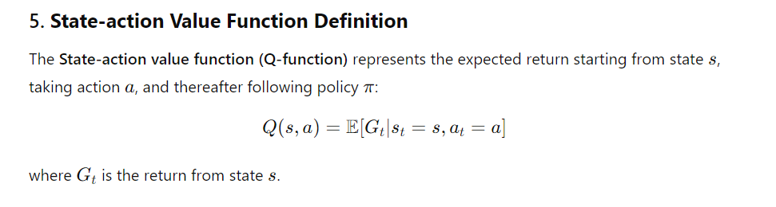

Slide 20
6. State-action Value Function Example
Example: In a simple grid-world environment, where an agent needs to navigate from one point to another, the Q-function estimates the value of moving in each direction (up, down, left, right) from any given point in the grid based on potential rewards (e.g., reaching the goal).

Slide 21
Advantages:
No labeled data needed.
Can adapt to changing environments.
Suitable for long-term planning.
Disadvantages:
Requires many interactions with the environment (slow learning).
High computational cost.
Difficult to implement in continuous action spaces.

Slide 22
Applications:
Robotics, self-driving cars, personalized recommendations, gaming (e.g., AlphaGo), and financial trading.
Real-time Use Case: In self-driving cars, RL can be used to make real-time decisions about navigation, braking, and lane-changing by learning from simulated driving environments.
Future Scope:
Expanding RL in fields like healthcare (e.g., treatment planning), industrial automation, personalized learning systems, and robotics with greater autonomy.

Slide 23
The Return in Reinforcement Learning: Understanding the concept of return, which represents the cumulative future reward“:
In reinforcement learning (RL), return is a key concept that represents the total reward an agent expects to receive from the current time step onward into the future. To understand this fully, let’s break down the essential elements involved in this concept
1. Reward in Reinforcement Learning
In RL, an agent interacts with an environment and takes actions in various states. For each action, the environment provides feedback in the form of a reward, which could be either positive or negative, depending on how beneficial the action was in relation to achieving a goal.

Slide 24
2. What is Return?
The return is the cumulative sum of rewards that the agent collects over time. When making decisions, the agent doesn’t just focus on immediate rewards; instead, it aims to maximize the total future rewards it can accumulate. Return helps formalize this concept, as it represents the expected future rewards from a given state or state-action pair.

Slide 25
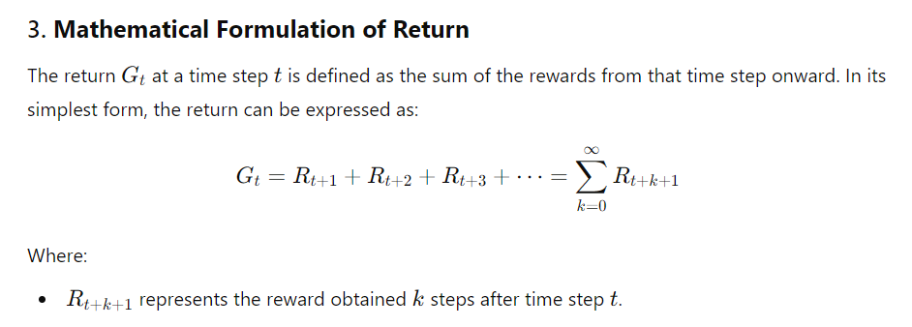
However, in many RL problems, we need to account for the fact that rewards in the distant future might be worth less than immediate rewards.
This is handled using a discount factor γ\gammaγ, which helps discount future rewards.

Slide 26
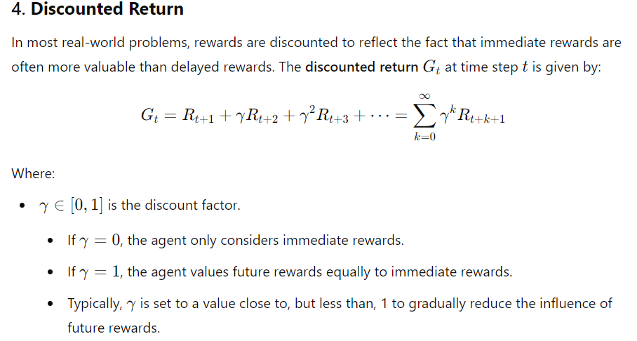

Slide 27
Conclusion
In reinforcement learning, the return encapsulates the idea of cumulative future rewards that guide the agent's learning process. By understanding and maximizing the return, the agent learns to make better decisions that lead to higher long-term rewards.
The return is at the heart of the objective in RL, as agents aim to optimize their behavior to achieve the highest possible return in their interactions with the environment.

Slide 28
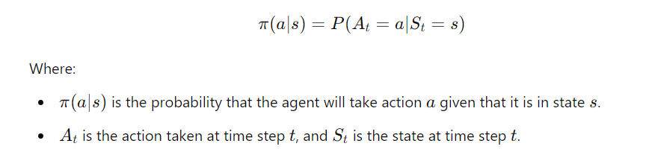
1. What is a Policy?
A policy in reinforcement learning is a function or rule that defines the agent's behavior. It tells the agent what action to take when it finds itself in a particular state. Mathematically, a policy π\piπ is represented as:

Slide 29
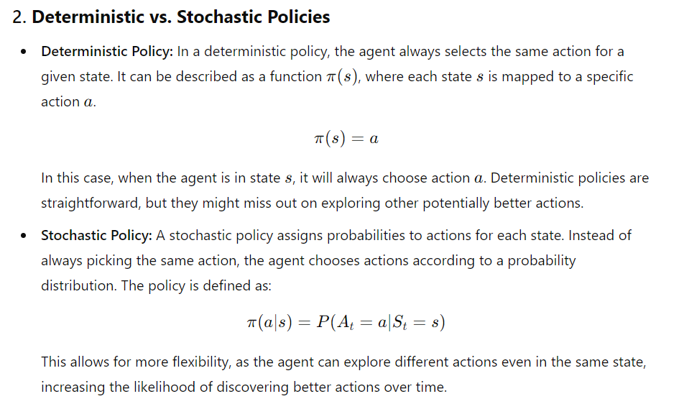

Slide 30
3. Role of Policies in Reinforcement Learning
The agent’s primary goal in RL is to find the optimal policy π∗\pi^*π∗ that maximizes the expected return—the cumulative future reward—when following that policy. The optimal policy leads to the highest long-term rewards from any given state. This is typically done by interacting with the environment and learning through trial and error.
The agent must strike a balance between:
Exploration: Trying new actions to discover their effects and potential long-term rewards.
Exploitation: Choosing actions that are known to provide high rewards based on past experience.

Slide 31
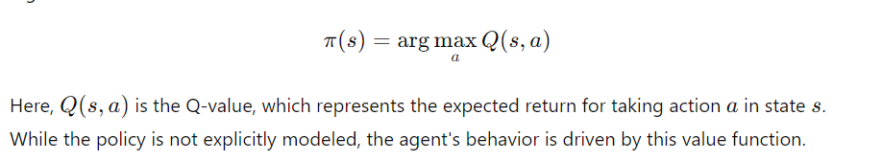
4. Types of Policies
There are two primary approaches to defining policies in RL:
a. Implicit Policies: Value-Based Methods
In value-based methods, such as Q-learning, the policy is not directly represented. Instead, the agent maintains a value function (such as the Q-value function) that estimates the expected return for each state-action pair. The agent then implicitly follows a policy that chooses the action with the highest value for each state:

Slide 32
Applications of Policies in Real-World Problems
Policies are the core of many real-world applications of reinforcement learning:
Robotics: A robot’s policy determines how it interacts with its environment, moving and adjusting to achieve tasks like object manipulation or autonomous navigation.
Game AI: In games, policies guide AI agents to make decisions, such as in AlphaGo or AlphaZero, where policies dictate moves based on game states.
Autonomous Driving: Policies in self-driving cars decide how the car should act in various traffic conditions.
Healthcare: In medical decision-making, policies could guide treatment plans based on patient states and expected outcomes.

Slide 33
Conclusion
In reinforcement learning, policies are fundamental because they define how the agent behaves in any given state.
Whether they are deterministic or stochastic, explicitly represented or learned indirectly through value functions, policies guide the agent’s decision-making process as it interacts with the environment.
The ultimate goal in RL is to find an optimal policy that maximizes the expected cumulative reward, ensuring that the agent makes the best possible decisions over time.

Slide 34
In reinforcement learning (RL), the state-action value function is a critical concept that helps an agent evaluate the effectiveness of actions taken in different states.
This function, commonly referred to as the Q-function and denoted as Q(s,a)Q(s, a)Q(s,a), represents the expected future reward that an agent can obtain by taking a particular action in a given state and then following a specific policy thereafter.

Slide 35
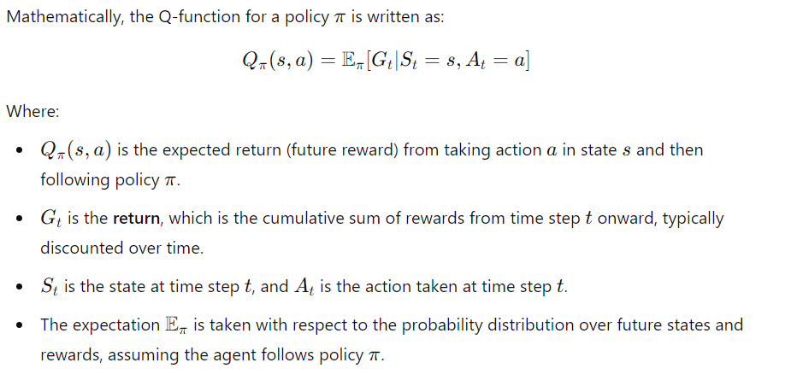
1. What is a State-Action Value Function?
The state-action value function or Q-function measures the long-term value of performing a certain action in a particular state under a specific policy. In other words, it tells the agent what total rewards it can expect if it chooses an action in the current state and follows the same strategy (policy) for future actions.

Slide 36
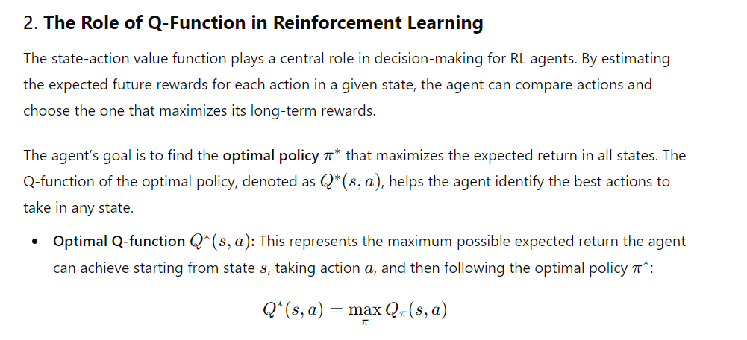

Slide 37
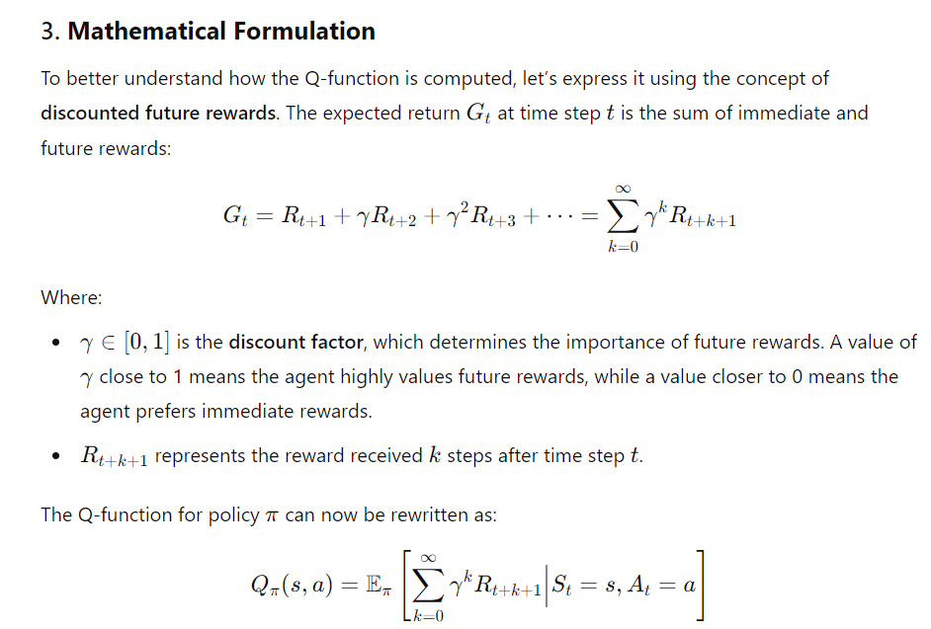

Slide 38
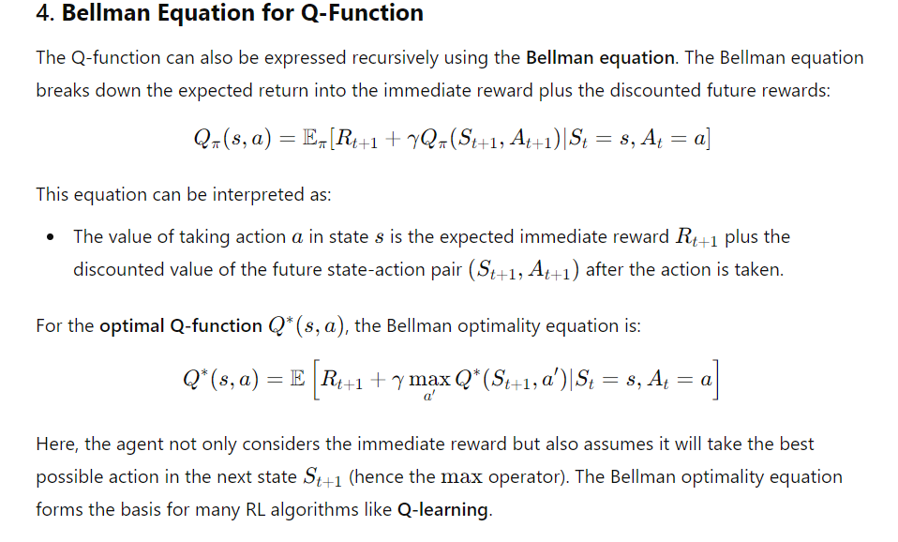

Slide 39
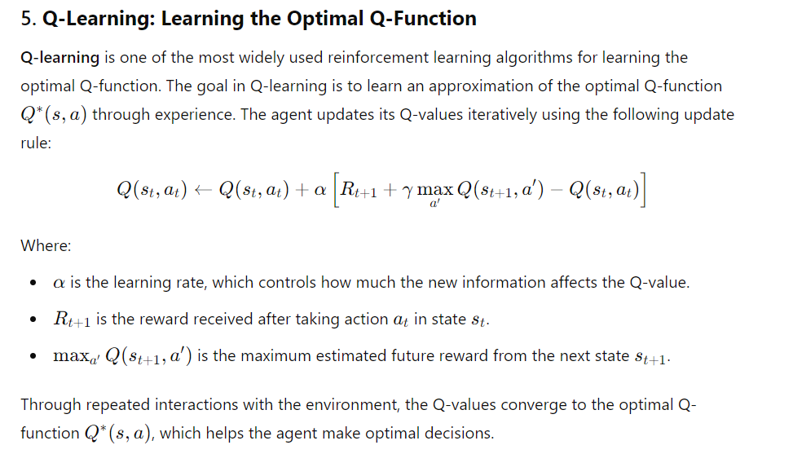

Slide 40
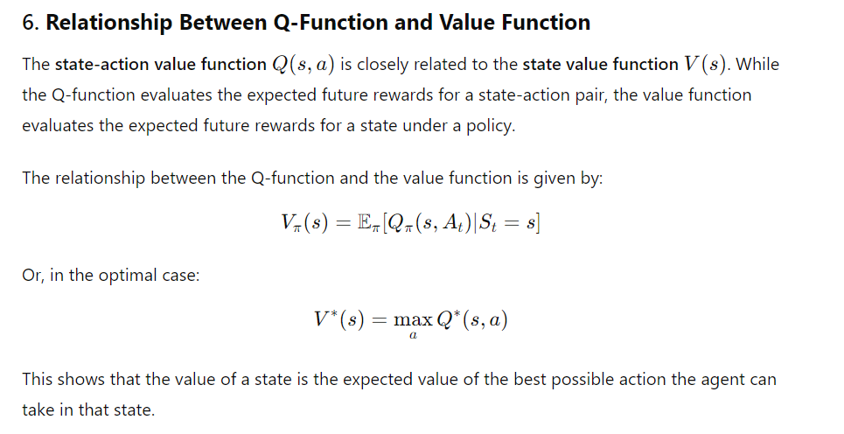

Slide 41
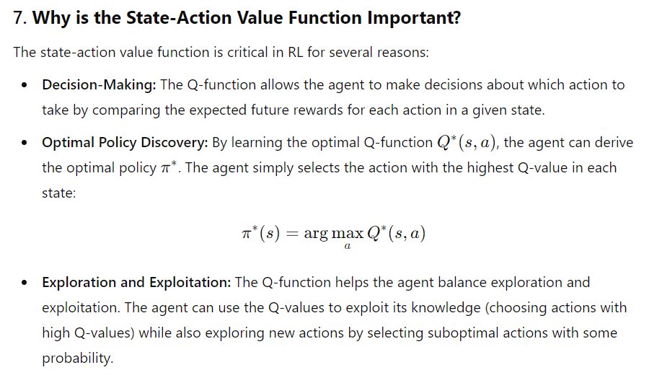

Slide 42
Extensions of the Q-Function
In practice, the Q-function can be extended or approximated in different ways, depending on the complexity of the problem:
Deep Q-Learning (DQN): When the state or action space is large, the Q-function can be approximated using deep neural networks. This leads to the Deep Q-Network (DQN) algorithm, where a neural network is trained to approximate Q(s,a)Q(s, a)Q(s,a) for all state-action pairs.
Double Q-Learning: This variation addresses the problem of overestimation bias in Q-learning by maintaining two sets of Q-values, which help reduce the bias when updating the Q-function.
Multi-Agent Q-Learning: In multi-agent environments, the Q-function is adapted to account for the presence of other agents, leading to algorithms like Independent Q-Learning or Joint Action Learners.

Slide 43
Conclusion
The state-action value function (Q-function) is a fundamental concept in reinforcement learning, representing the expected future reward of taking an action in a given state and following a particular policy thereafter.
It serves as the foundation for various RL algorithms, including Q-learning and Deep Q-Networks (DQN), and plays a vital role in enabling agents to make informed decisions and discover optimal policies in their environments.

Slide 44
The Bellman Equation is a fundamental concept in Reinforcement Learning (RL), particularly in the context of Markov Decision Processes (MDPs). It provides a recursive decomposition of the value of a decision problem, breaking it into immediate reward plus the value of the subsequent states.
This equation helps in determining the optimal policy (set of actions) to maximize long-term rewards in decision-making scenarios.

Slide 45
Key Components:
State (s): Represents the current situation or environment the agent is in.
Action (a): The decision or action the agent takes from the current state.
Reward (r): The immediate return or feedback the agent receives after taking an action.
Policy (π): The strategy the agent follows to decide which action to take in each state.
Value Function (V): Measures the long-term value or expected cumulative reward of being in a state under a specific policy.
Discount Factor (γ): A factor between 0 and 1 that discounts future rewards, indicating that rewards received sooner are preferred over those received later.

Slide 46
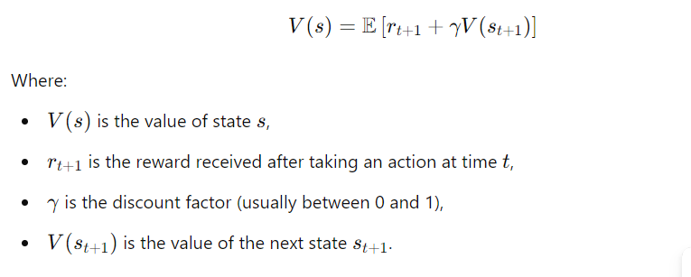
Bellman Equation for Value Function
The Bellman equation for the value function V(s)V(s)V(s) expresses the value of a state as the expected reward from taking an action and then following the optimal policy from the resulting next state. It can be written as:

Slide 47
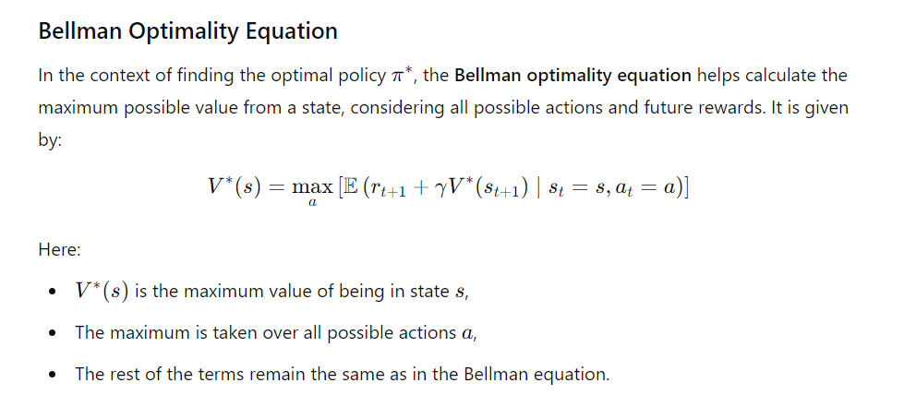

Slide 48
Use in Reinforcement Learning:
The Bellman equation is crucial for Dynamic Programming methods like Value Iteration and Policy Iteration in RL. It allows the agent to update its estimates of state values (or action values) by repeatedly applying the equation, leading to convergence towards the optimal value function and policy.
In summary, the Bellman equation provides a recursive way to solve for the value of decisions in sequential decision-making problems, and it forms the backbone of many algorithms in reinforcement learning.

Slide 49
1. Interactive Game Simulation:
Wow Moment: Let students play a simple grid-based game where an agent must find its way to a goal while avoiding traps and collecting rewards. The students can see how the agent learns to optimize its path using the Bellman Equation to evaluate states.
How It Works: Start with a random policy, then show how applying the Bellman equation helps the agent gradually improve its choices. As the policy improves, students will realize how future rewards and immediate rewards influence decisions.

Slide 50
. Real-Life Decision-Making Example:
Wow Moment: Introduce a relatable scenario like planning a trip with multiple stops. The students must consider immediate benefits (fun at each destination) vs. future costs (time, money). Demonstrate how the Bellman equation models this real-life problem by balancing short-term and long-term rewards.
How It Works: Let students make their own decisions for each stop, calculate the "value" of their plan, and compare it to the optimal plan generated by applying the Bellman equation. They will be surprised to see how a mathematical model can make better decisions!

Slide 51
Robotics Simulation:
Wow Moment: Show a robot navigating a maze with obstacles. At first, the robot gets stuck or takes inefficient paths. After running an algorithm based on the Bellman equation, the robot learns to navigate the maze quickly and efficiently.
How It Works: Use a simulation tool (or a physical robot if available) to illustrate how reinforcement learning with the Bellman equation allows the robot to learn from its actions. Students will be impressed by how the robot "learns" over time.

Slide 52
Financial Investment Scenario:
Wow Moment: Frame a financial problem: "Should you invest in a stock now or later?" Explain that this decision can be modeled with the Bellman equation, where immediate rewards (current stock price) and future rewards (potential future price) are taken into account.
How It Works: Present a scenario with fluctuating stock prices over time and ask students to use the Bellman equation to maximize their long-term investment returns. Seeing the optimal decision in such a real-world context is a powerful "aha!" moment.

Slide 53
Traffic Light Optimization:
Wow Moment: Present a scenario where students control traffic lights at an intersection. At first, cars may get stuck in traffic. After applying the Bellman equation, the traffic lights optimize flow to minimize wait time.
How It Works: Use a simple traffic simulation to demonstrate how the Bellman equation can model this problem. By balancing immediate rewards (few cars at the intersection) and future states (incoming traffic), students can see the efficiency of RL in real-world traffic management.

Slide 54
AI-powered Virtual Assistant:
Wow Moment: Create a story where an AI virtual assistant is trying to schedule tasks for its user. The assistant must balance immediate rewards (completing urgent tasks) with future benefits (scheduling breaks to avoid burnout). Applying the Bellman equation optimizes the assistant's decisions.
How It Works: Show how the assistant's actions evolve as it learns to prioritize based on the Bellman equation. The wow factor comes when students realize that everyday tools like virtual assistants can be powered by reinforcement learning principles.

Slide 55
Personalized Learning Path:
Wow Moment: Tailor a personalized study path for each student based on their current understanding of a subject (current state) and their long-term goal (mastering the topic). The study plan can be optimized using the Bellman equation to maximize their learning over time.
How It Works: Let students input their current understanding, and use the Bellman equation to generate an optimal path for study sessions. They will be amazed to see how this could guide their learning trajectory.

