Slide 1
DBSCAN

Slide 2
Introduction
Clustering analysis or simply Clustering is basically an Unsupervised learning method that divides the data points into a number of specific batches or groups, such that the data points in the same groups have similar properties and data points in different groups have different properties in some sense.
Partitioning methods (K-means) and hierarchical clustering work for finding spherical-shaped clusters or convex clusters. In other words, they are suitable only for compact and well-separated clusters.

Slide 3
K-Means | DBSCAN
K-means generally clusters all the objects. | DBSCAN discards objects that it defines as noise.
K-means needs a prototype-based concept of a cluster. | DBSCAN needs a density-based concept.
K-means has difficulty with non-globular clusters and clusters of multiple sizes. | DBSCAN is used to handle clusters of multiple sizes and structures and is not powerfully influenced by noise or outliers.
K-means can be used for data that has a clear centroid, including a mean or median. | DBSCAN needed that its definition of density, which depends on the traditional Euclidean concept of density, be significant for the data.
K-means can be used to sparse, high dimensional data, including file data. | DBSCAN generally implements poorly for such information because the traditional Euclidean definition of density does not operate well for high dimensional data.
The basic K-means algorithm is similar to a statistical clustering approach (mixture models) that consider all clusters come from spherical Gaussian distributions with several means but the equal covariance matrix. | DIISCAN creates no assumption about the distribution of the record.

Slide 4
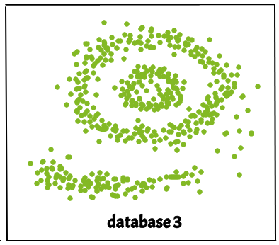
Real-life data may contain irregularities, like:
Clusters can be of arbitrary shape such as those shown in the figure below.
Data may contain noise.
The figure shows a data set containing non-convex shape clusters and outliers. Given such data, the k-means algorithm has difficulties in identifying these clusters with arbitrary shapes.

Slide 5
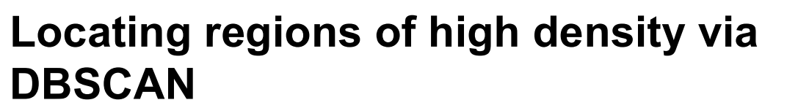
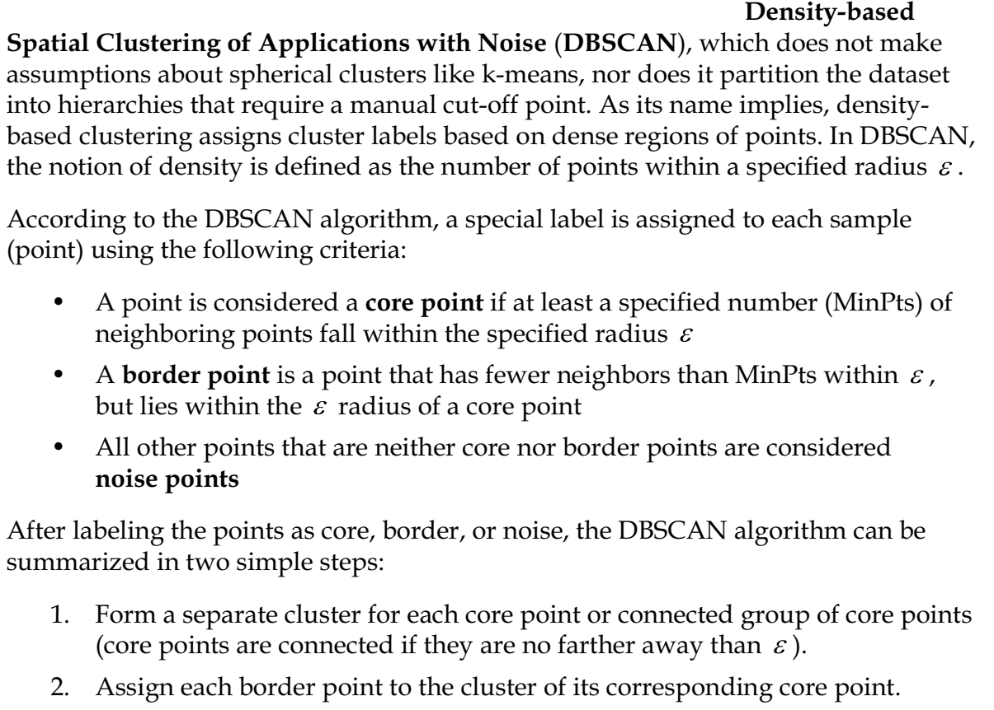

Slide 6
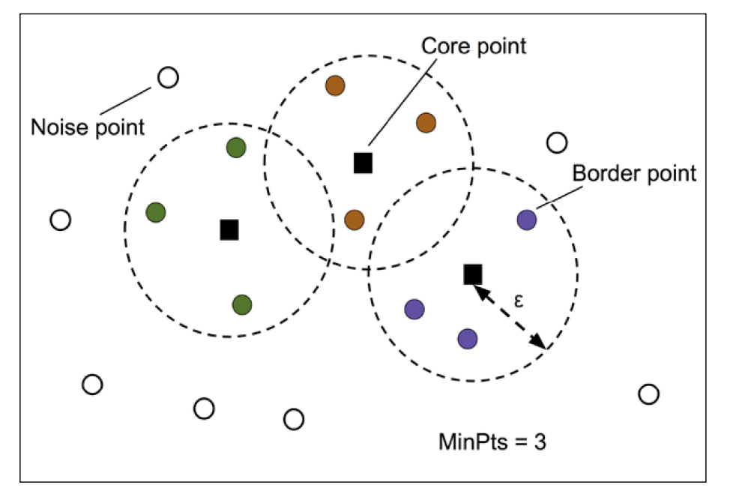

Slide 7
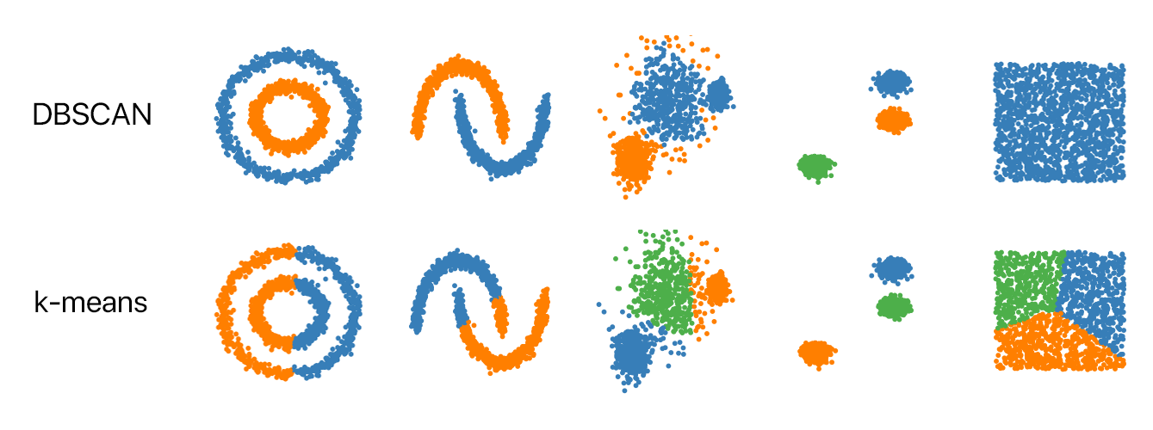

Slide 8
Parameters Required For DBSCAN Algorithm
Epsilon (ε): The maximum distance between two points for them to be considered as neighbors.
MinPts: The minimum number of points required to form a dense region (core points).
Minimum number of neighbors (data points) within eps radius. The larger the dataset, the larger value of MinPts must be chosen. As a general rule, the minimum MinPts can be derived from the number of dimensions D in the dataset as, MinPts >= D+1. The minimum value of MinPts must be chosen at least 3.
Let's set ε = 1.5 and MinPts = 3.

Slide 9
We start by randomly selecting a point from the dataset and check its ε-neighborhood. If the ε-neighborhood contains at least MinPts points, we consider it a core point and expand its cluster. We repeat this process until all the points are assigned to a cluster or identified as noise.

Slide 10
Steps Used In DBSCAN Algorithm
Find all the neighbor points within eps and identify the core points or visited with more than MinPts neighbors.
For each core point if it is not already assigned to a cluster, create a new cluster.
Find recursively all its density-connected points and assign them to the same cluster as the core point. A point a and b are said to be density connected if there exists a point c which has a sufficient number of points in its neighbors and both points a and b are within the eps distance. This is a chaining process. So, if b is a neighbor of c, c is a neighbor of d, and d is a neighbor of e, which in turn is neighbor of a implying that b is a neighbor of a.
Iterate through the remaining unvisited points in the dataset. Those points that do not belong to any cluster are noise.

Slide 11
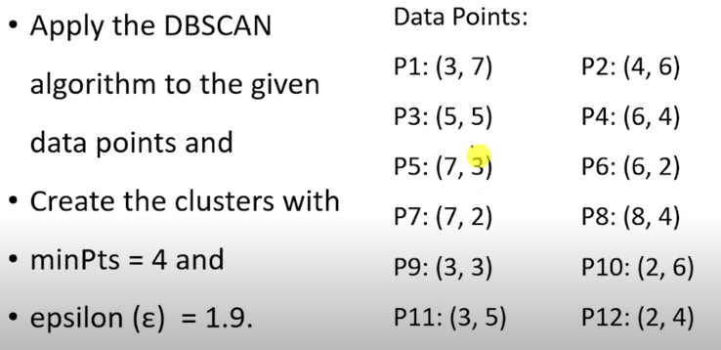

Slide 12
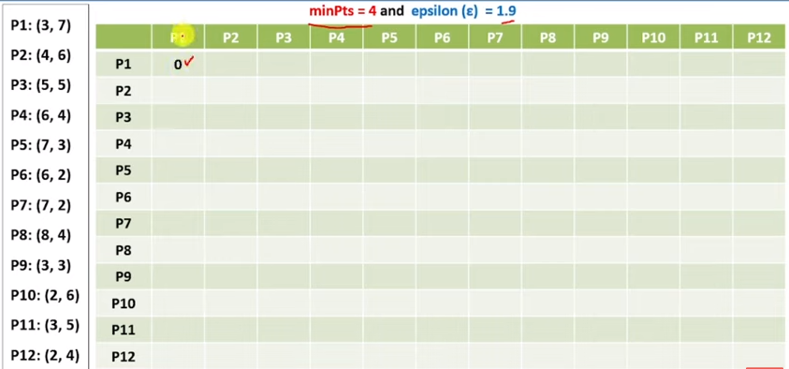

Slide 13
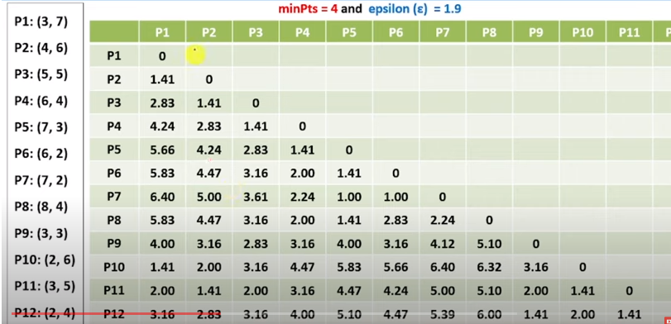

Slide 14
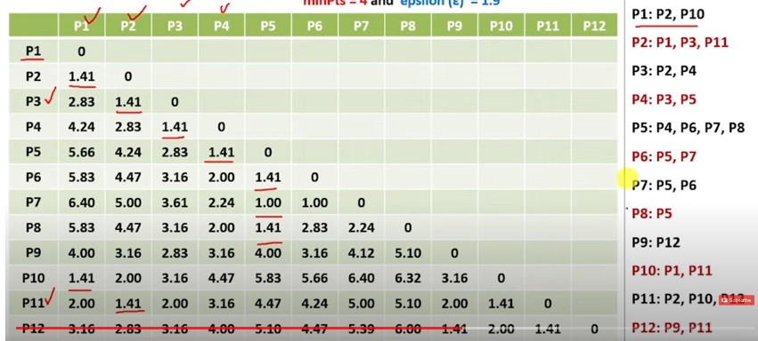

Slide 15
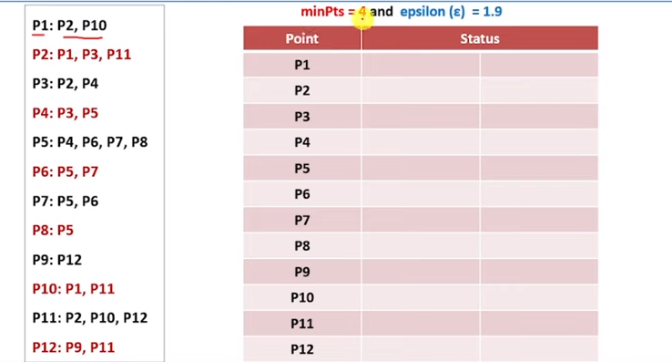

Slide 16
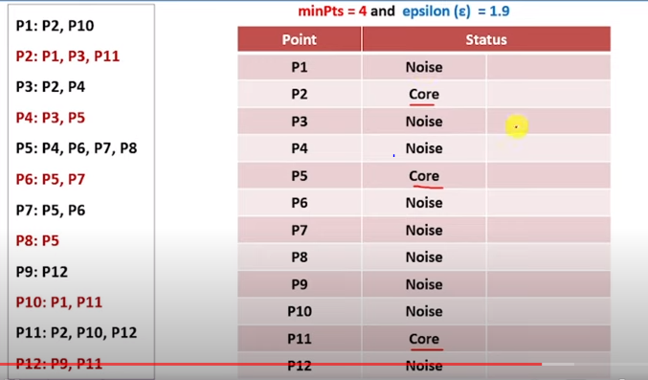

Slide 17
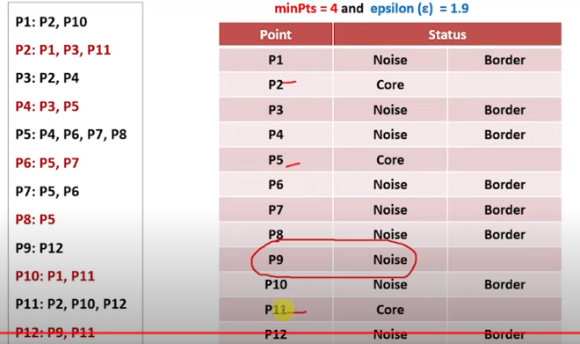

Slide 18
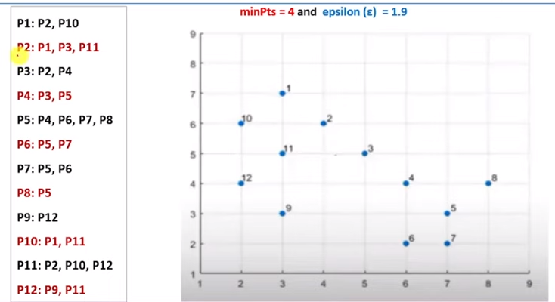

Slide 19
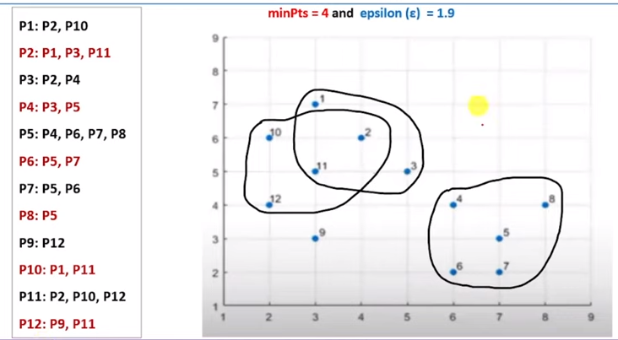
P9 is noise here

Slide 20
Here's a step-by-step breakdown of the DBSCAN algorithm for this example:
Suppose we have the following dataset of 2D points:
Let's set ε = 1.5 and MinPts = 3.
Points: [(2, 3), (2, 5), (3, 4), (5, 3), (5, 5), (6, 4), (8, 2), (8, 4), (9, 5)]

Slide 21
Start with the first point (2, 3). Its ε-neighborhood contains the points (2, 5), (3, 4), and (5, 3). Since the ε-neighborhood has MinPts (3) or more points, we create a new cluster and assign these points to the cluster.
Cluster 1: [(2, 3), (2, 5), (3, 4), (5, 3)]

Slide 22
Next, we move to the next unvisited point (5, 5). Its ε-neighborhood contains the point (6, 4). Since the ε-neighborhood has fewer than MinPts (3) points, (5, 5) is marked as noise.
Noise: [(5, 5)]

Slide 23
We move to the next unvisited point (6, 4). Its ε-neighborhood contains the points (5, 5), (8, 2), (8, 4), and (9, 5). The ε-neighborhood has MinPts (3) or more points, so we create a new cluster and assign these points to the cluster.
Cluster 2: [(6, 4), (5, 5), (8, 2), (8, 4), (9, 5)]
All the points have been visited, and we have two clusters and one noise point.

Slide 24
Cluster 1: [(2, 3), (2, 5), (3, 4), (5, 3)]
Cluster 2: [(6, 4), (5, 5), (8, 2), (8, 4), (9, 5)]
Noise: [(5, 5)]
In this example, the DBSCAN algorithm identified two clusters and one noise point in the dataset based on the specified parameters ε = 1.5 and MinPts = 3.

Slide 25
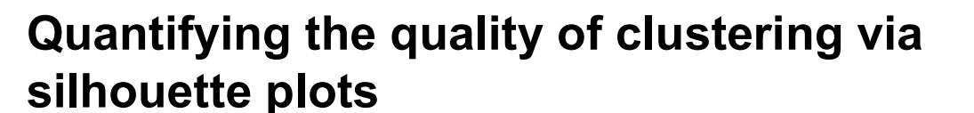
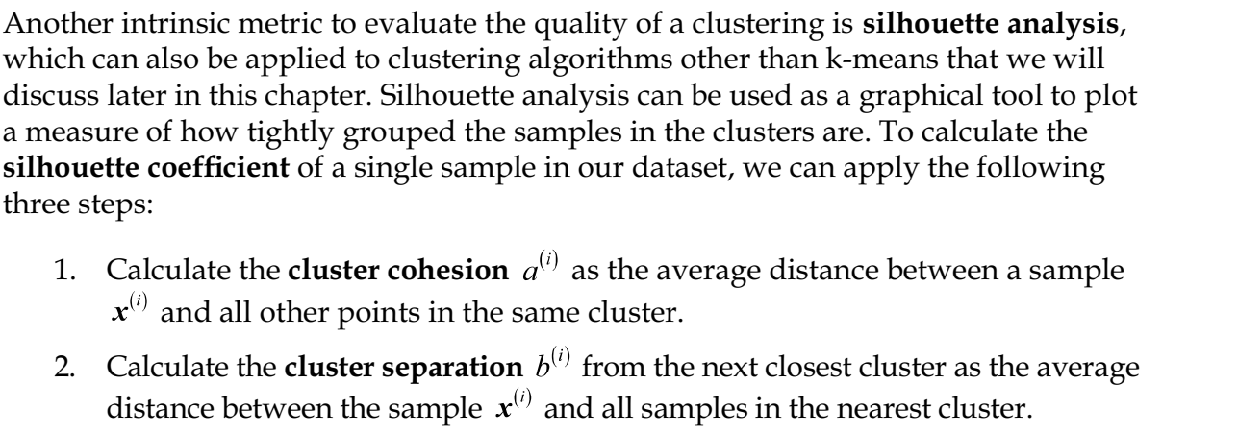
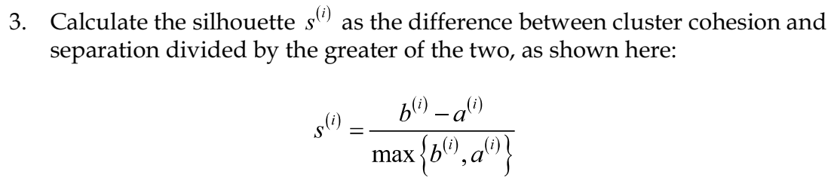

Slide 26
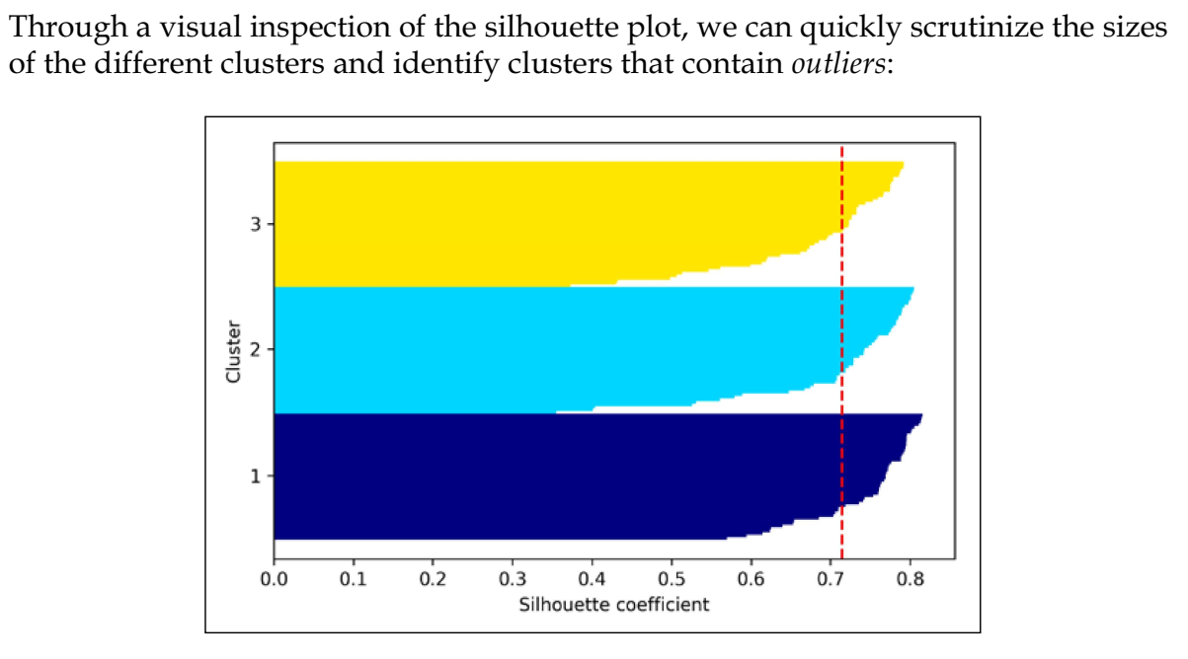

Slide 27
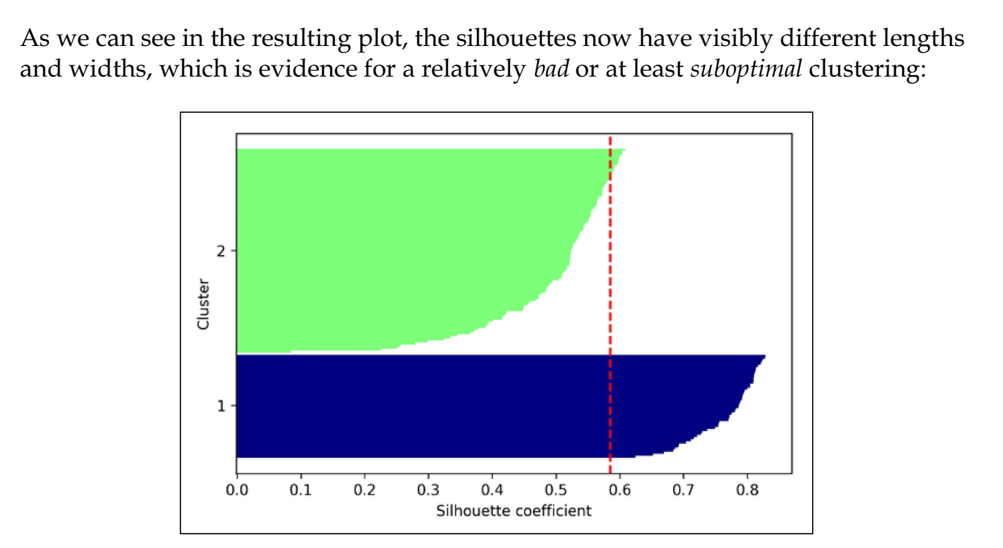

Slide 28
Import numpy as np
From sklearn.cluster import DBSCAN
From sklearn.metrics import silhouette_samples, silhouette_score
# Generate sample data
X = np.array([[2, 3], [2, 5], [3, 4], [5, 3], [5, 5], [6, 4], [8, 2], [8, 4], [9, 5]])
# Perform DBSCAN clustering
dbscan = DBSCAN(eps=1.5, min_samples=3)
cluster_labels = dbscan.fit_predict(X)
# Exclude noise points (-1) from silhouette analysis
valid_labels = cluster_labels != -1
valid_X = X[valid_labels]
valid_cluster_labels = cluster_labels[valid_labels]

Slide 29
# Compute silhouette scores
silhouette_avg = silhouette_score(valid_X, valid_cluster_labels)
sample_silhouette_values = silhouette_samples(valid_X, valid_cluster_labels)
# Print the silhouette score and silhouette values for each sample
print("Silhouette Score:", silhouette_avg)
for i, label in enumerate(valid_cluster_labels):
print("Sample", i+1, " - Cluster:", label, " - Silhouette Value:", sample_silhouette_values[i])

Slide 30
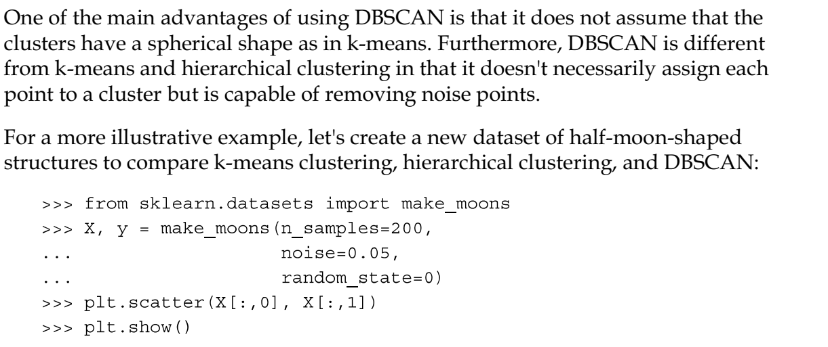

Slide 31
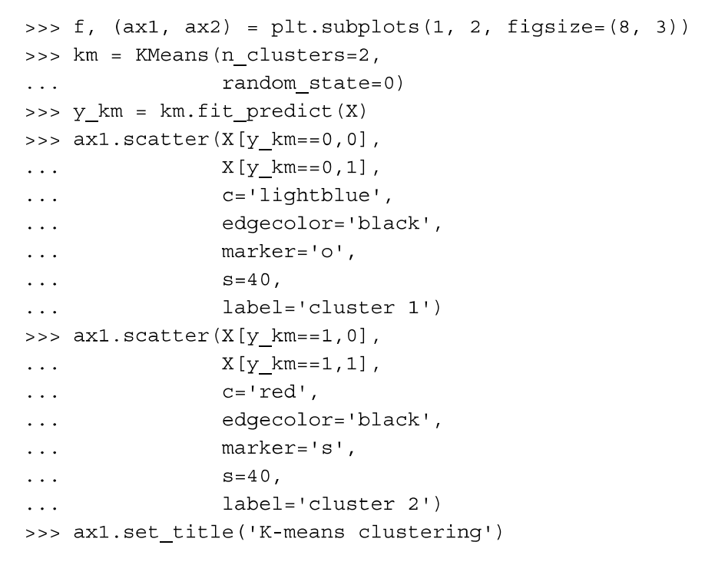

Slide 32
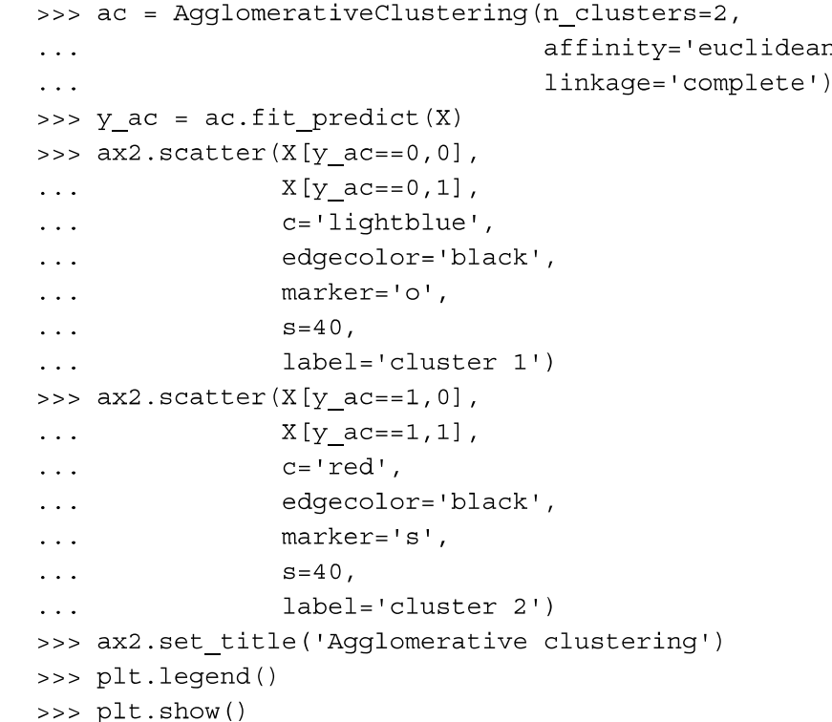

Slide 33
