Slide 1
CUSTOMER SHOPPING BEHAVIOR · ANALYTICS READOUT
3.9K
purchases in the analysis base
Customer shopping behavior:
where value, loyalty, and growth are hiding
A DECISION READOUT ACROSS REVENUE, DISCOUNTS, PRODUCTS, SHIPPING, SUBSCRIPTIONS, AND LOYALTY.

Slide 2
01 · DATA FOUNDATION
A clean 3,900-purchase base supports ten business questions
DATASET
DATA QUALITY
FEATURE WORK
3,900 rows across 18 columns spanning demographics, purchase details, shopping behavior, ratings, subscriptions, and shipping.
37 review ratings were missing; analysis filled them with category-level median ratings.
Created age groups and purchase-frequency days. Dropped promo_code_used after a redundancy check against discount_applied.
DECISION LAYER
Cleaned data was loaded into PostgreSQL and surfaced in a Power BI dashboard with filters for subscription, gender, category, and shipping type.
02

Slide 3
02 · BASELINE
The baseline is healthy, with clear room to move value
3.9K
$59.76
3.75
44.07
customers in the dashboard
average purchase amount
average review rating
mean customer age
PURCHASE AMOUNT RANGES FROM $20 TO $100.
03

Slide 4
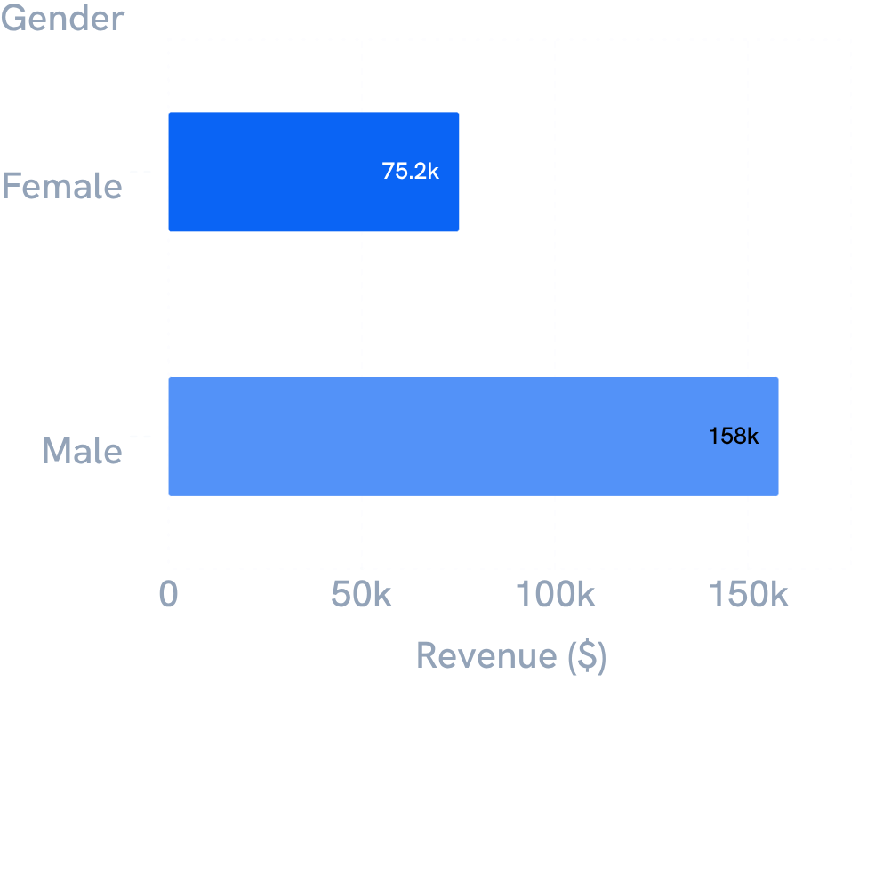
03 · REVENUE CONCENTRATION
Revenue is concentrated: male customers contribute $157,890 vs $75,191 female
Gender is a useful campaign lens, but not a standalone explanation. Keep category, subscription, and shipping context in the dashboard.
04

Slide 5
04 · DISCOUNT BEHAVIOR
Discounts are a growth lever, but product dependence is uneven
839 customers used discounts while still spending above the average purchase amount. Test discount depth by product rather than applying one blanket policy; protect margin where demand is already less dependent on discounting.
PRODUCT | DISCOUNT DEPENDENCE
Hat | 50.00%
Sneakers | 49.66%
Coat | 49.07%
Sweater | 48.17%
Pants | 47.37%
READ · PROTECT MARGIN WHERE DEMAND IS ALREADY LESS DEPENDENT ON DISCOUNTING.
05

Slide 6
05 · PRODUCT SIGNALS
Satisfaction leaders and purchase leaders are not the same list
TOP 5 BY AVERAGE RATING
TOP PURCHASES BY CATEGORY
Accessories: Jewelry 171; Sunglasses 161; Belt 161
Clothing: Blouse 171; Pants 171; Shirt 169
Footwear: Sandals 160; Shoes 150; Sneakers 145
Outerwear: Jacket 163; Coat 161
PRODUCT | RATING
Gloves | 3.86
Sandals | 3.84
Boots | 3.82
Hat | 3.80
Skirt | 3.78
Activation: feature highly rated products for trust and best sellers for reach.
06

Slide 7
06 · TARGETING SIGNALS
Express shipping commands a higher average purchase, while young adults lead age-group revenue
AVERAGE PURCHASE AMOUNT
REVENUE BY AGE GROUP
AGE GROUP | REVENUE
Young Adult | $62,143
Middle-aged | $59,197
Adult | $55,978
Senior | $55,763
$58.46
$60.48
Standard
Express
ACTIVATION · PRIORITIZE HIGH-REVENUE AGE GROUPS AND EXPRESS-SHIPPING AUDIENCES IN TARGETED CAMPAIGNS.
07

Slide 8
07 · SUBSCRIPTION GAP
Subscription coverage is 27% even though average spend is almost flat
SUBSCRIBERS · 27%
NON-SUBSCRIBERS · 73%
1,053
2,847
Average spend $59.49
Total revenue $62,645
Average spend $59.87
Total revenue $170,436
Read: the immediate opportunity is adoption and benefit design—not assuming subscribers already spend more.
08

Slide 9
08 · LOYALTY
Loyalty is already dominant, but the subscription bridge is unfinished
3,116
701
83
REPEAT BUYERS WITH >5 PURCHASES
958 subscribers
2,518 non-subscribers
Loyal
Returning
New
THE SOURCE REPORTS REPEAT-BUYER COUNTS, NOT A LIKELIHOOD PERCENTAGE.
09

Slide 10
09 · GROWTH AGENDA
Five moves turn the analysis into a growth agenda
01
Grow subscriptions
Make exclusive benefits visible and measurable.
02
Reward repeat buyers
Move more Returning customers into Loyal.
03
Rebalance discounts
Test product-level discount policy against the dependence list.
04
Merchandise winners
Pair top-rated products with top-selling products in campaigns.
05
Target precisely
Prioritize high-revenue age groups and express-shipping users.
10

