Slide 1
TRACK B: SCALABLE PROTOTYPE
LivingLink
Open-source support across the entire living kidney donor journey
FUNCTIONAL BETA • PILOT READY
THE PROBLEM & SOLUTION
OUR TEAM & CAPABILITY
THE CORE PROBLEM
Project lead: Richard Horsley, submission lead and prototype owner.
Repository capability: Next.js/TypeScript, Prisma/PostgreSQL, donor workflows, FHIR integration prototypes, security and accessibility planning.
Pilot partners: two transplant centers to be recruited; no institutional pilot partner is represented as confirmed.
Required advisors: prior donor, coordinator, transplant nephrologist, interoperability, security, privacy, and accessibility reviewers.
Willing donors face disconnected information, financial uncertainty, isolation, evaluation delays, and weak long-term follow-up. Each handoff creates another opportunity to withdraw.
OUR NOVEL APPROACH
One donor-centered platform combines five modules: ReadyCheck, DonorShield, MentorMatch, CenterFlow, and LifeAfter. Five public tools remove the sign-up wall; role-based workflows connect donor and center tasks.
MEASURABLE VALUE • 12-MONTH PILOT TARGETS (NOT YET CLINICALLY VALIDATED)
26% → 75%
−20%
−6 weeks
59% → 85%
NLDAC COMPLETION
DONOR WITHDRAWAL
EVALUATION DURATION
TWO-YEAR FOLLOW-UP
WHY IT CAN SCALE
MIT-licensed code and a single web application reduce deployment complexity and vendor lock-in.
Public education works without an account; authenticated workflows add role, center, consent, and patient-context boundaries.
No specialized hardware. Proposed pilots validate workflow fit, safety, accessibility, interoperability, and outcomes before clinical use.
LivingLink | KidneyX EMPOWER Track B

Slide 2
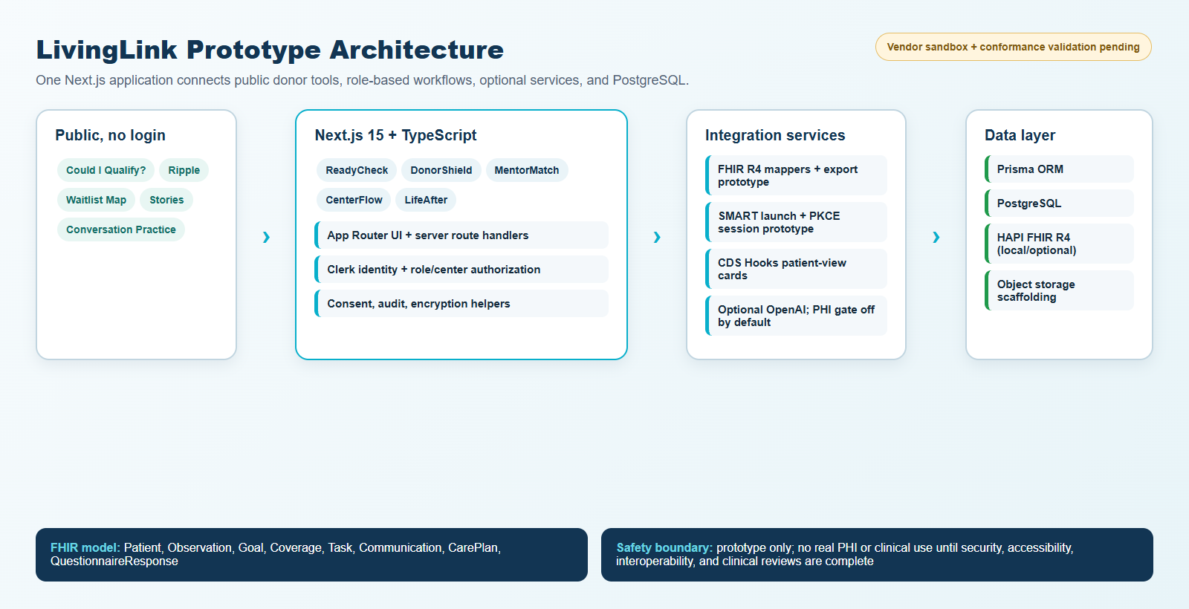
FUNCTIONAL BETA
Evidence of Efficacy & Prototype Showcase
EVIDENCE OF POTENTIAL EFFICACY
TECHNICAL INNOVATION & AI USE
EVIDENCE-BASED DESIGN
FHIR R4 mappings, SMART launch with PKCE, authenticated CDS Hooks cards, and pseudonymized export are implemented as prototypes. Optional GPT-4o supports public role-play and contextual assistance; authenticated health-data processing is configuration-gated and off by default.
Peer education is backed by a submission-cited randomized trial reporting 23% higher donation intent among ambivalent candidates.
DonorShield puts wage estimates and NLDAC guidance before clinical steps, addressing financial uncertainty early.
CenterFlow flags evaluations after 14 days without progress; LifeAfter pairs scheduled check-ins with PHQ-2 escalation at scores ≥3.
Four pilot outcomes are pre-specified: NLDAC completion, withdrawal, evaluation duration, and two-year follow-up.
SYSTEM ARCHITECTURE / UX PROTOTYPE
FUNCTIONAL BETA SURFACES
5 public experiences: eligibility pre-screen, ripple calculator, waitlist map, stories, AI conversation practice.
5 authenticated modules plus donor, coordinator, clinician, patient, and administrator views.
Prisma-backed APIs for goals, expenses, NLDAC, mentoring, evaluations, check-ins, consent, privacy, and alerts.
No pilot outcome or clinical efficacy is claimed yet.
LivingLink | KidneyX EMPOWER Track B

Slide 3
PILOT READINESS
Path to Implementation & Compliance
TECHNICAL FEASIBILITY
DEVELOPMENT ROADMAP
Single Next.js 15 / TypeScript application with server route handlers.
Prisma + PostgreSQL data layer; Clerk integration and role/center authorization helpers.
Local HAPI FHIR R4 plus FHIR mapping, export, SMART, and CDS Hooks prototypes.
Automated unit, integration, end-to-end, and limited axe-core accessibility test assets.
Assure
Validate
M1–M2
M3–M4
Assign clinical/security owners; risk analysis, penetration test, data governance, manual accessibility audit.
Center 1 workflow pilot; FHIR validator, usability, keyboard/screen-reader, and safety testing.
M4–M6
Integrate
M6–M12
Measure & Scale
Approved Epic/Oracle Health sandboxes; SMART/CDS contracts, identity, replay, token, and tenant tests.
Center 2 pilot; Spanish localization; outcome analysis; open-source release and deployment playbook.
INTEROPERABILITY
FHIR R4 resources: Patient, Observation, Goal, Coverage, Communication, Task, CarePlan, and QuestionnaireResponse.
SMART launch and patient-view CDS Hooks preserve issuer, center, patient mapping, consent, and minimum-necessary boundaries.
Epic and Oracle Health registration, sandbox testing, conformance validation, and production approval remain pilot milestones.
COMPLIANCE PLAN
FIPS 199
Provisional HIGH impact under the high-water-mark rule; system boundary and owner approval pending.
SECURITY
Selected AES-256-GCM fields, consent, application audit logging, and RBAC exist; key management, complete coverage, monitoring, BAAs, and external testing are required before PHI.
ACCESSIBILITY
Section 508 / WCAG 2.1 AA is a target. Complete authenticated axe coverage, keyboard and assistive-technology testing, chart data tables, PDF remediation, and VPAT/ACR assessment.
PILOT GATE: no clinical use or real PHI until security, privacy, clinical, accessibility, interoperability, and partner approvals are evidenced.
LivingLink | KidneyX EMPOWER Track B

