Slide 1
KIDNEY
X
EMPOWER CHALLENGE
Track B: Scalable Prototypes
Solutions ready for pilot testing.
LIVINGLINK
Open-source support for the living kidney donor journey

Slide 2
TRACK B: SCALABLE PROTOTYPE
LivingLink
Open-source support across the entire living kidney donor journey
FUNCTIONAL BETA • PILOT READY
THE PROBLEM & SOLUTION
OUR TEAM & CAPABILITY
THE CORE PROBLEM
Project lead: Richard Horsley, submission lead and prototype owner.
Repository capability: Next.js/TypeScript, Prisma/PostgreSQL, donor workflows, FHIR integrations, AI-assisted experiences, and cloud deployment.
Pilot partners: two transplant centers to be recruited; no institutional pilot partner is represented as confirmed.
Pilot support model: donor and coordinator onboarding, test-data setup, workflow training, and monthly outcome review.
Willing donors face disconnected information, financial uncertainty, isolation, evaluation delays, and weak long-term follow-up. Each handoff creates another opportunity to withdraw.
OUR NOVEL APPROACH
One donor-centered platform combines five modules: ReadyCheck, DonorShield, MentorMatch, CenterFlow, and LifeAfter. Five public tools remove the sign-up wall; role-based workflows connect donor and center tasks.
MEASURABLE VALUE • 12-MONTH PILOT TARGETS (NOT YET CLINICALLY VALIDATED)
26% → 75%
−20%
−6 weeks
59% → 85%
NLDAC COMPLETION
DONOR WITHDRAWAL
EVALUATION DURATION
TWO-YEAR FOLLOW-UP
WHY IT CAN SCALE
MIT-licensed code and a single web application reduce deployment complexity and vendor lock-in.
Public education works without an account; authenticated workflows add role, center, consent, and patient-context boundaries.
No specialized hardware. Proposed pilots validate workflow fit, user adoption, interoperability, and measurable outcomes.
LivingLink | KidneyX EMPOWER Track B

Slide 3
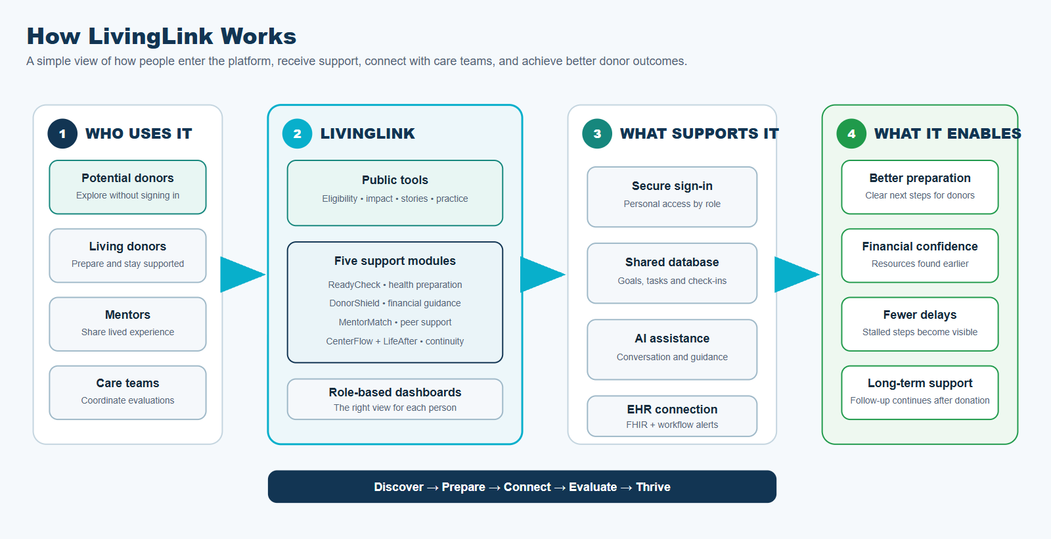
FUNCTIONAL BETA
Evidence of Efficacy & Prototype Showcase
EVIDENCE OF POTENTIAL EFFICACY
TECHNICAL INNOVATION & AI USE
EVIDENCE-BASED DESIGN
FHIR R4 mappings, SMART launch with PKCE, CDS Hooks cards, and structured export are implemented as prototypes. Optional GPT-4o powers public conversation role-play and contextual assistance, while the core donor workflows remain available without AI.
Peer education is backed by a submission-cited randomized trial reporting 23% higher donation intent among ambivalent candidates.
DonorShield puts wage estimates and NLDAC guidance before clinical steps, addressing financial uncertainty early.
CenterFlow flags evaluations after 14 days without progress; LifeAfter pairs scheduled check-ins with PHQ-2 escalation at scores ≥3.
Four pilot outcomes are pre-specified: NLDAC completion, withdrawal, evaluation duration, and two-year follow-up.
SYSTEM ARCHITECTURE / UX PROTOTYPE
FUNCTIONAL BETA SURFACES
5 public experiences: eligibility pre-screen, ripple calculator, waitlist map, stories, AI conversation practice.
5 authenticated modules plus donor, coordinator, clinician, patient, and administrator views.
Prisma-backed APIs for goals, expenses, NLDAC, mentoring, evaluations, check-ins, consent, privacy, and alerts.
No pilot outcome or clinical efficacy is claimed yet.
LivingLink | KidneyX EMPOWER Track B

Slide 4
PILOT READINESS
Path to Pilot Implementation
TECHNICAL FEASIBILITY
DEVELOPMENT ROADMAP
Single Next.js 15 / TypeScript application with server route handlers.
Prisma + PostgreSQL data layer; Clerk integration and role/center authorization helpers.
Local HAPI FHIR R4 plus FHIR mapping, export, SMART, and CDS Hooks prototypes.
Unit, integration, end-to-end, and accessibility test assets support iterative pilot preparation.
Prepare
Onboard
M1–M2
M3–M4
Deploy the pilot environment, finish mobile polish, and configure center roles and workflows.
Train Center 1 staff, connect test data, and run donor and coordinator usability sessions.
M5–M6
Pilot
M7–M12
Expand
Launch a limited pilot; monitor engagement, stalled evaluations, NLDAC steps, and follow-up completion.
Add Center 2, localize key journeys, publish results, and release the deployment playbook.
INTEROPERABILITY
FHIR R4 resources: Patient, Observation, Goal, Coverage, Communication, Task, CarePlan, and QuestionnaireResponse.
SMART launch opens the app from an EHR context; CDS Hooks can return readiness and stalled-evaluation cards.
The same standards-based integration pattern can be configured for participating EHR environments during a pilot.
PILOT PLAYBOOK
1
Configure
2
Train
3
Measure
Center, user roles, workflows, and outcome baseline.
Coordinator walkthrough, quick guide, and donor invitation flow.
Track four pilot targets monthly and refine the workflow.
DEPLOYMENT MODEL
Cloud-hosted web application • managed PostgreSQL • no specialized hardware • one center configuration at a time
12-MONTH GOAL: demonstrate repeatable deployment at two centers and measure donor and workflow outcomes.
LivingLink | KidneyX EMPOWER Track B

