Slide 1

Feature Extraction and Price Prediction for Mobile Phones
Data Science & AI
NextHikes Inernship
Name: Khushnaz
Submittion date 20/03/2025

Slide 2

Project Overview
Objective: Build a predictive model to estimate mobile phone prices based on features.
Key Tasks:
- Data Exploration
- Data Preprocessing
- Feature Extraction
- Model Building
- Model Evaluation
- Feature Importance Analysis

Slide 3

Data Exploration
Dataset Description:
- Information on various mobile phones (model, color, memory, RAM, battery capacity, cameras, AI lens, height, processor, price).
Initial Steps:
- Load and explore the dataset.
- Understand data structure and types.

Slide 4
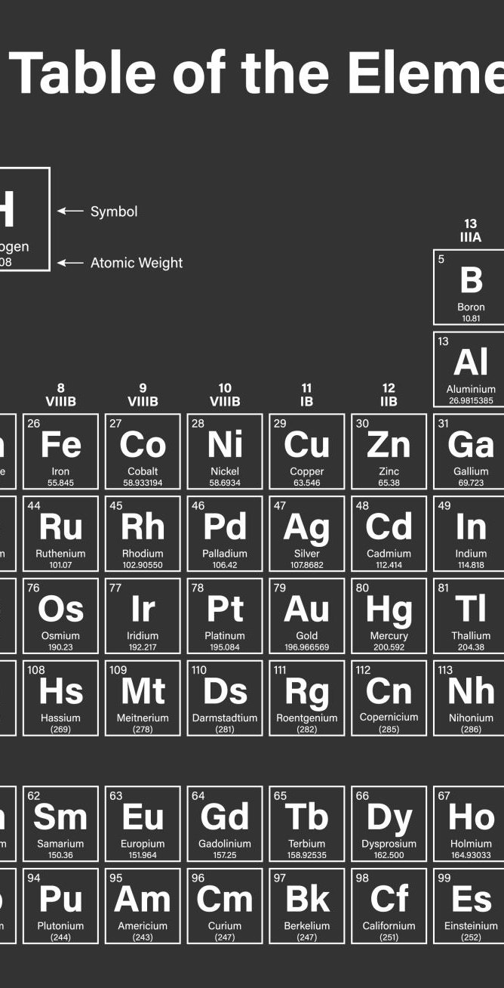
Data Preprocessing
Handling Missing Values:
- Techniques used (e.g., imputation).
Outliers and Inconsistencies:
- Methods to address them.
Categorical Variables:
- Conversion to numerical format (e.g., one-hot encoding).

Slide 5

Feature Extraction
Techniques Used:
- Statistical methods
- Visualizations
- Feature importance techniques (e.g., correlation analysis, feature selection, dimensionality reduction).
Key Features Identified:
- List of most relevant features affecting price.

Slide 6

Model Building
Dataset Split:
- Training and testing sets.
Algorithms Used:
- Linear Regression
- Decision Trees
- Random Forests
- Gradient Boosting

Slide 7
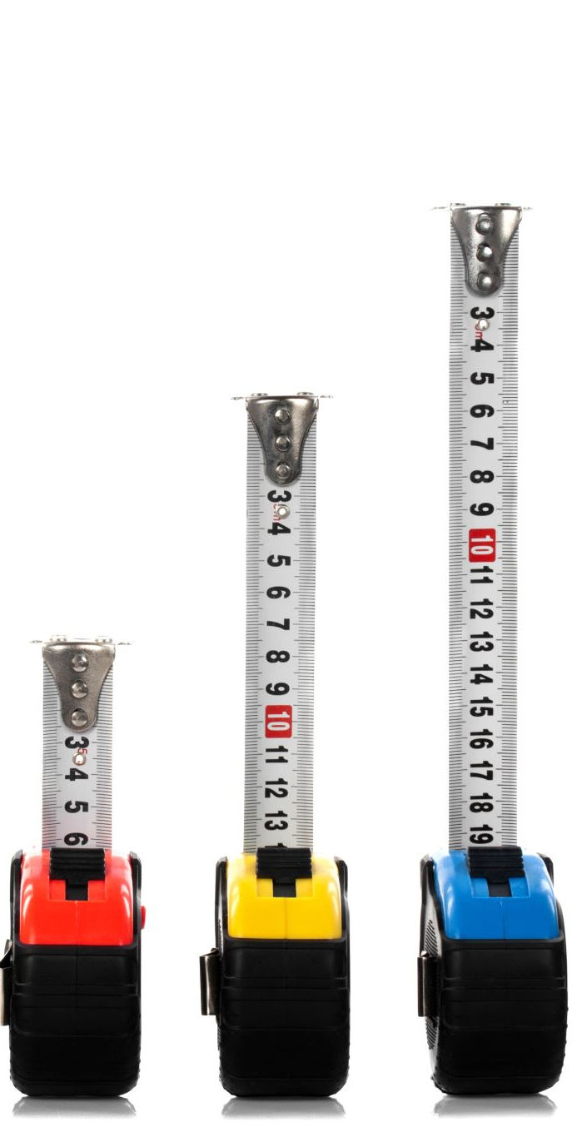
Model Evaluation
Performance Metrics:
- Mean Absolute Error (MAE)
- Root Mean Squared Error (RMSE)
Model Accuracy:
- Comparison of different models.

Slide 8
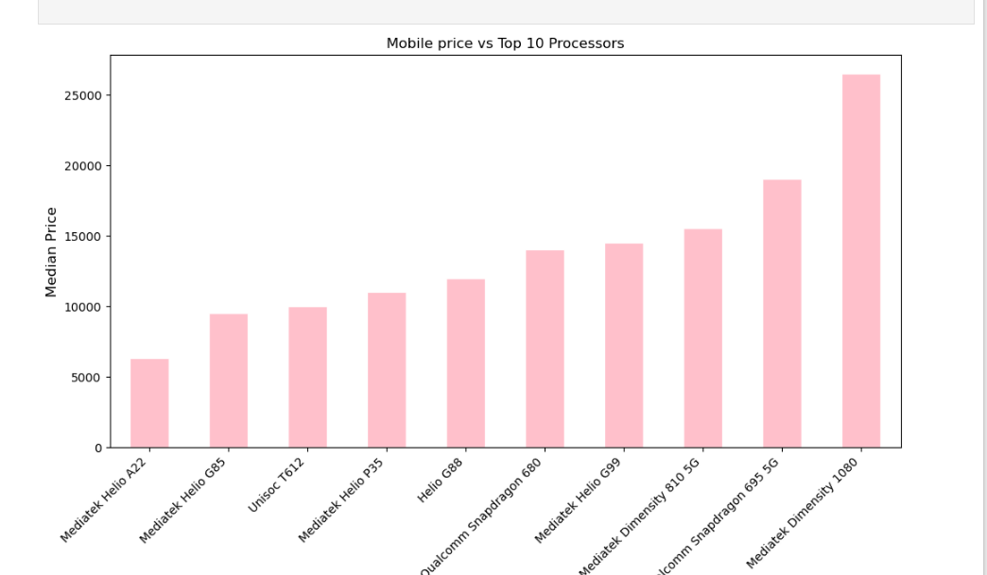
Feature Importance Analysis
Analysis Results:
- Importance of each feature as determined by the model.
Insights:
- Confirmation of significant features.

Slide 9

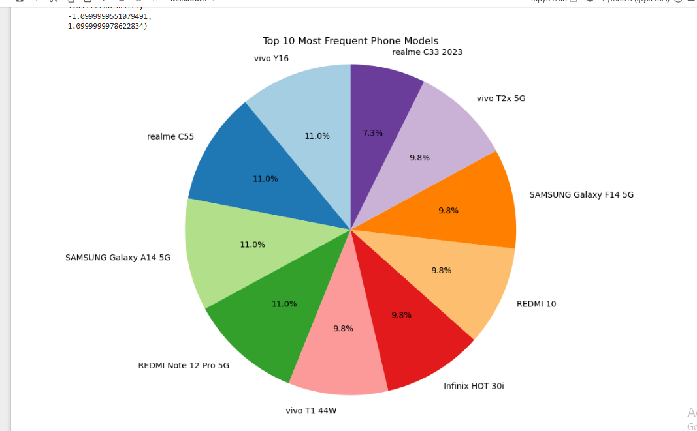
Visualizations
Graphs and Charts:
- Feature importance visualization.
- Model performance comparison.

Slide 10
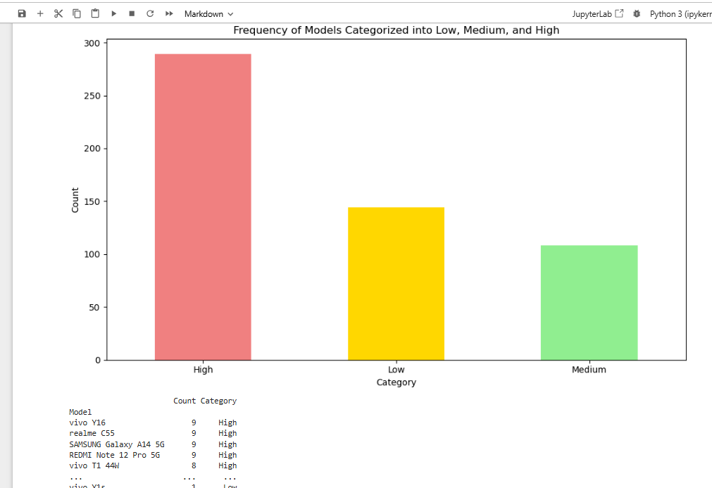
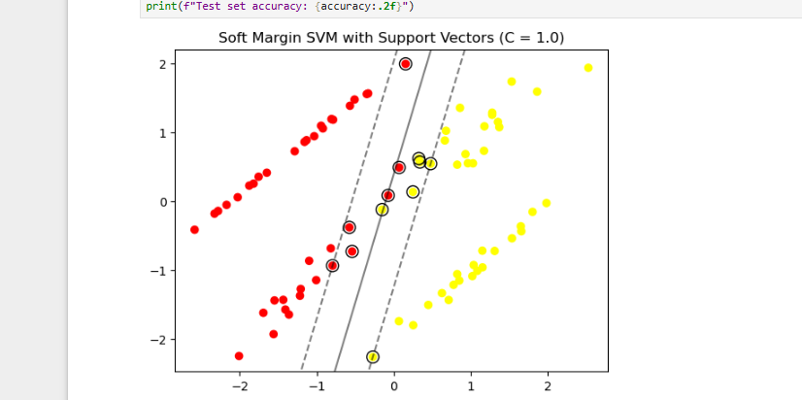
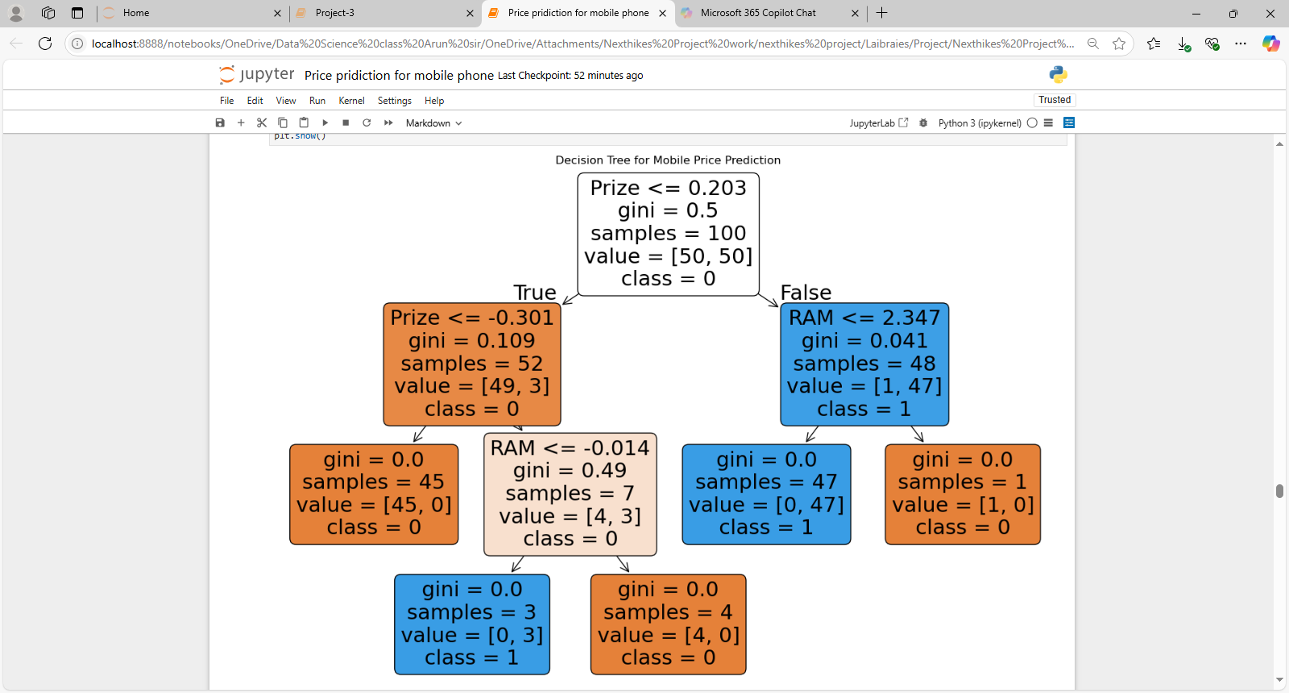
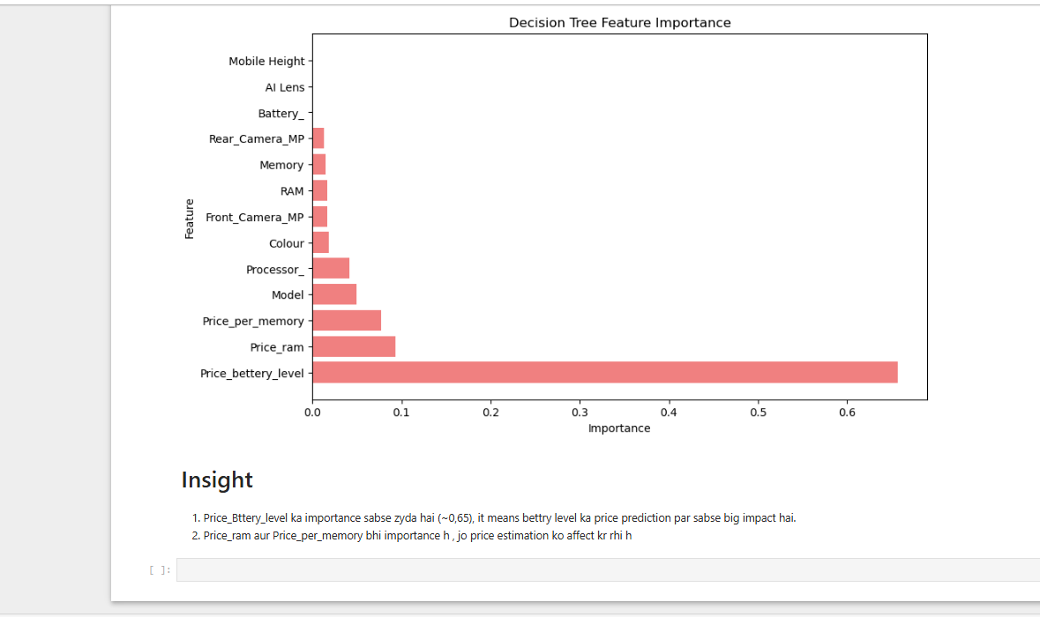
Visulization model and feature

Slide 11
Recommendations
Key Features Influencing Price:
- Summary of most significant features.
Pricing Strategy:
- Recommendations for the organization based on findings.

Slide 12

Conclusion
Summary of Findings:
- Recap of the project and key insights.
Future Work:
- Potential improvements and next steps.

Slide 13

THANK YOU

