Slide 1

PROJECT-1
GUI CALCULATOR USING PYTHON (TKINTER)
presented by
khushnaz khan

Slide 2
CONTENT
. Introduction
2. Basic function (Features)
3. Installation and setup
4. Use of calculator & history
5. Usage
6. Credits
7. License
8. Future scope of the project 9. References

Slide 3
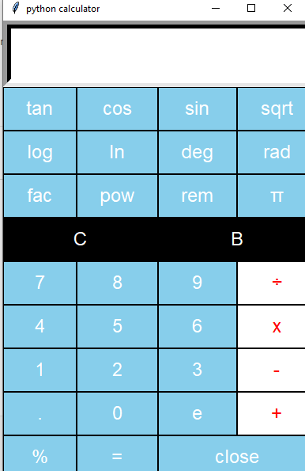
Introduction
Scientific calculator
The calculator was written by Rolf Haworth in early 1996 A fully featured scientific calculator with proper operator precedence is implemented, including trig goniometric function and logarithms, factorials, 12 levels of parentheses, Abacus, developed around 2000 BC, and the Mechanical calculator, developed in the 17th century. . Python is a popular programming language . It is used for web development, software development, system scripting . Python programming language is very well suited for beginners and experienced programming who are familiar with other programming language like _{C++ ,} . The biggest strength of python is a huge collection of standard libraries that can used for the following GUI Application like Kivy, Tkinter, PyQt, etc.

Slide 4
Basic function (features)
Addition : The addition (sum function) is used by clicking on the “+” button or using the keyboard . The function result for example a+b
Subtraction : The subtraction (minus function) is used by clicking on the “-” button or using the keyboard the function results in for example a-b
Multiplication: the multiplication (times function)is used by clicking on the “x” button or using the keyboard . The function results in for example a*b
Division : the division (divide function ) is used by clicking on the “/”button or using the keyboard “/” key. The function results in
For example a/b
Sign : the sign key(negative key) used by clicking on the “(-)” button. The function results in -1*x.
Square: the square function is used by clicking on the “x^2” button or type “x^2” the function results in x*x.
Square Root: the square root function is used by clicking on the “x” button or type “sqrt()”. This function represents x^.5 where the result squared is equal to x.
Logarithm: the logarithm (LOG) is used by clicking on the “LOG” button or type “LOG0”
Natural logarithm: the natural logarithm (LN) is used by clicking on the “LN” button or type “LN0”.
Inverse: multiplicative inverse(reciprocal function ) is used by pressing the “I/x” button or typing “inv()”. This function is the same as x^-1 or dividing 1 by the number.
Factorial” the factorial is used by clicking the “!” button or type”!”.
Exponent: numbers with exponents of 10 are displayed with an “e”, for example 4.5e+100 or 4.5e-100. this function represents 10^x. numbers are automatically displayed in the when the number is too large small for the display. To enter a number in this format use the exponent key “EEX”. To do this enter the mantissa (the non exponent part) then press “EEX” or type‘e” and then enter the exponent.
Raise to the power : the raise to the power (y raised to the x funciton)is used by clicking on the “y^x” button or type “^”.
Natural exponential: the natural exponential (e raised to the x)is used by clicking on the “e^x.” button or type “exp()”. The result is e (2.71828…)raised to x.

Slide 5
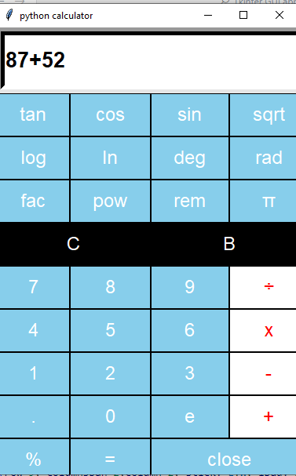
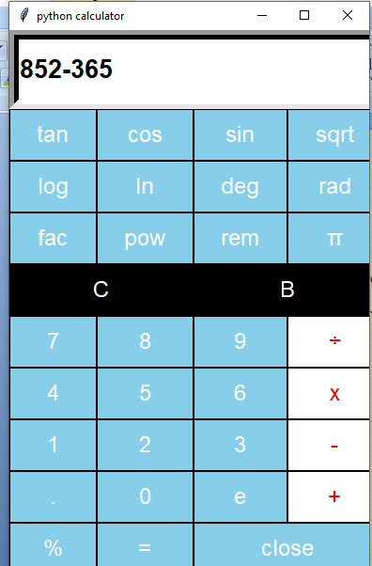
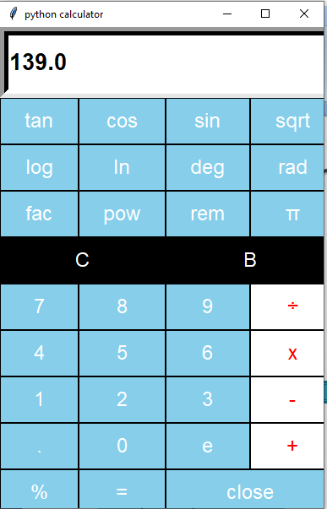
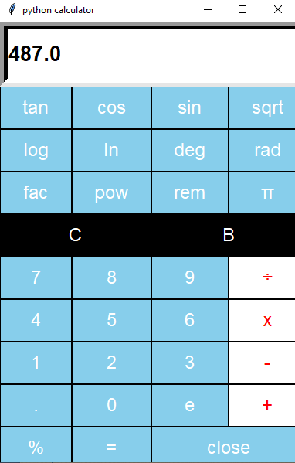
Some example addition , subtraction

Slide 6
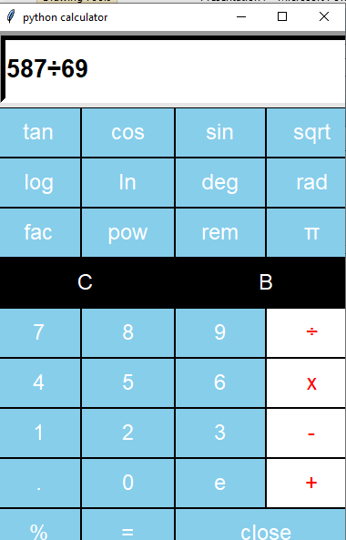
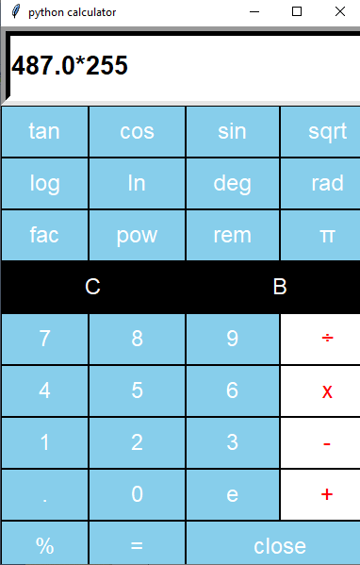
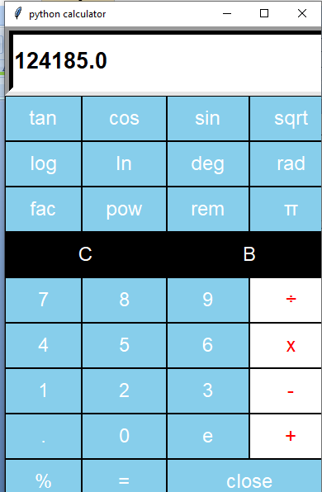
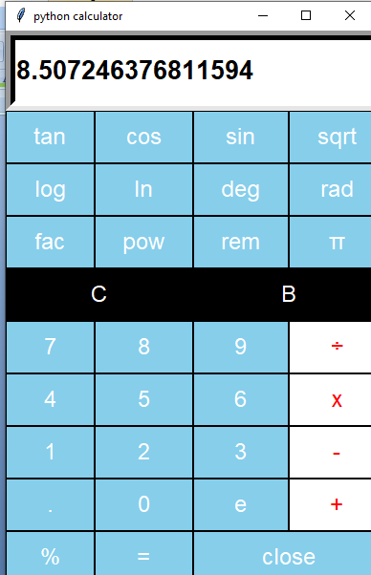
Multiplication , division

Slide 7
Use of calculator & history
. Calculator is used in many ways. It is used in the field of education and as well as in other field.
. Calculator is used to do basic arithmetic's and also to do complex arithmetic's.
. Calculator is used to calculating banks to find the compound interest, simple interest, and many other things.
. The first known tool used to aid arithmetic calculations was the Abacus, devised by Sumerians and Egyptians before 2000 BC.
In 1642, the Renaiaassance saw the invention of the mechanical calculator

Slide 8
Installation & setup
. Specify the require python version (3.12) install my system . And run it .
. After python install visual studio code install , and run it now any choose the folder and goto terminal type python -m venv my_venv and enter
. second line.\ my_venv\Script\activate and enter and next line
. pip install tkinter and enter
. Now successfully install GUI tkinter and run the program
Tkinter libraries is very use full this programme & standrard GUI library for python
. Tkinter provides a powerful object-oriented interface to the Tk GUI toolkit.

Slide 9
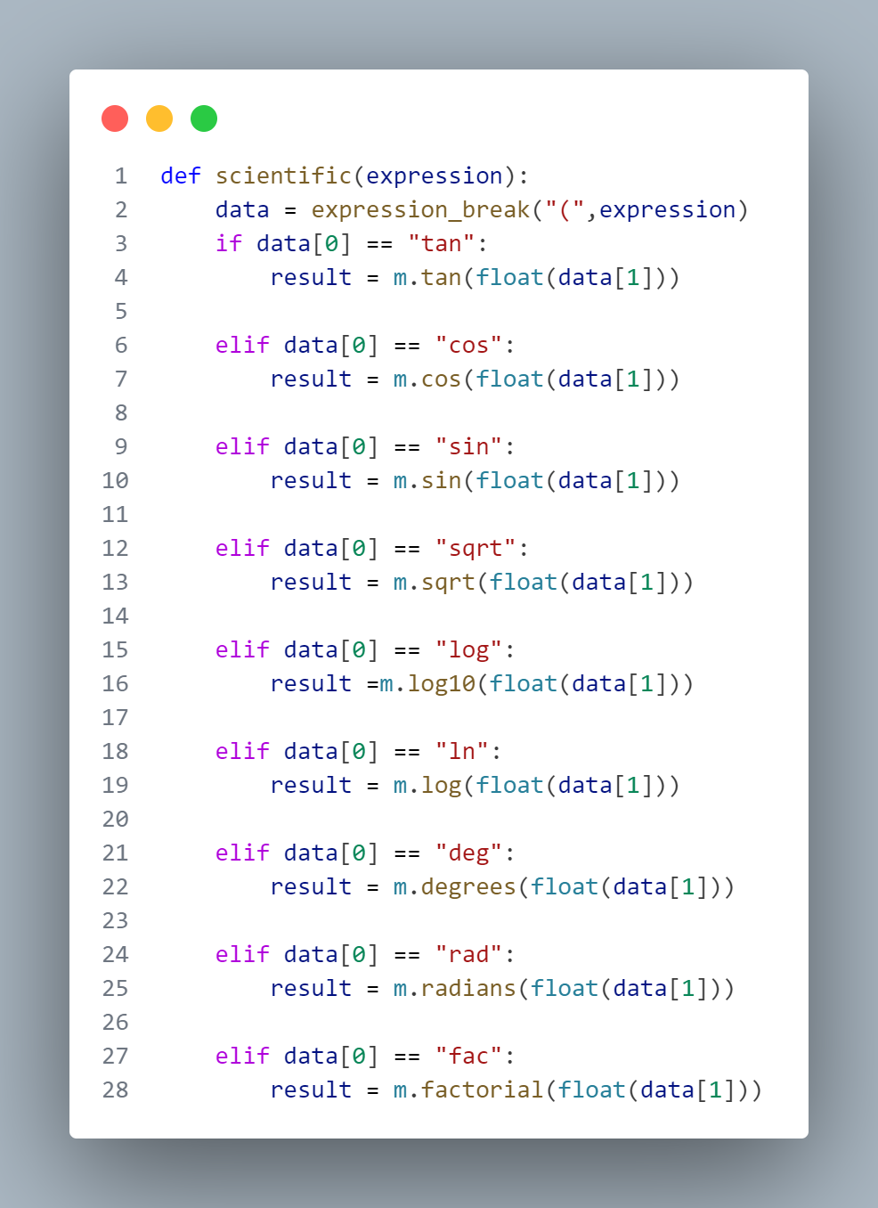
Usage
. GUI tkinter install after the making project by name “python calculator” and start the codeing like ‘s each button
. ( “sin”, “cos”, “tan”, “rem”.etc.)
And diferent modes likes’s (degrees , radians) like my code show this

Slide 10
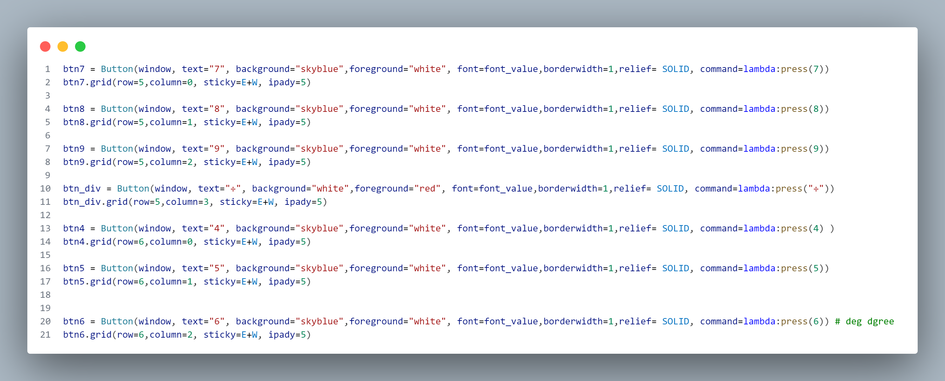
Buttons show the code

Slide 11
Out put after complete the programmed show this output
Calculator background button color blue and white , Clear and backspace color black and white multiplication, addition, subtraction and division color red and white

Slide 12
Future scope of the project & Improvements
future enhancements: Potential improvements include adding more advanced functions and reefing the UI.
Q & A .
The presentation is open for any question & suggestion from the reviewer.
Summary
the key points of the calculator project were discussed.

Slide 13
conclusion
Efficient calculations : the calculator handles a variety of mathematical
User-friendly design: the customized Tkinter interface provides a smooth user experiences.
Robust Performance: the app is designed to be reliable and handle user errors.

Slide 14
THANK YOU

